Slide 1
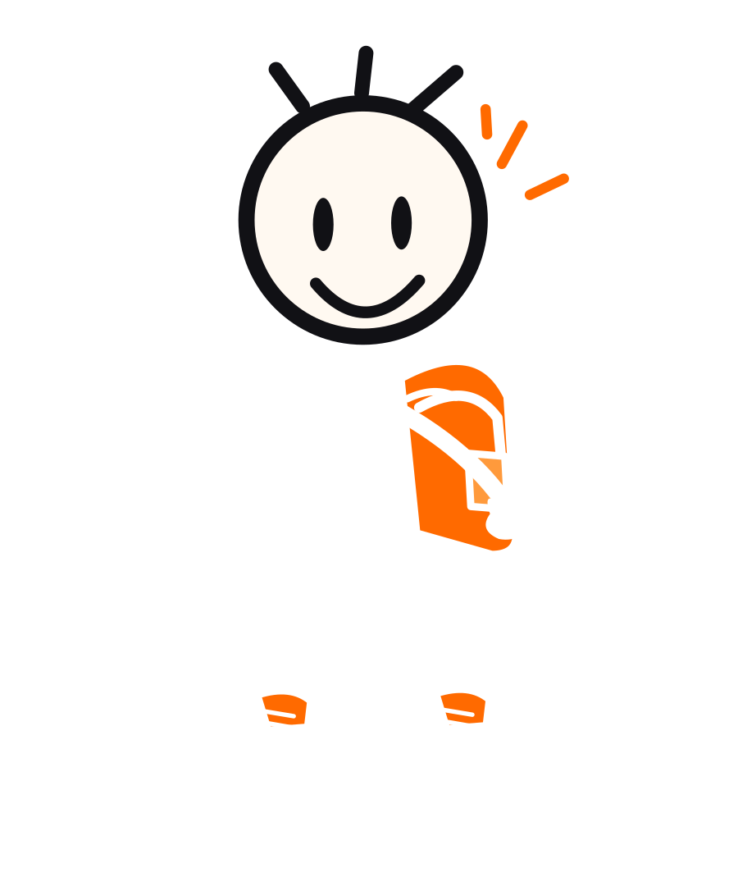
BRAND GUIDELINES / V1.3
Doddy.
Your mate in your pocket.
A complete character-led identity system for product, content and motion.
08 OCTOBER 2026 / PRODUCTION DRAFT

Slide 2
INTRODUCTION
A companion with a point of view.
A useful product with a recognisable character, not a generic AI face.
THE PRODUCT
THE CHARACTER
A conversational personal companion designed to help people think, remember, find answers and act on things.
A distinct, human-feeling editorial cartoon who makes assistance approachable without pretending to be human.
ROLE OF BRAND → BUILD FAMILIARITY. EARN TRUST. MAKE UTILITY FEEL PERSONAL.
02

Slide 3
STRATEGY
Brand essence
Every layer should feel like the same Doddy.
FRIENDLY
CAPABLE
Talks naturally, without fake enthusiasm.
Takes tasks seriously and communicates results clearly.
PLAYFUL
RELIABLE
Uses motion and humour as punctuation.
Makes limits, permissions and outcomes explicit.
03

Slide 4
POSITIONING
Character first. Utility always.
The character invites attention. The product earns repeat use.
01 DISCOVER
02 CONNECT
03 TRY
04 RETURN
Short-form stories, visual humour, everyday moments.
People recognise the face, voice and behaviour.
A clear entry point to voice, translation or help.
Relevant utility, privacy and trust create habit.
No animated character can substitute for a useful product.
04

Slide 5
PERSONALITY
The right kind of cheeky.
Not a corporate voice. Not a childish character. Not a know-it-all.
ALWAYS
NEVER
Clear, curious, conversational, helpful, honest about what has and has not happened.
Patronising, misleading, emotionally manipulative, over-familiar, or flippant about serious subjects.
05

Slide 6
CREATIVE CONCEPT
The controlled imperfection.
The look is built from tension between ink spontaneity and interface discipline.
BLACK INK
ORANGE SIGNAL
Handmade; iconic; high-contrast.
Energy, presence, intent; used selectively.
WARM PAPER
STRUCTURED UI
Editorial and approachable.
Readable, predictable where it matters.
06

Slide 7
DODDY / BRAND SYSTEM v1.3
01
Character system
Recognisable in one stroke. Flexible in a thousand moments.

Slide 8

CHARACTER / MASTER
One face. One body language.
The source SVG, not a screenshot, is the canonical character reference.
HEAD
Round, oversized and expressive.
EYES
Two upright black oval marks.
SMILE
Slightly asymmetric ink curve.
BODY
Single gestural pen strokes.
GEAR
Orange backpack and oversized trainers.
08

Slide 9
CHARACTER / GEOMETRY
Construction, not decoration.
Controlled proportions preserve recognition across illustration teams.
Face
Centre: 246,149 · radius: 79 (500×600 artboard)
Eyes
Centres x219 / x272 · tall upright ovals
Ink
Body 10–13 units; face outline 11 units
Torso
Neck ~245,232 · hip ~247,352
Shoes
Deliberately oversized, white with orange panels
Accent
Orange on bag, ball and editorial emphasis
09

Slide 10








CHARACTER / EXPRESSIONS
Expressions 1 / 3
Same core geometry; mood changes via eyes, mouth and limited brows.
NEUTRAL
HAPPY
EXCITED
CURIOUS
CONFUSED
THINKING
FOCUSED
PROUD
RELAXED
CHEEKY
LAUGHING
SURPRISED
10

Slide 11






CHARACTER / EXPRESSIONS
Expressions 2 / 3
Same core geometry; mood changes via eyes, mouth and limited brows.
CONCERNED
SUPPORTIVE
TIRED
CELEBRATING
DETERMINED
SAD
LISTENING
EXPLAINING
IMPRESSED
SKEPTICAL
EMBARRASSED
CONFIDENT
11

Slide 12
CHARACTER / EXPRESSIONS
Expressions 3 / 3
Same core geometry; mood changes via eyes, mouth and limited brows.
PLAYFUL
INTERESTED
RELIEVED
IMPATIENT
ENCOURAGING
WOW
WINK
ASLEEP
LOVE
12

Slide 13


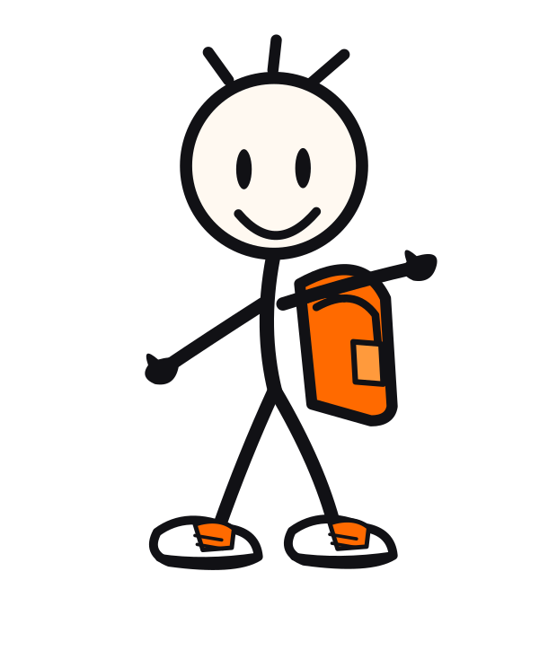
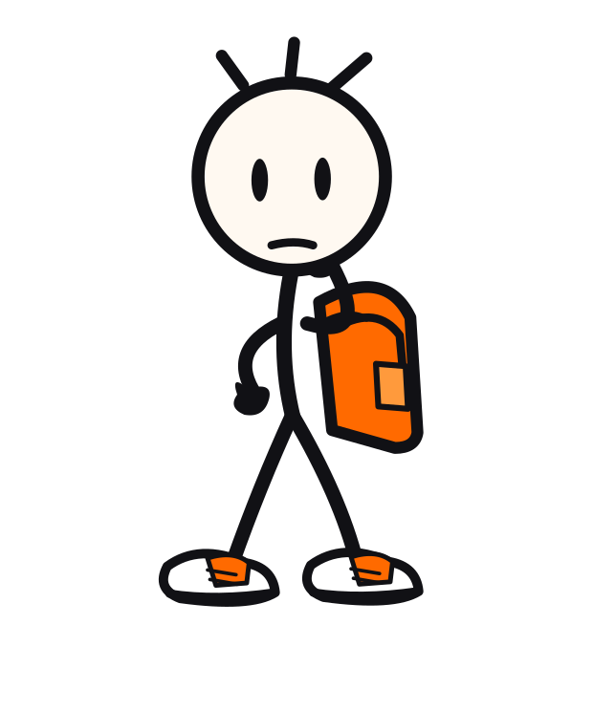



CHARACTER / POSE LIBRARY
Pose library 1 / 4
Independent SVG sources for approved gesture families.
NEUTRAL
WAVE
HELLO
POINT
THINKING
LISTEN
TALK
JUMP
13

Slide 14

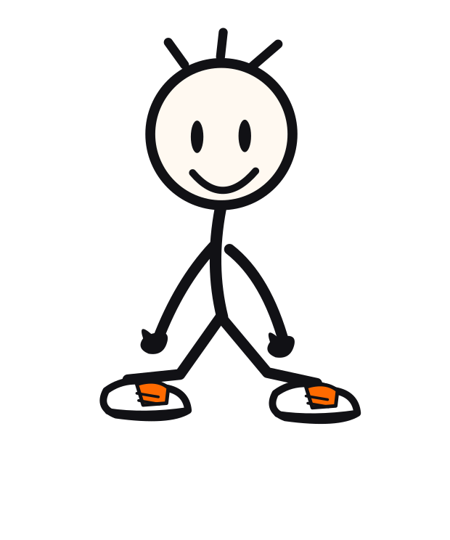

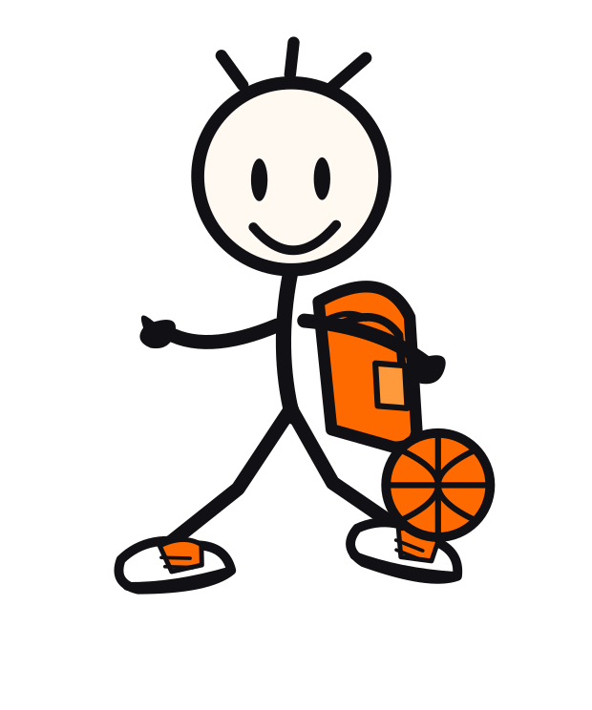

CHARACTER / POSE LIBRARY
Pose library 2 / 4
Independent SVG sources for approved gesture families.
CELEBRATE
WALK
RUN
SIT
LEAN
BASKETBALL
DRIBBLE
SHOOT
14

Slide 15
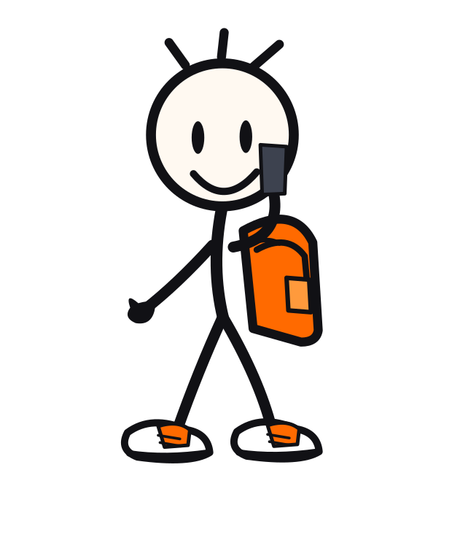



CHARACTER / POSE LIBRARY
Pose library 3 / 4
Independent SVG sources for approved gesture families.
PHONE
READ
WORK
REST
EXPLAIN
SUPPORT
LOOK
DANCE
15

Slide 16

CHARACTER / POSE LIBRARY
Pose library 4 / 4
Independent SVG sources for approved gesture families.
WAVE BOTH
HIGH FIVE
GREET
CARRY BAG
16

Slide 17

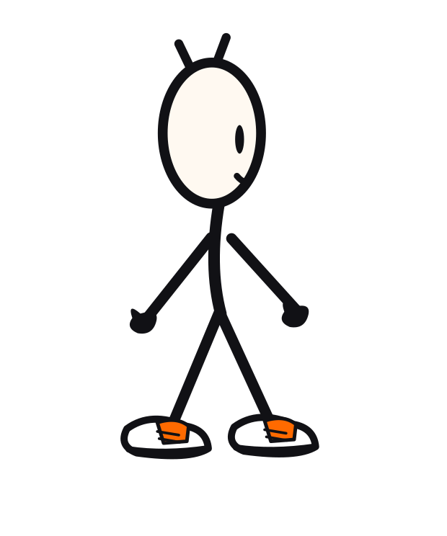

CHARACTER / CONSTRUCTION
Turnaround system
A consistent silhouette from multiple viewpoints.
FRONT
THREE QUARTER
SIDE
BACK
17

Slide 18



CHARACTER / SIGNATURE ELEMENTS
The little things matter.
The backpack, basketball and trainers are character clues - not mandatory props.
BACKPACK
BASKETBALL
TRAINERS
18

Slide 19
CHARACTER / GUARDRAILS
Protect recognition.
Make new poses freely. Do not redefine the face.
DO
DON’T
Keep vertical oval eyes.
Keep the large round head.
Use imperfect rounded ink strokes.
Keep mittens and oversized trainers.
Simplify appropriately at small sizes.
Add realistic anatomy or detailed hands.
Replace the face with emoji/robot tropes.
Vary eye geometry dramatically.
Use permanent random orange rays.
Stretch full-body art to tiny UI icons.
19

Slide 20

CHARACTER / RESPONSIVE USE
Use the right level of detail.
A 24px avatar is not a shrunken full-body illustration.
24–48 px
64–112 px
160–320 px
400 px +
Simple face mark
Face + minimal accent
Bust or half-body
Full figure + accessory
20

Slide 21
DODDY / BRAND SYSTEM v1.3
02
Visual identity
Ink, warmth and a bright burst of orange.

Slide 22


IDENTITY / LOGOS
A compact, flexible family.
Wordmark, slogan lockup, reversed use and reduced face icon.
PRIMARY + TAGLINE
REVERSED WORDMARK
22

Slide 23

IDENTITY / LOGO RULES
Give Doddy breathing room.
Minimum safe area: one face-eye width around the wordmark or mark.
PRACTICAL RULES
Keep x-height and underline readable.
Use ink on paper or white on charcoal.
No stretched/skewed variants.
No shadows or gradient outlines.
Outline approved logotype before launch.
23

Slide 24
IDENTITY / INCORRECT USE
No improvising the mark.
A clear brand is built through repetition, not decoration.
AVOID
PREFER
Stretching the wordmark
Replacing orange with random colours
Adding shadows or strokes
Using logo text as body font
Letting dark mode lose contrast
Approved lockups only
Responsive face mark at small sizes
Orange underline used deliberately
Accessible background combinations
Minimum negative space
24

Slide 25
IDENTITY / COLOURS
Distinctive. Restrained. Useful.
Orange is the cue, not the wallpaper.
ORANGE
#FF6A00
INK
#111115
PAPER
#F8F4EB
CREAM
#FFF9F1
WHITE
#FFFFFF
NIGHT
#16171C
GREY
#67676B
BLUE
#3178C6
25

Slide 26
IDENTITY / SEMANTICS
Make colour mean something.
Use orange for actions and expression; reserve other accents for information.
Primary action
Primary ink
Doddy Orange / #FF6A00
Ink Black / #111115
Light surface
Dark surface
Warm Paper / #F8F4EB
Night Charcoal / #16171C
Translator state
Low-priority metadata
Companion Blue / #3178C6
Grey / #67676B
26

Slide 27
IDENTITY / THEME MODES
Same character, two environments.
Use light by default, dark where context or user preference warrants it.
PAPER
NIGHT
Warm, editorial, readable.
Quiet, rich, still alive.
27

Slide 28
IDENTITY / TYPOGRAPHY
Playful display. Calm interface.
Typography should speak with personality without compromising readability.
Doddy
Hey!
DISPLAY / LOBSTER TWO
A quick answer beats a clever screen.
COMIC NEUE
Small handwritten labels only.
INTER / UI, BODY, DATA AND CONTROLS
28

Slide 29
IDENTITY / TYPE SCALE
Readable at every size.
Restrained type hierarchy is what makes the cartoon energy work.
DISPLAY
64px / 68px line height
Lobster Two
H1
48px / 52px line height
Inter
H2
34px / 40px line height
Inter
H3
26px / 32px line height
Inter
BODY
16px / 24px line height
Inter
SMALL
14px / 20px line height
Inter
LABEL
12px / 16px line height
Inter
29

Slide 30




IDENTITY / GRAPHIC LANGUAGE
Energy in short marks.
Arrows, motion marks and bubbles are accent vocabulary.
ARROWS
MOTION MARKS
DOODLES
SPEECH BUBBLES
30

Slide 31
IDENTITY / LAYOUT
Editorial discipline.
Keep one focal character and one dominant headline per composition.
1 / HERO
2 / UTILITY
3 / DETAIL
One recognisable moment.
One sentence.
Large breathing room.
Conventional navigation.
High-contrast type.
Honest state labels.
Sketches decorate.
Data remains precise.
Avoid excess UI ornament.
31

Slide 32
IDENTITY / ILLUSTRATION
A scene, not a sticker.
Place Doddy in a believable action; avoid floating poses without narrative purpose.
STORYTELLING RULES
Establish intent before expression.
Props should support the moment.
Use motion marks to clarify action.
Keep body language legible as a silhouette.
Let whitespace carry the composition.
32

Slide 33
DODDY / BRAND SYSTEM v1.3
03
Motion system
A living companion. Never an endless spinner.

Slide 34
MOTION / PRINCIPLES
Movement explains the state.
Character behaviour is part of UX, not decoration applied afterwards.
CONTINUITY
RESPONSE
CLARITY
Doddy shifts; never teleports.
Listening follows actual input.
Thinking tells users what is happening.
CONTROL
ACCESS
RESOLUTION
Every action can be interrupted.
Respect Reduce Motion.
Success and failure have distinct closure.
34

Slide 35
MOTION / TIMINGS
Fast where it matters.
Suggested interaction tokens, not hardcoded timing mandates.
120 ms
BUTTON ACK
A small commitment of attention.
240 ms
UI TRANSITION
A card stays spatially connected.
420 ms
CHARACTER GESTURE
Anticipation, follow-through and settle.
680 ms
CHARACTER RESET
Room for physicality, never blocking UI.
720 ms
WALK CYCLE
Illustrative natural cadence.
35

Slide 36
MOTION / SYSTEM STATES
Status is a promise.
Indicate only states that are actually true and observable.
IDLE
INVOKED
LISTENING
UNDERSTANDING
THINKING
ANSWER / ACTION
SUCCESS / ERROR
CANCEL / INTERRUPT must work from any active state.
36

Slide 37


MOTION / DEMOS
Three storyboard loops.
GIF previews demonstrate intent. They are not production Rive or Lottie rigs.
GESTURE
THINKING
CELEBRATE
37

Slide 38
DODDY / BRAND SYSTEM v1.3
04
Digital applications
Native-feeling utility. Instantly Doddy.

Slide 39
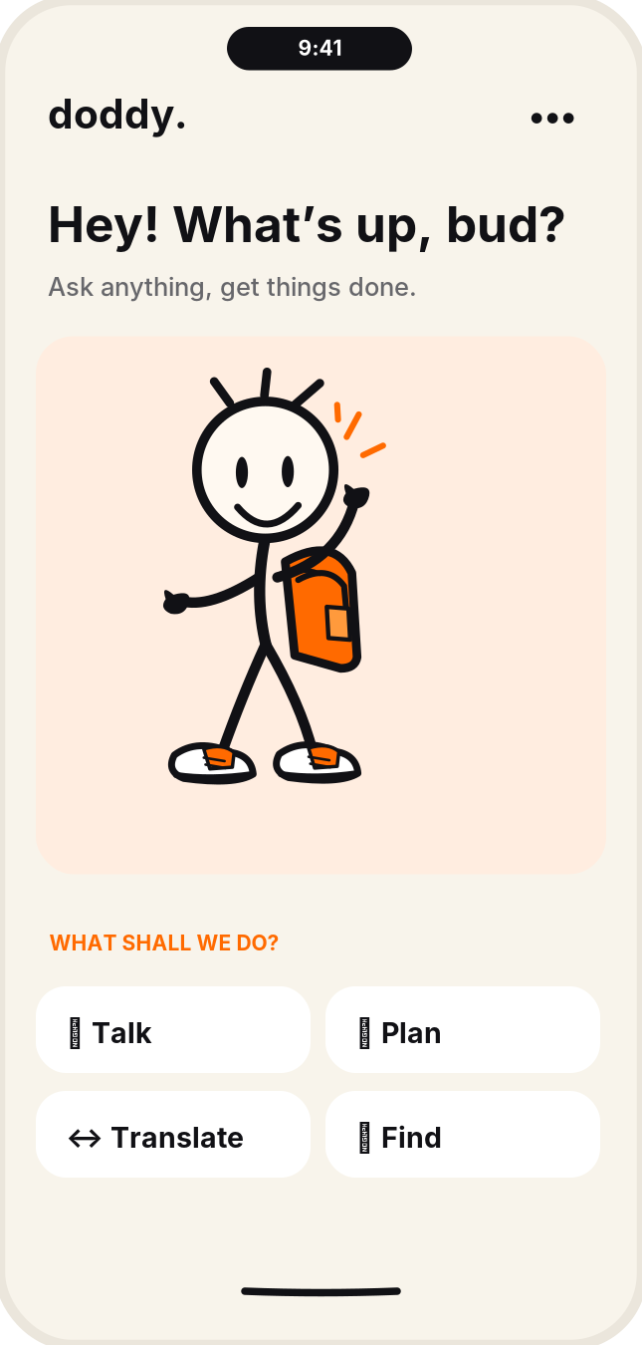
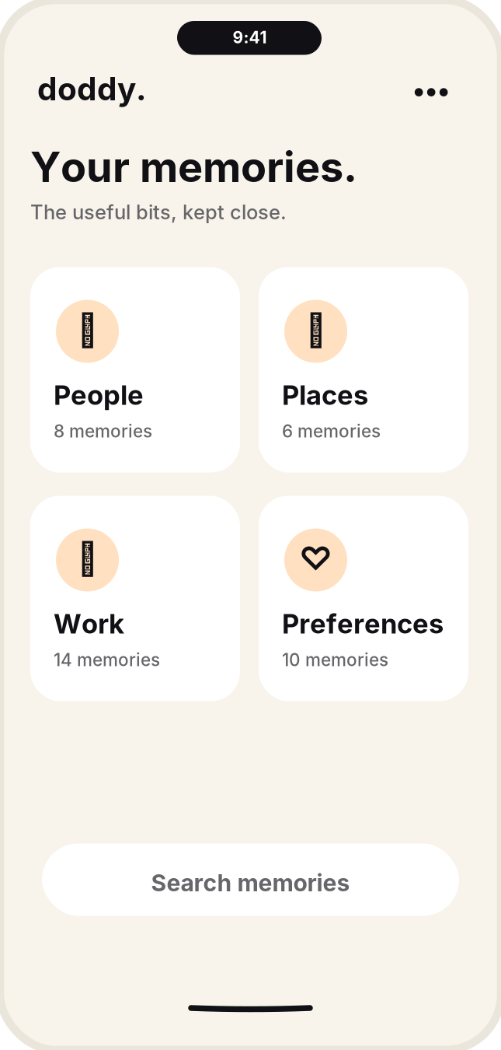
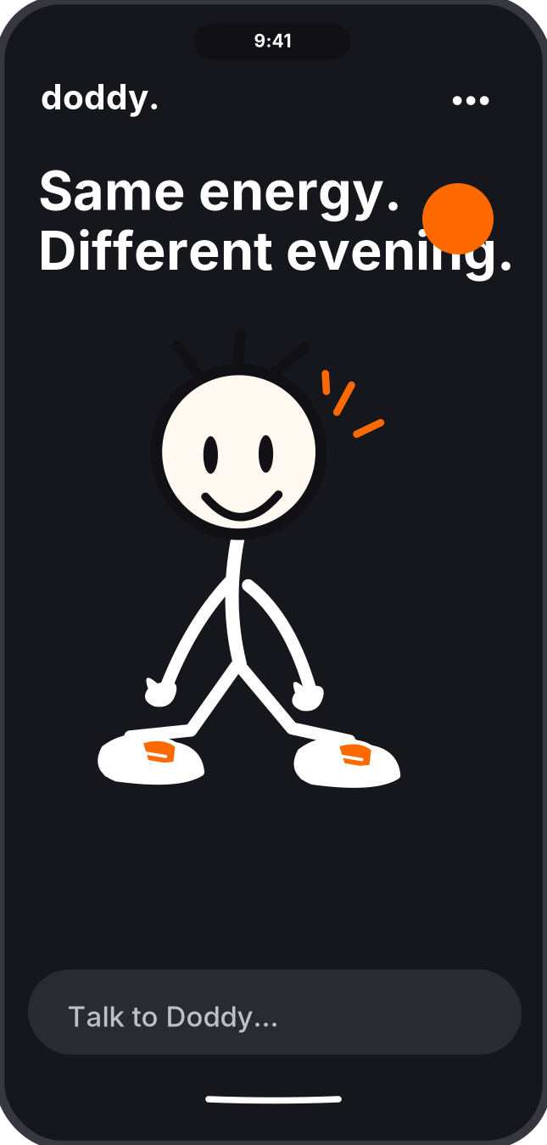
PRODUCT / CORE
A character who is genuinely useful.
These are design-system mockups, not proof of implemented functionality.
HOME
MEMORY
DARK
39

Slide 40
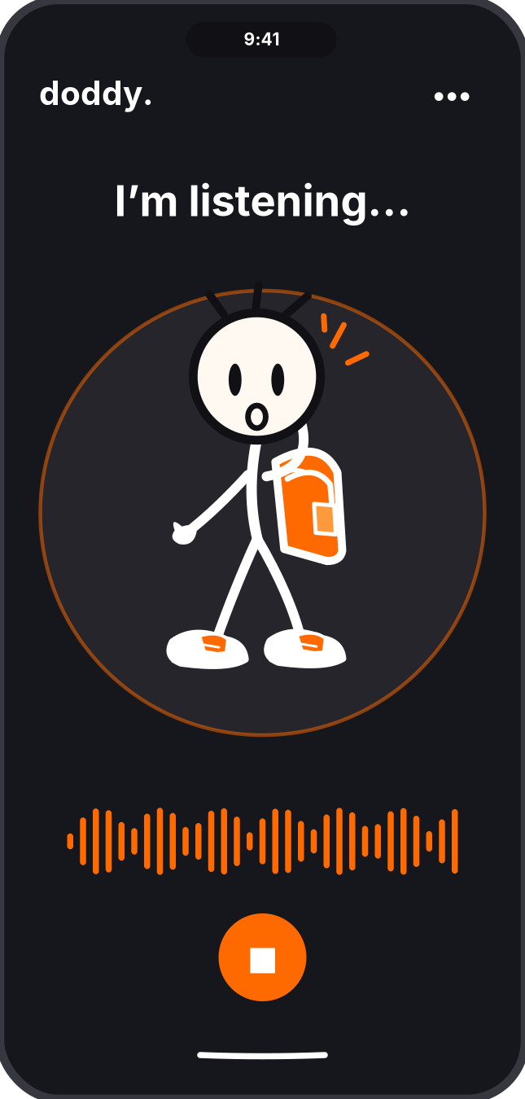
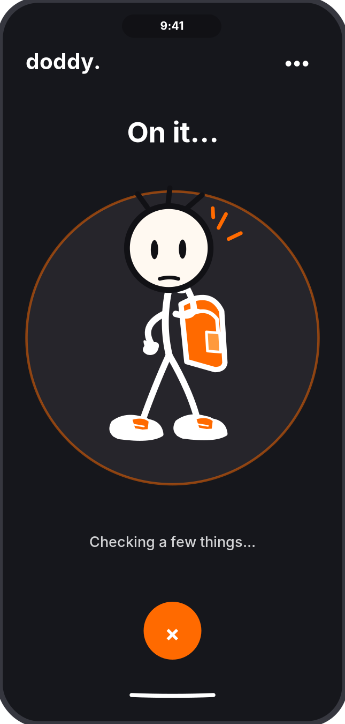
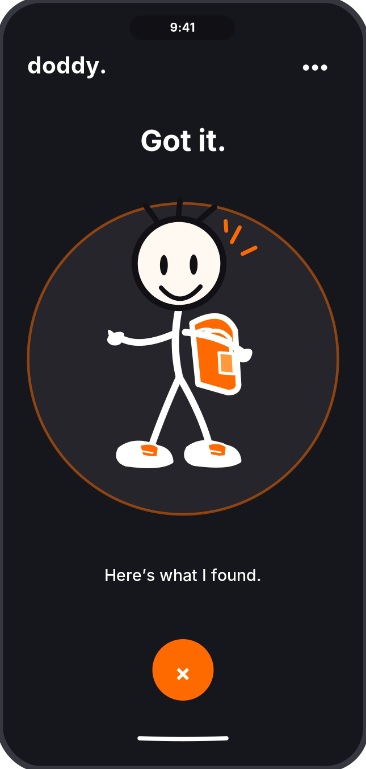
PRODUCT / VOICE
Listening is not thinking.
Avoid misleading interface signals: microphone activity must map to actual state.
LISTENING
THINKING
SPEAKING
40

Slide 41
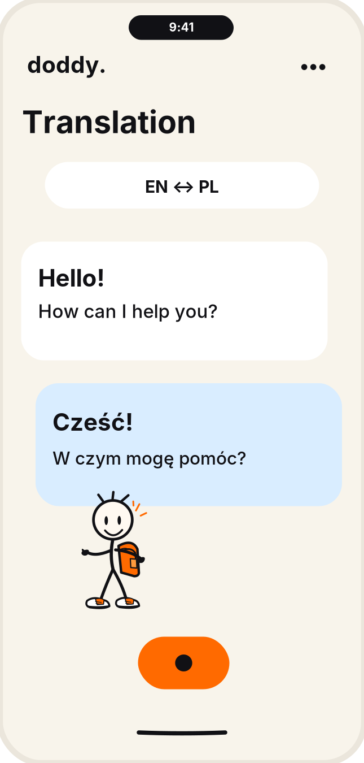
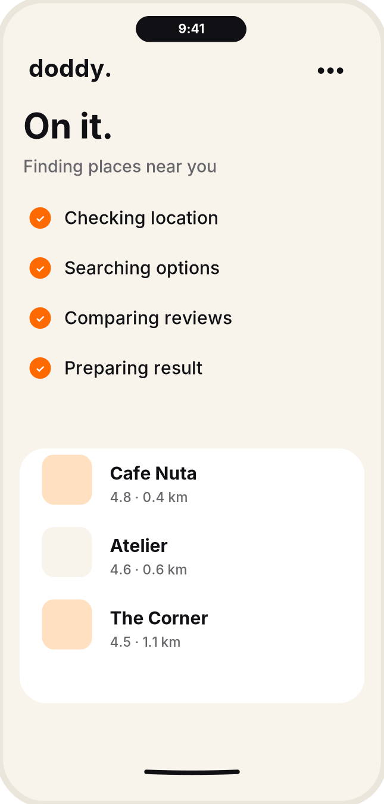
PRODUCT / UTILITY
Helpful states, consistent surface.
Translation and actions should keep outcome details visible.
TRANSLATE
ACTIONS
MEMORY
41

Slide 42
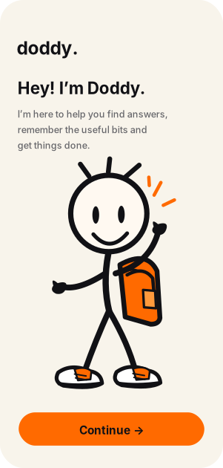
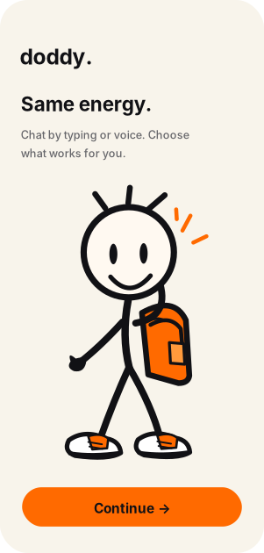
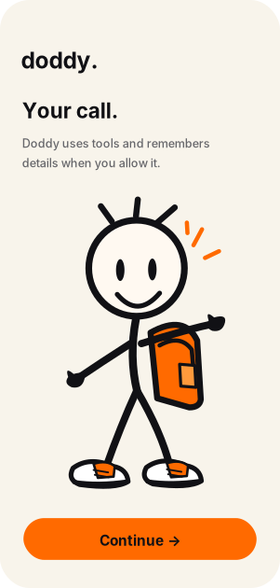
PRODUCT / ONBOARDING
Clarity from the first hello.
Use onboarding to establish utility, input modes and real privacy boundaries.
STEP 01
STEP 02
STEP 03
42

Slide 43
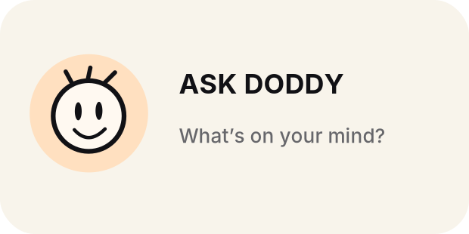
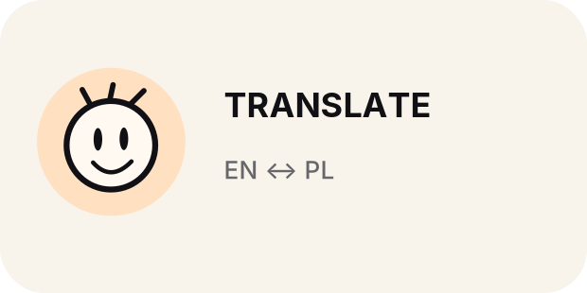
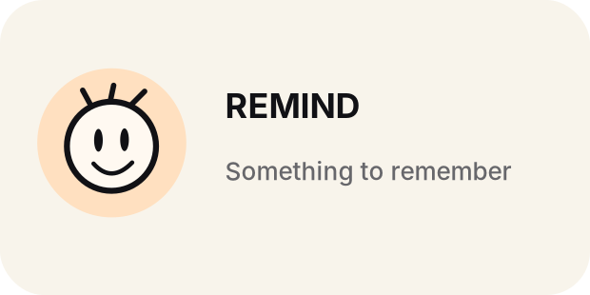
PRODUCT / PLATFORM
Be present when useful.
Widget examples are shortcut surfaces; Dynamic Island requires eligible system activity.
PLATFORM GUARDRAILS
No permanent always-on Dynamic Island mascot.
No automatic iPhone Back Tap configuration.
No microphone visuals without a live session.
Use system notifications sparingly.
Provide non-animated equivalents.
43

Slide 44
DODDY / BRAND SYSTEM v1.3
05
Content system
The first audience meets a character, not an interface.

Slide 45
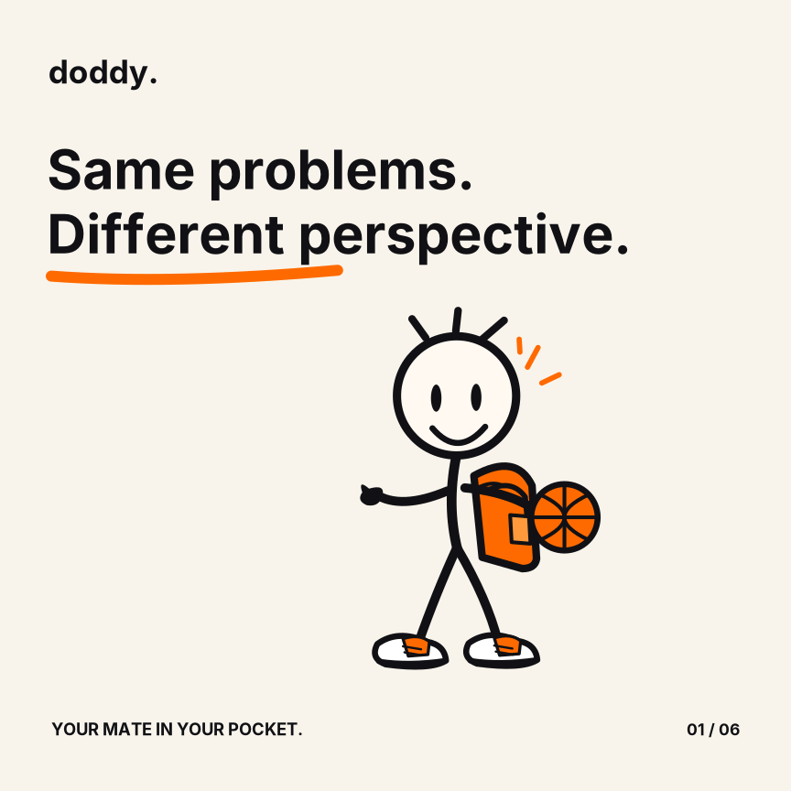
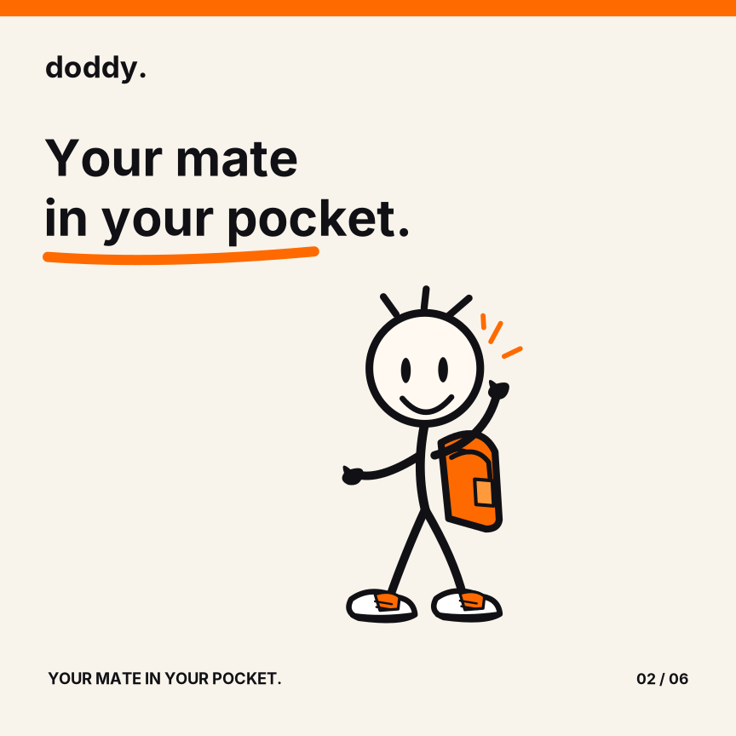
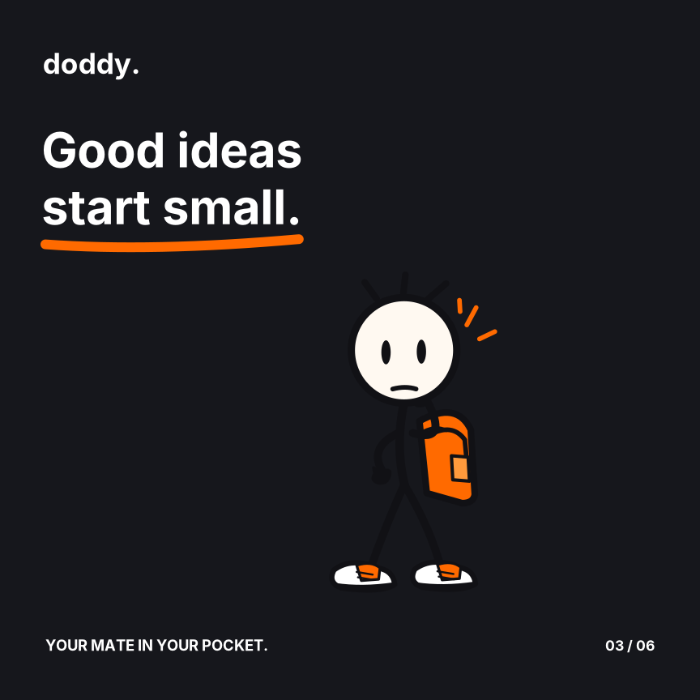
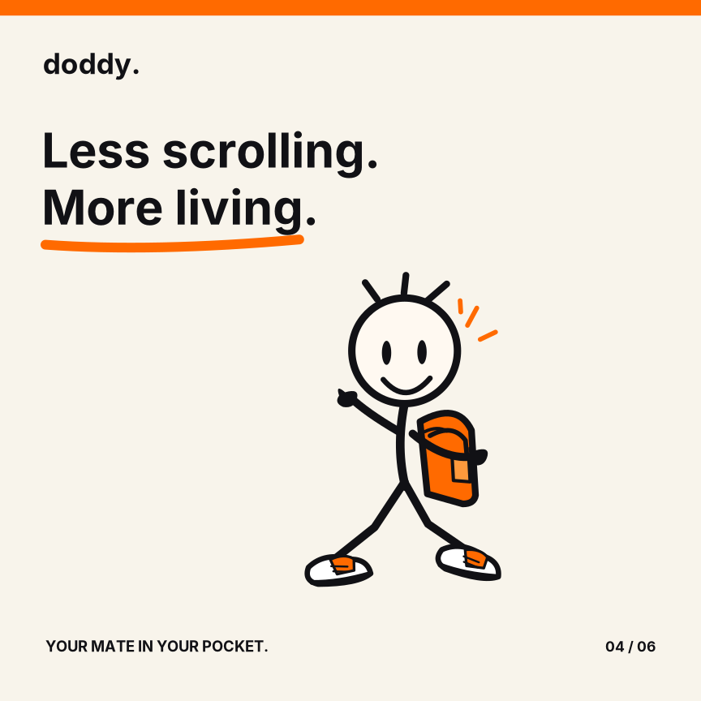
CONTENT / SERIES
One world. Repeatable formats.
Social templates should remain editable and simple to animate.
SOCIAL FRAME 01
SOCIAL FRAME 02
SOCIAL FRAME 03
SOCIAL FRAME 04
45

Slide 46
CONTENT / STORYTELLING
Every episode has a small arc.
Don’t write generic AI feature ads starring a mascot.
1. PROBLEM
2. REACTION
An ordinary moment the audience understands.
Doddy has a specific, charming point of view.
3. ACTION
4. PAYOFF
He attempts something real, useful or funny.
A clear resolution, surprise or honest miss.
46

Slide 47
CONTENT / CHANNELS
Built for organic recognition.
Create multiple formats from the same source poses.
SHORT VIDEOS
Character everyday-life sketches; 10–35 seconds.
REACTION CLIPS
One expressive face, one instant point of view.
CAROUSELS
A familiar problem shown across 4–6 frames.
EXPLAINERS
Demonstrate useful product moments without inflated claims.
COMMUNITY
Respond through Doddy, with clear brand voice.
47

Slide 48
VOICE / EDITORIAL RULES
A capable mate, not a know-it-all.
The more sensitive the subject, the less the character performs.
SOUNDS LIKE
DOES NOT SOUND LIKE
“Got it. Here’s what I found.”
“I might be wrong. Want me to check?”
“Want me to take another look?”
“Not sure yet. Here’s what I know.”
“Trust me, I know everything.”
“Done!” before an action succeeds.
Jokes about a serious health issue.
Unsolicited emotional dependence cues.
48

Slide 49
VOICE / CONTEXT
Personality adapts; principles do not.
Tune expressive level to the situation, not only a settings slider.
EVERYDAY
Short, direct, friendly; occasional humour.
UNCERTAIN
State uncertainty and what evidence would help.
ACTION
Confirm before consequential operations.
ERROR
Own the failure; offer a recoverable next step.
SENSITIVE
Calm, factual, serious; no sarcasm.
49

Slide 50
DODDY / BRAND SYSTEM v1.3
06
Production & governance
Files people can actually reuse.

Slide 51
GOVERNANCE / ACCESSIBILITY
Design for more people.
Test accessibility; do not claim that every screenshot is WCAG verified.
CONTRAST
MOTION
Check body, button and icon colours against actual surfaces.
Respect Reduce Motion; avoid endless attention-catching loops.
TOUCH
SPEECH
Target ≥44×44pt for primary interactive controls on iOS.
Provide transcript and captions for spoken content.
COGNITION
TYPE
Separate “understood” from “completed” in action flows.
Do not put critical UI labels in decorative handwriting.
51

Slide 52
GOVERNANCE / TRUST
Don’t fake understanding or memory.
Doddy can feel human without claiming human judgement or omniscience.
TRANSPARENT INPUT
TRANSPARENT OUTPUT
Only indicate “listening” during active authorised audio capture.
Explain what context is being used.
Give simple permission controls.
Do not imply access to closed apps or screens.
Differentiate suggestion from executed action.
Show source/time limitations where relevant.
Mark memory as explicitly saved when it is.
Support recovery from failures.
52

Slide 53
HANDOFF / DESIGN TOKENS
A small system that scales.
Machine-readable starting tokens are included in JSON, alongside CSS-style names.
--doddy-orange
#FF6A00
--doddy-ink
#111115
--doddy-paper
#F8F4EB
--doddy-night
#16171C
--radius-card
24px
--motion-character
420ms
53

Slide 54
HANDOFF / NAMING
Find it. Inspect it. Reuse it.
SVG sources are independent vector compositions; PPTX text is editable.
Character master
doddy_master_front.svg
Expression
doddy_expression_<emotion>.svg
Pose
doddy_pose_<action>.svg
App icon
doddy_app_icon_1024.png
App screen
doddy_ui_<state>.svg
Motion preview
doddy_motion_<state>_preview.gif
54

Slide 55
HANDOFF / QA
A real system needs checks.
Before publishing or handing to engineering:
ART
FORMATS
Check proportions across artboards and dark background.
Verify SVG renders, PNG alpha, GIF playback and ZIP integrity.
DOCUMENT
TRADEMARK
Review PDF visual output and editable slide copy.
Search for conflicts, clear naming and approve final outlined lettering.
FONTS
PRODUCT
Verify license conditions before commercial publishing.
Validate platform constraints, accessibility and technical feasibility.
55

Slide 56
RELEASE / LIMITATIONS
What v1.3 is - and isn’t.
Transparent production status prevents expensive downstream assumptions.
DELIVERED
NEXT PRODUCTION WORK
Vector character art and expressions.
Vector pose and turnaround system.
Logo and colour source files.
Editable presentation + PDF.
Social/app vector mockups.
Motion preview GIFs + specs.
Custom outlined final wordmark.
Trademark and font legal review.
Dedicated animator cleanup/rig.
Platform-validated app interactions.
Accessibility testing on real UI.
Production asset optimisation.
56

Slide 57
Good work.
Your mate in your pocket.
DODDY / BRAND GUIDELINES v1.3
Source art. Design tokens. Product examples. Motion.

