Slide 1
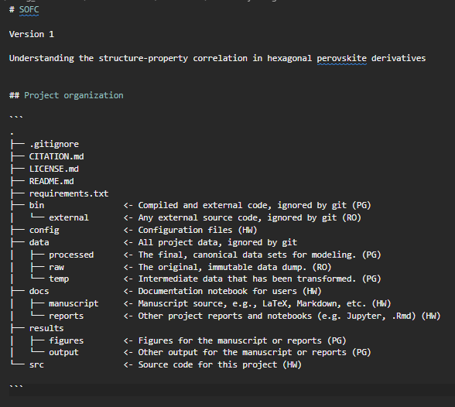
This data is generated by Bruker TopSpin Software. It has the format ‘.fid’ and a size of 240 KB.
YYMMDD_{sample_name}_{nmr_experimental_condition}.fid
Q1.
Q2. Examples contained in the <> to the right-hand side
Q3.
Nuclei Magnetic Resonance Data
Collect and analyse
This data is generated by the MT-Lab Software. The formats possible are .fra, .Z, and .dat. The size depends on how the data is collected.
YYMMDD_{sample_name}_{impedance_experimental_condition}.z
Electrochemical Impedance Data
Collect and analyse
This data is collected using the in-house Bruker X-ray diffractometer. The format could either .xrdml or .raw. The size is around 20 KB.
YYMMDD_{sample_name}.xrdml
X-Ray Diffraction Data
Collect and analyse
Name:
Topic:

Slide 2
Q1.
Q2. Examples contained in the <> to the right-hand side
Q3.
Python Scripts
These are created using VSCode. They have .ipynb format and the size is dependent on the length of each script. Theses scripts are written for data analysis and visualisation.
YYMMDD_{script_purpose}.ipynb
Create and publish
These include posters and presentation slides. The size is dependent on the quality and quantity of each file. The format could be .jpeg, .pdf, etc.
YYMMDD_{presentation_name}.pdf
Create and publish
Visuals (thanks to Héctor)

Slide 3
Nuclei Magnetic Resonance Data
This data is generated by Bruker TopSpin Software. It has the format ‘.fid’ and a size of 240 KB.
YYMMDD_{sample_name}_{nmr_experimental_condition}.fid
Q1. Data collection process/method
Q2. README file and Data dictionary
Q3. None
Collect and analyse
This data is generated by the MT-Lab Software. The formats possible are .fra, .Z, and .dat. The size depends on how the data is collected.
YYMMDD_{sample_name}_{impedance_experimental_condition}.z
Q1. Data collection process/method
Q2. README file and Data dictionary
Q3. None
Electrochemical Impedance Data
Collect and analyse
This data is collected using the in-house Bruker X-ray diffractometer. The format could either .xrdml or .raw. The size is around 20 KB.
YYMMDD_{sample_name}.xrdml
Q1. Data collection process/method
Q2. README file and Data dictionary
Q3. None
X-Ray Diffraction Data
Collect and analyse
Name:
Topic:

Slide 4
These are created using VSCode. They have .ipynb format and the size is dependent on the length of each script. Theses scripts are written for data analysis and visualisation.
YYMMDD_{script_purpose}.ipynb
Q1. Code versioning
Q2. Jupyter Notebook and Markdown files
Create and publish
Python Scripts
These include posters and presentation slides. The size is dependent on the quality and quantity of each file. The format could be .jpeg, .pdf, etc.
YYMMDD_{presentation_name}.pdf
Q1. Metadata
Q2. It depends
Create and publish
Visuals (thanks to Héctor)

Slide 5
Nuclei Magnetic Resonance Data
This data is generated by Bruker TopSpin Software. It has the format ‘.fid’ and a size of 240 KB.
YYMMDD_{sample_name}_{nmr_experimental_condition}.fid
Date of creation, author, name of sample, experimental details
Collect and analyse
This data is generated by the MT-Lab Software. The formats possible are .fra, .Z, and .dat. The size depends on how the data is collected.
YYMMDD_{sample_name}_{impedance_experimental_condition}.z
Date of creation, author, name of sample, experimental details
Electrochemical Impedance Data
Collect and analyse
This data is collected using the in-house Bruker X-ray diffractometer. The format could either .xrdml or .raw. The size is around 20 KB.
YYMMDD_{sample_name}.xrdml
Date of creation, author, name of sample, experimental details
X-Ray Diffraction Data
Collect and analyse
Name:
Topic:

Slide 6
Nuclei Magnetic Resonance Data
This data is generated by Bruker TopSpin Software. It has the format ‘.fid’ and a size of 240 KB.
YYMMDD_{sample_name}_{nmr_experimental_condition}.fid
Q1. The files are in .fid format, so you will be needing softwares that can read .fid docs to open it. Also, you can write a python script to read it if you do not want to pay for commercial softwares.
Q2. I do not see a need for that, but yes you can. .txt or .csv.
Q3.
Collect and analyse
This data is generated by the MT-Lab Software. The formats possible are .fra, .Z, and .dat. The size depends on how the data is collected.
YYMMDD_{sample_name}_{impedance_experimental_condition}.z
Q1. Yes, depending on how you want to analyse the data.
Q2. Yes, as well. You can convert to .txt, .csv or whatever format your data analysis software requires
Q3.
Electrochemical Impedance Data
Collect and analyse
This data is collected using the in-house Bruker X-ray diffractometer. The format could either .xrdml or .raw. The size is around 20 KB.
YYMMDD_{sample_name}.xrdml
Q1. Yes
Q2. .Yes. .raw, .xrdml, .txt, .csv. .xlsx
Q3.
X-Ray Diffraction Data
Collect and analyse
Name:
Topic:

Slide 7
Nuclei Magnetic Resonance Data
This data is generated by Bruker TopSpin Software. It has the format ‘.fid’ and a size of 240 KB.
YYMMDD_{sample_name}_{nmr_experimental_condition}.fid
Q1. All contributors
Q2. Project Data (U:)
Q3. Open
Collect and analyse
This data is generated by the MT-Lab Software. The formats possible are .fra, .Z, and .dat. The size depends on how the data is collected.
YYMMDD_{sample_name}_{impedance_experimental_condition}.z
Electrochemical Impedance Data
Q1. All contributors
Q2. Project Data (U:)
Q3. Open
Collect and analyse
This data is collected using the in-house Bruker X-ray diffractometer. The format could either .xrdml or .raw. The size is around 20 KB.
YYMMDD_{sample_name}.xrdml
Q1. All contributors
Q2. Project Data (U:)
Q3. Open
X-Ray Diffraction Data
Collect and analyse
Name:
Topic:

Slide 8
These are created using VSCode. They have .ipynb format and the size is dependent on the length of each script. Theses scripts are written for data analysis and visualisation.
YYMMDD_{script_purpose}.ipynb
Q1. All contributors
Q2. Project Data (U:)
Q3. Open
Create and publish
Python Scripts
These include posters and presentation slides. The size is dependent on the quality and quantity of each file. The format could be .jpeg, .pdf, etc.
YYMMDD_{presentation_name}.pdf
Q1. All contributors
Q2. Project Data (U:)
Q3. Open
Create and publish
Visuals (thanks to Héctor)

Slide 9
Nuclei Magnetic Resonance Data
This data is generated by Bruker TopSpin Software. It has the format ‘.fid’ and a size of 240 KB.
YYMMDD_{sample_name}_{nmr_experimental_condition}.fid
Q1.4TURepository
Q2. …
Q3. …
Q4. Yes, it does. I have no idea for now.
Collect and analyse
This data is generated by the MT-Lab Software. The formats possible are .fra, .Z, and .dat. The size depends on how the data is collected.
YYMMDD_{sample_name}_{impedance_experimental_condition}.z
Electrochemical Impedance Data
Q1.4TURepository
Q2. …
Q3. …
Q4. Yes, it does. I have no idea for now.
Collect and analyse
This data is collected using the in-house Bruker X-ray diffractometer. The format could either .xrdml or .raw. The size is around 20 KB.
YYMMDD_{sample_name}.xrdml
Q1.4TURepository
Q2. …
Q3. …
Q4. Yes, it does. I have no idea for now.
X-Ray Diffraction Data
Collect and analyse
Name:
Topic:

Slide 10
Actions
Flags
Create
Delete
Analyze
Confidential data
…
Collect
Transcribe
Anonymize
Commercial
data
Pseudo-anonymize
Publish
Copy
Personal data
…
Merge
Convert
Re-use
Closed access
Check usage rights
…
…

