Slide 1

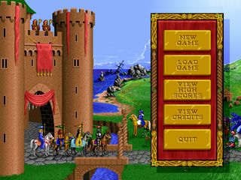


Advanced C++ Development
Source Files, Programs and Compilation Process, Preprocessor
Giorgio Ugazio

Slide 2
Translation Unit
The text of the program is kept in units called source files.
A source file together with all the headers and source files included via the preprocessing directive #include, less any source lines skipped by any of the conditional inclusion preprocessing directives, is called a translation unit.
The separate translation units of a program communicate by calls to functions whose identifiers have external linkage, manipulation of objects whose identifiers have external linkage, or manipulation of data files.
Translation units can be separately translated and then later linked by a Linker to produce an executable program.
(C++03)
Giorgio Ugazio, Advanced C++ Development

Slide 3
Compiling…
Compiling process is the process to transform a T.U. in object code.
The object code is impl.dep.
First step in compilation process is executing the Preprocessor.
All preprocessor directive (see later) are executed and the T.U. is built.
Second step is the Parser.
The TU is analyzed and every entity recognized. This step is also called tokenization. At this stage, the program is a sequence of tokens.
Third step is syntactic check.
Grammar rules are checked, the whole program must be a correct “sentence” in the C++ Language, respecting all the grammar rules.
Fourth step is translation.
Tokens are transformed in assembly code. You can usually see the disassembly of a TU (disassembly window on VS)
Fifth step is assembling.
Assembly language is transformed in machine code (object files)
Giorgio Ugazio, Advanced C++ Development

Slide 4
Linking…
The Linking phase is where all external object and function references are resolved.
Library components are linked to satisfy external references to functions and objects not defined in the current translation.
All such translator output is collected into a program image which contains information needed for execution in its environment.
// file1.cpp
int x = 1;
int y = 0;
extern int z;
// file2.cpp
int x; // multiple definition (already defined) violation ODR
extern double y; // different types
extern int z; // never defined (unresolved external)
Giorgio Ugazio, Advanced C++ Development

Slide 5
Linkage
A name that can be used in translation units different from the one in which it was defined is said to have external linkage.
A name that can be referred to only in the translation unit in which it is defined is said to have internal linkage.
Global and namespace level objects (variable and functions) have external linkage by default, unless they are declared static (this static is different for static ad storage modifier) or unless they are defined in unnamed namespace.
An inline function must be defined, by identical definitions, in every translation unit in which it is used.
By default, consts and typedefs have internal linkage. A const can be given external linkage by an explicit declaration.
extern const int x = 5;
Giorgio Ugazio, Advanced C++ Development

Slide 6
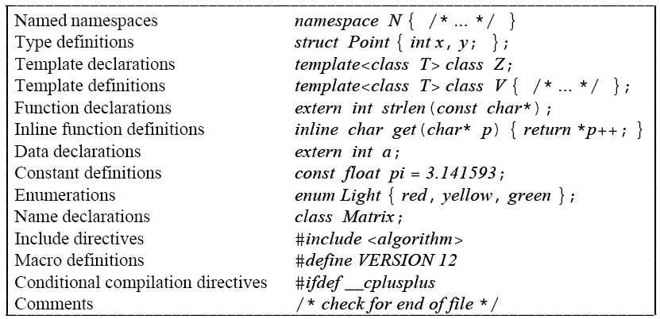
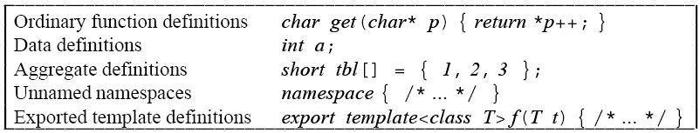
Header Files
Header files are useful tools to avoid declaring every entity you are using in each translation unit.
Giorgio Ugazio, Advanced C++ Development

Slide 7
Include Guards
To avoid multiple inclusion of the same header file (if it contains class definitions and/or inline function definitions) in a single translation unit, you need to surround your header files with include guards:
#ifndef UNIQUE_NAME
#define UNIQUE_NAME
// your header content here
#endif
Be sure that a UNIQUE_NAME is chosen for each header file or, if your compiler (and all compilers witch you think your code will be compiled) support some non-standard-but-de-facto-standard pragma.
#pragma once
It work on almost every compiler I’ve worked on (except some release of Metrowerks CodeWarrior... Wii and PSP)
Giorgio Ugazio, Advanced C++ Development

Slide 8
Header Files Recommendations
Behavior of your programs must not change if the order of header file inclusion changes. Never write code assuming a special order of inclusion in your header files.
Each header file should be self sufficient, meaning that an empty .cpp source file that does nothing but #include your header file should produce a translation unit that compile correctly.
[I usually test the previous condition including a header file as first statement that its relative source file]
Avoid using directive and using declaration in header files
Prefer forward declaration vs header inclusion
Giorgio Ugazio, Advanced C++ Development

Slide 9
Physical Structure of a Program
The organization of a program into source files is commonly called the physical structure of a program.
The physical separation of a program into separate files should be guided by the logical structure of the program.
Evolution of a project:
single source file
few source files (.cpp) and a single header file (.h)
lots of source files each one with its header files (avoid multiple inclusion of the same header using include guards or pragmas)
use of forward declaration (fast compilation)
use of precompiled header (fast compilation)
avoid coupling, reduce dependencies
library separation (fast recompilation)
bulk compilation (fast compilation)
solution separation (fast recompilation)
Giorgio Ugazio, Advanced C++ Development

Slide 10
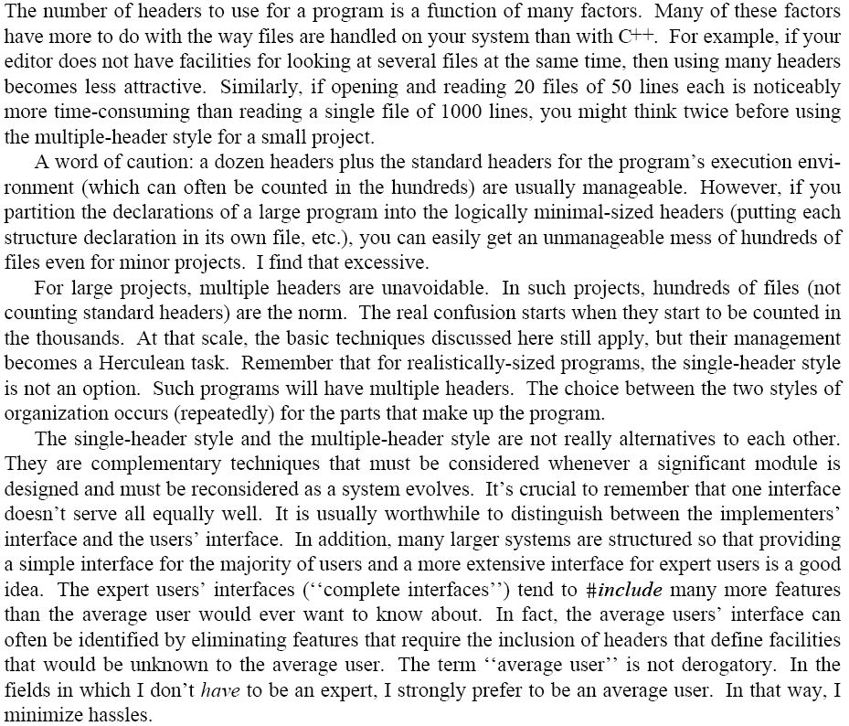
…
…
LOL
Giorgio Ugazio, Advanced C++ Development

Slide 11
Common Source Files Organization
We call source file any *.c or *.cpp files, header file any *.h or *.hpp and inline files any *.inl.
We have code organized in Projects. Each project can be a library (static or dynamic) or an executable.
In standard compilation, the files that must be compiled are the source files. Each one produces a translation unit that results in a object file, impl.dep.
There can be bulk builds that compiles only ad hoc source files that #includes all project cpp files in order to reduce TUs.
The project object files are linked together with external dependencies to produce the output of the project (the library or the executable).
Project are grouped (overlapping) in Solutions.
Giorgio Ugazio, Advanced C++ Development

Slide 12
Common Project Organization
Each project has several project configuration (debug, release, ...) where preprocessor defines are defined and different compiler/linker options are selected.
Each solution (a set of projects in VS) has several solution configuration (debug, release,...) where projects configurations are combined.
If you develop cross-platform and you want to use the same codebase you can use the solution platform specification (VS) or you can choose to manage different projects/solution for each platform (better)
The same source code can be part of different projects (usually one per platform) and each project can be part of different solutions. If it is application independent code (library), it is in several solution set.
External Libs, third party software, Engines, must be linked by the executable project using external dependencies, #pragma include lib specification, or project dependencies specification (see later)
Giorgio Ugazio, Advanced C++ Development

Slide 13
Compilation time
Compiling process may be a time consuming process.
Modern project (especially in videogame development) can have thousands of T.U. Each source file can #include hundreds or (maybe indirectly) thousands of header files.
Compilation time can be reduced using some techniques:
Internal techniques (design issue):
reduce dependencies (interfaces, decoupling, encapsulation)
use of forward declaration for what is not completely needed
use of design decoupling mechanism (bridge pattern, pimpl idiom)
External techniques (language-environment issues):
use of precompiled headers
bulk compilation
distributed compilation
Giorgio Ugazio, Advanced C++ Development

Slide 14
C++ Program Startup
A program consists of one or more translation units linked together
A program shall contain a global function called main, which is the designated start of the program. [It is implementation-defined whether a program in a freestanding environment is required to define a main function.]
All implementations shall allow both of the following definitions of main:
int main() { /* ... */ }
int main(int argc, char* argv[]) { /* ... */ }
Start-up and termination is implementation-defined;
Startup contains the execution of constructors for objects of namespace scope with static storage duration;
Termination contains the execution of destructors for objects with static storage duration.
Giorgio Ugazio, Advanced C++ Development

Slide 15
Static Initialization
Global variable, namespace variable, class static and function static (called collectively statics) are initialized before main is executed
False! Not always true with dynamic linked libraries!
False! Function static is initialized first time function is executed!
If a static variable has no explicit initializer, it is by default initialized to the default for its type. The default initializer value for builtin types and enumerations is 0.
Static variables in a translation unit are initialized in their declaration order. There is no guaranteed order of initialization of static variables in different translation units.
Avoid static variables with non trivial constructor. It will executed before main, it can require other entities yet constructed. (see Singleton instead)
Avoid static variables with initialization dependence.
Avoid global and namespace variables.
Giorgio Ugazio, Advanced C++ Development

Slide 16
C++ Program Termination
Calling the function exit(int); declared in <cstdlib> terminates the program without leaving the current block and hence without destroying any objects with automatic storage duration.
All functions registered with atexit() are called and all objects with static storage will be destroyed.
A return statement in main has the effect of leaving the main function (destroying any objects with automatic storage duration) and calling exit with the return value as the argument.
If control reaches the end of main without encountering a return statement, the effect is that of executing return 0;
Calling the function abort(); declared in <cstdlib> terminates the program without executing destructors for objects of automatic or static storage duration and without calling the functions passed to atexit().
Unhandled exceptions results in a call to terminate(); (that call abort() we’ll see later exception handling)
Giorgio Ugazio, Advanced C++ Development

Slide 17
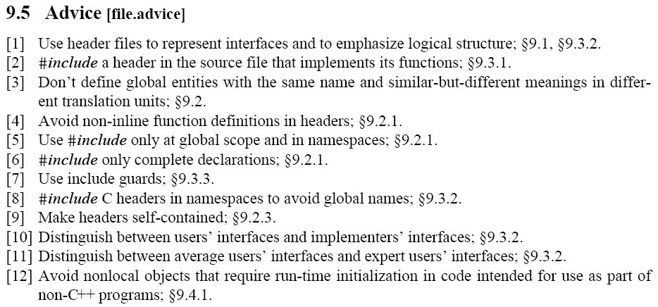
Advices
Giorgio Ugazio, Advanced C++ Development

Slide 18
Preprocessor
The “preprocessor” is a C legacy stuff that represent, as in C, the first step of the compilation process.
The preprocessor is language agnostic, so the “C Preprocessor” can be used to preprocess any language. C++ too.
Preprocessor essentially executes preprocessor directive that are:
include directives (#include)
macro definition (#define, #undef ... See next)
conditional compilation directives (see next)
control directives (#pragma ... See next)
force compilation errors and warning (#error, #warning non standard)
token concatenation (## in macro)
stringizing operator (# in macro)
Giorgio Ugazio, Advanced C++ Development

Slide 19
Conditional Compilation
#if, #ifdef, #ifndef, #else, #elif and #endif directives can be used for conditional compilation.
Example:
#if
// code
#elif
// code
#else
// code
#endif
Other usages...
#ifdef X
#if defined(X)
#ifndef X
#if !defined(X)
#if defined(X) && !defined(Y)
#elif defined(X) || !defined(Y)
Giorgio Ugazio, Advanced C++ Development

Slide 20
Pragmas
#pragma once
#pragma warning [push, disable:xyz, pop]
#pragma pack [push, xyz, pop]
#pragma message(“asd”)
#pragma comment (lib, “asd.lib”)
#pragma push_macro(“asd”)
#pragma pop_macro(“asd”)
#pragma inline_depth(xyz)
#pragma region xyz
#pragma endregion
#pragma optimize
Giorgio Ugazio, Advanced C++ Development

Slide 21
Macro
We’ve yet seen define and macro, we’ve seen why it’s better to avoid them too. Here we see something we didn’t:
Multiline macro, token concat, stringizing
#define F(a,b,c) a +b \
+ c + #c + a##b
std::string x = “lol”;
std::string y = “asd”;
std::string z = “rotfl”;
std::string xy = “O_o”;
std:: cout << F(x,y,z) << std::endl;
// prints out: lolasdrotflzO_o
C++ have some predefined macro:
__LINE__, __FILE__, __DATE__, __TIME__, __cplusplus, NDEBUG
Environments (like VS) define other environmental macro and keywords (sometimes called intrinsics: __int64, __alignof)
Giorgio Ugazio, Advanced C++ Development

Slide 22
Links
Compilation Process and not only
http://www.acm.uiuc.edu/sigmil/RevEng/
Preprocessor
http://en.wikipedia.org/wiki/C_preprocessor
http://www.cplusplus.com/doc/tutorial/preprocessor/
Giorgio Ugazio, Advanced C++ Development

