Slide 1
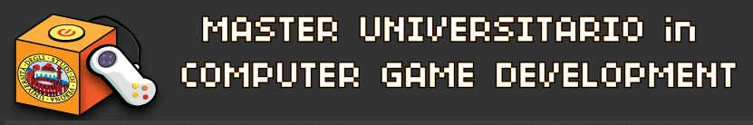


Advanced C++ Development
General Concepts
Giorgio Ugazio

Slide 2
Software Building
Software Design
Videogames Development
Giorgio Ugazio, Advanced C++ Development

Slide 3
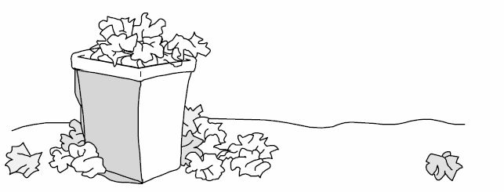
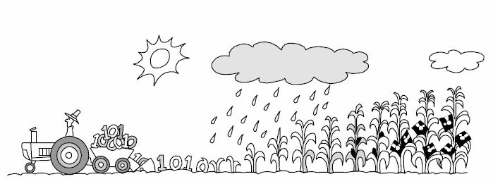
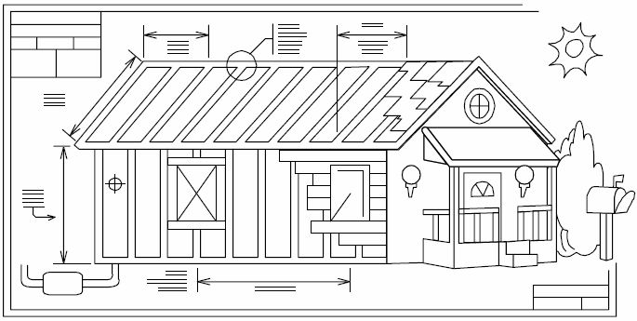
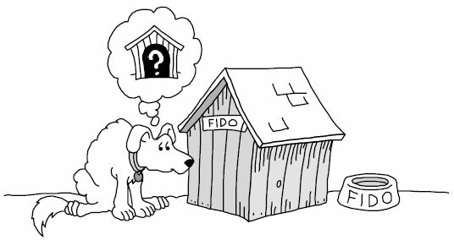
Software Metaphors
Software Writing
sequential approach, unpractical
weak metaphor...
Software Growing
sparse approach, modularity, independence
not a good metaphor
Software Building
up-front designing/planning plus iterations
abstraction, reuse, complexity depending on scale
good metaphor but...
Software ... What ??
Agile, XP, TDD, Scrums,
Giorgio Ugazio, Advanced C++ Development

Slide 4
Software Building
Building Steps
Analysis
Requirements
Specification
Methodology Selection
Architecture Design
Software Design
Implementation/Construction
Testing
Deployment
Maintenance
Reuse
Methodologies
Waterfall
Iterative
Agile
RAD (Fast Prototype)
RUP (Unified Process)
Spiral
V-Model
TDD
(Prerequisites)
(Design)
http://en.wikipedia.org/wiki/Software_development
Giorgio Ugazio, Advanced C++ Development

Slide 5
Prerequisites
Problem Definition (what the Software should do)
Specs (a detailed list (in “user” language) of what the Software should do... These are going to change during building!)
Requirements (a detailed list of needs to solve the Problem and to respect all the Specs: hardware, technologies, competencies, people, time)
Analysis (a boolean yes/no output about the affordability of the problem, or a counter-proposal with a new Specs attached)
Agreement (a set of “starting specs” (in “user” language) agreed by all parts – clients, stakeholders, owners, project managers, ...)
Giorgio Ugazio, Advanced C++ Development

Slide 6
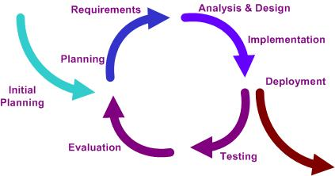
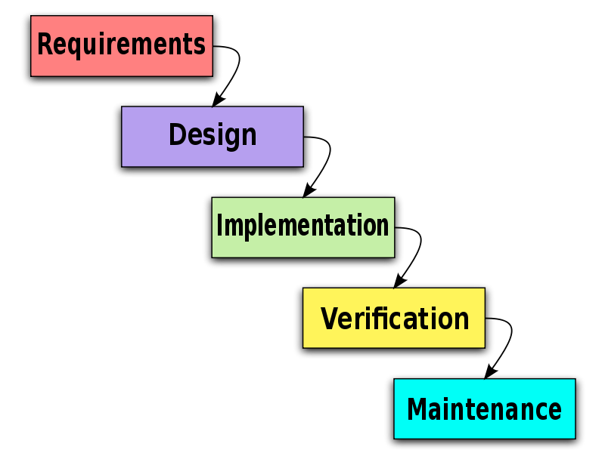
Methodologies 1
[Planning/Construction/Testing/Deployment] management:
Waterfall
Iterative
Giorgio Ugazio, Advanced C++ Development

Slide 7
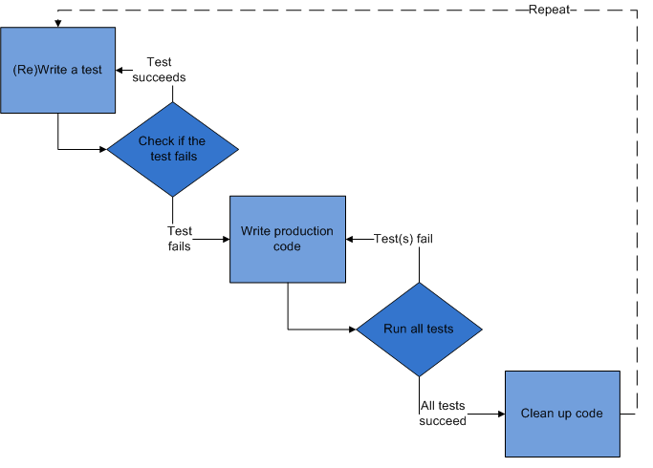
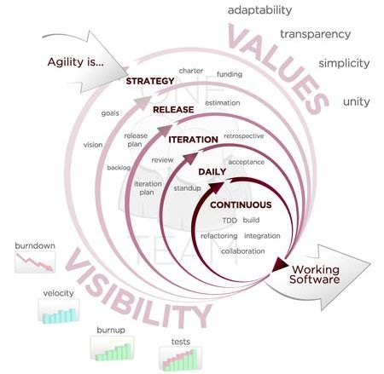
Methodologies 2
[Planning/Construction/Testing/Deployment] management:
Agile
Test Driven Development
Giorgio Ugazio, Advanced C++ Development

Slide 8
Software Building
Software Design
Videogames Development
Giorgio Ugazio, Advanced C++ Development

Slide 9
Design
Software/Architecture/Code Design is the process of Planning the production of the system we want to realize.
Design is a Wicked Problem (could be clearly defined only by solving it)
Design is a Heuristic Process (you can “hope” your approach works)
Design is a Sloppy Problem (a good solution is often only subtly different from a poor one)
Design is About Trade-Offs and Priorities
Design is Non-Deterministic
Design is Emergent
Main Design Goals: Managing Complexity & Speed up Production
Computing is the only profession in which a single mind is obliged to span the distance from a bit to a few hundred megabytes, a ratio of 1 to 10⁹, or nine orders of magnitude (Dijkstra 1989).
(today the ratio is 1 to 10¹⁵ or more…)
Giorgio Ugazio, Advanced C++ Development

Slide 10
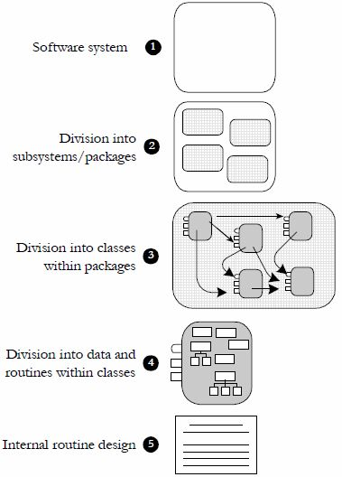
Design Levels
Level 0 : Architecture Design
Manager
Manager/Lead
Lead
Senior
Senior/Junior
Junior
Giorgio Ugazio, Advanced C++ Development

Slide 11
Level 0: Architecture Design
Business rules definition
Teamwork rules, responsibilities, management, needs
Time Management, Delivery Plan
Performance Constraints
Internationalization Issues
Security issues
Scalability Issues
Choice of Technologies
Buy/build decisions, tools planning, 3rd party software/assets
...Evidence that alternatives were taken into account...
Giorgio Ugazio, Advanced C++ Development

Slide 12
Level 1: Software System Design
Choice of “physical structure” of the Project
Choice of Programming Language(s)
Choice of Programming Convention
Overview of the system in broad terms
Major building blocks (20% of the system that does 80% of the job)
Responsibility, communication and visibility of each block
Reuse decisions
Data design
UI design
I/O and resource management
Error processing/robustness
Giorgio Ugazio, Advanced C++ Development

Slide 13
Other Levels
Level 2: Division in Subsystems (Abstraction, Modularity, Stratification, Low Coupling, Complexity Management)
Level 3: Subsystems Division in Classes (Abstraction, Ease of understanding, responsibility, Complexity Management)
Level 4: Class Design, Data & Routines (Abstraction, Information Hiding, High Cohesion, Complexity Management)
Level 5: Routine Design (Avoid Duplication, Information Hiding, algorithms implementation, central point of control, Portability, Complexity Management)
Keep coupling low. Avoid Semantic Coupling
Look for common (design) Patterns
Identify areas likely to change. Prevent them.
Identify reusable components. Enhance them.
Keep Complexity under Management.
Giorgio Ugazio, Advanced C++ Development

Slide 14
Design Heuristics
Minimize Complexity (KISS, YAGNI, Easy to understand)
Ease of Maintenance (clarity, readability)
Ease of Testing
Ease of Development (tools planning)
Modularity, Stratification
Minimize Coupling, Maximize Cohesion, Minimize Connections
Extensibility
High fan-in, Low fan-out
Portability, standard compliance
Robustness
Leanness (small is beautiful)
A book is finished not when nothing more can be added but when nothing more can be taken away. (Voltaire)
Giorgio Ugazio, Advanced C++ Development

Slide 15
Design Practices (Other Heuristics)
Iterate: cycle through candidates. Don’t stop at first attempt.
Divide and conquer: no one’s skull is big enough to contain all the details of a complex program, and that applies just as well to design. (functional decomposition)
Top-Down vs Bottom-Up: TD: Continue decomposing until it seems as if it would be easier to code the next level than to decompose it. BU: identify concrete objects and then generalizes aggregations of objects and base classes.
(In the final analysis, TD and BU design aren’t competing strategies, they’re mutually beneficial. Design is a heuristic process, which means that no solution is guaranteed to work every time; design contains elements of trial and error. Try a variety of approaches until you find one that works well.)
Prototype: write the absolute minimum amount of throwaway code that’s needed to answer a specific design question.
Collaborative Design: pair designing with a coworker. Formal or informal. On the paper or on the keyboard. Or… self pair designing! (design, forget for a week, redesign)
Giorgio Ugazio, Advanced C++ Development

Slide 16
Capturing Design
How Much Design is enough? It depends. When the design descends to the level of a task which you’ve done before or to a simple modification or extension of a task that you’ve done before, you’re probably ready to stop designing and begin coding
Avoid both BDUF and LDUF (Big/Little Design Up Front). Designing every last detail and not designing anything at all. The two positions advocated by extremists on both ends of the scale turn out to be the only two positions that are always wrong
How formal to make the design? It depends. Experience, size of the team, size of the project, criticality of the project, lifetime of the project…
How to “capture” it? You can write a design document or insert design documentation into the code itself, capture design discussions and decisions on a Wiki, write email summaries, create UML diagrams at appropriate levels of detail…
Giorgio Ugazio, Advanced C++ Development

Slide 17
Software Building
Software Design
Videogames Development
Giorgio Ugazio, Advanced C++ Development

Slide 18
Videogame Building
Different kind of Processes:
Publisher asking for a game development
Application to a publisher for a game development
Submission to a publisher of a game concept
Submission to a publisher of a game prototype
Submission to a publisher of a full feature game demo
Self develop, self publishing, self distribution
...
Different Roles:
The Publisher pays for the develop and (usually) advertises
The Developer develops the product
The Distributor sells the product
The Copyright Owners give you permissions to use their stuff
Giorgio Ugazio, Advanced C++ Development

Slide 19
Videogame Building Facts
The publisher provide requirements
Requirements always change. Always. Every meeting.
“Design” means not only “software design” but “game design”
You must provide a big “Conceptual Game Design” Up Front
Usually you start developing code after a Detailed Game Design.
Usually Software Design, Code Production and Game Design works in iteration.
Development cycle can be very tight
Agile methodologies are welcome
Code reuse between games is a great weapon.
Giorgio Ugazio, Advanced C++ Development

Slide 20
Videogame Building Cycle
Game Concept
Game Macro Design
Contact Publisher
Detailed Game Design
Prototype Design
Prototype Implementation
Publisher Agreement
Develop Milestone 1
...
Develop Milestone N
Publisher Agreement
Beta Version (Feature Freeze)
Debug
Submission
Distribution
Patch
Giorgio Ugazio, Advanced C++ Development

Slide 21
Indie Videogame Development
Small Team, small budget
No publisher, no distributor
No strict deadline
Game and Software Design usually produced by the same person
Game Engine usually not developed in house
Focus on Game Design, Gameplay and Graphic Assets
High Level Programming Languages or no programming at all!
Giorgio Ugazio, Advanced C++ Development

Slide 22
Links
Web:
http://en.wikipedia.org/wiki/Software_development
http://en.wikipedia.org/wiki/Scrum_%28development%29
http://www.htdp.org/2003-09-26/Book/curriculum-Z-H-1.html
Books:
Code Complete (McConnell, 2004)
Extreme Programming Explained: Embrace Change (Beck 2000)
Agile and Iterative Development: A Manager’s Guide (Larman 2004)
The Mythical Man Month (Brooks 1995)
Applying UML and Patterns (Larman 2001)
Giorgio Ugazio, Advanced C++ Development

