Slide 1




Advanced C++ Development
Basic, Types & Definitions
Giorgio Ugazio

Slide 2
What is C++
Noob answer:
“C++ is an Object Oriented Language…”
Giorgio Ugazio, Advanced C++ Development

Slide 3
What is C++
Multi-Paradigm Language that supports:
Procedural Programming: use variables, define procedures, call procedures like C does. (support: control structures, function definition, variable declaration, statements, expressions)
Data abstraction: define your types, define operations on types, redefine operators, call object methods. (support: struct/class, constructors, destructors, overloading, member functions, data hiding)
Object Oriented Programming: define class relationships, define hierarchies, behave polymorphically. (support: virtual methods, inheritance, overriding, pointers/references)
Generic Programming: define code (objects, algorithms) that can be used with different types. Make “the type” the variable part of the code. (support: template)
Functional Programming: programming paradigm that treats computation as the evaluation of mathematical functions and avoids state and mutable data. (support: C++11 lambda)
...So, it’s not only an OO language [Exceptional C++ item 25]
Giorgio Ugazio, Advanced C++ Development

Slide 4
Types
Definition/Declaration
Scopes/RValue/LValue/Typedef
Giorgio Ugazio, Advanced C++ Development

Slide 5
Types
Every name and expression in a c++ program has a type.
Fundamental Types
void
bool
char (signed, unsigned, plain)
Integers
Floating Points
User Defined Types
Enumerations
Pointers
Arrays
References
Functions (or function pointers)
Member Function Pointers
User Defined Unions/Structs/Classes
Standard Library Types
size_t, ptrdiff_t, FILE, time_t, clock_t, wchar_t
Giorgio Ugazio, Advanced C++ Development

Slide 6
Integral Types
char, signed char, unsigned char
3 different types, plain char could be signed or unsigned (impl.dep)
signed char, short int, int, long int
4 different signed integer types. Each one has a “unsigned” version.
1 = sizeof (char) <= sizeof (short) <= sizeof(int) <= sizeof(long)
Each unsigned type has the same memory occupation and alignment of signed counterpart (sizeof(N) = sizeof(signed N) = sizeof(unsigned N))
wchar_t must represent distinct codes for all members of the largest extended character set specified among the supported locales.
sizeof(char) <= sizeof(wchar_t) <= sizeof(long)
bool can contain true or false, but it’s another integral value that participate in integral promotion (1 <= sizeof(bool) <= sizeof(long))
Signed integral types could be represented in signed magnitude, 1’s complement, 2’s complement. It’s impl.dep.
Giorgio Ugazio, Advanced C++ Development

Slide 7
Floating Point Types
float, double, long double
3 different floating point types
sizeof(float) <= sizeof(double) <= sizeof(long double)
Floating point together with integral types are called arithmetic types.
Floating point memory representation is impl.dep but almost every implementation uses IEEE 754 standard.
It’s important to understand the concept of floating point precision and denormalized zone.
http://floating-point-gui.de/
http://en.wikipedia.org/wiki/Floating_point
http://en.wikipedia.org/wiki/IEEE_754-1985
Giorgio Ugazio, Advanced C++ Development

Slide 8
Void
The type void is syntactically a fundamental type. It can, however, be used only as part of a more complicated type;
there are no objects of type void. It is used either to specify that a function does not return a value or as the base type for pointers to objects of unknown type.
For example:
void x; // error: there are no void objects
void f(); // function f does not return a value
void *pv; // pointer to object of unknown type
Giorgio Ugazio, Advanced C++ Development

Slide 9
Enums
Each enumeration defines a type that is different from all other types.
Each enumerator has the type of its enumeration.
The underlying integral type is an unspecified integral type sufficient to contain the enumerator values. It’s impl.dep.
If the first enumerator has no initializer, the value of the corresponding constant is zero. An enumerator-definition without an initializer gives the enumerator the value obtained by increasing the value of the previous enumerator by one.
enum { a, b, c=0 }; // unnamed enums define integral consts
enum { d, e, f=e+2 };
defines a, c, and d to be zero, b and e to be 1, and f to be 3.
enum color { red, yellow, green=20, blue };
color c = 1; // error: type mismatch,
int i = yellow; // OK: yellow converted to integral value 1
Giorgio Ugazio, Advanced C++ Development

Slide 10
Literals
Integer Literals
12 (decimal) = 014 (octal) = 0xc = 0xC = 0Xc = 0XC (hex)
L, l = long int U, u = unsigned int;
LU, in every order, in every case in unsigned long int
Character Literals
‘x’, ‘\n’, ‘\t’, ‘\\’, ‘\?’, ‘\’’, ‘\”’
Floating Literals
-4.0594E-4, 0.4f, .4L, 1.f
String Literals (static storage, array of const char or wchar_t)
“asdasdasd”, L”lol”,
(string literals can be assigned to a char* due to C compatibility)
Boolean Literals
true, false
Giorgio Ugazio, Advanced C++ Development

Slide 11
Types
Definition/Declaration
Scopes/RValue/LValue/Typedef
Giorgio Ugazio, Advanced C++ Development

Slide 12
Declaration
Every name that denotes an entity is introduced by a declaration.
Before a name (identifier) can be used in a C++ program, it must be declared. That is, its type must be specified to inform the compiler to what kind of entity the name refers.
Some names denote types, classes, enumerations, or templates. In general, it is necessary to determine whether or not a name denotes one of these entities before parsing the program that contains it. The process that determines this is called name lookup.
An identifier used in more than one translation unit can potentially refer to the same entity in these translation units depending on the linkage of the identifier specified in each translation unit.
A declaration introduces names into a translation unit or redeclares names introduced by previous declarations. A declaration specifies the interpretation and attributes of these names.
Giorgio Ugazio, Advanced C++ Development

Slide 13
Declaration
A declaration consists of four parts: an optional ‘‘specifier,’’ a base type, a declarator, and an optional initializer.
static char *names[] = {“lol”, “asd”, “rotfl”};
A specifier is initial keyword (static, virtual, extern) that specifies non-type attributes of the entity declared
The declarator is composed by the name of the entity and other attributes (*, &, [], (), const, volatile, mutable,...)
The base type is the type of the declared entity or a property of the declared entity. It cannot be omitted.
The initializer is the initial value of the declared entity
Some Declarations are also Definitions.
Giorgio Ugazio, Advanced C++ Development

Slide 14
Declaration Examples
these are just declarations:
extern int a; // declares a
extern const int c; // declares c
int f(int); // declares f
struct S; // declares S
class C; // declares C
typedef int Int; // declares Int
extern X anotherX; // declares anotherX
using N::d; // declares N::d
Giorgio Ugazio, Advanced C++ Development

Slide 15
Definition
A declaration is a definition unless:
it declares a function without specifying the function’s body
it contains the extern specifier or a linkage-specification and neither an initializer nor a function-body
it declares a static data member in a class declaration (unless the static data member is an integral constant)
it is a class/struct name declaration
it is a typedef declaration
it is a using-declaration
it is a using-directive
Giorgio Ugazio, Advanced C++ Development

Slide 16
One Definition Rule
ODR:
In any translation unit, a template, type, function, or object can have no more than one definition. Some of these can have any number of declarations. A definition provides an instance.
In the entire program, an object or non-inline function cannot have more than one definition; if an object or function is used, it must have exactly one definition. You can declare an object or function that is never used, in which case you don't have to provide a definition. In no event can there be more than one definition.
Some things, like types, templates, and extern inline functions, can be defined in more than one translation unit. For a given entity, each definition must be the same. Non-extern objects and functions in different translation units are different entities, even if their names and types are the same.
http://en.wikipedia.org/wiki/One_Definition_Rule
Giorgio Ugazio, Advanced C++ Development

Slide 17
Definition Examples
Example: all but one of the following are definitions:
int a; // defines a
extern const int c = 1; // defines c
int f(int x) { return x+a; } // defines f and defines x
struct S { int a; int b; }; // defines S, S::a, and S::b
struct X // defines X
{
int x; // defines nonstatic data member x
static int y; // declares static data member y
X(): x(0) { } // defines a constructor of X
};
int X::y = 1; // defines X::y
enum { up, down }; // defines up and down
namespace N { int d; } // defines N and N::d
namespace N1 = N; // defines N1
X anX; // defines anX
Giorgio Ugazio, Advanced C++ Development

Slide 18
Implicit Definitions
in some circumstances, C + + implementations implicitly define the default constructor, copy constructor, assignment operator, or destructor member functions.
struct C
{
string s; // string is the standard library class
};
int main()
{
C a;
C b = a;
b = a;
}
…
Giorgio Ugazio, Advanced C++ Development

Slide 19
Implicit Definitions 2
…
the implementation will implicitly define functions to make the definition of C equivalent to:
struct C
{
string s;
C(): s() { }
C(const C& x): s(x.s) { }
C& operator=(const C& x) { s = x.s; return *this; }
˜C() { }
};
Giorgio Ugazio, Advanced C++ Development

Slide 20
ODR
One Definition Rule:
No translation unit shall contain more than one definition of any variable, function, class type, enumeration type or template.
Every program shall contain exactly one definition of every non-inline function or object that is used (we skip definition of “use”) in that program.
The definition can appear explicitly in the program, it can be found in the standard or a user-defined library, or it is implicitly defined
An inline function shall be defined in every translation unit in which it is used.
Exactly one definition of a class is required in a translation unit if the class is used in a way that requires the class type to be complete (sometimes fdw will be enough)
Giorgio Ugazio, Advanced C++ Development

Slide 21
ODR
There can be more than one definition, in a program, of
a class type
enumeration type
inline function with external linkage
class template
non-static function template
static data member of a class template
member function of a class template
template specialization for which some template parameters are not specified
Each definition must appear in a different translation unit, and the definitions must satisfy some complex requirements (essentially, each definition must consist of the same sequence of tokens)
Giorgio Ugazio, Advanced C++ Development

Slide 22
Types
Definition/Declaration
Scopes/RValue/LValue/Typedef
Giorgio Ugazio, Advanced C++ Development

Slide 23
Scopes
A declaration introduces a name into a scope; that is, a name can be used only in a specific part of the program text.
For a name declared in a function (often called a local name), that scope extends from its point of declaration to the end of the block in which its declaration occurs.
A block is a section of code delimited by a { } pair.
A name is called global if it is defined outside any block, function, class, or namespace. The scope of a global name extends from the point of declaration to the end of the file in which its declaration occurs.
Giorgio Ugazio, Advanced C++ Development

Slide 24
Lvalue & Rvalue
Each expression can be either a LValue or RValue.
LValue represent objects or contiguous region in memory. Something that can be evaluated and altered. The original definition of LValue referred to "an object that can appear on the left-hand side of an assignment.”
The actual definition is more complex, because const objects and arrays are considered LValue but cannot be modified.
Here we consider LValue an expression we can take its address.
Every other expression is a RValue.
Some built-in operators needs LValue (such built-in assignment).
A LValue can always be converted in RValue.
Giorgio Ugazio, Advanced C++ Development

Slide 25
Lvalue & Rvalue Examples
#include <string>
using namespace std;
int& f();
void func()
{
int n;
char buf[3];
n = 5; // n is an lvalue; 5 is an rvalue
buf[0] = 'a'; //buf[0] is an lvalue, 'a' is an rvalue
string s1 = "a", s2 = "b", s3 = "c"; // "a", "b", "c" are rvalues
s1 = // lvalue
s2 +s3; //s2 and s3 are lvalues that are implicitly converted to rvalues
s1 = string("z"); // temporaries are rvalues
int * p = new int; // p is an lvalue; 'new int' is an rvalue
f() = 0; // a function call that returns a reference is an lvalue
s1.size(); // otherwise, a function call is an rvalue expression
}
Giorgio Ugazio, Advanced C++ Development

Slide 26
Typedef
A declaration prefixed by the keyword typedef declares a new name for the type rather than a new variable of the given type.
[Code]
Typedef are great tool for:
decoupling (DRY)
type independence (see Int16, Int32, etc)
readability (std::vector<std::pair<int, double> >::iterator… vs “Iter”)
Typedef types are not new types! It can’t be forward declared, it doesn’t overload with original type, etc.
Use typedef extensively [More Exceptional C++ Item 38]
Giorgio Ugazio, Advanced C++ Development

Slide 27
Variable Initialization
Constant objects must be initialized where defined.
If an initializer is specified for a variable object, that initializer determines the initial value of an object. Not all variable objects can be initialized (example: class data members)
If no initializer is specified:
a global, namespace, or local static object (collectively called static objects) is initialized to 0 of the appropriate type.
a local (function level, block level) object is not initialized, so it contains random value, whatever the memory assigned to it contains.
(here with the term object we intend a base type object)
Giorgio Ugazio, Advanced C++ Development

Slide 28
Binding Time
Hard Coding
int x = 31; // the only meaningful hardcoded value should be 0 and maybe 1
Compile Time
static const NUM_DAYS_OF_DECEMBER = 31;
int x = NUM_DAYS_OF_DECEMBER;
Link Time
static const int NUM; // in a class declaration, in file c.h
const int c::NUM; // in a source file c.cpp
int x = c::NUM; // in another file, say d.cpp
Run Time / Setup Time
int x = GetXFromXML(); // or get it from the keyboard once in the program
Run Time / Init Time
// get the value in initialization of a module. The module can be reinited.
Run Time / Frame Time (videogames, 3D applications)
// get the value every time it is needed, by reloading in some way
Giorgio Ugazio, Advanced C++ Development

Slide 29
Variable Good Practice
Define variables close to the first use.
(Almost) Always initialize variables, and check the need for reinit.
Pay attention to counters and accumulators.
Look at your compiler warning messages for unitialized variables.
Use each variable for a single purpose.
Use all declared variables.
Give variables the shortest visual localization possible.
Minimize variable scope. (see you later)
Minimize variable lifespan/persistence. (see you later)
Give variables good and meaningful names.
Name length should be related to the variable scopes.
Use prefixes and postfixes.
Establish conventions, adhere to a Standard.
Choose the right binding time for variables.
Giorgio Ugazio, Advanced C++ Development

Slide 30
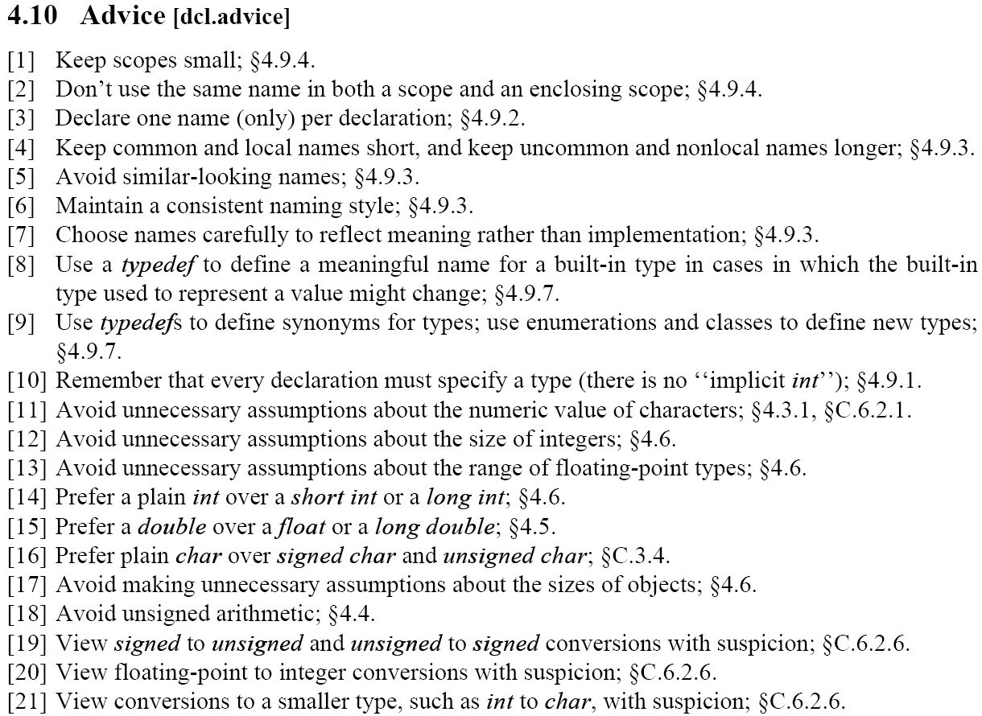
…
…
Giorgio Ugazio, Advanced C++ Development

Slide 31
Links
Web:
Books:
The C++ Programming Language (Stroustrup, 2000)
International Standard – Programming Language C++ (ISO/IEC 2003)
Giorgio Ugazio, Advanced C++ Development

