Slide 1
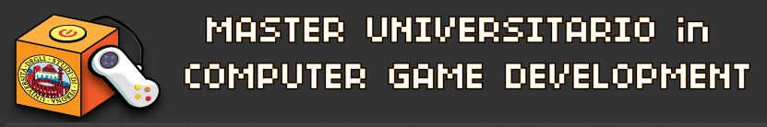



Advanced C++ Development
Pointers, Arrays, Structures, Expressions and Statements
Giorgio Ugazio

Slide 2
Pointers, Array,
References, Structs
Keywords, Expressions, Operators,
Statements, Type Conversions
Giorgio Ugazio, Advanced C++ Development

Slide 3
Pointers
For a type T, T* is the type ‘‘pointer to T ’’
A variable of type T* can hold the address of an object of type T.
int x;
int* y = &x; // y holds the address of x. & is the “address of” operator
The fundamental operation on a pointer is dereferencing, that is, referring to the object pointed to by the pointer.
The dereferencing operator is (prefix) unary *.
int x;
int *y = &x;
*y = 5; // 5 is assigned to the location addressed by y (i.e. x)
In C there were NULL that indicates a wrong pointer.
In C++ the pointer literal that indicates wrong pointer is 0.
In C++11 the pointer literal that indicates wrong pointer is nullptr.
http://stackoverflow.com/questions/1282295/what-exactly-is-nullptr-in-c0x
http://en.wikibooks.org/wiki/More_C%2B%2B_Idioms/nullptr
Giorgio Ugazio, Advanced C++ Development

Slide 4
Arrays
For a type T, T[size] is the type ‘‘array of size elements of type T’’
The elements are indexed from 0 to size-1.
int asd[10]; // asd is an array of 10 ints
The size must be a constant expression.
Multidimensional arrays are array of array (row majors).
int lol[5][10]; // lol is an array of 5 arrays of 10 ints
(I usually prefer to avoid them) [Code]
Arrays of POD type can be initialized with a list of initializers:
int x[5] = {1,2,3,4,5}; // initialization with 5 values
char* y[] = { “lol”, “rofl”, “asd”}; // size can be deducted a compile time
int z[3] = {1,2,3,984239849}; // error, too many initializers
char w[4] = {“._.”}; // ok, the remaining value will be ZERO initialized
Giorgio Ugazio, Advanced C++ Development

Slide 5
Pointer Arithmetic
In C++, pointers and arrays are closely related. The name of an array can be used as a pointer to its initial element.
An Lvalue of each element into an array can be accessed by subscript operator [].
int x[10];
x[3] = 5; // third element of the array x now has value 5
*(x + 3) = 5; // same as before
int n;
T* p;
T* q = (p + n);
Pointer plus integer gives a pointer to the n-th element of the “hypothetical array starting at p”. (operators pointers-integers are +, -, ++, --)
Low-Level stuff: address is incremented by n times the sizeof(T).
Giorgio Ugazio, Advanced C++ Development

Slide 6
On array and pointers
int v[10];
int* p = v;
v; v[5]; &v[5];
v+5; *(v+5); *v + 5;
v++; ++v; p--;
p+10; p-10; p+=5;
++p; p+v; *(p-v);
*(&v); &(*v + 3); &v[v[5]];
5[p]; v[*p]; v = p;
Most C++ implementations offer no range checking for arrays.
This array concept is inherently low-level. A more advanced notion of arrays can be provided through the use of classes
(We don’t see now the concept of address space, pointers with/without ownership, memory management, dangling pointers, dereferencing dangling or null pointers,...)
Giorgio Ugazio, Advanced C++ Development

Slide 7
Void Pointers
A pointer of any type of object can be assigned to a variable of type void*, a void* can be assigned to another void*, void*s can be compared for equality and inequality, and a void* can be explicitly
converted to another type.
Other operations would be unsafe because the compiler cannot know what kind of object is really pointed to. Consequently, other operations result in compile-time errors.
The primary use for void* is for passing pointers to functions that are not allowed to make assumptions about the type of the object and for returning untyped objects from functions.
To use such an object, we must use explicit type conversion.
Functions using void* pointers typically exist at the very lowest level of the system, where real hardware resources are manipulated.
Functions and Member Function Pointers cannot be assigned to void*
Giorgio Ugazio, Advanced C++ Development

Slide 8
Problem With Pointers...
Pointer errors are the most common source of bugs in C++.
void PointerHell()
{
// easy
char* x = new char;
delete x;
delete x; // Deleting a dangling pointer
*x = ‘x’; // Access Violation: Dereferencing a dangling pointer
x = 0;
*x = ‘x’; // Access Violation: Dereferencing a NULL pointer
delete x; // it’s OK, you can delete a NULL pointer
// hard
x = new char;
*((bool*)(x)) = false; // Handling raw memory. Misinterpreting types
*(x+1) = ‘x’; // hope for Access Violation!
char* y = x;
*y = ‘y’; // Sharing possibly unwanted shared resources
} // Leaking Resources
Giorgio Ugazio, Advanced C++ Development

Slide 9
Solutions
Check Pointers before using them
Avoid using pointers when you don’t need (prefer refences)
Set deleted pointer outside the dtor to NULL
Avoid handling raw memory. If you need to handle raw memory, encapsulate it in a class
Avoid heavy pointer arithmetic (at least encapsulate it)
Take into account the use of smart pointers or at least encapsulate memory management.
Document (and watch other documentation for)
memory ownership of the pointed object
sharing issues of the pointed object.
lifetime of the pointed object
not NULL guarantee
(We’ll be back here in Memory Management Lesson)
Giorgio Ugazio, Advanced C++ Development

Slide 10
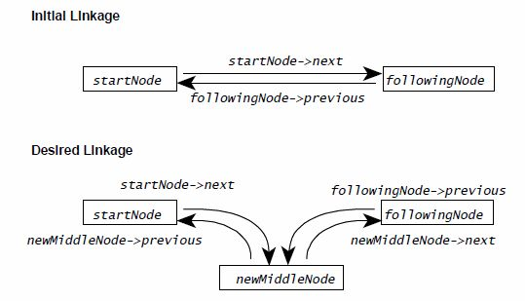
Draw a Picture
Giorgio Ugazio, Advanced C++ Development

Slide 11
Multilevel Pointers
int x;
int* y = &x;
int** z = &y;
z contains the address of the variable y, which contains the address of the variable x. Dereferencing z you still have a pointer: (*z) is a pointer of type int*, (**z) is an int.
Multidimensional array are not strictly multilevel pointers.
int x[10][10]; //x is not an int**, but somewhat related...
Plain array can be considered constant pointers
int x[10]; //x is of type int * const.
The actual situation is more complex (and that’s the reason why I avoid multilevel array).
[Code]
Giorgio Ugazio, Advanced C++ Development

Slide 12
Constants
C++ offers the concept of a user defined constant, a const , to express the notion that a value doesn’t change directly.
int x;
const int x1 = 5; // const must be initialized!
int const x2 = 4; // same as before. More grammar-regular
const int* y1 = &x1; // *y1 cannot be changed, y1 can be changed. OK
int* const y2 = &x1; // y2 cannot be changed, *y2 can. ERROR
const int* const y3 = &x1; // neither y3, nor *y3 can be changed OK
(see other code samples for pointers and const) [Code]
Const is an access restrictor, but it is also a good documentation tool, a compiler hint to optimization, a compiler hint to error reporting.
Enum are a good alternative for integer constant.
(We don’t see now const object, const references, const data member, const member functions, const correctness, mutable, volatile,...)
Giorgio Ugazio, Advanced C++ Development

Slide 13
References
A reference is an alternative name for an object. The main use of references is for specifying function arguments, return values and “Lvalue typedef”
The notation X& means reference to X.
int x;
int& y = x; // a reference declaration must be bound to an lvalue
const int& z = x; // ok, but you can’t modify x using z
&x == &y; // true! x and y refers to the same lvalue. & is “address of”
y = 5; // now both x and y have value 5
NOTE:
References are not pointers. [More Effective C++ Item 1]
References are not const pointers (usually implemented in that way, but in some cases, the compiler can optimize away a reference so that there is no object representing that reference at runtime)
Reference definition operator “&” is not “address of” operator
Giorgio Ugazio, Advanced C++ Development

Slide 14
References
References must always be initialized in definition.
The initializer for a plain T& must be an LValue of type T.
The initializer for a const T& need not be an LValue or even of type T.
If the referenced goes out of scope, using the reference is undefined behaviour (it’s almost impossible, only in return value. [Code])
Readability, LValue typedef:
for(std::map<int,int>::iterator it= myMap.begin(); it!= mymap.end(); ++it)
{
int& value = it->second;
// use value here
}
Remember that a reference is just a name, a name for some existing object. Whenever you see the declaration for a reference, you should immediately ask yourself what it is another name for, because it must be another name for something. [Effective C++ item 23]
Giorgio Ugazio, Advanced C++ Development

Slide 15
C Structs
An array is an aggregate of elements of the same type. A struct is an aggregate of elements of arbitrary types.
struct S
{
int x;
char y;
char* z;
}; // semicolon after the curly bracket
Variable of type S can be declared like other variables. They can be initialized if they are composed of POD type:
S temp = {10, ‘\0’, “lol”};
Members can be accessed by Member Selection Operators: “dot” operator ‘.’ from an object and “arrow” operator ‘->’ from a pointer:
S a;
S* b = &a;
a.x = 5;
b->z = “asd”; // equivalent to (*b).z = “asd”;
Giorgio Ugazio, Advanced C++ Development

Slide 16
C Structs
Structures are different types even if they have the same members.
struct S {int x;};
struct T {int x;};
are two different types, so
S a ;
T b = a ; // error: type mismatch
Structure types are also different from fundamental types, so
S a ;
int i = a ; // error: type mismatch
(despite struct and class are almost equivalent, we don’t see now all the stuff relative to “classes”, but we’ve limited the tour to C struct)
Giorgio Ugazio, Advanced C++ Development

Slide 17
When to use Structs
In C++ Classes and Structs has identical behavior.
However it’s a common practice to use “struct” when you need a simple aggregator of data with no (complex) behavior. Like in C.
Structs are used as a form of documentation for behaviorless classes
Sometimes structs are used to simplify function parameters list:
void InitUiManager(T1 x1, T2 x2,... Tn xn); // bad
void InitUiManager(UiManagerInitParams param); // good
struct UiManagerInitParams
{
T1 x1;
T2 x2;
};
// ...better: void InitUiManager(const UiManagerInitParams&);
Giorgio Ugazio, Advanced C++ Development

Slide 18
How to read C++ Declarations
What is this?
int *p[5];
And this?
double* const (*p)();
And WTF is this???
char *(*(**foo [][8])())[];
“go right when you can, go left when you must”
(http://www.unixwiz.net/techtips/reading-cdecl.html)
[Code]
Giorgio Ugazio, Advanced C++ Development

Slide 19
Pointers, Array,
References, Structs
Keywords, Expressions, Operators,
Statements, Type Conversions
Giorgio Ugazio, Advanced C++ Development

Slide 20

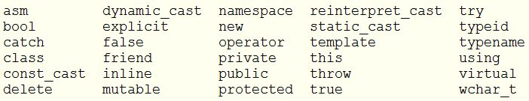
C++ Keywords
C Keywords (C++ keywords too)
C++ Only keywords (they are legal identifier for C programs)
Giorgio Ugazio, Advanced C++ Development

Slide 21
Expressions
An expression is a sequence of operators and operands that specifies a computation.
An expression can result in a value (lvalue or rvalue) and can cause side effects.
Expressions are also:
function call
member function call
parenthesized expression
... There’s a lot of stuff classified (by the standard) as “expression”.
For our goals, we know that an expression could be:
x+5
a.b()
f = f + 2
(n.first < n.second) && (x != 0)
y
static_cast<DestTypePtr>(i_srcPtr)
Giorgio Ugazio, Advanced C++ Development

Slide 22
Operators
Unary Operators
& address of, * indirection
+,- sign: (arithmetic or enum → arithmetic or enum)
! Logical negation: (bool → bool)
˜ one’s complement: (integral or enum → integral or enum)
++, -- inc, dec: (prefix: lvalue→lvalue, postfix: rvalue→ rvalue)
sizeof size of: (expression or type → size_t)
cast operators (expression of a type → value of another type)
new, delete, We’ll see them apart
Binary Operators
*, /, % multiplicative, +, - additive, <<, >> shift
<, <=, >, >= relational, ==, != equality, &&, || logical and, or
.*, ->* pointer to members
&, |, ^ bitwise and, or, xor
=, *=, /=, %=, +=, -=, >>=, <<=, &=, ˆ=, |= assignment
, comma, :: scope resolution
(), function call
Ternary Operator
? : conditional operator (expr ? case_true : case_false)
Giorgio Ugazio, Advanced C++ Development

Slide 23
Operators
Unary operators and assignment operators are right associative; all others are left associative.
a = b = c; // means a = ( b = c )
a + b + c; // means (a + b ) + c
*p++; // means *(p++), not (*p)++
The result types of arithmetic operators are determined by a set of rules known as ‘‘the usual arithmetic conversions’’
The order of evaluation within an expression is undefined.
You cannot assume that the expression is evaluated left to right:
x = f(a) + g(b); // you cannot assume f is evaluated before g
v[i] = i++; // undefined behaviour
The operators , (comma), && (logical and), and || (logical or) guarantee that their left operand is evaluated before their right operand.
Logical operators has short-circuit evaluation.
Giorgio Ugazio, Advanced C++ Development

Slide 24
Statements
Statements are program steps.
Simple statement are simple expression followed by a semicolon “;”
A statement can be
compound: a block and a sequence of statements
labeled: (switch case, switch default, goto label)
comma separated: expr1, expr2, expr3;
selection: (if, if-else, switch)
iteration: (while, do-while, for)
jump: (break, continue, return, goto)
try block: (...)
declaration: (...)
... Do you know the difference between break and continue ?
Giorgio Ugazio, Advanced C++ Development

Slide 25
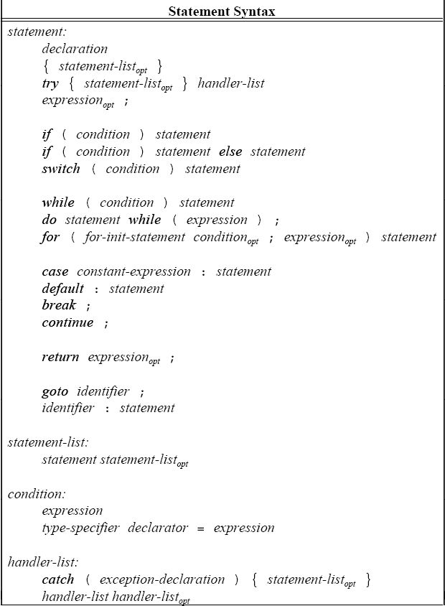
Giorgio Ugazio, Advanced C++ Development

Slide 26
On Statements...
Keep related statements close each other
Make code tread from top to bottom
Prefer normal case first in if-then-else statements
Test each control path in if-then-else statements
Chain if - else if - else if - .... - else
Check always default case in switch statements
Control loop variable and loop invariants
Check ending conditions
Keep code structured, avoid free jumps (break, continue, return, goto)
Avoid infinite loops
Avoid empty loops
Keep loops short (no more than a full screen, 50 lines)
Avoid deep nesting (avoid more than 3 nesting levels)
Check against type-dependent 0 (‘\0’, NULL, false, 0, 0u, 0.0f)
Put RValue on the left of an (in/dis)equality test (while(0 == i){} )
Giorgio Ugazio, Advanced C++ Development

Slide 27
Type Conversion
Implicit type conversion:
Lvalue-Rvalue, Array-Pointer (int v[10]; int x = v[5]; int* p = v;)
Qualification Conversion (const int x; int y = x;)
Integral promotion, Float Promotion (short int x; int y=x;)
Integral Conversion, Float Conversion (int x; unsigned short int y = x;)
Float-Integral Conversion (int x; double y = x;)
Pointer Conversion (Derived* x; Base* y = x;)
Bool Conversion (int x; bool y = x;)
Constructors with one argument (S(int)) ... See you later!
Conversion operator (operator double()) ... See you later!
Explicit type conversion:
Explicit constructors ... See you later!
Function Style Cast ( int(num) )
C Cast ( (int)num )
C++ Casts ... See you later!
Custom Casts ... See you Later
Giorgio Ugazio, Advanced C++ Development

Slide 28
C Style Casts
In C you can explicitly convert an expression to the type you want using the C-Style cast: (type)(expression).
int x;
float y = (float)x;
The result is a Lvalue if the “type” is a reference, else the result is a Rvalue.
Avoid it. C-Style cast is type-unsafe, const-incorrect, hard to find in code, not readable.
For built-in types it is slightly better to use function style casts (or ctor casts):
int x;
float y = float(x);
Giorgio Ugazio, Advanced C++ Development

Slide 29
static_cast (spoiler)
Instead of C Cast, you can usually use the C++ static_cast.
unsigned int x = 5;
int y = x; // it generates a warning, you should look at it and,
// if it is a known issue, fix the warning with a static_cast.
int z = (int)x; // bad solution to warning fix.
int w = static_cast<unsigned int>(x); // good solution.
static_cast performs the type check.
static_cast is performed at compile time
static_cast is self documenting.
You can easily search casts in the code with an easy search query.
Giorgio Ugazio, Advanced C++ Development

Slide 30
static_cast (spoiler)
There are situations where explicit cast is neither needed nor useful:
Lvalue-Rvalue, Array-Pointer, Qualification Conversion, Promotions
Upcasting (see later)
There are situations where explicit cast is not needed but useful:
Integral Conversion, Float Conversion, Float-Integral Conversion
Pointer Conversion, Bool Conversion
There are situations where explicit cast is required, (not “warning fix”):
Downcasting (see later)
However, there are things you can’t do with a static_cast:
remove constness (anyway, a bad thing to do!)
const int x = 5;
int* y = &x; //error
int* z = static_cast<int*>(&x); //error
int* w = &static_cast<int>(x); //errors: address of temporary and static cast
int* k = &static_cast<int&>(x); //error
int* j = const_cast<int*>(x); //ok…
Crosscasting (see later)
Reinterpreting pointers of statically unrelated types
Giorgio Ugazio, Advanced C++ Development

Slide 31
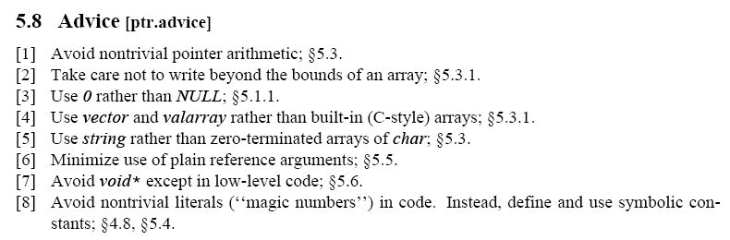
Advices... From Stroustrup!
Giorgio Ugazio, Advanced C++ Development

Slide 32
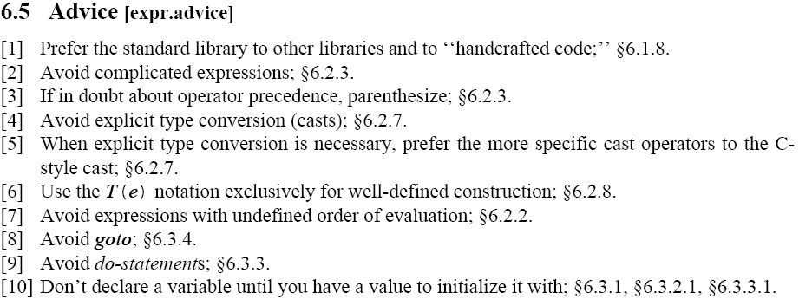
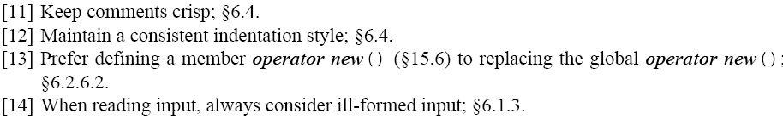
More Advice
Giorgio Ugazio, Advanced C++ Development

Slide 33
Links
Web:
http://www.codeproject.com/KB/cpp/PointerArticle.aspx
http://www.fnal.gov/docs/working-groups/fpcltf/Pkg/ISOcxx/doc/POD.html
Books:
The C++ Programming Language (Stroustrup, 2000)
International Standard – Programming Language C++ (ISO/IEC 2003)
Giorgio Ugazio, Advanced C++ Development

