Slide 1
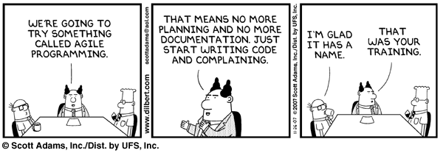
Comics

Slide 2
敏捷开发中的需求管理
Requirements Management in Agile
清华大学软件学院 刘璘

Slide 3
Requirements Management
At its simplest, software development is about creating product that meets its users’ needs
  In Scrum terms, turning backlog into increments of functionality
    Assuming needs are expressed as requirements
Requirements issues rank top in most surveys of software project failures
  For example, the CHAOS* report
    Incomplete requirements (13.1 %)
    Lack of user involvement (12.4 %)
    4. Unrealistic expectations (9.9 %)
    6. Changing requirements and specifications (8.7 %)
    8. Didn’t need the project any longer (7.5 %)
*The CHAOS Report. The Standish Group, 1995-2010.
Notes:
<*s*o*u*r*c*e*>*9*1*8*c*1*-*3*-*4*<*/*s*o*u*r*c*e*>

Slide 4
Agile Requirements Management
Requirements Management is a broad discipline that includes
  Requirements elicitation
  Requirements analysis
  Requirements specification
  Requirements testing
  Requirements tracing
Traditional approaches rely on adding levels of management control
  Produces reams of requirements documentation
  Most of the work is done up front
    And often needs to be completed before development work can proceed
But for complex systems, it is impossible to define all requirements up front
  Not least because they are liable to change
Agile approaches tend towards doing “just enough” up-front requirements
  Where “enough” means “enough to start development”
  And then continuously evolving them
Notes:
<*s*o*u*r*c*e*>*9*1*8*c*1*-*3*-*5*<*/*s*o*u*r*c*e*>

Slide 5


Recap: The Sprint Planning Meeting
Sprint Planning Meeting
Part One
Sprint Planning Meeting
Part Two
Product
Backlog
How much can
be done
What?
Sprint Goal
How?
What features are highest
priority
Product Owner
Feature
Team
Sprint Backlog
Notes:
<*s*o*u*r*c*e*>*9*1*8*c*1*-*3*-*6*<*/*s*o*u*r*c*e*>

Slide 6
Requirements in Scrum
Product Backlog is the requirements in Scrum.
  Features/Acceptance Cases
  Estimation
  Priority
The most common way of writing a product backlog is through user stories.

Slide 7
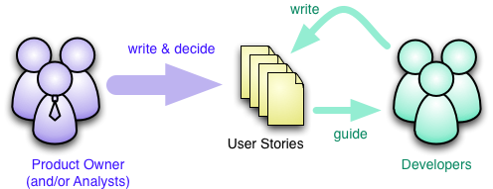
RE in Scrum
PO’s(Product Owner) responsibility to maintain the Product Backlogs.
“No change” during Sprint.
Scrum team break backlogs into tasks.

Slide 8
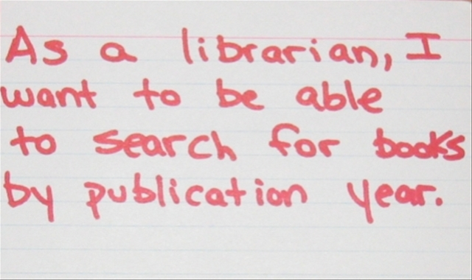
User Story Standard Format
As a <type of user>, I want <some goal> so that <some reason>.

Slide 9

The Life Cycle of a User Story
Idea
User Story
~~~~~~~~~~~~~~~~~~~~~~~~~
Implemented Product
Conversation
Tests
Notes:
<*s*o*u*r*c*e*>*9*1*8*c*1*-*3*-*1*0*<*/*s*o*u*r*c*e*>
Jogger text: The Life Cycle of a User Story
Direction: Left
Instructor notes:
Elaboration: This graphic (adapted from Agile Coaching by Davies and Sedley) focuses on the essential role of user stories in driving conversation. The point that this leaves open the level of documentation. You might add Business Service Requirements documents and System Requirements around the edges – the first as an ‘input’ to the lightbulb and the second as an output from the chrysalis just to make that point – of course the actual production of these documents would not normally be laid upon the shoulders of the Feature Team.

Slide 10
User Stories
A common Agile technique is user stories
  Derived from Extreme Programming (XP)
    A popular Agile software development method
A user story is a simple description of some requirement written from a user’s viewpoint
  Usually on an index card, typically 6" x 4"
  Not a completely defined requirement
    XP says, “There are no (system) requirements to start with”
  A “reference point for a conversation”
    Detailed requirements will evolve through interaction between the customer and the developers
The aim is to shift toward having face-to-face conversations about requirements and technical issues
  Rather than manage documentation about them
Notes:
<*s*o*u*r*c*e*>*9*1*8*c*1*-*3*-*8*<*/*s*o*u*r*c*e*>
Jogger text: User Stories
Direction: Left
Instructor notes:

Slide 11
User Stories: An Example
User Story #7 View Shopping Cart Contents
As a registered customer, I want to be able to view all items currently in my Shopping Cart together with their prices, so that I can see how much money I am spending.
Priority: Estimate:
There is no standard format for writing user stories
The above example is typical:
  As a <role> I want <feature> so that <goal>
Often, the back of the card describes the acceptance test for the requirement
Notes:
<*s*o*u*r*c*e*>*9*1*8*c*1*-*3*-*9*<*/*s*o*u*r*c*e*>
Jogger text: User Stories: An Example
Direction: Right
Instructor notes:
Elaboration: User Stories are often written on 6”x 4” index cards
‘Priority’ is a ranking based on business value of the features – determined by PO
‘Estimate’ is an holistic measure of effort/complexity of construction – made by the Feature Team

Slide 12
Activity: Refining the User Story
Together with your group, quickly brainstorm a list of questions that would need to be answered to turn the user story into a “potentially shippable increment of functionality”
If you have time, identify at what point a Feature Team would have sufficient information to begin work
  The point here is that wireframes, prototypes and ‘real’ development can form part of the conversation(s) involving User Stories

Slide 13
The Definition of “Done”
How does the Feature Team know when it has met a requirement?
Scrum requires that every increment be “potentially shippable”
  The Product Owner may decide to deploy it immediately
    Even if the Sprint is not at the end of a scheduled release
  This means gaining agreement about what it means to be “done”
Different people have different perspectives
  A programmer might believe “done” is when the code is complete
  A tester is “done” when unit and integration testing is done
  A customer might regard “done” as
    Installation, deployment of the system
    Together with user documentation
    And (perhaps) user training
In Scrum, “done” is an agreement between the Product Owner and the Feature Team
  Minimally, the acceptance test for a story
  At this level, it will vary from user story to user story
Notes:
<*s*o*u*r*c*e*>*9*1*8*c*1*-*3*-*1*4*<*/*s*o*u*r*c*e*>

Slide 14
3C’s
A well written user story will describe what the desired functionality is, who it is for, and why it is useful.
There are 3 parts to a fully fleshed out user story. If you like marketing-speak, then you can call them the “3 C’s”:
  The Card
  The Conversation
  The Confirmation

Slide 15
The Card
A typical user story follows this template:
“As a [user], I want [function], so that [value]”
  As a [role], I want [feature] because [reason]
  As a [role], I can [feature]
  As a [role], I can [feature] so that [reason]
written on 3x5 bits of plain card, usually to give a physical constraint which limits the possible length of the story.
Here’s a few hypothetical examples written for YouTube. I’ve defined a “Creator” as someone who contributes videos to the site, and “User” as someone who just watches them:
  “As a Creator, I want to upload a video so that any users can view it.”
  “As a User, I want to search by keyword to find videos that are relevant to me.”

Slide 16
Conversation
Think of the conversation as an open dialogue between everyone working on the project, and the client. Anyone can raise questions, ask for things to be clarified, and the answers can be recorded down as bullet points for later reference. It is also a stage where you can reevaluate your user story, and possibly split it into multiple stories if required.
For example, we discuss the creator upload user story, and decide that there are actually multiple things that can happen, so we split them, and expand on them.
As a Creator, I want to upload a video from my local machine so that any users can view it.
  The “Upload” button will be a persistent item on every page of the site.
  Videos must not be larger than 100MB, or more than 10 minutes long.
  File formats can include .flv, .mov, .mp4, .avi, and .mpg.
  Upload progress will be shown in real time.
As a Creator, I want to edit the video’s metadata while a video is uploading, to save myself time.
  Editable fields include Video Name, description, tags, and privacy settings.
  Once saved, the user will be taken to their video’s dedicated page.
Once you write a few of these and get into the swing of it, you’ll find you’re getting a lot of data written down very quickly. Because of this, it’s important to organise your user stories in a manageable way. I like to group them by interface, and present them next to a wireframe showing the intended functionality.

Slide 17
Confirmation
The confirmation is basically just a test case. If you’re not familiar with test plans and test cases, think of a test case as a series of steps that a user must do to achieve the User Story. A test plan is a collection of test cases.
With full coverage of your system in your test plans, you can easily test every core piece of functionality and tick them off as you go through them.
A test case for our YouTube example might look like this:
As a Creator, I want to upload a video from my local machine so that any users can view it.
  Click the “Upload” button.
  Specify a video file to upload.
    Check that .flv, .mov, .mp4, .avi, and .mpg extensions are supported.
    Check that other filetypes aren’t able to be uploaded.
    Check that files larger than 100MB results in an error.
    Check that movies longer than 10 mins result in an error.
  Click “Upload Video”.
  Check that progress is displayed in real time.

Slide 18
INVEST
It stands for all the things a good user story should be:
Independent
Negotiable
Valuable
Estimable
Small
Testable

Slide 19
More user story examples
Students can purchase monthly parking passes online.
Parking passes can be paid via credit cards.
Parking passes can be paid via PayPal �.
Professors can input student marks.
Students can obtain their current seminar schedule.
Students can order official transcripts.
Students can only enroll in seminars for which they have prerequisites.
Transcripts will be available online via a standard browser.

Slide 20
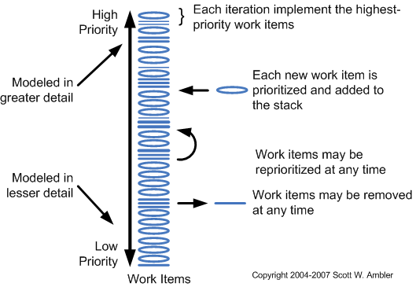
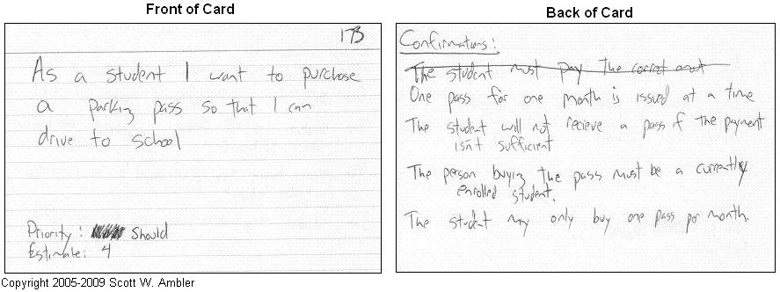
Important considerations for writing user stories:
Stakeholders write user stories.
Use the simplest tool.
Remember non-functional requirements.
Indicate the estimated size.
Indicate the priority.
Optionally include a unique identifier.

Slide 21
The Five Most Common Mistakes
1. User Story for a User
Example: "As a user I want to be able to manage ads, so that I can remove expired and erroneous ads."
At the first glance you don’t see any issues with that User Story, because all the required elements are present.
Now tell me who is the user for whom you are going to build that feature of ads management and what does he understand ads management?
Is that a portal administrator, who wants to have possibly of database clean-up and ads moderation?
Or maybe it is an advertiser, who wants to have list of all ads he submitted to the side and have possibility of removing ads when they are not needed any longer or there was error found in the content?
As you may noticed, I mentioned only two different roles with different expectations from the system.
In this case what is missing is persona or role mentioned.

Slide 22
The Five Most Common Mistakes
2. User Story for Product Owner
Example: "As a Product Owner I want the system to have possibility of deleting ads, so that users have possibility of deleting ads."
And again, all three elements are here, but there is something wrong.
First of all this User Story is type of ‘you want story, here you have one’. Obviously person writing this User Story did that only for sake of doing it.
You can have a Product Owner as role of person using the system if you build software for teams using agile software development. That indicates issues with implementation of agile methodology in that organization.
Second of all you have here exactly the same issue as in the previous example. There is no role or persona to give you clues about user expectations.

Slide 23
The Five Most Common Mistakes
3. User Story for Developer
Example: "As a developer I want to replaced the folder widget, so that I have maintained folder widget."
This typical example of Story for a Technical Backlog or technical requirement representation. Sometimes User Stories like this one are also part of so called technical debt.
Technical debt consists of necessary maintenance tasks like software updates, re-factoring, changing frameworks and so on. They are totally rightful to be implemented, but represented like in the example above they do not represent value for the customer and you will not get a buy-in from Product Owner.
Also from the ‘agile point of view’, you need to deliver a business value at the end of every iteration and the team needs to be able to present it to the stakeholders on the review meeting.
How to write such a story correctly? Rewrite it from a user point of view with persona on role.
Example: ‘As a commercial user I want the system to allow me run multiple searches at the same time, so that I can do my job faster.’
Task to go with it can be: ‘Re-factor search handling mechanism to allow multiple threads for single user.’, ‘Update java version to 64-bit one.’
Acceptance criteria need to define some measurable and testable definition of improvement like: ‘Single user can run 5 searches at the same time.’ and ‘Search returns results in less than 4 seconds.’

Slide 24
The Five Most Common Mistakes
4. No Business Value or Benefit for Customer
Example: "As an commercial advertiser I want to have filtering option."
We have the role, we have the need, but reason and business value are missing. Why does an commercial advertiser want to have filtering option? What does he want to achieve?
5. No Acceptance Criteria or Conditions of Satisfaction
Here you can use as an example one of the examples above. The problem in such practice is often underestimated.
Not having Acceptance Criteria sometimes referred as Conditions of Satisfaction can cause the whole chain of mistakes starting with wrong definition of development tasks or wrong estimation.
Story can fail the tests or Test Cases will cover different criteria due to lack of understanding.
Acceptance Criteria pay great role is confirmation of requirement understanding and decide about acceptance of iteration deliverables. Conditions of Satisfaction question the User Story enable conversation between the Product Owner and the team. Good way of gathering Acceptance Criteria is asking questions such as ‘What if … ?’, ‘Where …?’, ‘When …?’, ‘How …?’. Use examples and simple drawings to remove assumptions. It can happen that Story needs to be refined and re-planed or quite often split to smaller stories.

Slide 25
How detailed should a user story be?
Too broad
"A team member can view iteration status."
Too detailed
"A team member can view a table of stories with rank, name, size, package, owner, and status."
"A team member can click a red button to expand the table to include detail, which lists all the tasks, with rank, name, estimate, owner, status."
Just right
"A team member can view the iteration's stories and their status, with main fields."
"A team member can view the current burndown chart on the status page, and can click it for a larger view."
"A team member can view or hide the tasks under the stories."
"A team member can edit a task from the iteration status page."

Slide 26
中文实例
故事2 运行处理退款请求故事（优先级：高 技术风险：低）
估算：开发时间 2周
2.1 获得某时间段银行的退款明细 0.5天
2.2 分页显示某时间段银行的退款明细列表，提供选择退款记录 2.5天
2.3 运行处理退款 2天
2.4 （约束）2.3可以补充退款信息卡号、姓名信息，如果要求输入卡号要输入2遍复核
2.5 （约束）2.4输入卡号提供3个4位输入第4个不限位数的分割输入，利于校对
2.6 （约束）2.4卡号栏目后面要留输入标注（本）（异）来区分本地卡和异地卡的空间
2.7 （约束）2.3可以选择部分或全部明细进行退款处理
2.8 （约束）2.3处理后退款明细记录状态要变更为运行已处理状态，并置运行处理日期
2.9 （约束）2.3按确认后要一个确认对话框，防止误操作
2.10 可以按条件获得退款明细列表 1天
2.11 （约束）2.10条件可以为：银行&退款处理状态&退款请求日期段
2.12 （约束）2.10条件可以为：商户&退款处理状态&退款请求日期段
2.13 （约束）不需要查询还在申请状态的退款
2.14 分页显示按条件获得运行已处理的退款明细列表 1.5天
2.15 （约束）2.14表头里须含查询条件信息及总笔数与金额信息
2.16 可以下载退款明细列表 2.5天
2.17 （约束）2.16数据组织成execl表格格式
2.18 （约束）2.16表可以按每个支付网关生成一份
2.19 （约束）2.16表可以按每个商户生成一份
2.20 （约束）2.16表中，部分支付网关除基本栏目外，一些栏目可以配置打印与否。
2.21 可以把运行已经处理过的退款交易回退给运行部门重新处理。
2.22 （约束）2.21可回退的退款交易必需是还没有被财务退过款的。

Slide 27
Real Example and Problems-1
User stories are not all written by POs and they are not identical in format
As the SDE, I expect that I can publish reports for <$SERVICE_NAME> back to the portal so that a customer may review them.
Hide "help" icon in the header if the login customer user's organization only purchases <$SERVICE_NAME> from Oracle
Make Subject field editable
Solution: Let it be

Slide 28
Real Example and Problems-2
We can’t get conversation and confirmation of user stories from POs timely and quickly
Distributed team
Multiple POs
Not full-time
Solution: weekly call, emails and a scrum tool

Slide 29
Real Example and Problems-3
Some tasks are necessary, but they are not business needs
e.g. setup development environment, defects, code refactoring, dev/qa/prod environment support etc.
Solution: Add a “Common Task Pool” user story in each sprint for each team

Slide 30
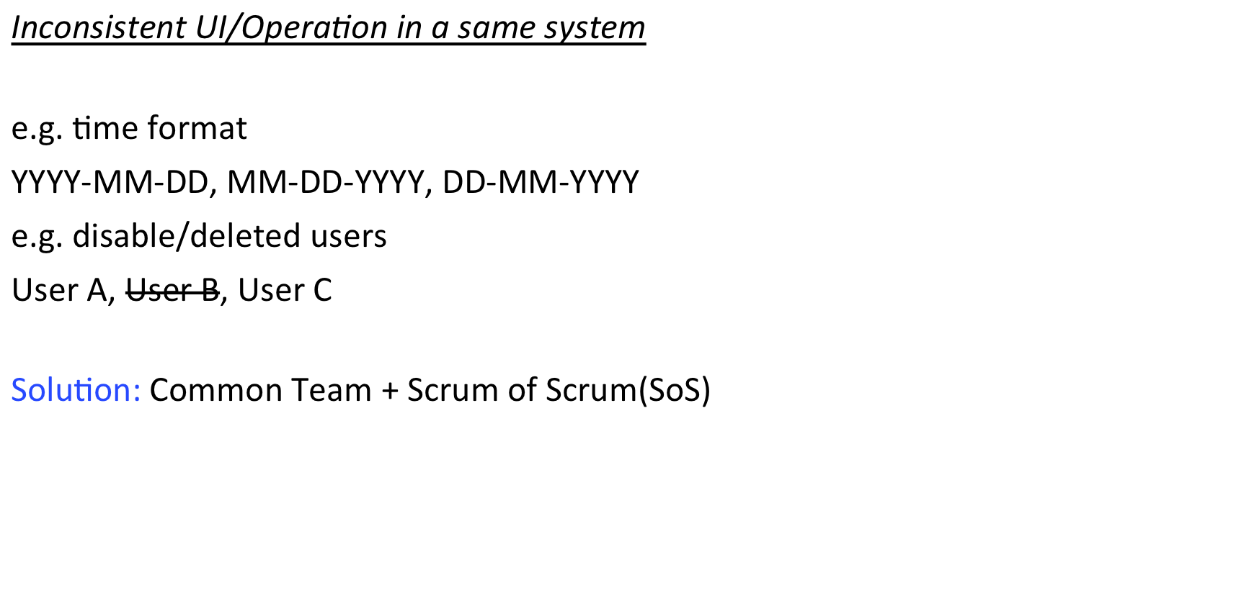
Real Example and Problems-4

