Slide 1
交互建模
Modelling Interactions
清华大学软件学院 刘璘

Slide 2
interaction diagrams (交互图)
An interaction is a behavior that comprises a set of messages exchanged among a set of objects within a context to accomplish a purpose.
交互是指对象为实现某种目的而彼此传递消息的行为
Interaction diagrams describe how groups of objects collaborate in some behavior.
交互图描述对象之间如何进行协作
The UML defines many forms of interaction diagram, of which the most common is: Sequence Diagram.
UML定义多种交互图：其中应用最广的为顺序图（也称为时序图）

Slide 3
UML sequence diagrams
sequence diagram: an "interaction diagram" that models a single scenario executing in the system
  perhaps 2nd most used UML diagram (behind class diagram)
relation of UML diagrams to other exercises:
  use cases -> sequence diagrams
  CRC cards -> class diagram

Slide 4
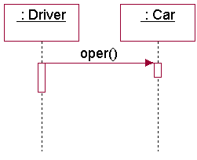
Sequence Diagram(顺序图)
A sequence diagram is a diagram that shows object interactions arranged in time sequence. 顺序图按时间次序表示对象间的交互。
In particular, it shows the objects participating in an interaction and the sequence of messages exchanged. 主要表示有哪些对象参加交互，以及消息传递的序列。

Slide 5
Sequence Diagram(顺序图)
A message is a specification of a communication between objects that conveys information and value.
消息用于描述对象间的交互操作和值传递过程活动
Message types:
  sync 同步消息
  Async 异步消息
  Time-out 超时等待
  Uncommitted／Balking 阻塞

Slide 6
Sequence Diagram and Use Cases 顺序图与用例的关系 I
A Sequence Diagram (SD) captures the behavior of a single scenario. There will be a SD for each Use Case in the system.
顺序图表达单个情景实例的行为。每个用例对应一个顺序图。
We draw SDs in order to document how objects collaborate to produce the functionality of each use case.
顺序图表达对象间如何协作完成用例所描述的功能。
The SDs show the data and messages which pass across the system boundary and the messages being sent from one object to another in order to achieve the overall functionality of the Use Case.
顺序图用于表示为了完成用例而在系统边界输入输出的数据以及消息及对象间的消息传递。

Slide 7
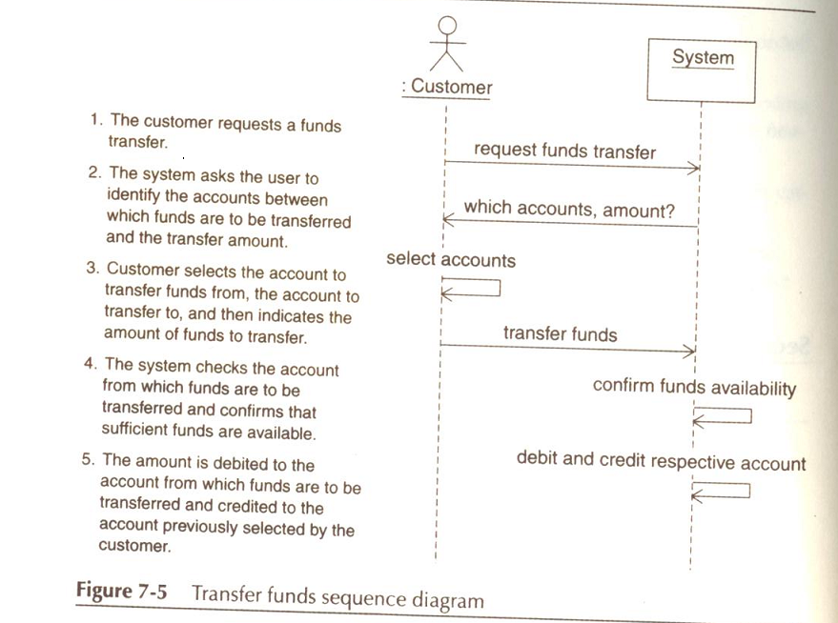
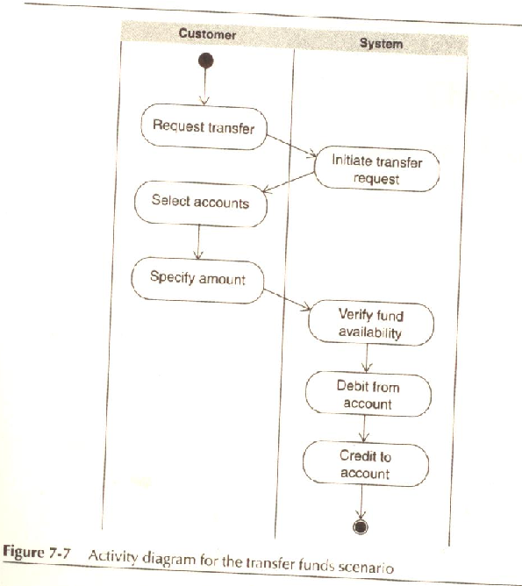

Slide 8
Sequence Diagram and Use Cases顺序图与用例的关系 II
A Sequence Diagram can be seen as an expansion of a use case to the lowest possible level of detail.
顺序图可帮助分析人员对用例图进行扩展、细化和补遗
Sequence diagrams can be drawn at different levels of details and also to meet different purposes at several stages in the development life-cycle.
顺序图可用于开发周期的不同阶段，服务于不同目的，描述不同粒度的行为
Analysis Sequence Diagrams normally do not
  include design objects 分析阶段的顺序图不包含设计对象
  Specify message signatures in any detail 分析阶段的顺序图不关注消息参数

Slide 9
Drawing Sequence Diagram 绘制顺序图
The name of the class and the name of the instance of that class (object), if required, at the top of the column that represents it.
在顺序图顶端写出类名和实例（对象）名
Including the arrows marked Return makes it easier to follow the flow of control from object to object.
在图中包含表示返回信息的箭头便于跟踪对象间的控制流
The vertical line for each object represents its lifeline.
每个对象下面的竖线表示该对象的生命线。
The thick bar represents its activation. 生命线上的矩形框表示对象的激活期
  i.e. when it is doing something 即正在执行某项操作

Slide 10
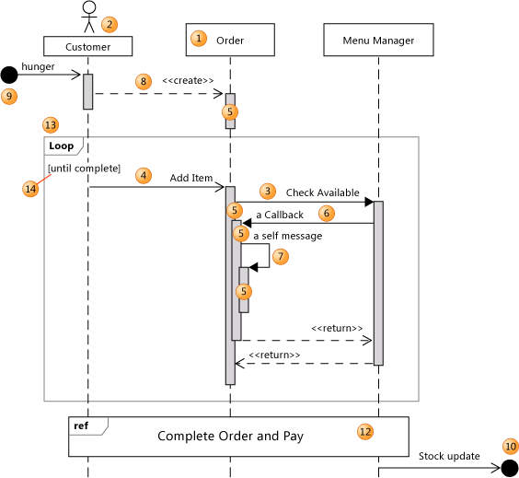
Key parts of a SD
participant: an object or entity that acts in the sequence diagram
  sequence diagram starts with an unattached "found message" arrow
message: communication between participant objects
the axes in a sequence diagram:
  horizontal: which object/participant is acting
  vertical: time (down -> forward in time)

Slide 11
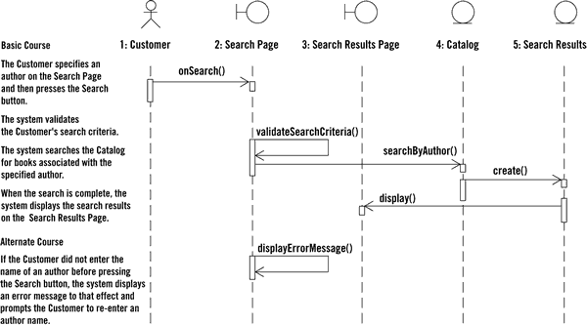
Sequence diagram from use case

Slide 12
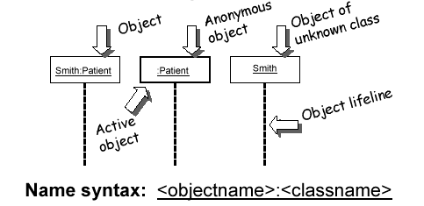
Representing objects
squares with object type, optionally preceded by object name and colon
  write object's name if it clarifies the diagram
  object's "life line" represented by dashed vert. line

Slide 13
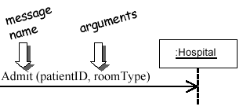
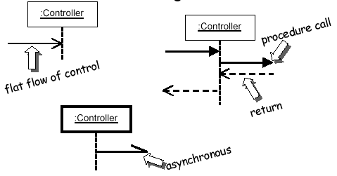
Messages between objects
message (method call) indicated by horizontal arrow to other object
  write message name and arguments above arrow
  dashed arrow back indicates return
  different arrowheads for normal / concurrent (asynchronous) methods

Slide 14
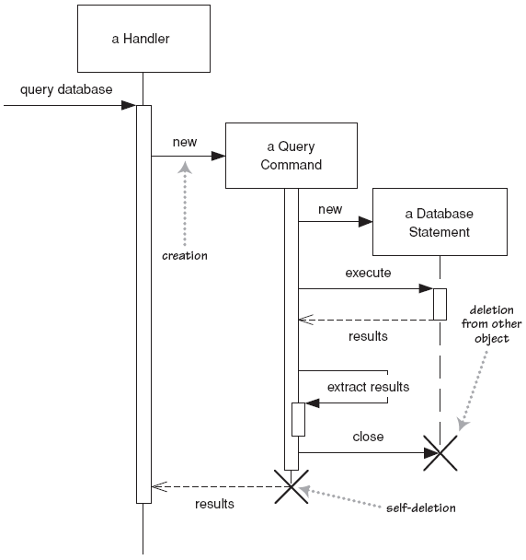
Lifetime of objects
creation: arrow with 'new' written above it
  notice that an object created after the start of the scenario appears lower than the others
deletion: an X at bottom of object's lifeline
  Java doesn't explicitly delete objects; they fall out of scope and are garbage-collected

Slide 15
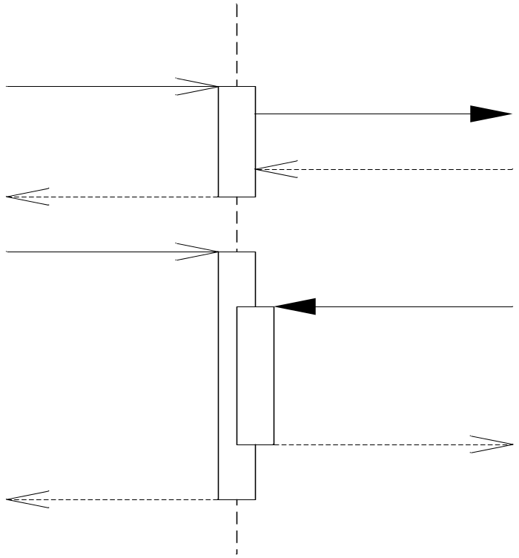
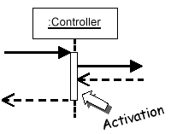
Indicating method calls
activation: thick box over object's life line; drawn when object's method is on the stack
  either that object is running its code, or it is on the stack waiting for another object's method to finish
  nest to indicate recursion
Activation
Nesting

Slide 16
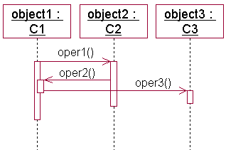
focus of control的嵌套
嵌套的FOC可以更精确地说明消息的开始和结束位置。
图例：
activation(激活期)表示对象执行一个动作的期间，也即对象激活的时间段。
An activation represents the period during which an object performs an operation either directly or through a subordinate operation.
FOC和activation是同一个概念。

Slide 17
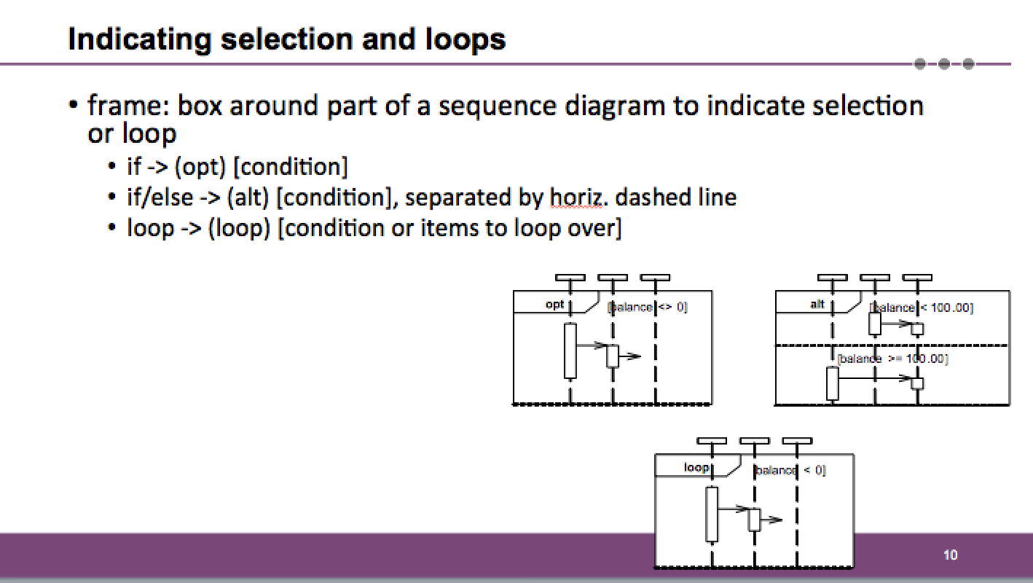

Slide 18
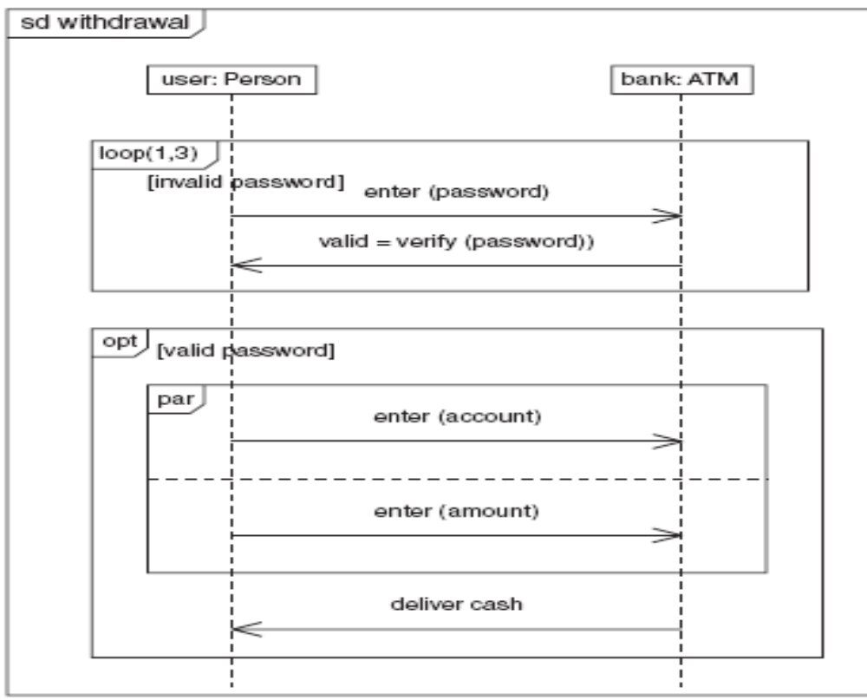
Another Example
Notes:
上图展示了一个简化了的例子，其中有一些控制操作符。用户启动这个序列。第一个操作符是循环操作符，圆括号内的数字（1，3）表示循环执行的最少次数和最多次数。因为最少是一次，所以在检测条件之前主体至少执行一次。在循环内，用户输入密码，系统验证它。只要密码不正确，那么该循环就会继续。但是，如果超过了三次，那么无论如何循环都会结束。
下一个操作符是可选操作符。如果密码是正确的，那么就执行这个操作符的主体；否则就跳过该顺序图后面的部分。这个可选操作符的主体内还包括了一个并行操作符。正如图中所表明的，操作符可以嵌套。
并行操作符有两个分区：一个让用户输入帐号，另一个让用户输入数额。因为这两个分区是并行的，所以没有规定应该按照什么次序输入这两者，按照什么次序输入都可以。需要强调的是，并发并不总是意味着物理上的同时执行。并发其实是说两个动作没有协作关系，而且可按任意次序发生。如果它们确实是独立的动作，那么它们就可以交叠；而如果它们是顺序的动作，那么它们可以按任意的次序发生。
一旦并行操作符的两个动作都被执行过，那么该并行操作符也就执行完毕。在可选操作符中的下一个动作是银行向给用户交付现金。至此，顺序图执行完毕。

Slide 19
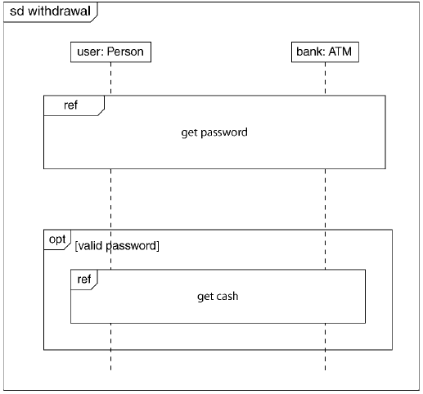
Deliver cash

Slide 20
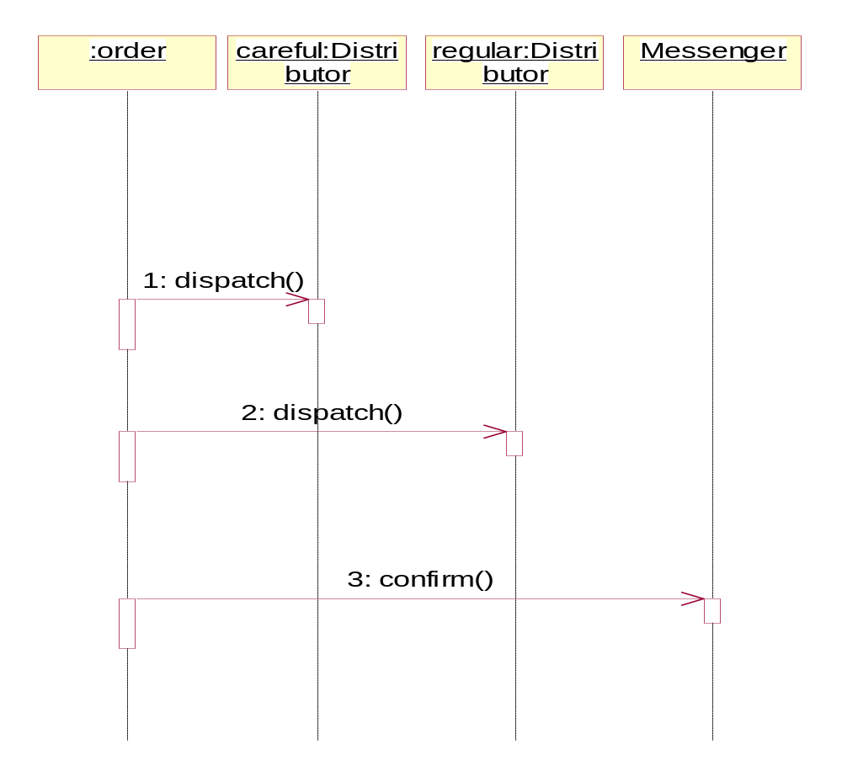
dispatch
loop
[For each line item]
alt
[value>$10000]
[else]
opt

Slide 21
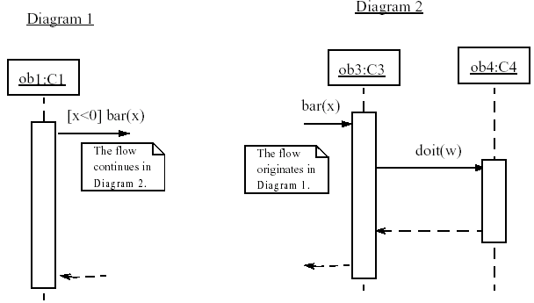
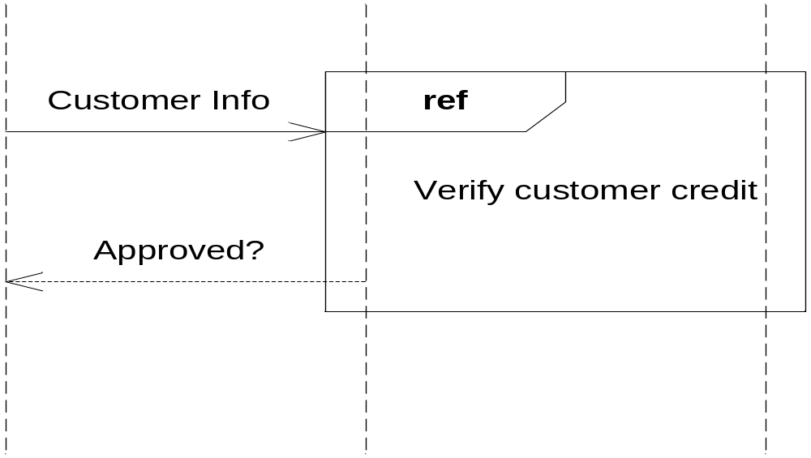
linking sequence diagrams
if one sequence diagram is too large or refers to another diagram, indicate it with either:
  an unfinished arrow and comment
  a "ref" frame that names the other diagram
  when would this occur in our system?

Slide 22
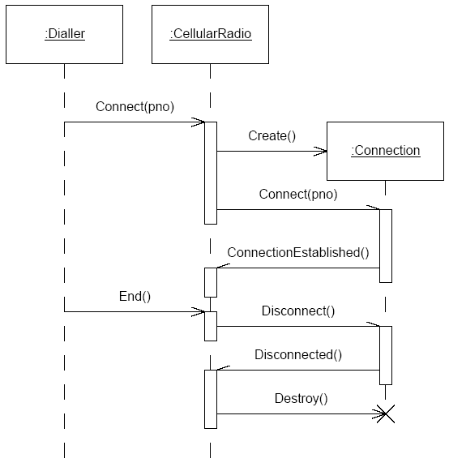
Flawed sequence diagram 1
What's wrong with this sequence diagram?
(Look at the UML syntax and the viability of the scenario.)

Slide 23
Possible right answer
s :电话
:交换机
r :电话
{b.receiveTime-a.sendTime<1分钟}
a:拿起话筒
b:发拨号声
{c.receiveTime-c.sendTime<1秒}
c:*拨号 {时间少于30秒}
逻辑连通
创建
c:会话
阵铃
{30秒}
连接s与r
拿起话筒
接通
<5秒
接通
问题：时间超过30秒的情况没说明
会话对象没有说明计费等情况
Notes:
交换机上由多个线程，故要等待相应会话的结束。

Slide 24
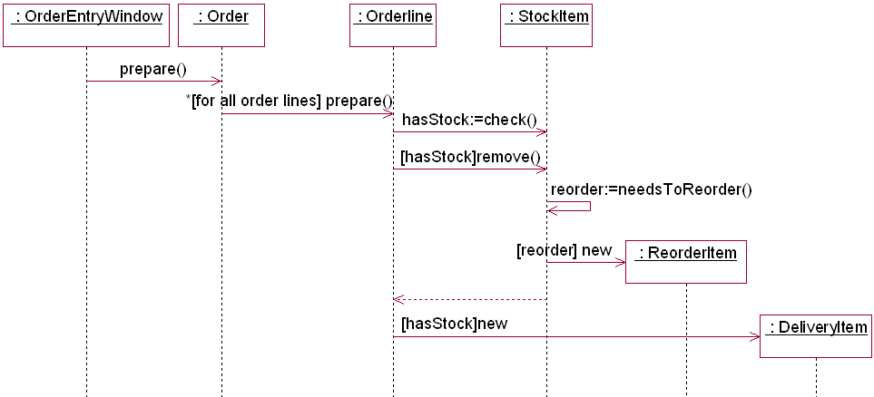
Some concepts used in a sequence diagram
object
条件
循环
返回消息
创建对象

Slide 25
例题 银行系统的交易验证
创建
：交易
创建
：交易协调器
创建
信用：交易检查器
创建
担保：交易检查器
成功
全部做完？
成功
返回有效性
全部做完？
Notes:
可把“信用”对象的返回异步消息画斜。

Slide 26
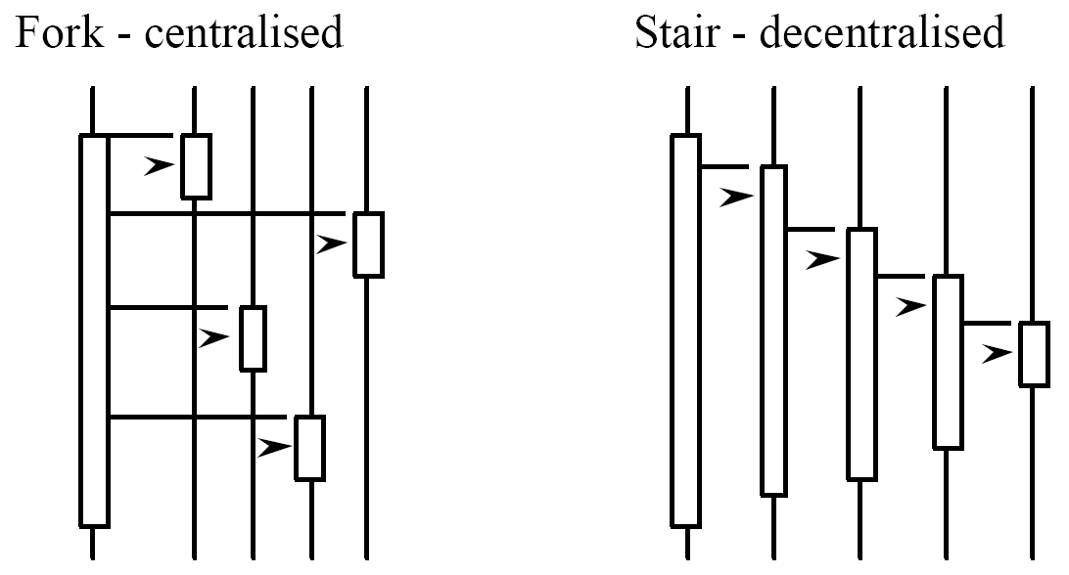
(De)centralized system control
What can you say about the control flow of each of the following systems?
  centralized?
  distributed?

Slide 27
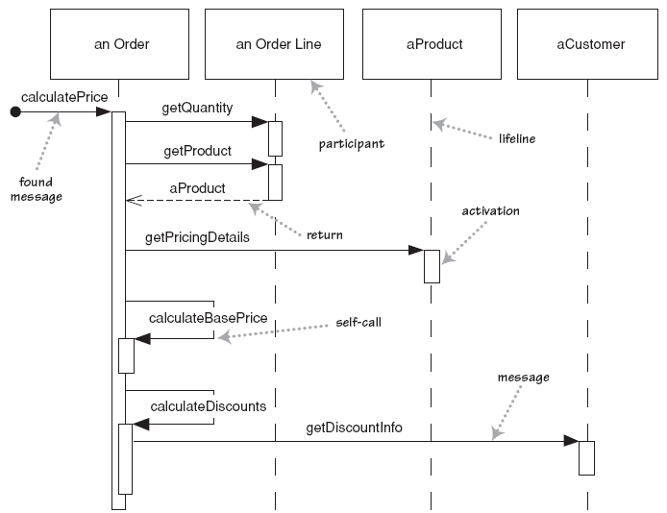
Example 1: A sequence diagram for centralized control
集中控制的计价系统顺序图
an Order
An Order Line
aProduct
aCustomer
CalculatePrice
1. getQuantity
2. getProduct
2.1. aProduct
2.1.1. getPricingDetails
3. calculateBasePrice
4. calculateDiscounts
4.1. getDiscountInfo

Slide 28
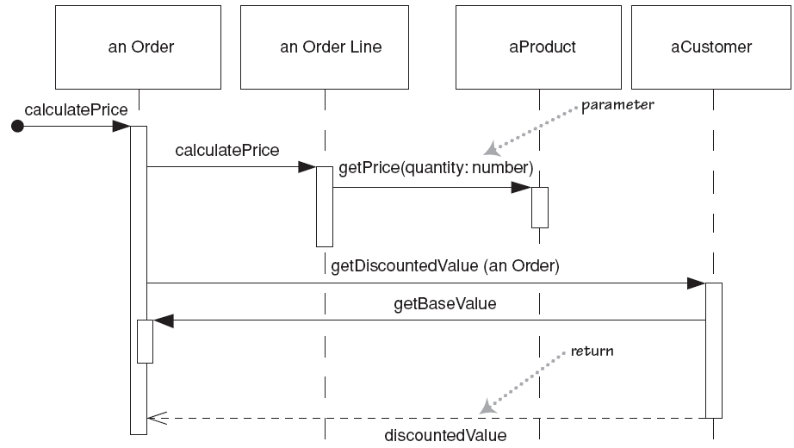
Example 2: A sequence diagram for distributed control
分布控制的计价系统顺序图
an Order
An Order Line
aProduct
aCustomer
CalculatePrice
1. calculatePrice
1.1. getPrice(quantity:number)
2. getDiscountedValue(an Order)
2.1. getBaseValue
2.2. discountedValue

Slide 29
Why not just code it?
Sequence diagrams can be somewhat close to the code level. So why not just code up that algorithm rather than drawing it as a sequence diagram?
a good sequence diagram is still a bit above the level of the real code (not EVERY line of code is drawn on diagram)
sequence diagrams are language-agnostic (can be implemented in many different languages
non-coders can do sequence diagrams
easier to do sequence diagrams as a team
can see many objects/classes at a time on same page (visual bandwidth)

Slide 30
Sequence diagram exercise 1
Let's do a sequence diagram for the following casual use case, Start New Poker Round :
  The scenario begins when the player chooses to start a new round in the UI. The UI asks whether any new players want to join the round; if so, the new players are added using the UI.
  All players' hands are emptied into the deck, which is then shuffled. The player left of the dealer supplies an ante bet of the proper amount. Next each player is dealt a hand of two cards from the deck in a round-robin fashion; one card to each player, then the second card.
  If the player left of the dealer doesn't have enough money to ante, he/she is removed from the game, and the next player supplies the ante. If that player also cannot afford the ante, this cycle continues until such a player is found or all players are removed.

Slide 31
Sequence diagram exercise 2
Let's do a sequence diagram for the following casual use case, Add Calendar Appointment :
  The scenario begins when the user chooses to add a new appointment in the UI. The UI notices which part of the calendar is active and pops up an Add Appointment window for that date and time.
  The user enters the necessary information about the appointment's name, location, start and end times. The UI will prevent the user from entering an appointment that has invalid information, such as an empty name or negative duration. The calendar records the new appointment in the user's list of appointments. Any reminder selected by the user is added to the list of reminders.
  If the user already has an appointment at that time, the user is shown a warning message and asked to choose an available time or replace the previous appointment. If the user enters an appointment with the same name and duration as an existing group meeting, the calendar asks the user whether he/she intended to join that group meeting instead. If so, the user is added to that group meeting's list of participants.

Slide 32
例：一些消息的例子
2: display (x, y)
简单消息
1.3.1: p:= find(specs)
嵌套消息，消息带返回值
4 [x < 0] : invert (x, color)
条件消息
3.1*: update ( )
循环消息
A3,B4/ C2: copy(a,b)
线程间同步

Slide 33
顺序图建模风格
建模风格1：把注意力集中于关键的交互。
  创建模型时要把注意力集中于系统的关键方面，而不要包括无关的细节。
  例如：如果顺序图是用于描述业务逻辑的，就没必要包括对象和数据库之间的详细交互，像save()和delete()这样的消息可能就足够了。或者简单地假定持久性(persistence)会适当地被处理，而不用考虑持久性方面的细节问题。

Slide 34
建模风格2：对于参数，优先考虑使用参数名而不是参数类型。
例如，消息addDeposit(amount, target)比addDeposit(Currency, Account)传递了更多的信息。
在消息中只使用类型信息不能传递足够的信息。
参数的类型信息用UML类图捕获更好。
建模风格只是建议，不是规定。如果只是需要表示“有某些东西要传递”这个事实，而不需要提供更多的细节，则可以指明参数的类型作为占位符。

Slide 35
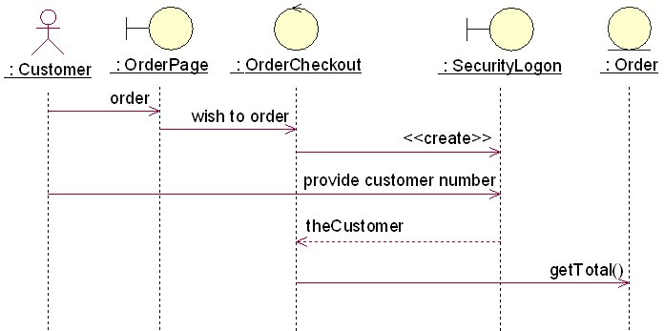
建模风格3：不要对明显的返回值建模。
  例：创建安全登录对象的行为会导致生成一个顾客对象，这个是不明显的；而向订单对象发送请求其总数的消息，其返回值是显然的。
建模风格4：可以把返回值建模为方法调用的一部分。

Slide 36
顺序图常见问题分析
顺序图中消息的循环发送
  在消息名字前加循环条件
例：
1.1 *[ for all order lines]: message1()
2.1 *[i:=1..n]: message2()

Slide 37
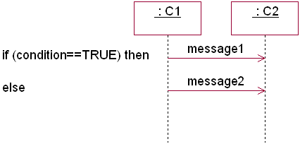
顺序图中消息的条件发送
1. 在消息名字前加条件子句；
2. 使用文字说明；
3. 分成多个Sequence Diagram。
例：

Slide 38
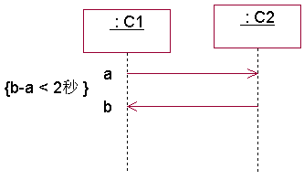
顺序图中时间约束的表示
  用constraint(约束)来表示。
例：

Slide 39
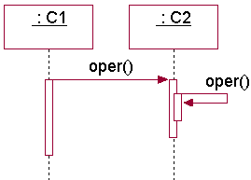
顺序图中递归的表示
  利用嵌套的FOC表示
例1. 单个对象自身的递归。

Slide 40
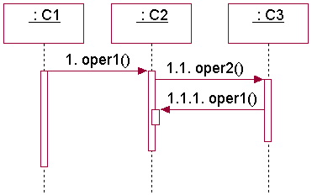
例2. 多个对象间相互递归调用的表示。

Slide 41
Collaboration/Communication (协作/通信图)
协作图包含一组对象和链(link)，用于描述系统的行为是如何由系统的成员协作实现的。
A collaboration diagram is a diagram that shows interactions organized around roles—that is, slots for instances and their links within a collaboration.
协作图中的一些主要元素：
  Object(包括actor实例，多对象，主动对象)
  Message
  Link(链)

Slide 42

multiobject (协作图中的多对象)
A multiobject is used within a collaboration to show operations that address the entire set of objects as a unit rather than a single object in it.

Slide 43


Active Object
主动对象是一组属性和一组方法的封装体，其中至少有一个方法不需要接收消息就能主动执行(称作主动方法)。
An object that owns a thread of control and can initiate control activity。
除含有主动服务外，主动对象的其它方面与被动对象没有什么不同。
目前并无商品化的OOPL能支持主动对象的概念，需要程序员在现有的语言条件下设法把它实现成一个主动成分。
主动对象的表示
(1) UML中的表示：加粗的边框
(2) Rose中的表示

Slide 44
link (协作图中的链)
协作图中用链(link)来连接对象，而消息显示在链的旁边。
  链是association(关联)的instance(实例)
一个链上可以有多个消息。
链的两端不能有多重性(multiplicity)标记。
协作图中重复和条件分支的表示
和顺序图中的表示方法类似
  用*[i:=1..n]或*表示要重复发送的消息。
  用类似[x > 0]的条件语句表示消息的分支。
  UML并没有规定[]中的表达式的格式，因此可以采用伪代码的格式或某种程序设计语言的语法格式。

Slide 45
建立collaboration图的步骤
1. 确定交互过程的上下文(context)；
2. 识别参与交互过程的对象；
3. 如果需要，为每个对象设置初始特性；
4. 确定对象之间的链(link)，以及沿着链的消息；
5. 从引发这个交互过程的初始消息开始，将随后的每个消息附到相应的链上；
6. 如果需要表示消息的嵌套，则用Dewey十进制表示法；
7. 如果需要说明时间约束，则在消息旁边加上约束说明；
8. 如果需要，可以为每个消息附上前置条件和后置条件。

Slide 46
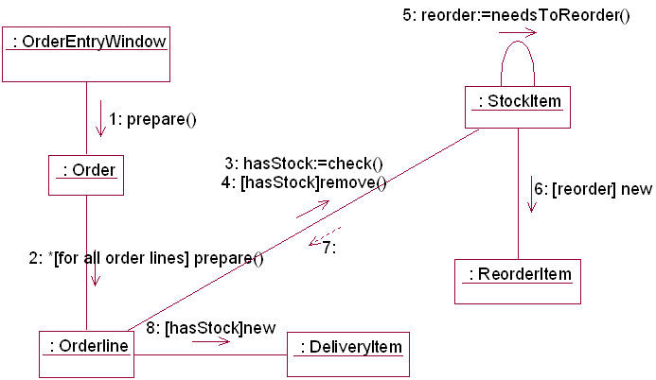
Collaboration图的例子：由顺序图转换来的协作图

Slide 47
协作图建模风格
类似于顺序图：
把注意力集中于关键的交互。
对于参数，优先考虑使用参数名而不是参数类型。
不要对明显的返回值建模。
可以把返回值建模为方法调用的一部分。

Slide 48
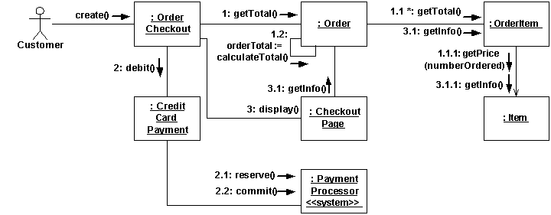
其他的建模风格：
建模风格5：为每个消息画出箭头。
  便于可视化地确定流向一个给定对象的消息数量，以此判断该对象所涉及的潜在耦合情况，这通常是在对设计进行重构时要考虑的一个重要因素。
  例子：

Slide 50
建模风格6：注明导航性(Navigability)时要慎重。
  可以在协作图中对导航性建模，但这不是很常见，因为这太容易和消息流混淆。
  用UML类图来描绘导航性更好。
  例子：Slide 49

Slide 51
顺序图和协作图的比较
顺序图强调消息的时间顺序，协作图强调参加交互的对象的组织，两者可以相互转换。
顺序图不同于协作图的两个特征：
  顺序图有对象生命线
  顺序图有控制焦点
协作图不同于顺序图的两个特征：
  协作图有路径
  协作图必须有消息顺序号

Slide 52
和协作图相比，顺序图：
  Take more space
  Easier to follow algorithms
  Easier to depict lifetimes
  Easier to show multithreading in one object
  More difficult to visualizing multiple concurrent flows of control
  Do not show association links
顺序图可以表示某些协作图无法表示的信息；同样，协作图也可以表示某些顺序图无法表示的信息。

Slide 53
工具支持
1. 模型以动画的方式执行；
2. 正向工程和逆向工程；
3. Rose中的顺序图和协作图
  不支持UML1.5中的全部符号；
  顺序图和协作图相互转换时不转换text box元素。

Slide 54

常见问题分析
Sequence图中的对象如何确定？与Class图是否是同时生成并交互修改?
交互图中的多态性问题：如果对象具有多态性，发送对象不可能事先知道目标对象属于哪个类，因此在交互图中如何确定目标对象所属的类？
答：多态性属于运行时问题，这个类是目标对象有可能所属的所有类的超类(一般类，父类)。

Slide 55
总结
基本概念：交互图，顺序图，协作图，Lifeline (生命线)，Focus of control(控制焦点)，activation(激活期)，消息的类型和语法格式， active object(主动对象)， multiobject(多对象)，Link(链)
交互图的应用

Slide 56
思考题
如何根据用例图、交互图、类图、活动图、状态图等来生成测试用例？
例：Aynur Abdurazik and Jeff Offutt, Using UML Collaboration Diagram for Static Checking and Test Generation.
  <<UML 2000>>国际会议论文，
  这篇论文给出了一个根据UML的协作图(设计阶段的结果)对系统进行静态分析和动态执行路径检查的方法。
主要想法：
由于协作图包含了对象间所传递的消息及消息的顺序，协作图提供了设计层的数据流和控制流信息。因此，利用协作图可以
(1) 在代码生成前利用数据流和控制流信息产生测试数据；
(2) 对协作图本身进行静态检查；
(3) 对代码进行静态检查。

Slide 57
撰写需求文档
Writing and Reviewing Requirements
清华大学软件学院 刘璘

Slide 58

Software Requirements Specification （SRS）
Is a contractually binding document stating clearly what the software will do, and when necessary, what it won’t do.
Describes functional requirements in terms of input, outputs, and transformations from input to outputs.
Describes non-functional requirements that have been negotiated and agreed upon by the stakeholders.
Is supported by the requirements definition document, containing clear definitions of all terms in the SRS.
Is an active, living, specification

Slide 59
Styles of SRSs
Generated from a requirements database:
Commercial requirements databases have built-in facilities to generate filtered requirement specifications, e.g., a specification for a particular product from a product-line specification database.
Generated from a hybrid model: Feature model and a use-case model
Narrative natural language text (typical with marketing)
From a use-case model:
A use-case model is expressed as a directed graph that can be traversed. If requirements are placed in the model as use cases, then a traversal can generate a full set of requirements.
The last two are often done with the help of templates

Slide 60
Overview of Methods for producing Different Styles of SRSs
Method | When to Use | Suitable For | Effort | Resources Needed
Narrative Text | Small projects | Informal specifications for small products | Medium | Analyst with good writing skills
Generate from a Use Case Model | Medium to large projects | Formal specifications, product lines | Medium | Analysts with modeling skill, good process standards, modeling tool(s)
Generated from a Requirements Database | Medium to Large projects | Formal specifications, product lines | Light | Requirements database, analyst with DBA skills
Generated from a Hybrid | Small to medium project | Single product definition | Light to medium | Analyst with good writing skills, RE, DBA, or Modeling skills

Slide 61
User’ Manuals as SRSs
Fred Brooks’s Mythical Man Month describes using a users’ manual as the requirements specification.
Legend has it that the users’ manual for the first Macintosh was written before coding began.
Several have advocated writing a users’ manual as a cost-effective way to kill two birds with one stone, to get both an SRS and a users’ manual.
Using a users’ manual as an SRS works well for systems that interact with users, that are interaction driven.
A good manual describes all scenarios for all use case.
But…
A users’ manual does not describe
  Non-functional requirements very well
  Functional requirements of a system that does not interact with users, i.e., a system that is a function, filter, or translator.

Slide 62

Outline of a Users’ Manual
Introduction
  Product overview and rationale
  Terminology and basic features
  Summary of display and report formats
  Outline of the Manual
Getting started
  Sign-on
  Help mode
  Sample run
Modes of operation:
  Commands/Dialogues/Reports
Advanced Features
Command Syntax and system options

Slide 63
Users of Requirements Specification
Provide the requirements, check that they meet the needs
Define a competitive feature set based on the voice of the buyer and manage product releases
Use the requirements to understand what the system is to do and build the system
Use the requirements to verify & validate the system through testing and asking customer.
Take the core product and enhance with local features.
Customer or end user
Marketer or salesperson
Product developer
Quality assuror
Different regions and countries

Slide 64

Purpose of High-Quality Requirements Specification
A high-quality requirements specification
Is the documentation of all requirements describing what a product needs to provide
Is the basis for a commercial contract to build the solutions
Is the basis for deriving a test plan
Defines the product’s requirements in a measurable way
Is the prerequisite for tracing of product requirements, and
Influences the project plan to build the product
Usually, the specified solution is a system…

Slide 65
Generating a Requirements Specification
The preferred mechanism for creating any type of requirement specification is to generate it from a requirements database
The specification is never modified. The requirements in the database are modified and the document is regenerated
Requirements Database
Specification Generator*
Product Specification
Document Templates

Slide 66

Criteria for a High-Quality Requirements Specification
Feasible
Correct = Validated
Unambiguous
Testable = Verifiable
Modifiable
Consistent
Complete
Traceable
Project-or-product-specific other characteristics
When we are discussing written requirements specifications
Concise

Slide 67

Concise
Definition: A requirement statement is concise if
  It describes a single property of the desired system
  Includes no information beyond that necessary to describe the property
  And is stated in clear, simple, and understandable terms.
  Avoid words such as “should”, “could”, “might”, and “may”.
Example:
  “Emergency calls from the public shall be answered in the order in which they are received” is concise, but
  “Emergency calls from the public should be answered in precisely the order in which they are received and stored in a first-in-first-out queue for being answered” is not concise
Notes:
Terms with underscore should be defined in the requirements definition document.

Slide 68
Conciseness – class exercise
For each sentence, determine how the sentences is not concise, and rewrite the sentence to be more concise
Exercises:
  The program shall calculate the square root of the input accurate to one less decimal digit than the hardware’s precision, using the Newton-Raphson iterative approximation.
  To determine the first class passengers, the program shall step through the list of passengers, storing in a temporary file each passenger for which the passenger’s class = “F” and then later shall present the elements of the temporary file as a list.

Slide 69
Structure of Requirements Specification
Overall systems Reqs Spec.
System Reqs spec for Subsystem A
System Reqs spec for Subsystem B
System Reqs spec for Subsystem C
System Reqs spec for Subsystem A-1
System Reqs spec for Subsystem A-2
System Reqs spec for Subsystem C-1
System Reqs spec for Subsystem C-2
SubSystem A-2 Hardware Reqs spec
SubSystem A-2 Hardware Reqs spec
The hierarchy can contain both COTS components and software you will develop.

Slide 70
Conventions about Verbs in SRSs
Indicative (“is” “was”): about domain independently of the system to be built
“shall”: about what the system is required to do, i.e., for stating a requirement of the system
“will”: about the domain after the system is deployed in it
Questions?
How do you decide what to put where
How do you decide what verbs to use?
The next two dozen or so slides, until the section on ambiguities, are directed to answering these question.

Slide 71

SRS templates
An SRS should be structured according to a standard prescribing predefined sections, i.e., a template.
Templates for SRS make it easier to create uniform SRSs
It is easier for QA to define SRS metrics.
Templates are typically created for business and system requirements specifications as well as SRSs
A template can be used to semi automatically generate an SRS from an RE database or a use-case model.

Slide 72

SRS Template Outline from IEEE-830
Introduction
Glossary
Specification of customer’s requirements
System architecture
Specification of system requirements
System models
Evolution of system
Appendix
Index

Slide 73
Another outline for SRS
Introduction
  System reference
  Overall description
  Software project constraints
Informal description
  Information content representation
  Information flow representation
    Data flow
    Control flow
Functional description
  Functional partitioning
  Functional description
    Processing narrative
    Restrictions/limitations
    Performance requirements
    Design constraints
    Supporting diagrams
  Control description
  Design constraints

Slide 74

Pro and Con of SRS Templates
Pro
A template is helpful in that it is harder to forget to include important information when a complete outline is in front of you.
Con
Not all sections of a template are relevant for all systems. If management or standards insist that all sections of a template be filled, people often write nonsense in the irrelevant sections, just to be able to fill the section and please management or the standards.
Sometimes, the reader of an SRS e.g., an implementer, has difficulty distinguishing nonsense from true requirements.

Slide 75
Summary
Write requirements as soon as possible
Determine what attributes will be used to classify and elaborate requirements
Produce an initial version to stimulate feedback
Exposure to users is much better than analysis by “experts”
Rules to follow when writing requirements:
  Use simple direct language
  Write testable requirements
  Use defined and agreed terminology
  Write one requirement at a time

