Slide 1
状态机图
清华大学软件学院 刘璘

Slide 2
Modelling “State”
What is State?
  State space for an object
  concrete vs. abstract states
Finite State Machines
  states and transitions
  events and actions
Modularized State machine models: Statecharts
  superstates and substates
  Guidelines for drawing statecharts

Slide 3
Getting objects to behave
All objects have “state”
  The object either exists or it doesn’t
  If it exists, then it has a value for each of its attributes
  Each possible assignment of values to attributes is a “state”
    (and non-existence of the object is also a state)
E.g. For a stack object
Push()
Push()
Push()
Push()
new()
…
empty
1 item
2 items
3 items
4 items
Pop()
Top()
Pop()
Top()
Pop()
Top()
Pop()
Top()
Notes:
Note that the state “non-existence” is draw in a distinct way, as a black dot.

Slide 4
What does the model mean?
Finite State Machines
  There are a finite number of states (all attributes have finite ranges)
    E.g. imagine a stack with max length = 3
  The model specifies a set of traces
    E.g. new();Push();Push();Top();Pop();Push()…
    E.g. new();Push();Pop();Push();Pop()…
    There may be an infinite number of traces (and traces may be of infinite length)
  The model excludes some behaviours
    E.g. no trace can start with a Pop()
    E.g. no trace may have more Pops than Pushes
    E.g. no trace may have more than 3 Pushes without a Pop in between
Push()
Push()
Push()
new()
empty
1 item
2 items
3 items
Pop()
Top()
Pop()
Top()
Pop()
Top()

Slide 5
Abstraction
The state space of most objects is enormous
  State space size is the product of the range of each attribute
    E.g. object with five boolean attributes: 2⁵+1 states
    E.g. object with five integer attributes: (maxint)⁵+1 states
    E.g. object with five real-valued attributes: …?
  If we ignore computer representation limits, the state space is infinite
Only part of that state space is “interesting”
  Some states are not reachable
  Integer and real values usually only vary within some relevant range
  Often, we’re only interested in certain thresholds:
    E.g. for Age, we may be interested in age<18; 18≤age≤65; and age>65
    E.g. for Cost, we may want to distinguish cost≤budget, cost=0, cost>budget, and cost>(budget+10%)
Notes:
Note: The +1 on the state space size comes from the extra “object non-existence” state.
State space for machine representation of objects (e.g. entries in a database, objects in a java program) is very large, but finite, if the range of the attribute datatypes is finite.
State space for real world objects is nearly always infinite, but the “interesting” part of that state space is often very small.

Slide 6
Collapsing the state space
Push()
Push()
Push()
Push()
new()
…
empty
1 item
2 items
3 items
4 items
Pop()
Top()
Pop()
Top()
Pop()
Top()
Pop()
Top()
Push()
Push()
new()
empty
not empty
Top()
Pop() [sc=1]
Pop() [sc>1]
  The abstraction usually permits more traces
    E.g. this model does not prevent traces with more pops than pushes
    But it still says something useful
Notes:
Ask of audience: which model is better? (the answer is, of course, “it depends”).
Key point is that for *every* model, you have to choose a level of abstraction (cannot ever model the full detail of the real world).
So you need to decide which level of abstraction allows enough of the traces you want to include, and excludes enough of those you want to exclude - I.e. the differences between the model and the world don’t matter for the purposes of the analysis you are doing.

Slide 7

What are we modelling?
Application Domain
Machine Domain
C - computers
D - domain properties
s - specification
R - requirements
P - programs
(D) Observed states of an application domain entity?
    E.g. a phone can be idle, ringing, connected, …
  Model shows the states an entity can be in, and how events can change its state
  This is an indicative model
(R) Required behaviour of an application domain entity?
    E.g. a telephone switch shall connect the phones only when the callee accepts the call
  Model distinguishes between traces that are desired and those that are not
  This is an optative model
(S) Specified behaviour of a machine domain entity?
    E.g. when the user presses the ‘connect’ button the incoming call shall be connected
  Model specifies how the machine should respond to input events
  This is an optative model, in which all events are shared phenomena
Notes:
Indicative and optative are taken from the linguistic terms: A verb in the indicative mood describes a fact about the current state of the world. A verb in the optative mood describes a wish about some state of the world that you would like to achieve. E.g. “I sing” vs. “I shall sing”
Models of D and R are useful during requirements exploration and analysis. Models of S might appear in the eventual specification.

Slide 8
Is this model indicative or optative?
on hook
busy
Dial [callee busy]
Callee disconnects
Callee
accepts
idle
off hook
dial
tone
Dial
[callee idle]
ringing
connected
on hook
on hook
on hook
Notes:
The key point being that you can’t tell just by looking at the model - it depends on the context in which the models was constructed.

Slide 9
the world vs. the machine
:person
dateOfBirth
dateOfDeath
recordBirth()
setDOB()
recordDeath()
setDateofDeath()
:person
age
havebirthday()
blank
recordBirth()
/setDOB()
havebirthday()
[age < 18]
child
child
when
[thisyear-birthyear>18]
havebirthday()
[age = 18]
adult
havebirthday()
[age < 65]
adult
when
[thisyear-birthyear>65]
havebirthday()
[age = 65]
senior
havebirthday()
recordDeath()
/setDateofDeath()
senior
deceased
Notes:
On the left we have a typical (D) model - what are the real (interesting) states of the application domain entity “person”
On the right we have a typical (S) model - what states does the information object representing a person need to have.
To check this is a valid specification, we’ll need to demonstrate that the transitions in the S model somehow can be made to correspond to the transitions in the D model, or at least with some minimal amount of error.

Slide 10
StateCharts
  States
    “interesting” configurations of the values of an object’s attributes
    may include a specification of action to be taken on entry or exit
    States may be nested
    States may be “on” or “off” at any given moment
  Transitions
    Are enabled when the state is “on”; disabled otherwise
    Every transition has an event that acts as a trigger
    A transition may also have a condition (or guard)
    A transition may also cause some action to be taken
    When a transition is enabled, it can fire if the trigger event occurs and its guard is true
    Syntax: event [guard] / action
  Events
    occurrence of stimuli that can trigger an object to change its state
    determine when transitions can fire

Slide 11
Superstates
States can be nested, to make diagrams simpler
  A superstate consists of one or more states.
  Superstates make it possible to view a state diagram at different levels of abstraction.
OR superstates
  when the superstate is “on”, only one of its substates is “on”
AND superstates
(concurrent substates)
  When the superstate is “on”, all of its states are also “on”
  Usually, the AND substates will be nested further as OR superstates
employed
employed
probationary
on payroll
after [6 months]
full
assigned
to project

Slide 12
Superstates example
on hook
busy
Dial
[callee busy]
Callee disconnects
idle
off hook
dial
tone
Dial
[callee idle]
ringing
Callee
accepts
connected
on hook
on hook
on hook
Off-hook
busy
on hook
Dial
[callee busy]
Callee disconnects
idle
off hook
dial
tone
Dial
[callee idle]
ringing
Callee
accepts
connected
Notes:
Key point - superstates allow you to simplify the diagram by removing repeated transitions.

Slide 13
A more detailed example
child
adult
working age
senior
deceased
single
coupled
married
widowed
unmarried
divorced
separated
Notes:
Features to observe: parallel states in the superstate “Adult” - a person is always in one of the states above the dotted line *and* one of the states below the line. Transitions in the two parts are independent of one another
Transitions into a superstate can go to the default start state, or to a specific state. Ditto for transitions out of a super state (but not shown here).

Slide 14
States in UML
A state represents a time period during which
  A predicate is true
    e.g. (budget - expenses) > 0,
  An action is being performed, or an event is awaited:
    e.g. checking inventory for order items
    e.g. waiting for arrival of a missing order item
States can have associated activities:
  do/activity
    carries out some activity for as long as the state is “on”
  entry/action and exit/action
    carry out the action whenever the state is entered (exited)
  include/stateDiagramName
    “calls” another state diagram, allowing state diagrams to be nested

Slide 15
Events in UML
Events are happenings the system needs to know about
  Must be relevant to the system (or object) being modelled
  Must be modellable as an instantaneous occurance (from the system’s point of view)
    E.g. completing an assignment, failing an exam, a system crash
  Are implemented by message passing in an OO Design
In UML, there are four types of events:
  Change events occur when a condition becomes true
    denoted by the keyword ‘when’
    e.g. when[balance < 0]
  Call events occur when an object receives a call for one of its operations to be perfomed
  Signal events occur when an object receives an explicit (real-time) signal
  Elapsed-time events mark the passage of a designated period of time
    e.g. after[10 seconds]

Slide 16

(1) Call event: The event of receiving a call for an operation that is implemented by actions on state machine transitions.
Call event的语法格式如下：
  事件名 ( [逗号分隔的参数列表] )
其中参数列表中的参数格式为：
  参数名：类型
例：

Slide 17
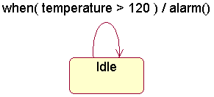
(2) Change event: The event of a Boolean expression becoming satisfied because of a change to one or more of the values it references.
Change event用关键字when表示。例
Change event和警戒条件(guard condition)的区别：
  警戒条件只在所相关的事件出现后计算一次，如果值为false，则不进行状态转移。

Slide 18
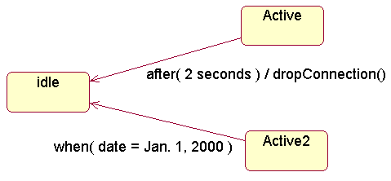
(3) Time event: An event that denotes the satisfaction of a time expression, such as the occurrence of an absolute time or the passage of a given amount of time after an object enters a state.
Time event用关键字after或when表示。
例：

Slide 19
(4) Signal event: An event that is the receipt by an object of a signal sent to it, which may trigger a transition in its state machine.
Signal event的语法格式和Call event一样。
信号事件是一个异步事件，调用事件一般是一个同步事件。

Slide 20
Signal(信号)
信号表示由一个对象异步地发送、并由另一对象接收的一个已命名的对象。
A signal is a kind of event that represents the specification of an asynchronous communication between objects.
说明：
信号用版型为<<signal>>的类图标表示。
信号之间可以具有泛化关系，形成层次结构。
在UML中，例外(exception)是信号的一种。

Slide 21
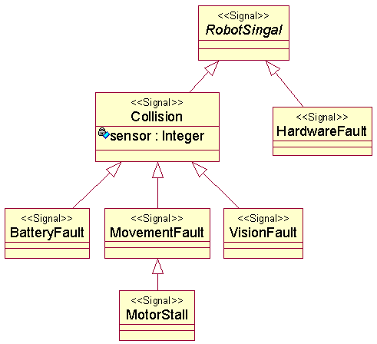
例：信号之间泛化关系的例子。

Slide 22
Checking your Statecharts
Consistency Checks
  All events in a statechart should appear as:
    operations of an appropriate class in the class diagram
  All actions in a statechart should appear as:
    operations of an appropriate class in the class diagram
Style Guidelines
  Give each state a unique, meaningful name
  Only use superstates when the state behaviour is genuinely complex
  Do not show too much detail on a single statechart
  Use guard conditions carefully to ensure statechart is unambiguous
    Statecharts should be deterministic (unless there is a good reason)
You probably shouldn’t be using statecharts if:
  you find that most transitions are fired “when the state completes”
  many of the trigger events are sent from the object to itself
  your states do not correspond to the attribute assignments of the class

Slide 23
Statecharts & Relationship to Other Diagrams
Events on the statechart diagram should appear as an incoming message for the appropriate object on a sequence and collaboration diagram.
状态图中的事件应为顺序图/交互图中该对象的输入消息
A statechart diagram is prepared for every object class in the Class Diagram with non-trivial behaviour.
状态图应针对类图中具有重要行为的类进行建模
Every event should correspond to an operation on the appropriate class.
每个事件均映射为相应类的一个动作

Slide 24
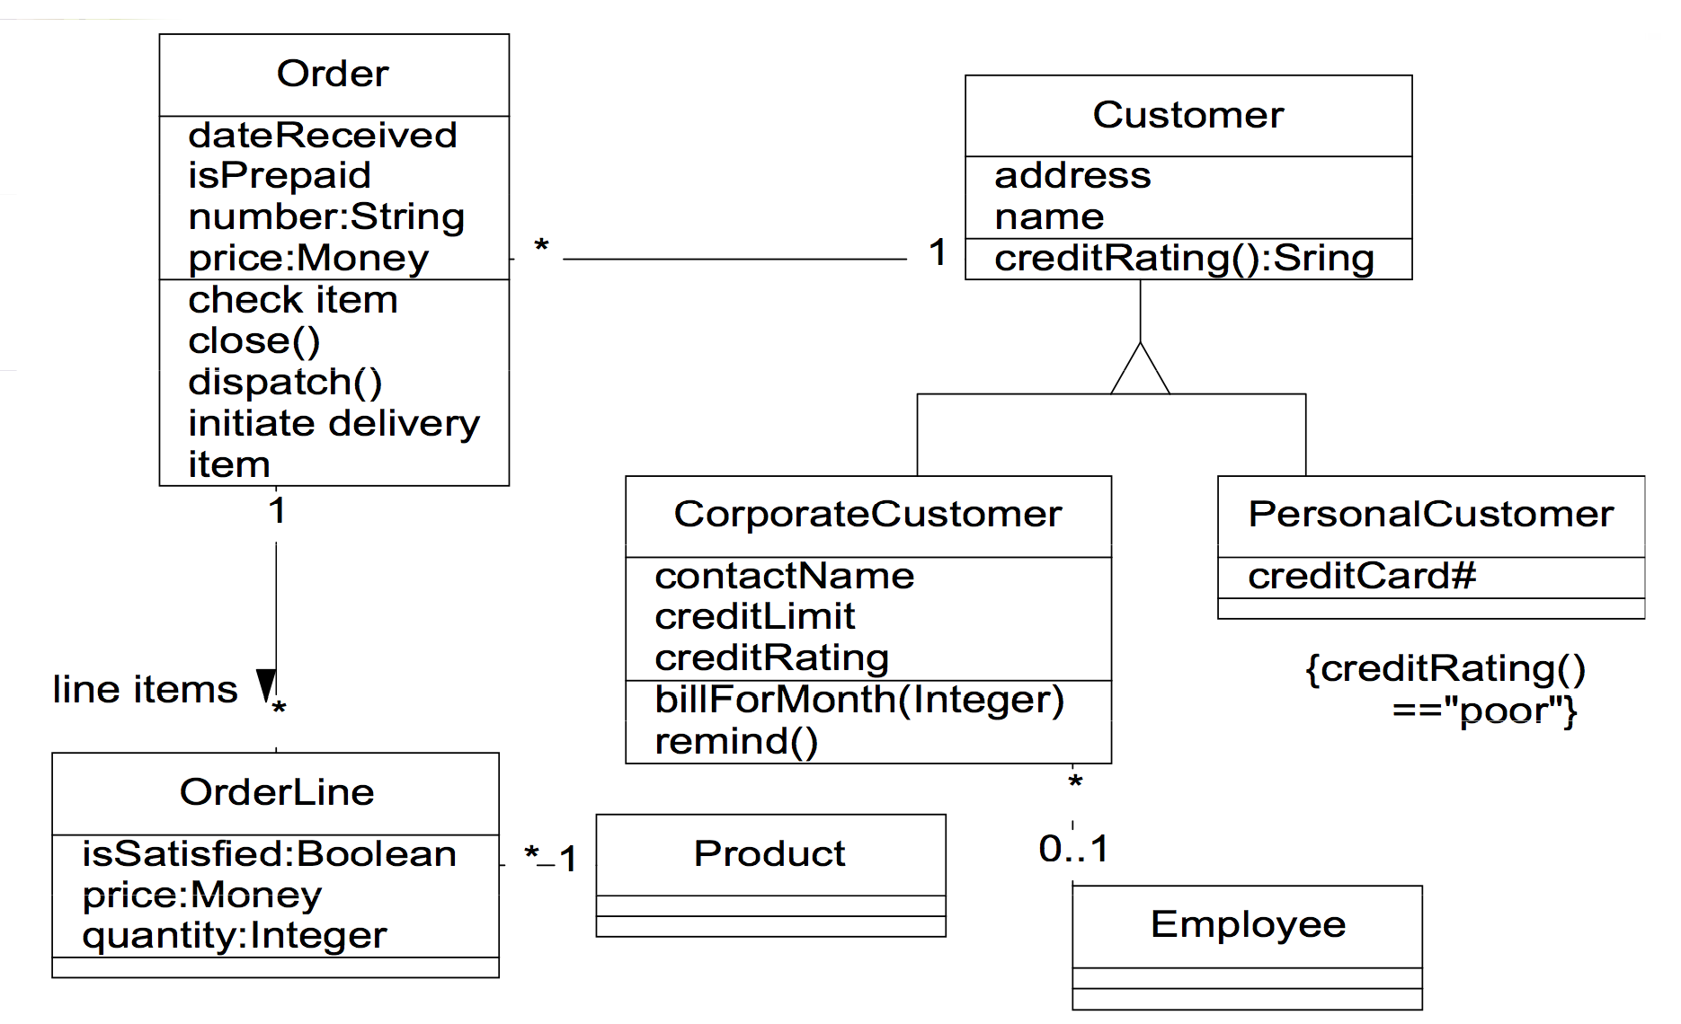
Class Diagram: Order Processing

Slide 25
Add a new state and separate transitions to the diagram to show that an order can be cancelled at any point before it is delivered.
Order Statechart Diagram
Start
Order
/get first item
get next item
[Not all items checked]
[All items checked &&
Checking
all items available]
Dispatching
do: check item
do: initiate delivery
[All items checked &&
some items not in stock]
Item Received
Delivered
[all items available]
Waiting
Delivered
Item Received
[some items not in stock]

Slide 26
Supertransition 超级迁移
Where transitions may occur from several states to a single state the Statechart Diagram may show this single state as a Supertransition
可将由多个状态发出的指向同一个状态的迁移定义为超级迁移
    e.g. a Purchase Order may be cancelled at any point prior to delivery.
This may be drawn with several transitions or by creating a Superstate.
超级迁移可图形表示为多条迁移，或为之创建一个超级状态

Slide 27
Complex Statechart Transitions
Transition to superstate boundary ≡ transition to initial state of the superstate.
指向组合状态边界的迁移等价于指向该组合状态初态的迁移
  entry actions of all regions entered are performed
  所有属于该组合状态的入口条件将被执行
There may also be transitions directly into a complex state region (like program “gotos”).
迁移可直接指向组合状态的子状态
Transition from a superstate boundary ≡ transition from the final state of the superstate
从组合状态边界转出的迁移等价于从该组合状态的终态发出迁移
  exit actions of all regions exited are performed
  所有出口条件均将被执行

Slide 28
Order Statechart Diagram: Superstates & Supertransition
Order
Start
Superstate name
Active
/get first item
get next item
[Not all items checked]
[All items checked &&
Checking
all items available]
Dispatching
do: check item
do: initiate delivery
[All items checked &&
some items not in stock]
Item Received
[all items available]
Item Received
Waiting
Delivered
[some items not in stock]
cancellation
Cancelled
Delivered

Slide 29
Nested (Super) States
Transmission
select R
Neutral
Reverse
select N
select N
select F
Forward

Slide 30
Nested (Super) States
Transmission
select R
Neutral
Reverse
select N
select N
select F
Forward
stop
upshift
upshift
First
Second
Third
downshift
downshift

Slide 31
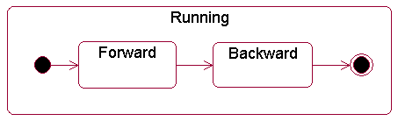
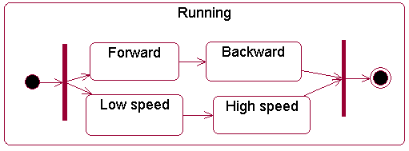
例1：子状态之间“or”关系的例子。
例2：子状态之间“and”关系的例子。

Slide 32
Concurrent States:Order
Cancelled
Waiting
Checking
Dispatching
Delivered
Authorizing
Authorized
Rejected

Slide 33
History State(历史状态)
History State: A pseudostate whose activation restores the previously active state within a composite state.
使用历史状态，可以记住从组合状态中退出时所处的子状态，当再次进入组合状态时，可直接进入到这个子状态，而不是再次从组合状态的初态开始。

Slide 34
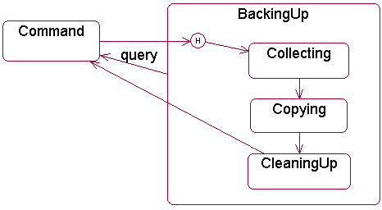
H和H*的区别：
  H只记住最外层的组合状态的历史。
  H*可记住任何深度的组合状态的历史。
例：历史状态的例子。

Slide 35
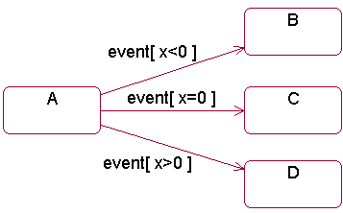
一个转移包括五部分：source state, event trigger, guard condition, action, target state.
对于一个给定的状态，最终只能产生一个转移，因此从相同的状态出来的、事件相同的几个转移之间的条件应该是互斥的。
例：

Slide 36
Action(动作)
An action(动作) is an executable atomic computation.
一个动作是一个可执行的原子计算。
说明：
动作是原子的，不可被中断的，其执行时间可忽略不计的。
UML并没有规定描述action的语言格式，一般建模时采用实际的程序设计语言来描述。

Slide 37
两种特殊的动作: entry action(进入动作)和exit action(退出动作)。
  Entry动作：进入状态时执行的活动，格式如下：
‘entry’ ‘/’action-expression
  Exit动作：退出状态时执行的活动，格式如下：
‘exit’ ‘/’action-expression
  (其中 action-expression 可以用到对象本身的属性和输入事件的参数)

Slide 38
Statecharts & Relationship to Other Diagrams
Every action should correspond to the execution of an operation on the appropriate class.
每个动作均对应于某个类操作的一次具体执行
Entry/Action, Exit/Action and Do/Activity within a State will normally be equivalent to Operations in the Class Diagram.
状态图中的操作定义等价于类图中的操作定义
Every outgoing message sent from a statechart must corrrespond to an operation on another class.
状态图中的每个输出消息均对应于其他类的一个操作

Slide 39
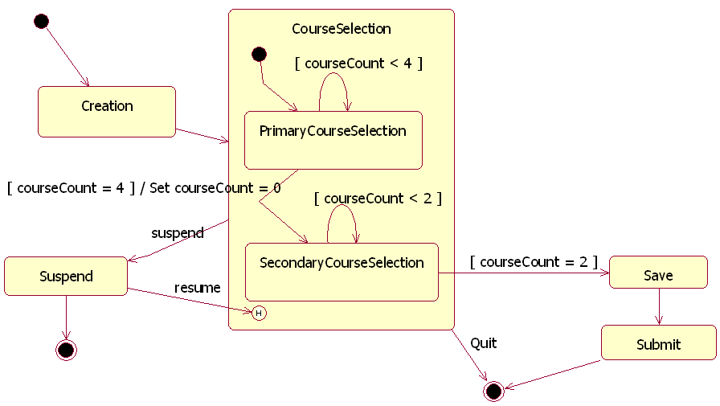
类型为RegistrationController的对象的状态图：

Slide 40
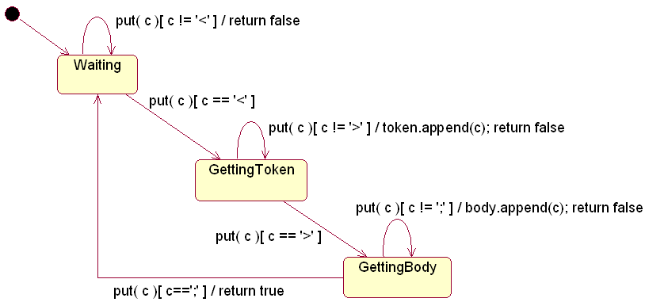
状态图的工具支持
正向工程：根据状态图生成代码。例：
所生成的代码示例：

Slide 41
class MessageParser {
public boolean put(char c) {
switch (state) {
case Waiting:
if (c == '<') {
state = GettingToken;
token = new StringBuffer();
body = new StringBuffer();
}
break;
case GettingToken :
if (c == '>')
state = GettingBody;
else
token.append(c);
break;
case GettingBody :
if (c == ';') {
state = Waiting;
return true;
}
else
body.append(c);
}
return false;
}
public StringBuffer getToken() {
return token;
}
public StringBuffer getBody() {
return body;
}
private final static int Waiting = 0;
private final static int GettingToken = 1;
private final static int GettingBody = 2;
private int state = Waiting;
private StringBuffer token, body;
}

Slide 42
状态图建模风格
建模风格1：把初态放置在左上角；把终态放置在右下角。
建模风格2：用过去式命名转移事件。
  这样做是为了反映转移是事件的结果这个事实。也就是说，事件出现在转移之前，因此引用事件时要用过去式。
  例如：用cancelled， closed， scheduled等命名事件。

Slide 43
建模风格3：警戒条件不要重叠。
  从一个状态出来的相似转移上的警戒条件相互之间必须互斥。
  例如，像x < 0，x = 0和x > 0这样的警戒条件是互斥的，而像x <= 0和 x >= 0这样的警戒条件是非互斥的。
建模风格4：不要把警戒条件置于初始转移上。
  当警戒条件为假的时候，这个对象做什么？

Slide 44
3.画出描述录像带生命进程的状态图。 （10 分）
假定录像带首先被工厂生产出来，然后出售，被录像带商店购入后，进行适当的包装和编号，存入录像带商店的数据库，准备出租。顾客选中并准备租用时，在柜台取带，并于三天内归还。如果逾期不还，录像带商店将在次日打电话给顾客催还。两天后将再次打电话给顾客催还。如再过两天后仍未还带，商店将委托代理取带，并从数据库中清除该录像带。如果还回的录像带破损，也将从数据库中清除该带。如果在年度检查中发现该录像带从库存中遗失，也将被清除。
注意画出状态迁移的事件和条件。

Slide 45
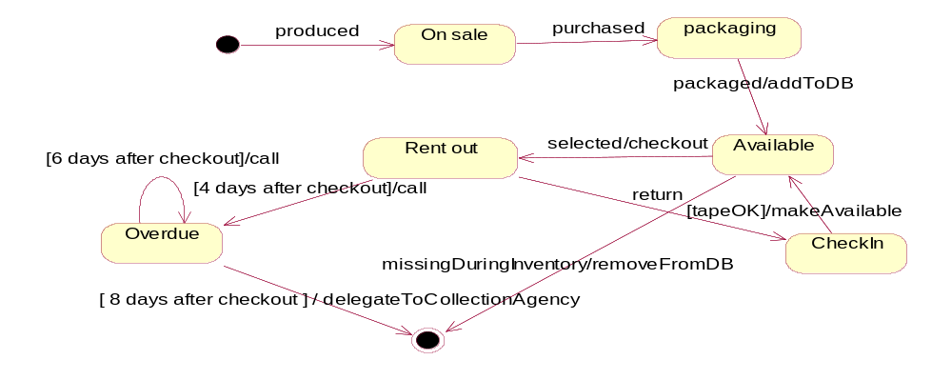

Slide 46
活动图
清华大学软件学院 刘璘

Slide 47
Activity Diagram(活动图)
An activity diagram is a special case of a state diagram
活动图是状态图的特例
in which all (or at least most) of the states are action or sub-activity states
状态为持续性的活动
and in which all (or at least most) of the transitions are triggered by completion of the actions or sub-activities in the source states.
迁移由活动的结束来触发
(UML specification 1.5, pp3-156)
Notes:
说明：
活动图是对系统的动态行为建模的五个图之一。
活动图是由状态图变化而来的，活动图中一个活动结束后将立即进入下一个活动(在状态图中状态的转移可能需要事件的触发)。
活动图是状态图的特例。

Slide 48
Activity Diagrams
Activity diagrams describe activities which involve concurrency and synchronization.
活动图用于描述并发和同步
Variation of Statecharts that focuses on a flow of activity driven by internal processing within an object rather than events that are external to it.
与状态图的不同在于它关注对象内部的事务处理，而非外部的相关事件。
Notes:
活动图对表示并发行为很有用。

Slide 49
Activity Diagrams
Can be used
  To model business workflows (in business modeling for instance).
  对系统的工作流(workflow)建模，即对系统的业务过程建模。
  To describe a system function that is represented within a use case or between use cases.
  对系统功能建模，尤其是那些表示为一个或一组用例的功能
  In operation specifications, to describe the logic of an operation.
  对具体的操作建模，描述计算过程的细节。
Notes:
活动图可用于描述用于不同目的、不同详细程度的工作流。从这个意义上讲，活动图是非常灵活的，它可用于找出描述高层企业需求的用例，也可用于描述复杂用例，以及对象内部的复杂行为。

Slide 50
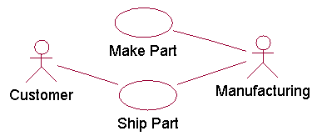
例1：用活动图对工作流程建模的例子。
(1)：产品制造和发货的use case图。

Slide 51
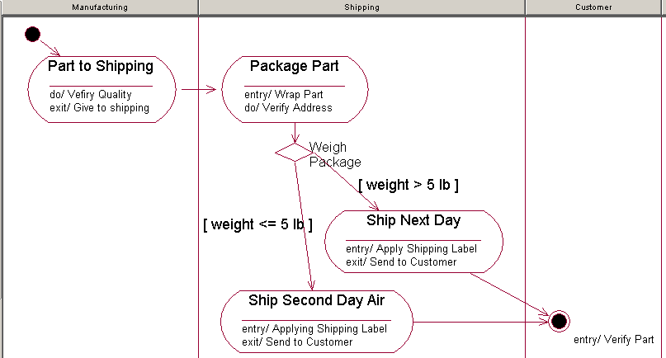
(2). 用活动图来说明具体的工作流程。

Slide 52
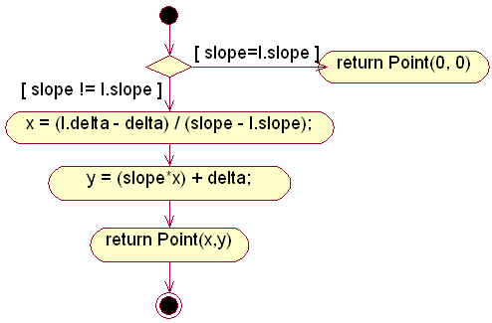
例2：用活动图对操作建模的例子：用活动图描述类Line的操作intersection的算法。

Slide 53
活动图中的基本概念
Activity (活动)
transition (转移)
swimlane (泳道)
branch (分支)
fork and join (分叉和汇合)
object flow (对象流)

Slide 54
activity(活动)
An activity represents the performance of task or duty in a workflow. It may also represent the execution of a statement in a procedure.
说明：
Action 和activity的区别：
  Action是原子的，而activity可进一步分解。

Slide 55
Activities (in UML 2.0)
Activities consists of action nodes, object nodes, and control nodes linked by activity edges.
Validate and accept car sharer
Pre/post conditions
Activity Name
Applicant
Check details
Send welcome
pack to sharer
carSharer
Parameter
Correct
problem
Activity final node
X
Flow final node

Slide 56
Actions
An action represents an activity state in the execution of the activity. An activity state normally contains an action expression and usually has no associated name.
Actions may be described by:
  Natural language
  Structured English
  Pseudo-code
  Programming language
  Another activity diagram
An action expression may only use attributes and links of the owning object.
Notes:
Normal carry out actions, but occasionally may be a stop point waiting for an event.
When there are multiple flows in, the action does not fire until all the inward flows arrive (an implicit join). When there are multiple flows out, parallel flows are initiated.

Slide 57
More About Activity Diagrams
Decision point/node:
Dead end: there may be transitions in an activity diagram with no destination state; this can mean that:
  Not all processing has been specified,
  Or, that another activity diagram will take over.
Calculate
total cost
[cost < $50]
Charge
customer’s
account
[cost ≥ $50]
Get
authorization

Slide 58
Swimlanes/ Activity Partition
An activity diagram can be divided into swimlanes.
A swimlane is a partition on activity graphs for organizing responsibilities for activities.
Each swimlane:
  Represents one focus of responsibility(责任区) in the activity.
  May be handled by a distinct operation in one or more objects.
The order of the swimlanes has no significance.
Notes:
每个泳道代表一个。

Slide 59
Swimlanes
swimlane
Purchase
Order Dept.
Get Order
Synchronization bar
Waiting
Checking
Dispatching
[cancelled]
Authorizing
Authorized
[accepted]
Finance
Dept.
[rejected]

Slide 60
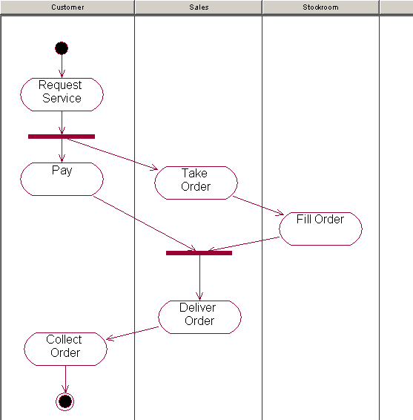
例：使用泳道的例子。

Slide 61
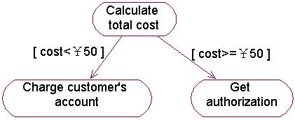
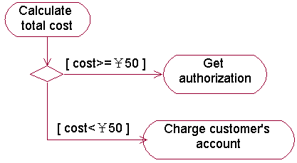
branch(分支)
A branch is an element in a state machine in which a single trigger leads to more than one possible outcome, each with its own guard condition.
表示分支的两种方法：
方法1
方法2

Slide 62
fork和join(分叉和汇合)
A fork is a complex transition in which one source state is replaced by two or more target states, resulting in an increase in the number of active states.
A join is a transition with two or more source states and one target state.

Slide 63
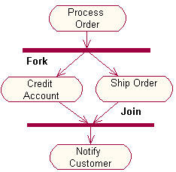
说明：
利用fork和join可以表示系统中或对象中的并发行为。
例：fork和join的例子。

Slide 64
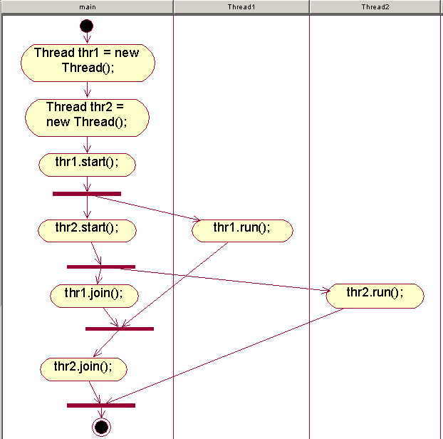
例：用活动图描述Java中使用多线程的过程。

Slide 65
对象流
在活动图中可以出现对象。对象可以作为活动的输入或输出。
An object flow on an activity diagram represents the relationship between an activity and the object that creates it (as an output) or uses it (as an input).

Slide 66
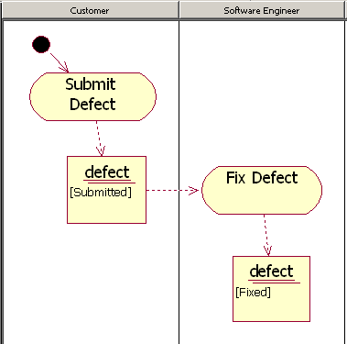
对象流的例子。

Slide 67
Example: Order Processing
The Process Order use case:
“When we receive an order, we check each line item on the order to see if we have the goods in stock. If we do, we assign the goods to the order. If this assignment sends the quantity of those goods in stock below the reorder level, we reorder the goods. While we are doing this, we check to see if the payment is O.K. If the payment is O.K. and we have the goods in stock, we dispatch the order. If the payment is O.K. but we do not have the goods, we leave the order waiting. If the payment is not O.K., we cancel the order.”

Slide 68
Order Processing Activity Diagram
Receive
Order
*
for each line
item on order
[failed]
Authorize
Payment
Check
Line
Item
Cancel
Order
[succeeded]
[in stock]
Assign to
Order
[stock assigned to
all line items and
payment authorized]
[need to
reorder]
Dispatch
Order
Reorder
Item

Slide 69
With Swimlanes
Finance
Order
Processing
Stock
Manager
Receive
Order
Receive
Supply
*
for each line
item on order
Check
Line
Item
Choose
Outstanding
Order Items
Authorize
Payment
[failed]
[succeeded]
Cancel
Order
[in stock]
for each chosen
order item
*
Assign to
Order
Assign
Goods to
Order
[stock assigned to
all line items and
payment authorized]
[need to
reorder]
[all outstanding
order items filled]
Dispatch
Order
Reorder
Item
Add
Remainder
to Stock

Slide 70
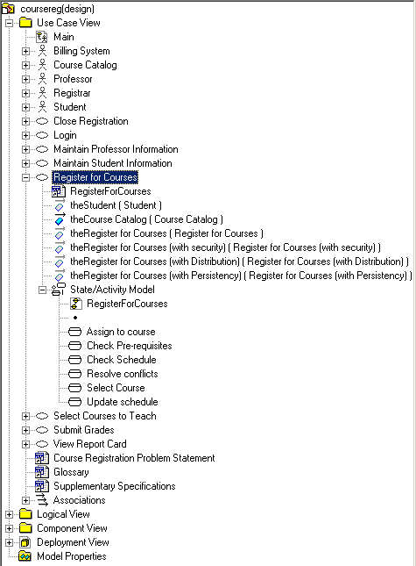
例3：课程注册系统中的活动图例子

Slide 71
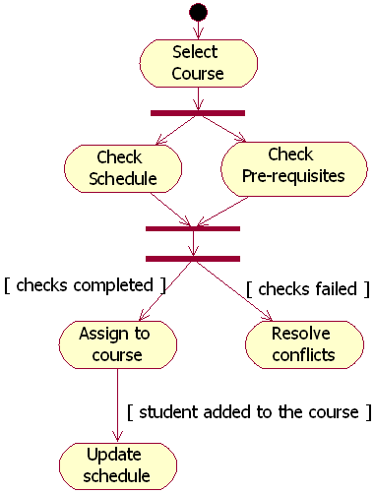
分析用例 Register for Courses的活动图：

Slide 72
活动图的工具支持
正向工程：
  利用活动图产生代码，特别是对具体操作建模的活动图。
  例：根据Slide 55活动图生成的代码：
Point Line::intersection (l : Line) {
if (slope == l.slope) return Point(0,0);
int x = (l.delta - delta) / (slope - l.slope);
int y = (slope * x) + delta;
return Point(x, y);
}

Slide 73
活动图与状态图比较
1. 活动图和状态图描述的重点不同：
  活动图描述的是从activity到activity的控制流，而状态图描述的是对象的状态及状态之间的转移。
2. 活动图和状态图使用的场合不同：
  对于以下几种情况可以使用活动图：
    分析用例
    理解涉及多个用例的工作流
    处理多线程应用
  对于下面的情况要使用状态图：
    显示一个对象在其生命周期内的行为。
说明：如果要显示多个对象之间的交互情况，可用顺序图或协作图。

Slide 74
活动图建模风格
建模风格1：确保从决策点出来的每个转移都有一个警戒条件。
  这可以确保建模人员已经考虑到这个决策点的所有可能情况。
建模风格2：确保决策点上的警戒条件形成一个完备集。
  不管什么情况，要一定能够可以从决策点离开。
  例如，像x < 0和x > 0这样的警戒条件是不完备的，因为当x等于0时会发生什么并不清楚。
建模风格3：警戒条件不要重叠。

Slide 75
建模风格4：确保每个分叉只有一个进入转移。
  当发现需要几个转移到同一个分叉时，表明建模人员或者遗漏了一个活动，或者在该点事实上并不需要并发活动。
建模风格5：确保每个汇合只有一个退出转移。
  当某个汇合点需要多个退出转移时，表明仍然需要并发的活动，因此，把汇合点沿着总体活动过程向前移动。
建模风格6：要小于5条泳道。
  泳道的一个缺点是使得建模人员无法自由地在图中排列活动以节省空间，因此会增加图的大小。泳道数目越多，这个问题越严重。

Slide 76

Why Build Models?
To understand the problem better
To communicate with other persons
To find errors or omissions
To plan out the design
To generate code

Slide 77
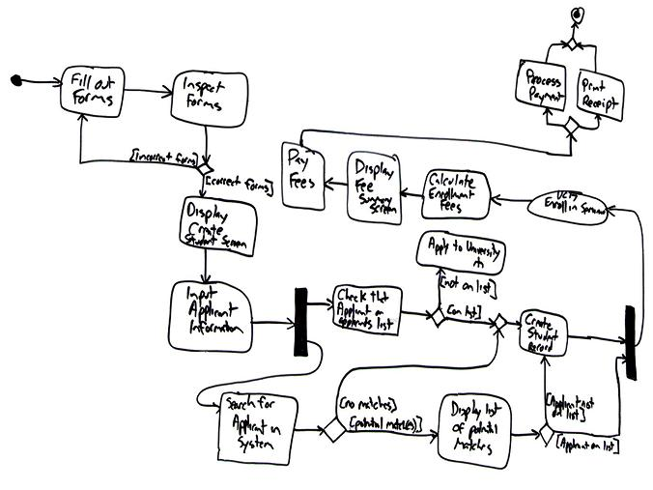
activity diagram (活动图) : Procedural and parallel behavior

Slide 78
Sequence Diagram
A sequence diagram shows step by step what must happen to accomplish a piece of functionality provided by the system.
: Student
registration
registration
math 101
math 101
form
manager
section 1
1: fill in info
2: submit
3: add Joe to Math 101
4: add Joe
5: are you open?
6: add Joe
Notes:
A scenario may be shown graphically in a sequence diagram. This diagram shows you step by step what must happen to accomplish a piece of functionality in the use case. A sequence diagram is also known as an interaction diagram.
You start by identifying the objects in the scenario. Let’s look at adding a student to a course offering. A student wants to take Math 101. The scenario is initiated by the student and needs four objects—registration form, registration manager, math 101, and section 1. Next, we identify the object interactions that must occur. We see the following:
The student fills in the information on the registration form.
The student submits the registration form.
The registration form tells the registration manager that Joe wants to take math 101.
The registration manager tells math 101 to add Joe.
Math 101 asks section one if it is accepting students. In this scenario, the answer is yes.
Math 101 tells section 1 to add Joe.
Question: How may sequence diagrams do you create?
Answer: As many as needed to understand the system. When you discover that you are not finding anything new about the system by adding another scenario, it’s time to move on.
Although we’ll be covering interaction diagrams in another module, you may want to define scenario.
A scenario is one path through a use case’s flow of events.

Slide 79
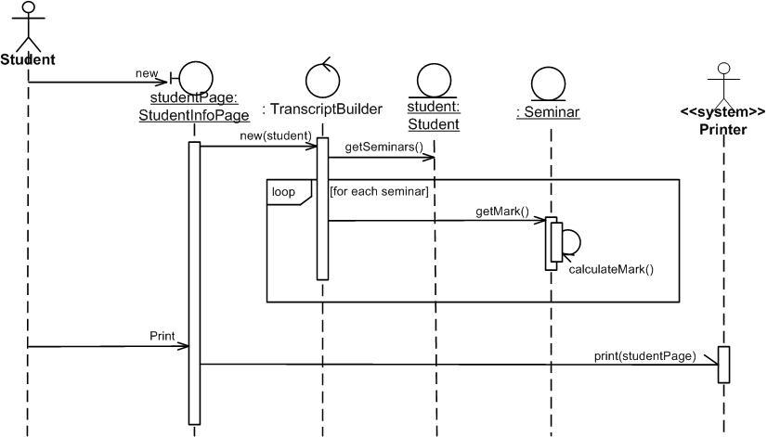
sequence diagram (顺序图) : Interaction between objects;
emphasis on sequences

Slide 80
Collaboration Diagram
A collaboration diagram displays object interactions organized around objects and their links to one another.
course form :
1: set course info
CourseForm
2: process
: Registrar
3: add course
aCourse :
theManager :
Course
CurriculumManager
4: new course
Notes:
A collaboration diagram is a different graphical view of a scenario. This type of diagram shows the objects and their links to one another. A collaboration diagram is also known as an interaction diagram.

Slide 81
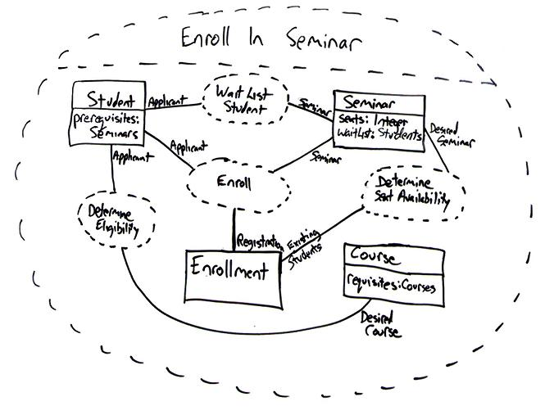
collaboration diagram (协作图) : Interaction between objects;
emphasis on links

Slide 82
Class Diagram
A class diagram shows the structure of your software.
RegistrationForm
ScheduleAlgorithm
0..*
1
RegistrationManager
addStudent(Course, Student)
Course
1
RegistrationUser
0..*
name
numberCredits
name
Student
open()
major
addStudent(StudentInfo)
1
3..10
Professor
1..*
4
CourseOffering
tenureStatus
1
location
0..4
open()
addStudent(Student)
Notes:
Class diagrams are created to show the structure of the system. Class diagrams contain classes, relationships, and multiplicity indicators.
Objects in interaction diagrams (both sequence and collaboration diagrams) are grouped into classes, where a class is a collection of objects with common structure, common behavior, common relationships, and common semantics. The UML notation for a class is a compartmented rectangle. The first compartment shows the name of the class. (Naming standards should be agreed on before classes are created. For example, should underscores be used? Does it matter? No. What matters is that everyone adheres to the same standard.)
Each class also has data associated with it. This is the structure of the class, represented by its set of attributes.

Slide 83
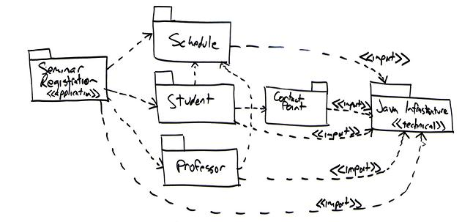
  Package Diagram
    Compile-time hierarchic structure

Slide 84
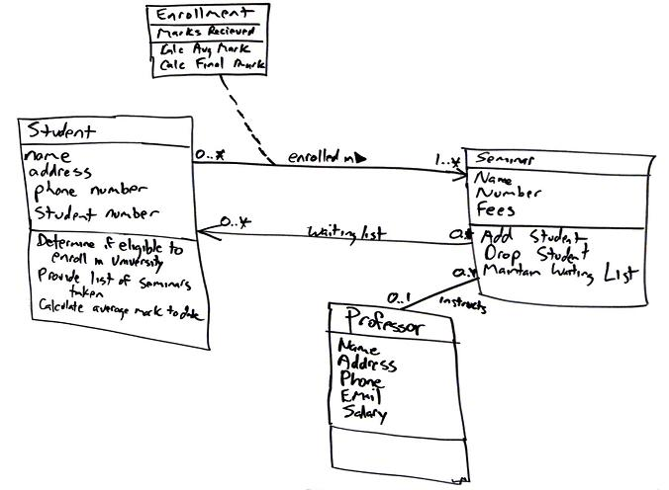
class diagram (类图) :
Class, features, relationships

Slide 85
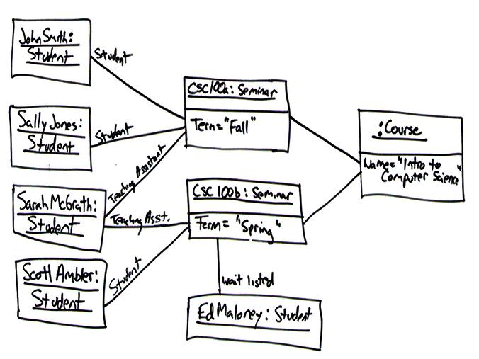
object diagram (对象图) : Example configurations of instances

Slide 86
Statechart Diagram
A statechart diagram shows the lifecycle of a single class.
Add student[ count < 10 ]
Add Student /
Initialization
Set count = 0
Open
do: Initialize course
entry: Register student
exit: Increment count
Cancel
Cancel
[ count = 10 ]
Canceled
do: Notify registered
students
Closed
Cancel
do: Finalize course
Notes:
For classes that exhibit significant dynamic behavior, it is often necessary to examine their states. A statechart diagram looks at the lifecycle of a single class. A state is a condition that an object in the class may be in. Look at the CourseOffering class on the slide.
Here, we have identified four states—Initialization, Open, Closed, and Canceled. There are two special states—a start state, the state an object is in when it is created and an end state, the state an object is in when it is destroyed.
There is only one start state, but there can be zero or more end states. Transitions show how to get from one state to another. A transition may have an event associated with it. There may also be an action associated with the transition. For example, if you are in the Initialization state and receive the Add student message, set the count to zero and transition to the Open state.
A transition may also have a guard condition. If you are in the Open state and the count reaches 10, you automatically transition to the Closed state. If you look at the Open state, there are two ways to enter into it. If there is something that you want to do whenever you enter a state, you can show this behavior as an entry action. Similarly, if there is something that you want to do whenever you leave a state, you can show it as an exit action.
Finally, show behavior that occurs while in a state as an activity. The activity starts when the state is entered and finishes. Or, it may be interrupted by an outgoing transition.
We will not model the statechart diagram in this course.

Slide 87
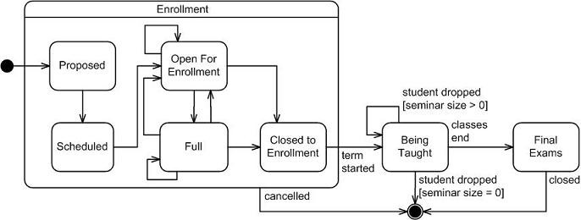
statecharts diagram (状态图) : how events change an object over its life

Slide 88
Component Diagram
A component diagram illustrates the organization and dependencies among software components.
Billing.exe
Register.exe
Billing
System
People.dll
Course.dll
User
Course
Notes:
The component diagram shows relationships between the components in the system.
Interfaces are drawn as circles. This shows the connectivity between the defined components.
A component may be a software component (for example, a .h file in C++ or a .Java file in Java), a run-time component (for example, a .DLL), or an executable component. The circles represent the interface to the component. This is often called lollipop notation. The dashed lines represent dependencies.
We will not model a component diagram in this course.

Slide 89
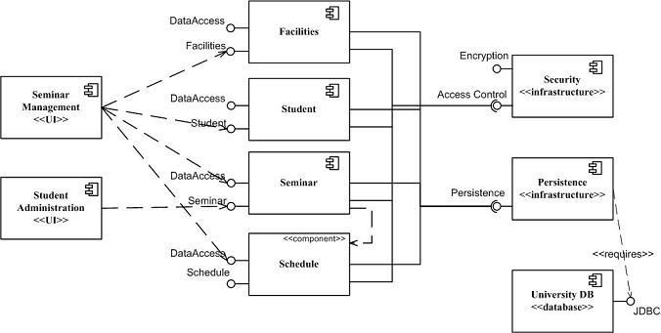
component diagram (构件图) : structure and connections of components

Slide 90
Deployment Diagram
A deployment diagram visualizes the distribution of components across the enterprise.
Registration
Database
Main
Library
Building
Dorm
Notes:
The last diagram is the deployment diagram. This diagram shows the nodes in the system and the connections between them.
The deployment diagram above represents our system.
We will not model a deployment diagram in this course.

Slide 91
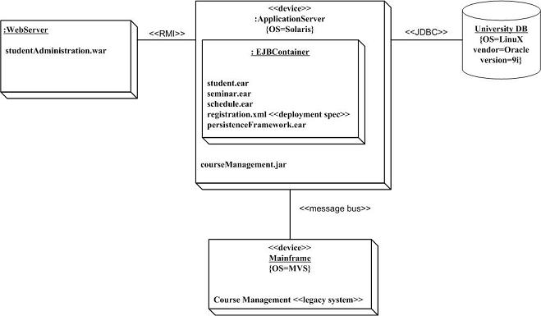
deployment diagram (部署图) : deployment of artifacts to nodes

Slide 92
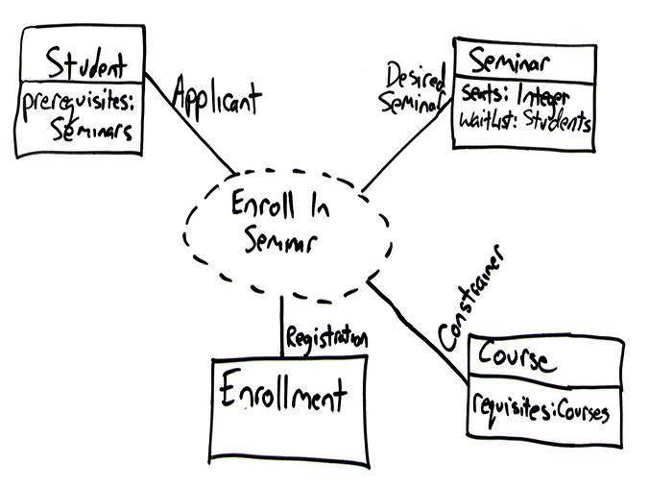
  Composite Structure Diagram (组成结构图)
    Runtime decomposition of a class

Slide 93
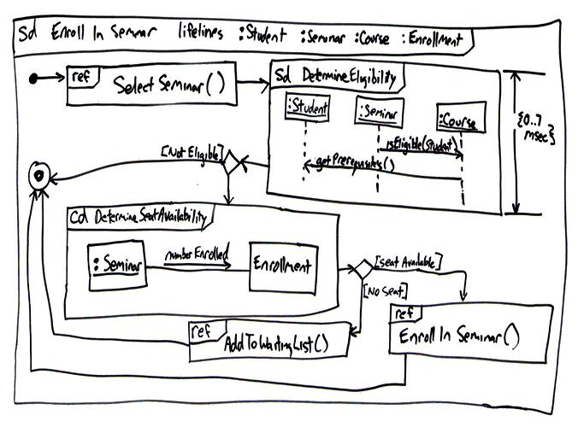
  Interaction Overview Diagram (交互概要图)
    Mix of sequence and activity diagram

Slide 94
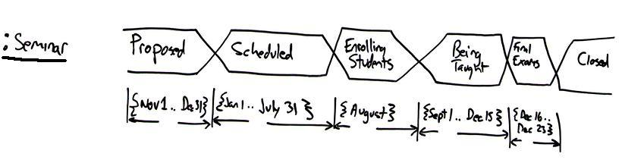
  Timing Diagram (定时图)
    Interaction between objects; emphasis on timing

