Slide 1
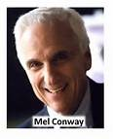
Conway’s Law
“The structure of a software system
reflects the structure of the organisation
that built it”

Slide 2
软件体系结构设计
Software Systems Architecture Design
清华大学软件学院 刘璘

Slide 3
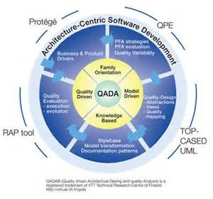
Software Architecture
A software architecture defines:
the components of the software system
how the components use each other’s functionality and data
How control is managed between the components

Slide 4
Coupling and Cohesion
Architectural Building blocks:
A good architecture:
  Minimizes coupling between modules:
    Goal: modules don’t need to know much about one another to interact
    Low coupling makes future change easier
  Maximizes the cohesion of each module
    Goal: the contents of each module are strongly inter-related
    High cohesion makes a module easier to understand
connector
module
module
X

Notes:
内聚是从功能角度来度量模块内的联系，一个好的内聚模块应当恰好做一件事。它描述的是模块内的功能联系；
耦合是软件结构中各模块之间相互连接的一种度量，耦合强弱取决于模块间接口的复杂程度、进入或访问一个模块的点以及通过接口的数据。
软件架构设计的目的简单说就是在保持软件内在联系的前提下，分解软件系统，降低软件系统开发的复杂性，而分解软件系统的基本方法无外乎分层和分割。但是在保持软件内在联系的前提下，如何分层分割系统，分层分割到什么样的力度，并不是一件容易的事，这方面有各种各样的分解方法，比如：关注点分离，面向方面，面向对象，面向接口，面向服务，依赖注入，以及各种各样的设计原则等，而所有这些方法都基于高内聚，低耦合的原则。 高内聚和低耦合是相互矛盾的，分解力度越粗的系统耦合性越低，分解力度越细的系统内聚性越高，过度低耦合的软件系统，软件模块内部不可能高内聚，而过度高内聚的软件模块之间必然是高度依赖的，因此如何兼顾高内聚和低耦合是软件架构师功力的体现。
高内聚，低耦合的系统有什么好处呢？事实上，短期来看，并没有很明显的好处，甚至短期内会影响系统的开发进度，因为高内聚，低耦合的系统对开发设计人员提出了更高的要求。高内聚，低耦合的好处体现在系统持续发展的过程中，高内聚，低耦合的系统具有更好的重用性，维护性，扩展性，可以更高效的完成系统的维护开发，持续的支持业务的发展，而不会成为业务发展的障碍。

Slide 5
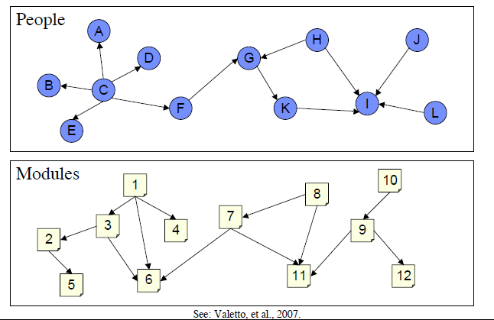
Socio-Technical Congruence

Slide 6
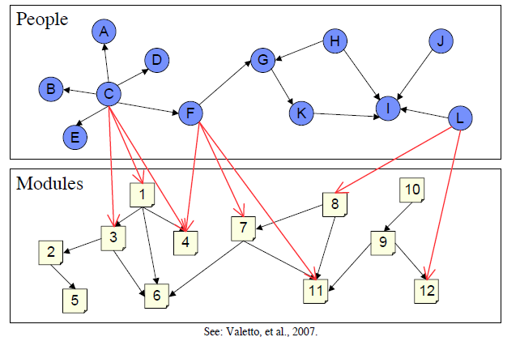
Socio-Technical Congruence

Slide 7
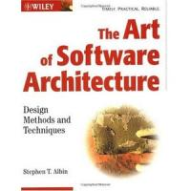
Moving into Design
Analysis vs. Design
  Why the distinction?
Design Processes
  Logical vs. Physical Design
  System vs. Detailed Design
Architectures
  System Architecture
  Software Architecture
  Architectural Patterns
Useful Notation
  UML Packages and Dependencies

Slide 8
Refresher: Lifecycle models
Waterfall model
Agile development
perceived
need
reqts
Collect
User stories
architecture
(high level design)
Release
Planning
game
Each cycle:
approx 2 weeks
code
(low level design)
unit test
code
Write test
cases
integrate
integrate
maintain
test
version 1
Spiral
model
Evaluate
alternatives
and risks
reqts
design
code
test
integ-
rate
O&M
constraints₄
risk analysis₄
constraints₃
risk analysis₃
alternatives₄
Constr-
aints₂
risk
analysis₂
lessons learnt
alternatives₃
Altern-
atives₂
alternatives
constraints
version 2
risk
analysis₁
reqts
design
code
test
integ-
rate
O&M
budget₄
budget₃
budget₂
budget₁
prototype₁
prototype₂
prototype₃
prototype₄
requirements,
lifecycle plan
concept of
operation
software
requirements
detailed
design
lessons learnt
software
design
Evolutionary development
(each version incorporates new requirements)
version 3
development plan
validated
requirements
code
reqts
design
code
test
integ-
rate
integration and test plan
validated,
verified design
unit
test
Plan
system
test
Develop
and
test
implementation plan
acceptance
test

Slide 9
Analysis vs. Design
Analysis
  Asks “what is the problem?”
    what happens in the current system?
    what is required in the new system?
  Results in a detailed understanding of:
    Requirements
    Domain Properties
  Focuses on the way human activities are conducted
Design
  Investigates “how to build a solution”
    How will the new system work?
    How can we solve the problem that the analysis identified?
  Results in a solution to the problem
    A working system that satisfies the requirements
    Hardware + Software + Peopleware
  Focuses on building technical solutions
Separate activities, but not necessarily sequential
  …and attempting a design usually improves understanding of the problem

Slide 10
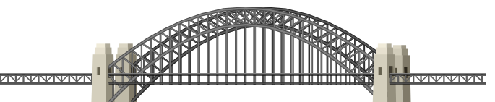
Refresher: different worlds
Analysis is all about
studying this world
Design is all about
building this world
Application Domain
Machine Domain
s - specification
D - domain properties
C - computer
R - requirements
P - program
But who builds the bridge?

Slide 11





Four design philosophies
Decomposition & Synthesis
  Drivers:
    Managing complexity
    Reuse
  Example:
    Design a car by designing separately the chassis, engine, drivetrain, etc. Use existing components where possible
Search
  Drivers
    Transformation
    Heuristic Evaluation
  Example:
    Design a car by transforming an initial rough design to get closer and closer to what is desired
Negotiation
  Drivers
    Stakeholder Conflicts
    Dialogue Process
  Example:
    Design a car by getting each stakeholder to suggest (partial) designs, and then compare and discuss them
Situated Design
  Drivers
    Errors in existing designs
    Evolutionary Change
  Example:
    Design a car by observing what’s wrong with existing cars as they are used, and identifying improvements

Slide 12
Logical vs. Physical Design
Logical Design concerns:
  Anything that is platform-independent:
    Interactions between objects
    Layouts of user interfaces
    Nature of commands/data passed between subsystems
  Logical designs are usually portable to different platforms
Physical Design concerns:
  Anything that depends on the choice of platform:
    Distribution of objects/services over networked nodes
    Choice of programming language and development environment
    Use of specialized device drivers
    Choice of database and server technology
    Services provided by middleware
Choose
Platform
Logical
Design
Physical
Design

Slide 13
System Design vs. Detailed Design
System Design
  Choose a System Architecture
    Networking infrastructure
    Major computing platforms
    Roles of each node (e.g. client-server; clients-broker-servers; peer-to-peer,…)
  Choose a Software Architecture
  Identify the subsystems
  Identify the components and connectors between them
    Design for modularity to maximize testability and evolveability
    E.g. Aim for low coupling and high cohesion
Detailed Design
  Decide on the formats for data storage
    E.g. design a data management layer
  Design the control functions for each component
    E.g. design an application logic layer
  Design the user interfaces
    E.g. design a presentation layer

Slide 14
Global System Architecture
Choices:
  Allocates users and other external systems to each node
  Identify appropriate network topology and technologies
  Identify appropriate computing platform for each node
Example:
  See next slide…

Slide 15
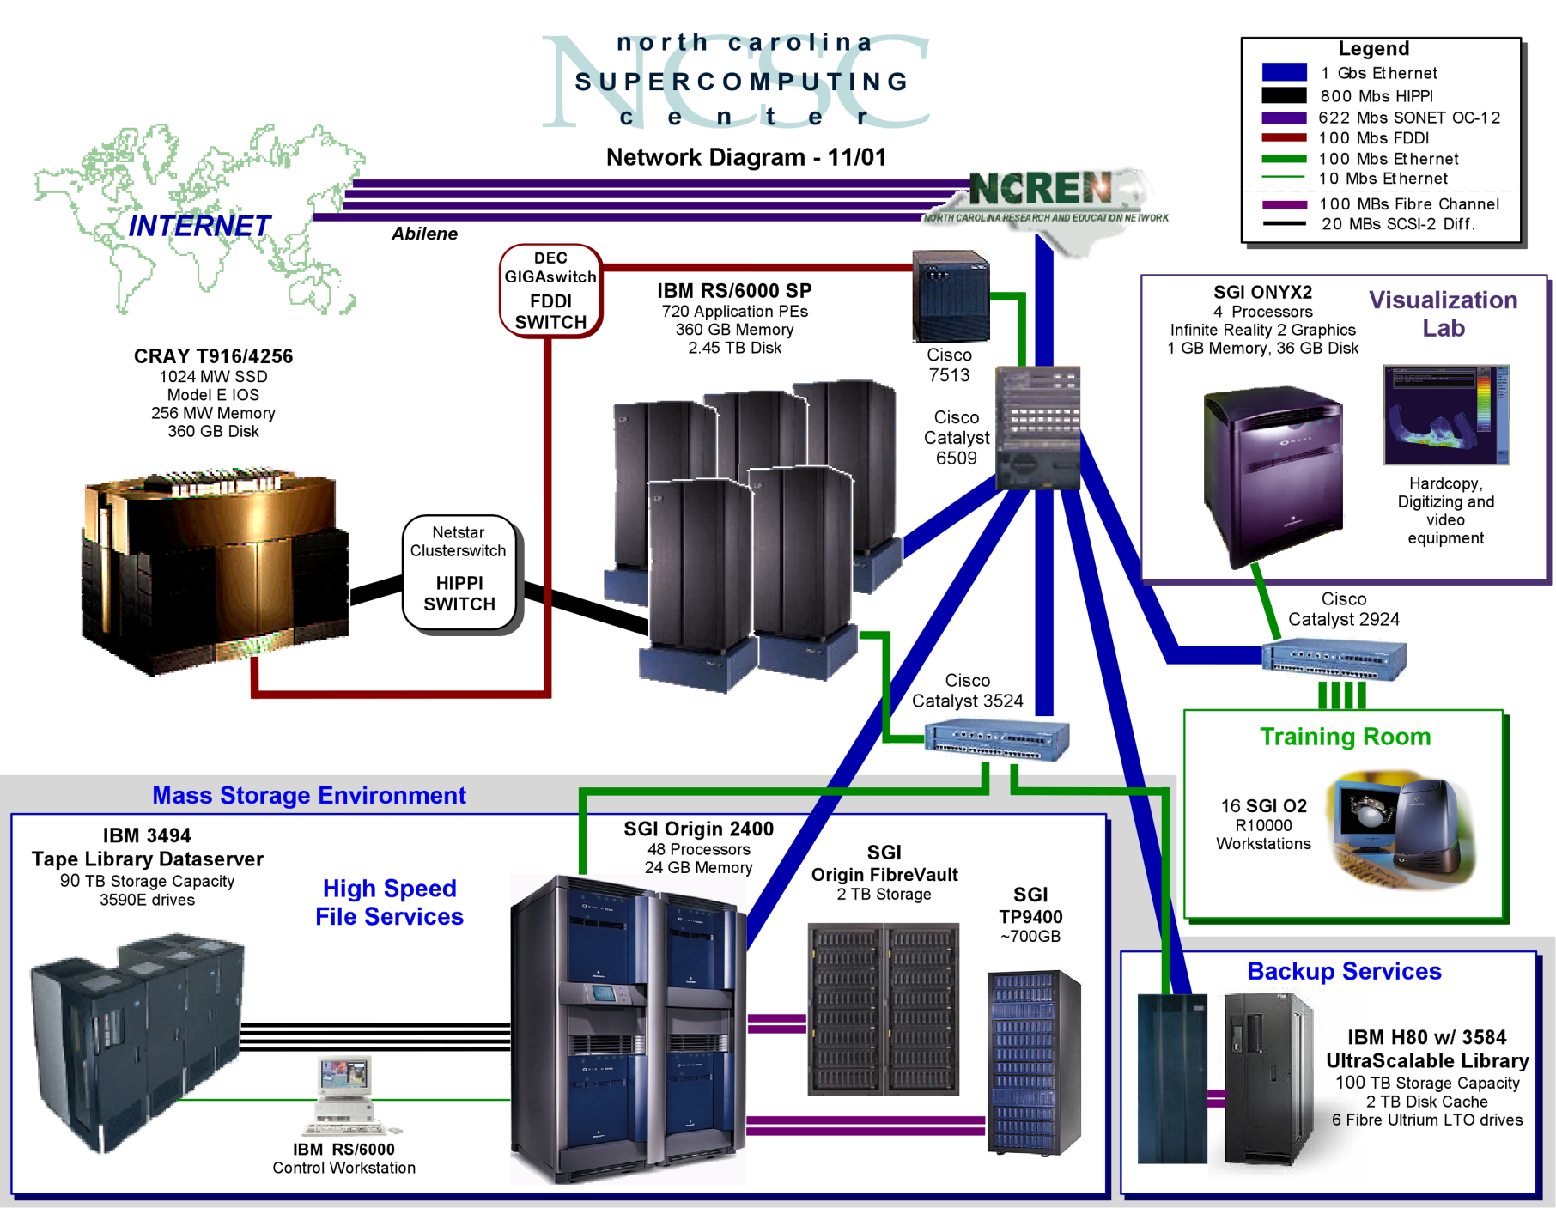

Slide 16
System Architecture Questions
Key questions for choosing platforms:
  What hardware resources are needed?
    CPU, memory size, memory bandwidth, I/O, disk space, etc.
  What software/OS resources are needed?
    application availability, OS scalability
  What networking resources are needed?
    network bandwidth, latency, remote access.
  What human resources are needed?
    OS expertise, hardware expertise, sys admin needs,
    user training/help desk requirements.
  What other needs are there?
    security, reliability, disaster recovery, uptime requirements.
Key questions constraining the choice:
  What funding is available?
  What resources are already available?
    Existing hardware, software, networking
    Existing staff and their expertise
    Existing relationships with vendors, resellers, etc.

Slide 17
Data Management Questions
How is data entry performed?
  E.g. Keyless Data entry
    bar codes; Optical Character Recognition (OCR)
  E.g. Import from other systems
    Electronic Data Interchange (EDI), Data interchange languages,…
What kinds of data persistence is needed?
  Is the operating system’s basic file management sufficient?
  Is object persistence important?
  Can we isolate persistence mechanisms from the applications?
Is a Database Management System (DBMS) needed?
  Is data accessed at a fine level of detail
    E.g. do users need a query language?
  Is sophisticated indexing required?
  Is there a need to move complex data across multiple platforms?
    Will a data interchange language suffice?
  Is there a need to access the data from multiple platforms?

Slide 18
Software Architecture
A software architecture defines:
  the components of the software system
  how the components use each other’s functionality and data
  How control is managed between the components
An example: client-server
  Servers provide some kind of service; clients request and use services
  applications are located with clients
    E.g. running on PCs and workstations;
  data storage is treated as a server
    E.g. using a DBMS such as DB2, Ingres, Sybase or Oracle
    Consistency checking is located with the server
  Advantages:
    Breaks the system into manageable components
    Makes the control and data persistence mechanisms clearer
  Variants:
    Thick clients have their own services, thin ones get everything from servers
  Note: Are we talking about logical (s/w) or physical (h/w) architecture?

Slide 19
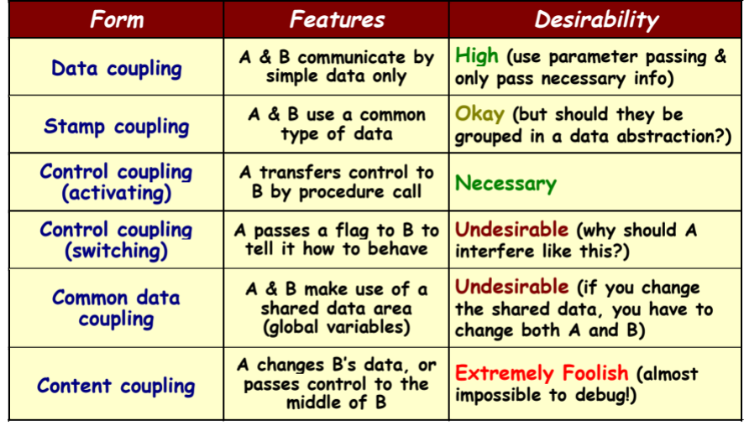
Coupling
Given two units (e.g. methods, classes, modules, …), A and B:

Slide 20
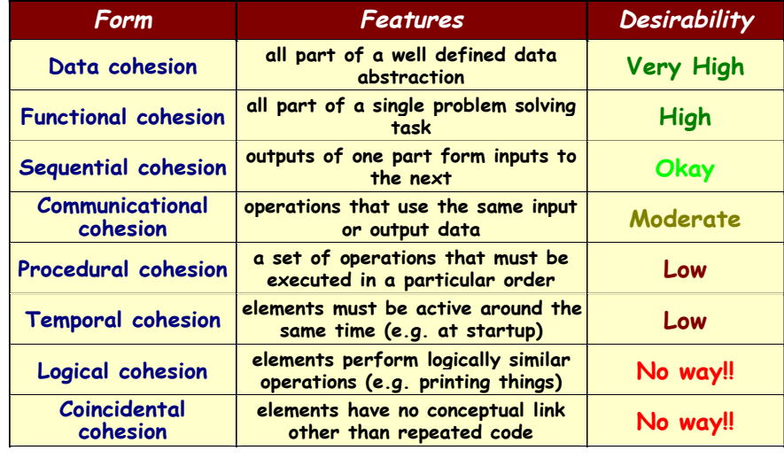
Cohesion
How well do the contents of an object (module, package,…) go together?

Slide 21
UML Packages
We need to represent our architectures
  UML elements can be grouped together in packages
  Elements of a package may be:
    other packages (representing subsystems or modules);
    classes;
    models (e.g. use case models, interaction diagrams, statechart diagrams, etc)
  Each element of a UML model is owned by a single package
  Packages need not correspond to elements of the analysis or the design
    they are a convenient way of grouping other elements together
Criteria for decomposing a system into packages:
  Ownership
    who is responsible for working on which diagrams
  Application
    each problem has its own obvious partitions;
  Clusters of classes with strong cohesion
    e.g., course, course description, instructor, student,…
  Or use an architectural pattern to help find a suitable decomposition

Slide 22
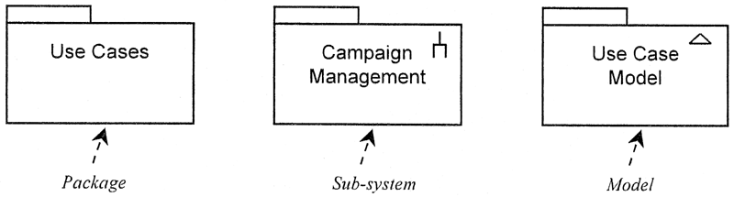
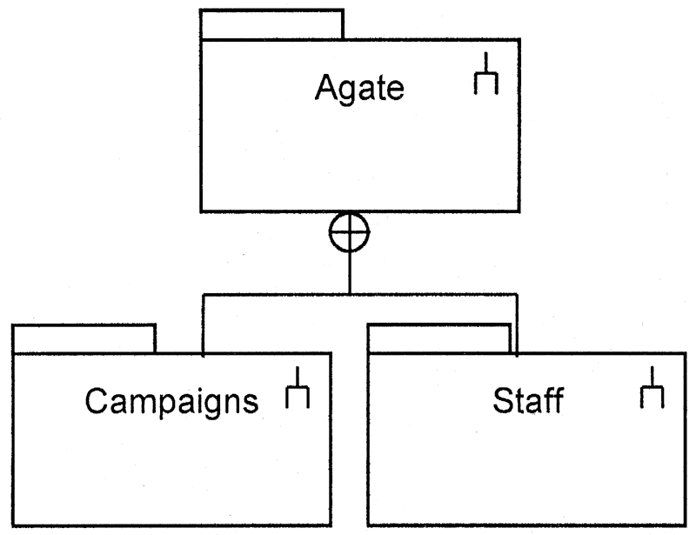
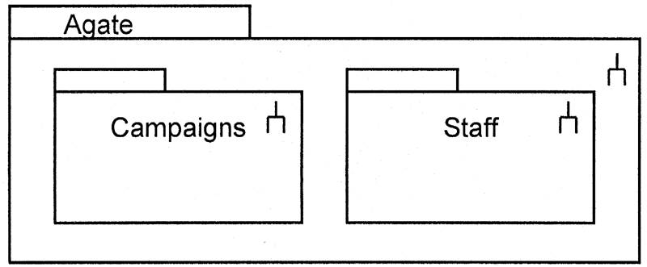
Package notation
2 alternatives for showing package containment:

Slide 23
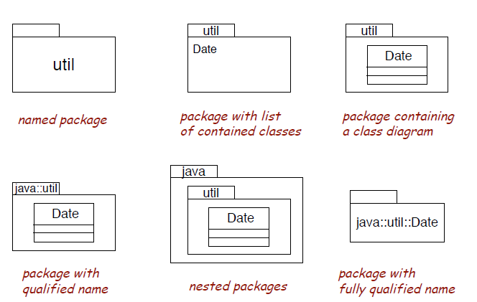
Package notation

Slide 24
Package Diagrams
Dependencies:
  Similar to compilation dependencies
  Captures a high-level view of coupling between packages:
    If you change a class in one package, you may have to change something in packages that depend on it
A good architecture minimizes dependencies
  Fewer dependencies means lower coupling
  Dependency cycles are especially undesirable
Persons
Constraints
Meetings
dependency
(read as “depends on”)

Slide 25
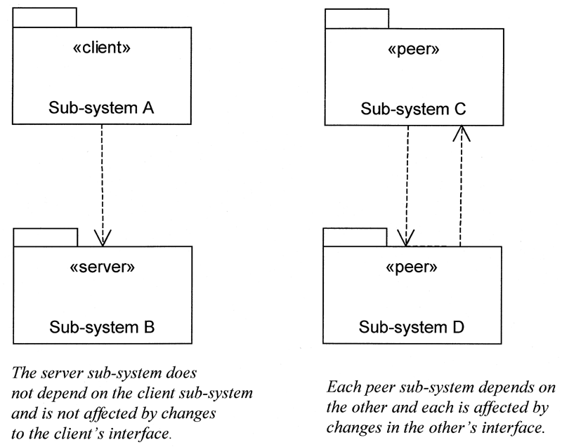
…Dependency Cycles

Slide 26
Architectural Patterns
E.g. 3 layer
architecture:
Presentation Layer Package
Application
Windows
Java AWT
Presentation
Layer
Application Logic Layer Package
Application
Logic Layer
Control
Objects
Storage
Layer
Business
Objects
Storage Layer Package
JDBC
Object to
Relational
Java SQL

Slide 27
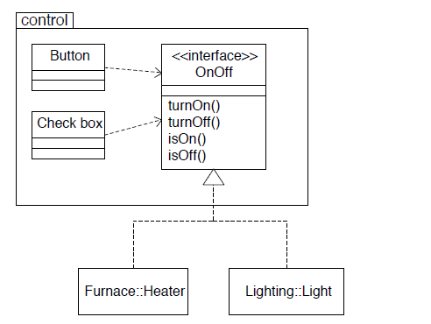
Towards component-based design

Slide 28

Software Architectures
Architectural Styles
  Pipe and filter
  Object oriented:
    Client-Server; Object Broker
  Event based
  Layered:
    Designing Layered Architectures
  Repositories:
    Blackboard, MVC
  Process control

Slide 29
Pipe-and-filter
Source: Adapted from Shaw & Garlan 1996, p21-2. See also van Vliet, 1999 Pp266-7 and p279
pipe
pipe
filter
filter
pipe
filter
pipe
filter
pipe
pipe
filter
pipe
pipe
filter
pipe
Examples:
  UNIX shell commands
  Compilers:
    Lexical Analysis -> parsing -> semantic analysis -> code generation
  Signal Processing
Interesting properties:
  filters don’t need to know anything about what they are connected to
  filters can be implemented in parallel
  behaviour of the system is the composition of behaviour of the filters
    specialized analysis such as throughput and deadlock analysis is possible

Slide 30
Object Oriented Architectures
Source: Adapted from Shaw & Garlan 1996, p22-3.
method
invocation
object
method
invocation
object
object
object
method
invocation
object
method
invocation
Examples:
  abstract data types
Interesting properties
  data hiding (internal data representations are not visible to clients)
  can decompose problems into sets of interacting agents
  can be multi-threaded or single thread
Disadvantages
  objects must know the identity of objects they wish to interact with

Slide 31
Variant 1: Client Server
client
client
method
invocation
client
method
invocation
method
invocation
Server
Interesting properties
  Is a special case of the previous pattern object oriented architecture
  Clients do not need to know about one another
Disadvantages
  Client objects must know the identity of the server

Slide 32
Variant 2: Object Brokers
client
server
client
server
broker
client
Interesting properties
  Adds a broker between the clients and servers
  Clients no longer need to know which server they are using
  Can have many brokers, many servers.
Disadvantages
  Broker can become a bottleneck
  Degraded performance

Slide 33
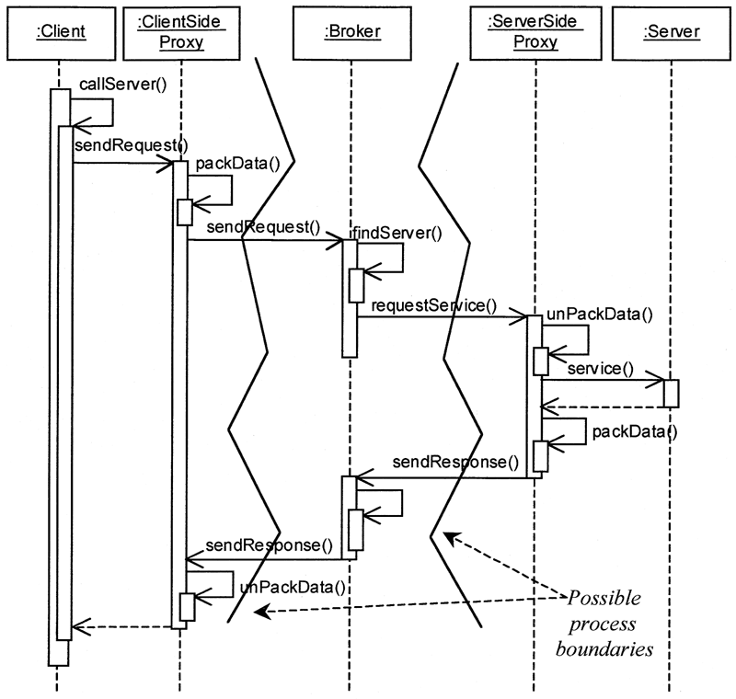
Broker Architecture Example

Slide 34
Event based (implicit invocation)
Source: Adapted from Shaw & Garlan 1996, p23-4. See also van Vliet, 1999 Pp264-5 and p278
announce
event
agent
agent
broadcast
medium
listen for
event
broadcast
medium
agent
listen for
event
announce
event
agent
Examples
  debugging systems (listen for particular breakpoints)
  database management systems (for data integrity checking)
  graphical user interfaces
Interesting properties
  announcers of events don’t need to know who will handle the event
  Supports re-use, and evolution of systems (add new agents easily)
Disadvantages
  Components have no control over ordering of computations

Slide 35
Layered Systems
Source: Adapted from Shaw & Garlan 1996, p25. See also van Vliet, 1999, p281.
application layer
kernal
utilities
users
kernal
Examples
  Operating Systems
  communication protocols
Interesting properties
  Support increasing levels of abstraction during design
  Support enhancement (add functionality) and re-use
  can define standard layer interfaces
Disadvantages
  May not be able to identify (clean) layers

Slide 36
Variant: 3-layer data access
Presentation layer
Java
AWT
Appl’n
Views
Application Logic layer
Contol
objects
Business
logic
Storage layer
DBMS
Query
Engine
File
Mgmnt

Slide 37
Open vs. Closed Layered Architecture
closed architecture
  each layer only uses services of the layer immediately below;
  Minimizes dependencies between layers and reduces the impact of a change.
open architecture
  a layer can use services from any lower layer.
  More compact code, as the services of lower layers can be accessed directly
  Breaks the encapsulation of layers, so increase dependencies between layers
Layer N
Layer N-1
Layer 2
Layer 1
Layer N
Layer N-1
Layer 2
Layer 1

Slide 38
How many layers?
2-layers:
  application layer
  database layer
  e.g. simple client-server model
3-layers:
  separate out the business logic
    helps to make both user interface and database layers modifiable
4-layers:
  Separates applications from the domain entities that they use:
    boundary classes in presentation layer
    control classes in application layer
    entity classes in domain layer
Partitioned 4-layers
  identify separate applications
Application (client)
Database (server)
Presentation layer (user interface)
Business Logic
Database
Presentation layer (user interface)
Applications
Domain Entities
Database
UI1 UI2 UI3 UI4
App1 App2 App3 App4
Domain Entities
Database

Slide 39
Repositories
Source: Adapted from Shaw & Garlan 1996, p26-7. See also van Vliet, 1999, p280
agent
agent
blackboard
(shared
data)
agent
agent
agent
agent
Examples
  databases
  blackboard expert systems
  programming environments
Interesting properties
  can choose where the locus of control is (agents, blackboard, both)
  reduce the need to duplicate complex data
Disadvantages
  blackboard becomes a bottleneck

Slide 40
Variant: Model-View-Controller
view
view
propagate
propagate
access
access
controller
controller
model
update
update
Properties
  One central model, many views (viewers)
  Each view has an associated controller
  The controller handles updates from the user of the view
  Changes to the model are propagated to all the views

Slide 41
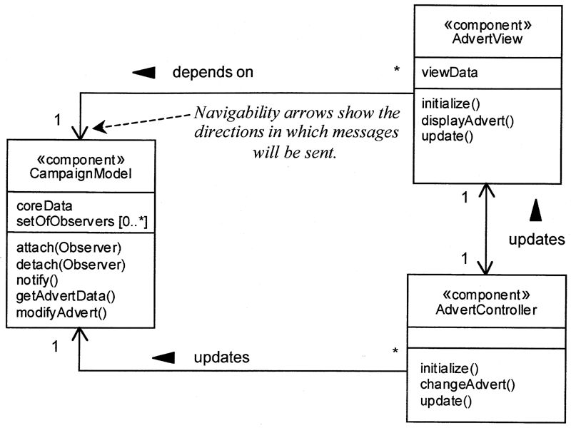
Model View Controller Example

Slide 42
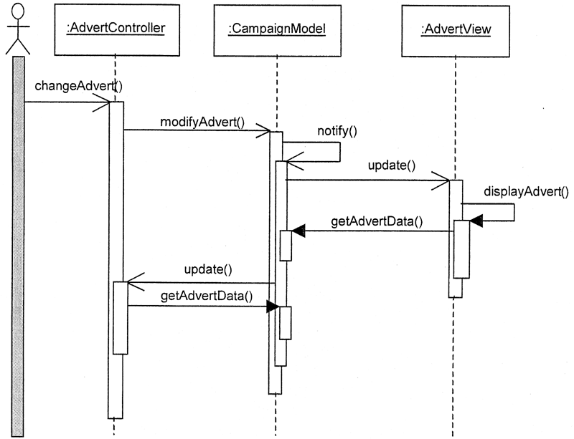
MVC Component Interaction

Slide 43
Process Control
Source: Adapted from Shaw & Garlan 1996, p27-31.
input variables
sensors
control
parameters
controller
manipulated
variables
process
controlled
variables
actuators
Examples
  aircraft/spacecraft flight control systems
  controllers for industrial production lines, power stations, etc.
  chemical engineering
Interesting properties
  separates control policy from the controlled process
  handles real-time, reactive computations
Disadvantages
  Difficult to specify the timing characteristics and response to disturbances

Slide 44
验证非功能性需求
The Architecture Tradeoff Analysis Method
清华大学软件学院 刘璘

Slide 45
Why evaluate an Architecture ?
All design involves tradeoffs
A software architecture is the earliest life-cycle artifact that embodies significant design decisions: choices and tradeoffs
The ATAM^{(sm)} is a service marked product of the Software Engineering Institute of Carnegie Mellon University
http://www.sei.cmu.edu/ata/ata_method.html

Slide 46
Purpose of the ATAM
To assess the consequences of architectural decision tradeoffs in the light of quality attribute requirements
  Discover Risks
    Alternatives that might create problems in some future quality attribute
  Discover Sensitivity Points
    Alternatives for which a slight change makes a big difference in some quality attribute
  Discover Tradeoffs
    Decisions affecting more than one quality attribute
The point of the ATAM analysis is not to provide precise analysis ---- rather discover risks created by architectural decisions

Slide 47
Purpose of the ATAM cont’d
Discover trends – the correlation between architectural decisions and predictions of system properties
Discovered risks and then be made subjects of mitigation activities:
    FURTHER DESIGN
    FURTHER ANALYSIS
    PROTOTYPING

Slide 48
Quality Attributes
The ATAM focuses on quality attribute requirements. Therefore, it is critical to have precise characterizations for each quality attribute.
Quality attribute characterizations answer the following questions about each attribute:
  What are the stimuli to which the architecture must respond?
  What is the measurable or observable manifestation of the quality attribute by which its achievement is judged?
  What are the key architectural decisions that impact achieving the attribute requirement?

Slide 49
ATAM Steps
1. Present ATAM
2. Present business drivers
3. Present architecture
4. Identify architectural styles
5. Generate quality attribute utility tree
6. Elicit and analyze architectural styles
7. Generate seed scenarios
8. Brainstorm and prioritize scenarios
9. Map scenarios onto styles
10. Present out-brief and/or write report

Slide 50
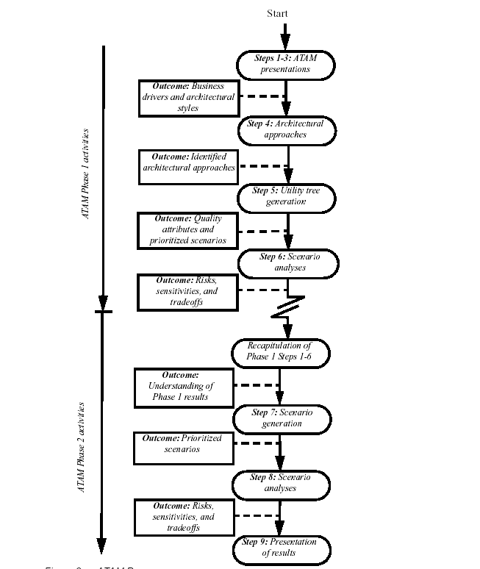

Slide 51
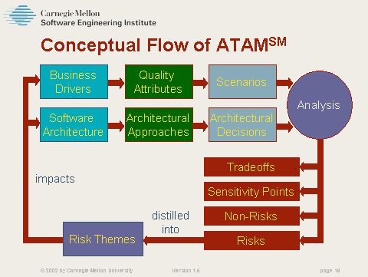

Slide 52
Step 1. Present ATAM
Evaluation team presents an overview of ATAM including:
  ATAM steps in brief
  techniques
    utility tree generation
    style-based elicitation/analysis
    scenario brainstorming/mapping
  outputs
    scenarios
    architectural styles
    quality attribute questions
    risks and “non-risks”
    utility tree

Slide 53
Step 2 Present Business Drivers
ATAM customer representative describes the system’s business drivers including:
  business context for the system
  high-level functional requirements
  high-level quality attribute requirements
    architectural drivers: quality attributes that “shape” the architecture
    critical requirements: quality attributes most central to system
  Major stakeholders
  Any relevant technical, political, economic or managerial constraints

Slide 54
Step 3 Present Architecture
Architect presents an overview of the architecture including:
  Driving architectural requirements and any existing standards/models approaches
  High level architectural views
    Functional – Key abstractions. Domain elements and or data flows
    Decomposition
    Concurrency, flows, events
    Physical (deployment)
  Architectural styles, mechanisms employed and how they address quality attributes
  Use of COTS
  Trace of most important scenarios
  Trace of most important growth scenarios
  Architectural issues
Evaluation team begins probing for:
  risks
  architectural styles

Slide 55
Step 4 Identify Architectural Styles
High-level overview of architecture is completed by itemizing architectural styles found in the architecture.
Examples:
  client-server
  3-tier
  pipeline
  publisher-subscriber

Slide 56
Step 5 Generate Quality Attribute Utility Tree
Identify, prioritize and refine the most important quality attribute goals by building a utility tree.
  a utility tree is an AHP (analytic hierarchy process)-like model of the “driving” attribute-specific requirements
  typically performance, modifiability, security, and availability are the high-level nodes
  scenarios are leaves of utility tree
Output: a prioritization of specific quality attribute requirements.

Slide 57
Quality Attribute Goals
In Step 5, the participants identify, prioritize, and refine the most important quality attribute goals by building a utility tree.
  A utility tree is a top-down vehicle for characterizing the “driving” attribute-specific requirements. The most important quality goals are the high-level nodes
    typically
      performance,
      modifiability,
      security,
      and availability.
    Scenarios are the leaves of the utility tree,
    Scenarios are used to represent stakeholders’ interests and should cover a range of anticipated
      uses of the system (use case scenarios),
      anticipated changes to the system (growth scenarios),
      or unanticipated stresses to the system (exploratory scenarios).
A good scenario clearly indicates
  which stimulus causes it and what responses are important.
During scenario prioritization, scenarios are categorized by two parameters,
  importance and
  difficulty,
  using a scale of
    Low (L)
    Medium (M)
    -High (H).

Slide 58
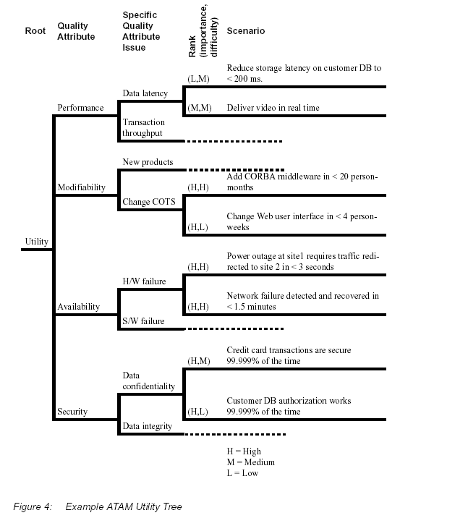

Slide 59
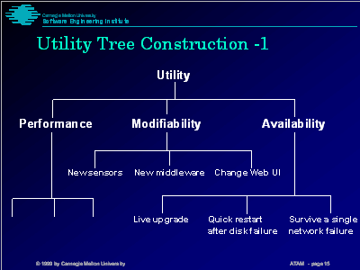

Slide 60
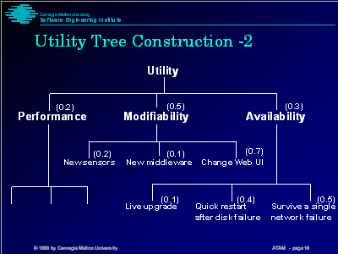

Slide 61
Step 6 Elicit and Analyze Architecture Styles
6. Evaluation team probes architectural styles from the point of view of specific quality attributes to identify risks.
  Identify the styles which pertain to the highest priority quality attribute requirements
  Generate quality-attribute specific questions for highest priority quality attribute requirement
  Ask quality-attribute specific questions
  Identify and record risks and non-risks

Slide 62
Categories
Each quality attribute characterization is divided into three categories:
  external stimuli,
  environment,
  and responses.
External stimuli (or just stimuli for short) are the events that cause the architecture to respond or change.
  What the stakeholder does to initiate interaction; invoke a function, request a change, etc.
Environment what’s going on at the time of the stimulus – what is the system state, heavily loaded? A processor down? – under “normal conditions” not described
Responses – how the system responds to the stimulus; is the function successful? Does reconfiguration happen?

Slide 63
Example Scenarios
Use case
  Remote user comes via the web to access report database.
Growth scenario
  Add a new data server to reduce latency by 50%.
Exploratory scenario
  Half of the servers go down during operation.
=> Scenarios should be as specific as possible.

Slide 64
Quality Attribute Questions
Quality attribute questions probe styles to elicit architectural decisions which bear on quality attribute requirements.
Performance
  How are priorities assigned to processes?
  What are the message arrival rates?
Modifiability
  Are there any places where layers/facades are circumvented ?
  What components rely on detailed knowledge of message formats?

Slide 65
Risks and Non-Risks
Risks are potentially problematic architectural decisions,
Non-risks are good decisions relying on implicit assumptions.
Risk and non-risk constituents
  architectural decision
  quality attribute requirement
  rationale
Sensitivity points – a property of one or more components that is critical for achieving a particular quality attribute
  Example level of confidentiality sensitive to the number of bits of encryption
Tradeoff points – a property that affects more than one attribute and is a sensitivity point for more than one attribute
  Example changing level of encryption could have an effect on both security and performance
Sensitivity points are candidate risks and risks are candidate tradeoff points.

Slide 66
Step 7 Generate Seed Scenarios
Scenarios are used to
  Represent stakeholders’ interests
  Understand quality attribute requirements
Seed scenarios are sample scenarios
Scenarios are specific,
  anticipated uses of (use cases),
  anticipated changes to (growth scenarios), or
  unanticipated stresses (exploratory) to the system.

Slide 67
Step 8 Brainstorm and Prioritize Scenarios
Stakeholders generate scenarios using a brainstorming process.
Each stakeholder is allocated a number of votes roughly equal to 30% of the scenarios
Prioritized scenarios are compared with the utility tree and differences are reconciled.

Slide 68
Step 9 Map Scenarios onto Styles
Identify styles and components within styles impacted by each scenario.
Continue identifying risks and non-risks.
Continue annotating architectural information.

Slide 69
Step 10 Present Out-Brief/Write Report
Recapitulate steps of ATAM
Present ATAM outputs
  styles
  scenarios
  questions
  utility tree
  risks
  non-risks
Offer recommendations

Slide 70
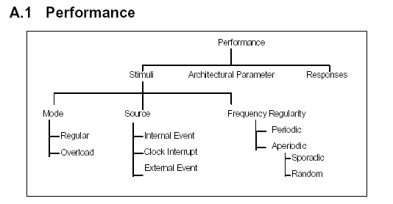
Attribute Characteristics

Slide 71
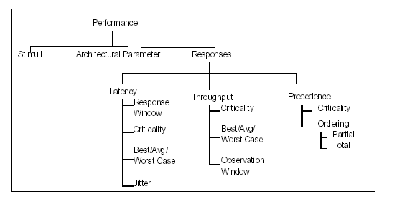
Attribute Characteristics

Slide 72
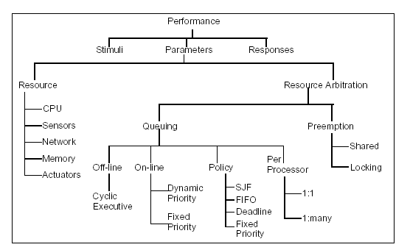
Attribute Characteristics

Slide 73
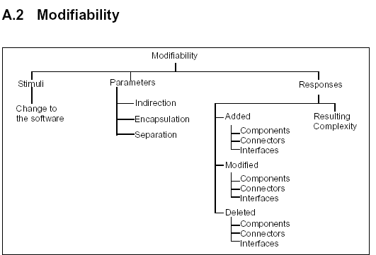
Attribute Characteristics

Slide 74
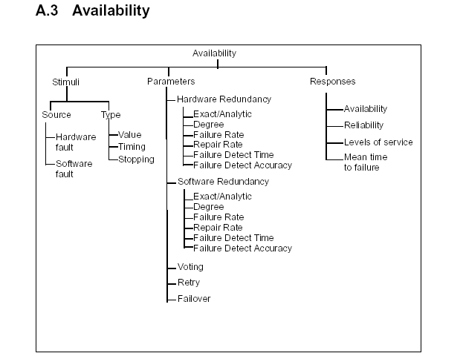
Attribute Characteristics

Slide 75
Summary
ATAM is a method for evaluating an architecture with respect to multiple quality attributes.
It is an effective risk mitigation strategy to avoid the disastrous consequences of a poor architecture. ATAM:
  can be done early
  requires stakeholder participation
The key to the method is looking for trends, not in making precise analyses.
ATAM relies crucially on:
  Clearly-articulated quality attribute requirements
  Active stakeholder participation
  Active participation by the architect
  Familiarity with architecture styles and quality attribute models

Slide 76
Summary of Benefits
Gets all stakeholders in same room again
Forces articulation of specific quality goals (NFR’s)
Sets early design goals
Results in prioritization of conflicting goals
Improves the quality of the architecture documentation
Uncovers opportunities for cross project reuse
More explicit presentation of the architecture

