Slide 1

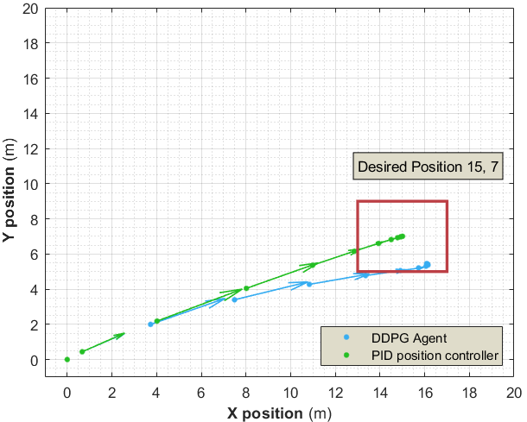
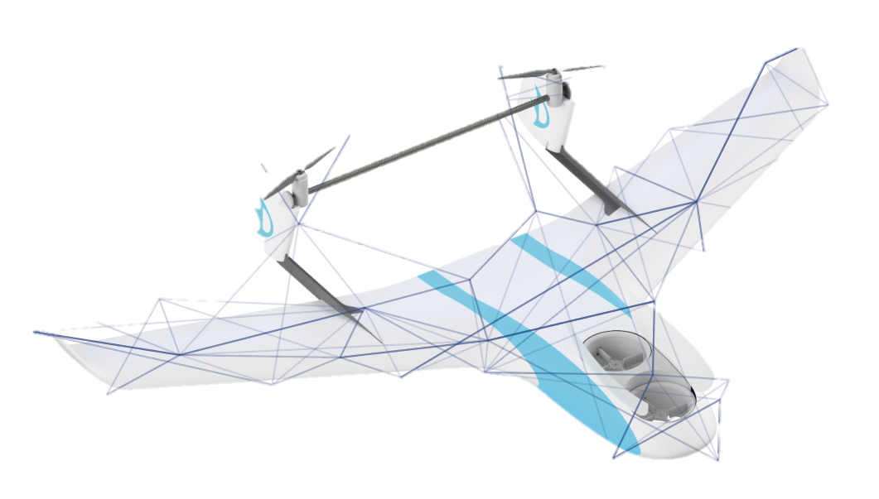
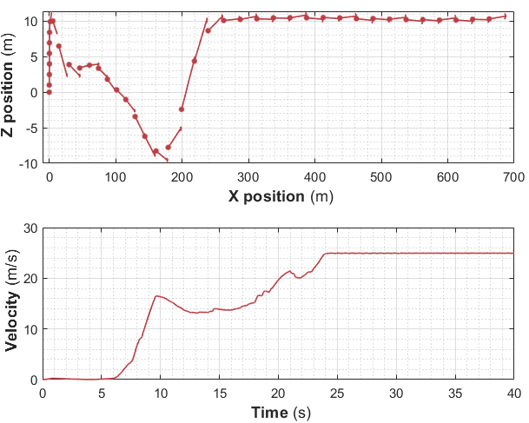
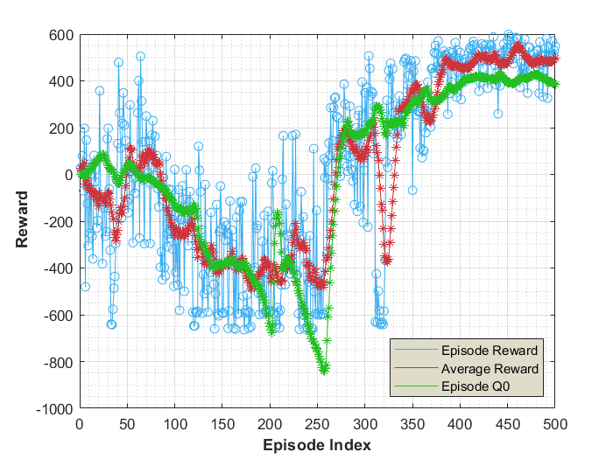
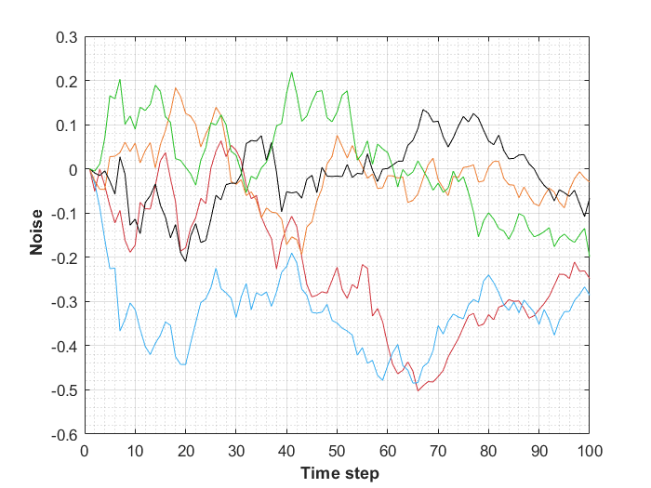
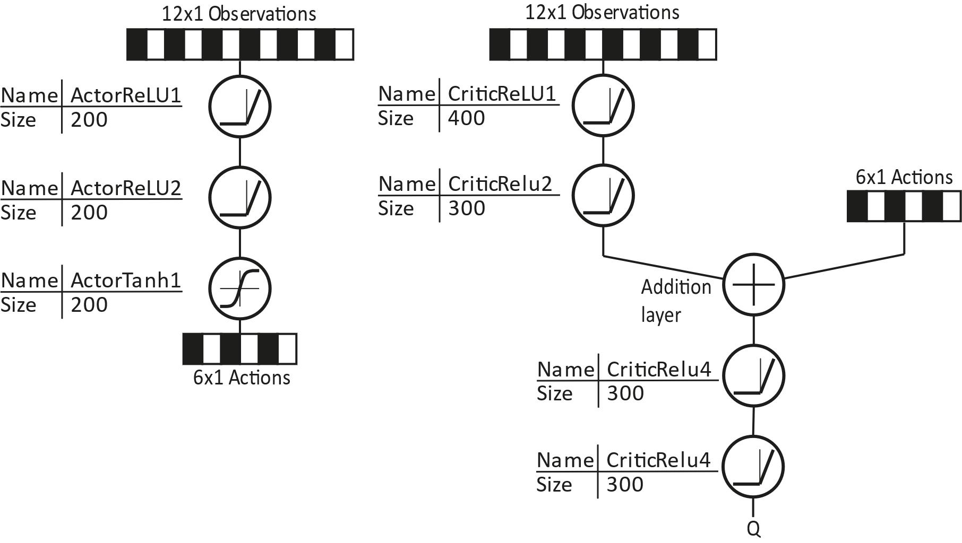
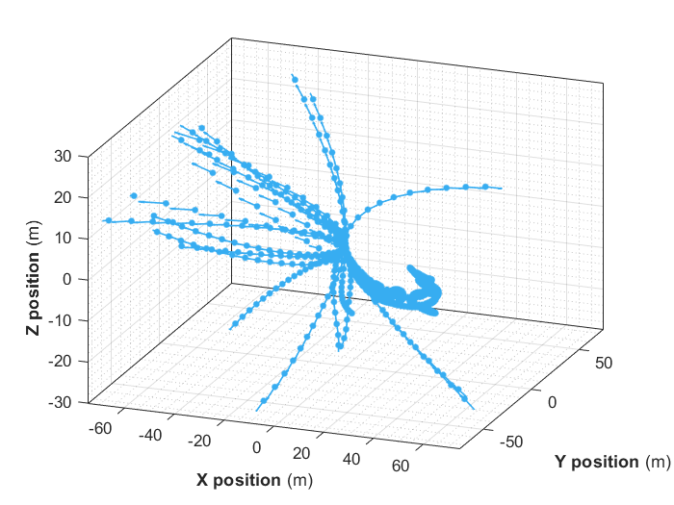
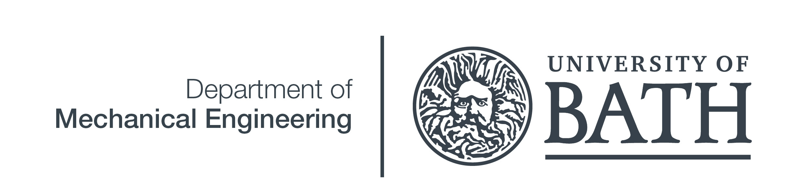
Michael Morris
Deep Reinforcement Learning for UAV Control
Supervisor: Dr P. Iravani
Project Outline
VTOL aircraft are capable of fast forward flight and precise low speed manoeuvring. Artificial intelligence provides a novel way of learning an aircraft’s characteristics and controlling it despite their complex flight modes. Reinforcement learning was used as to control the aircraft through its transition between vertical and horizontal flight using modern Artificial Intelligence (AI) techniques.
Forward Planning
Simulation
A full flight dynamics model and flight controller model were created. The goal of the AI is to act as the pilot, providing suitable controller inputs.
When attempting to fly to a goal the agent learns plans ahead and slows down before it gets there. This behaviour is learnt rather than being programmed in
Reinforcement Learning
An agent interacts with an environment and receives a reward based on its performance. Over time it learns to maximise its reward. Many reinforcement learning algorithms were considered. Deep deterministic policy gradients was chosen as it uniquely works in continuous space
Transition
Training Progress
The agent learnt to accelerate the aircraft my flying downwards before pulling up when the aircraft was past its stall speed
The critic trains first (episode Q0) then when it has a good approximation of the reward function the actor starts to converge.
Exploration
Ornstein-Uhlenbeck noise is added to the actor to force exploration
Actor and Critic
Two neural networks control the agent. The ‘critic’ assesses the quality of the agents moves. The ‘actor’ creates actions based on the gradient of the expected quality of its actions.
Actor
Action
Through the training process the agent attempts to fly in many different directions while searching for an optimal solution
Q
Reward
Environment
Critic
State
REFERENCES: T. P. Lillicrap, J. J. Hunt, A. Pritzel, N. Heess, T. Erez, Y. Tassa, D. Silver and D. Wierstra, “Continuous control with deep reinforcement learning,” CoRR, vol. abs/1509.02971, 2016.
Background: Freepik.com
MEng Integrated Mechanical and Electrical Engineering
Academic Year 2018/19

