Slide 1
UCDs & DMs
Use Case Diagrams &
Domain Models
Are artifacts of requirements specification

Slide 2
UCD
UCDs are used to represent the functionality of the system and the user classes entitled to perform that functionality.
They associate user classes with the system functionalities/features they may use.

Slide 3
UCD
A UCD is composed of:
A system boundary. A rectangle enclosing the system features/functionalities.
A number of functionalities drawn as ovals inside the system boundary and named for the use cases they represent.
Actors. Actors represent the user classes that may operate the system. They may be classes of people or other systems which access the system you are building.
Connectors. Lines drawn between Actors and the system functionalities that Actor can use.

Slide 4
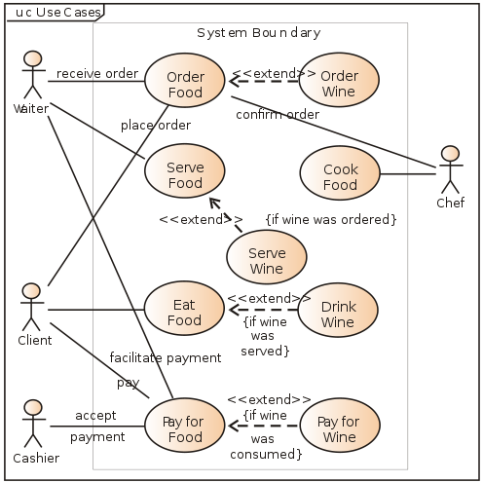
UCD source:http://en.wikipedia.org/wiki/Use_case_diagram
UCD

Slide 5
DMs
Domain Models represent our initial understanding of what conceptual classes are likely to be necessary to build the system.
They show these Domain Level Objects (DLOs) along with the associations between them.

Slide 6
DLOs
Domain Level Objects are depicted as Two box containers with the top box filled with the name of the DLO and the bottom box filled with the (untyped) attributes we think that DLO might need to perform the functions we believe it will need to perform.

Slide 7
Associations
Associations connect DLOs. They are composed of 3 main components.
A connector between two DLOs. If, and only if, this connection does not go left-to-right or top-to-bottom a directionality should be shown.
A name: an active verb describing the relationship between the connected DLOs.
Cardinalities: The multiplicity of the association should be depicted at both ends of the connector.

Slide 8
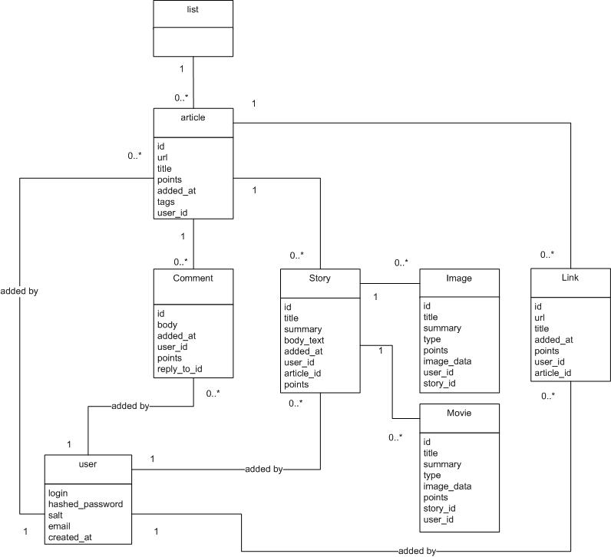
Domain Models source: http://nubyonrails.files.wordpress.com/2007/07/domain-model.jpg

Slide 9
DMs
Note that in the last slide some of the associations are unnamed. This is incorrect.
All associations should be named unless they are inheritance, composition or aggregation.
The above need not be named as they have specially drawn connectors.

