Slide 1
UCDs & DMs
Use Case Diagrams &
Domain Models
Are artifacts of requirements specification

Slide 2
UCD
UCDs are used to represent the functionality of the system and the user classes entitled to perform that functionality.
They associate user classes with the system functionalities/features they may use.

Slide 3
UCD
A UCD is composed of:
A system boundary. A rectangle enclosing the system features/functionalities.
A number of functionalities drawn as ovals inside the system boundary and named for the use cases they represent.
Actors. Actors represent the user classes that may operate the system. They may be classes of people or other systems which access the system you are building.
Connectors. Lines drawn between Actors and the system functionalities that Actor can use.

Slide 4
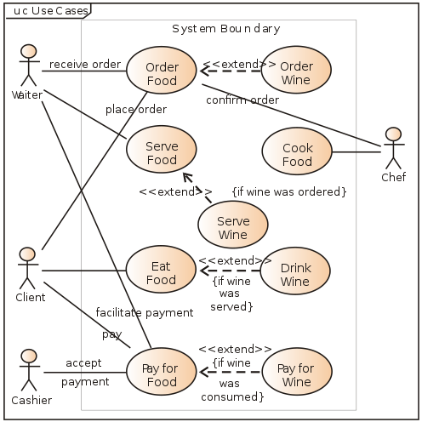
UCD source:http://en.wikipedia.org/wiki/Use_case_diagram
UCD

Slide 5
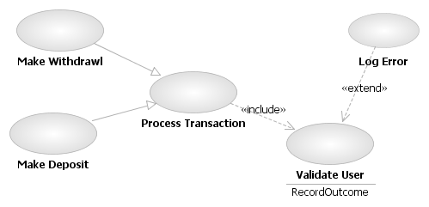
Use Case Relationships from: http://en.wikipedia.org/wiki/Use_case_diagram

Slide 6
Use Case Relationships
Four relationships among use cases are used often in practice.
Include
In one form of interaction, a given use case may include another. "Include is a Directed Relationship between two use cases, implying that the behavior of the included use case is inserted into the behavior of the including use case".
The first use case often depends on the outcome of the included use case. This is useful for extracting truly common behaviors from multiple use cases into a single description. The notation is a dashed arrow from the including to the included use case, with the label "«include»". This usage resembles a macro expansion where the included use case behavior is placed inline in the base use case behavior. There are no parameters or return values. To specify the location in a flow of events in which the base use case includes the behavior of another, you simply write include followed by the name of use case you want to include.
From: http://en.wikipedia.org/wiki/Use_case_diagram

Slide 7
Use Case Relationships
Four relationships among use cases are used often in practice.
Extend
In another form of interaction, a given use case (the extension) may extend another. The relationship indicates that the behavior of the extension use case may be inserted in the extended use case under some conditions. The notation is a dashed arrow from the extension to the extended use case, with the label "«extend»". The notes or constraints may be associated with this relationship to illustrate the conditions under which this behavior will be executed.
Modelers use the «extend» relationship to indicate use cases that are "optional" to the base use case. Depending on the modeler's approach "optional" may mean "potentially not executed with the base use case" or it may mean "not required to achieve the base use case goal".
From: http://en.wikipedia.org/wiki/Use_case_diagram

Slide 8
Use Case Relationships
Four relationships among use cases are used often in practice.
Generalization
In the third form of relationship among use cases, a generalization/specialization relationship exists. A given use case may have common behaviors, requirements, constraints, and assumptions with a more general use case. In this case, describe them once, and deal with it in the same way, describing any differences in the specialized cases. The notation is a solid line ending in a hollow triangle drawn from the specialized to the more general use case (following the standard generalization notation)
From: http://en.wikipedia.org/wiki/Use_case_diagram

Slide 9
Use Case Relationships
Four relationships among use cases are used often in practice.
Associations
Associations between actors and use cases are indicated in use case diagrams by solid lines. An association exists whenever an actor is involved with an interaction described by a use case. Associations are modeled as lines connecting use cases and actors to one another, with an optional arrowhead on one end of the line. The arrowhead is often used to indicate the direction of the initial invocation of the relationship or to indicate the primary actor within the use case. The arrowheads imply control flow and should not be confused with data flow.
From: http://en.wikipedia.org/wiki/Use_case_diagram

Slide 10
DM Overview
The domain model is created in order to represent the vocabulary and key concepts of the problem domain. The domain model also identifies the relationships among all the entities within the scope of the problem domain, and commonly identifies their attributes. A domain model that encapsulates methods within the entities is more properly associated with object oriented models. The domain model provides a static, structural view of the domain that can be complemented by other dynamic views, such as Use Case models.
An important advantage of a domain model is that it describes and constrains the scope of the problem domain. The domain model can be effectively used to verify and validate the understanding of the problem domain among various stakeholders. It is especially helpful as a communication tool and a focusing point both amongst the different members of the business team as well as between the technical and business teams.
From: http://en.wikipedia.org/wiki/Domain_model

Slide 11
DMs
Domain Models represent our initial understanding of what conceptual classes are likely to be necessary to build the system.
They show these Domain Level Objects (DLOs) along with the associations between them.

Slide 12
DLOs
Domain Level Objects (DLOs) are depicted as Two box containers with the top box filled with the name of the DLO and the bottom box filled with the (untyped) attributes we think that DLO might need to perform the functions we believe it will need to perform.

Slide 13
Associations
Associations connect DLOs. They are composed of 3 main components.
A connector between two DLOs. If, and only if, this connection does not go left-to-right or top-to-bottom a directionality (open arrowhead) should be shown.
A name: an active verb describing the relationship between the connected DLOs.
Cardinalities: The multiplicity of the association should be depicted at both ends of the connector.

Slide 14
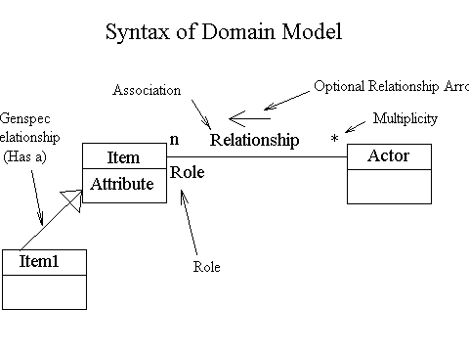
Domain Model Syntax
From: http://www.comptechdoc.org/independent/uml/begin/umldomainmodel.html

Slide 15
Domain Model Elements
There can be multiple relationships between objects in the domain model. For instance an object may handle a single transaction, then make a record of all transactions it handles. In the domain model the following are shown:
Concepts (Objects)
Attributes of Objects - Attributes must be simple attributes such as numbers. They cannot be objects, dimensioned numbers, or keys to part of a database.
Association between objects
Multiplicity
Optional direction of relationship arrow
Optional role of object
From:http://www.comptechdoc.org/independent/uml/begin/umldomainmodel.html

Slide 16
DLOs
Identify with noun analysis of requirements and use cases.
Domain Model Candidates:
Your Corporation has
multiple plants has
multiple departments has
multiple machines
From: http://www.comptechdoc.org/independent/uml/begin/umldomainmodel.html

Slide 17
Associations
Associations describe important relationships between concepts and may be bidirectional. Use an association to relate classes, not attributes. Some associations may be:
A is a part of B
line item of
Contained inside
Is a member of
Is a policy of
Is next to
Uses
Communicates with
A relates to B due to a transaction
When creating associations, ask yourself, "Does one need to know about the other?". If the answer is yes, there should probably be an association. There may be more than one association between two objects.
From: http://www.comptechdoc.org/independent/uml/begin/umldomainmodel.html

Slide 18
Multiplicity
Describes how many instances of one concept can be associated with one instance of the related concept.
* = Zero or more
0..3 = Zero to three
2,4,6 = Two, four, or six
10 = Exactly 10
1..* = One or more
0..* = Zero or more
From: http://www.comptechdoc.org/independent/uml/begin/umldomainmodel.html

Slide 19
Some Guidelines
Put items up in this order:
  Concepts
  Label associations
  Types on attributes
If concepts have both data (attributes) and behavior (methods) they more likely fit in the domain model (though the methods are not shown in the DM).
Analyze items that may have additional types.
From: http://www.comptechdoc.org/independent/uml/begin/umldomainmodel.html

Slide 20
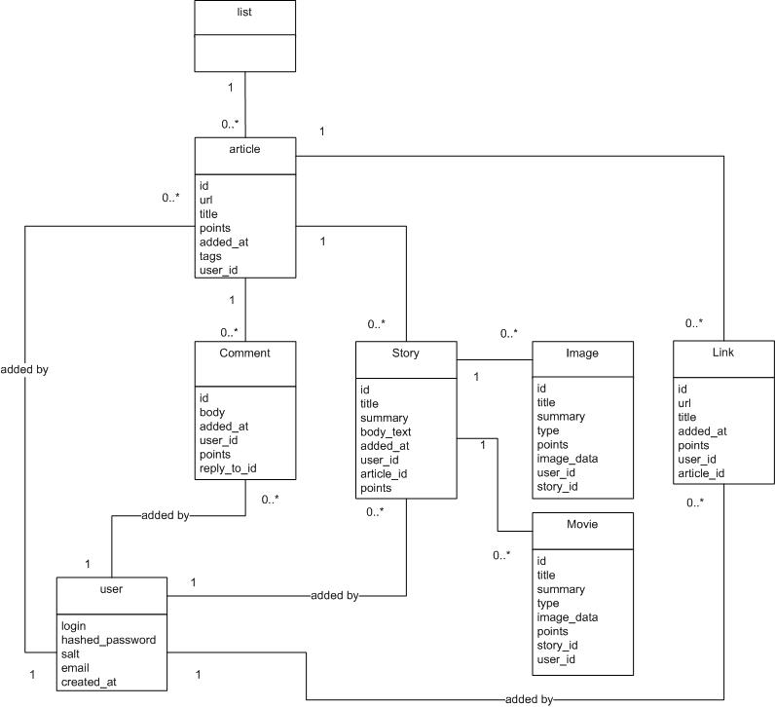
Domain Models source: http://nubyonrails.files.wordpress.com/2007/07/domain-model.jpg

Slide 21
DMs
Note that in the last slide some of the associations are unnamed. This is incorrect.
All associations should be named unless they are inheritance, composition or aggregation.
The above need not be named as they have specially drawn connectors which contain within their very definition the nature of their association.

