Slide 1

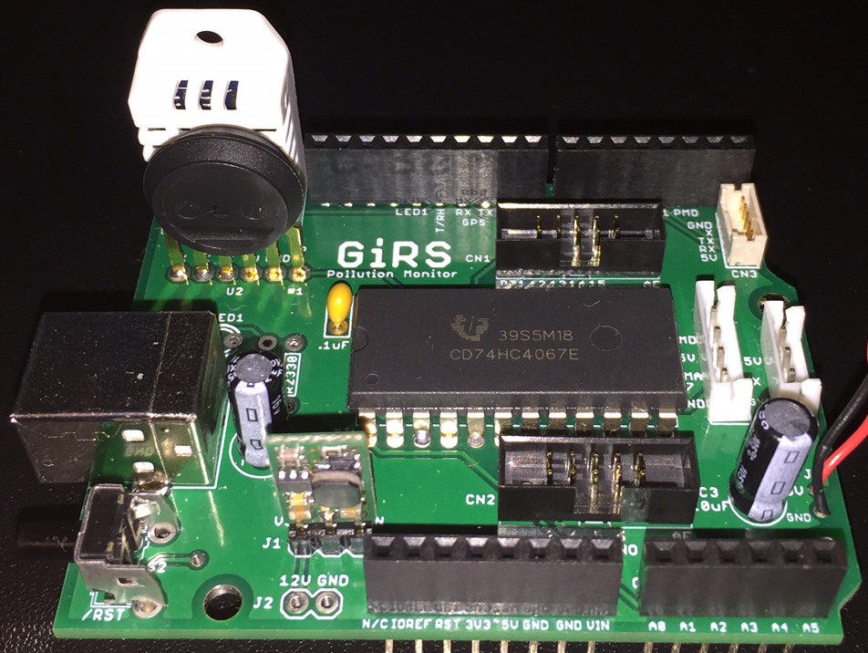
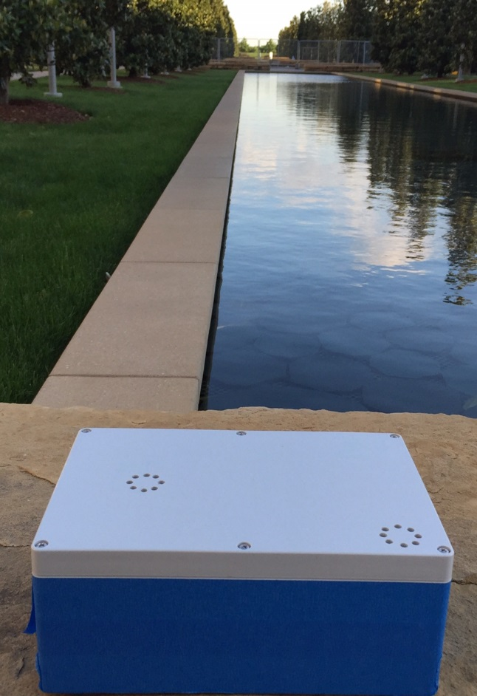
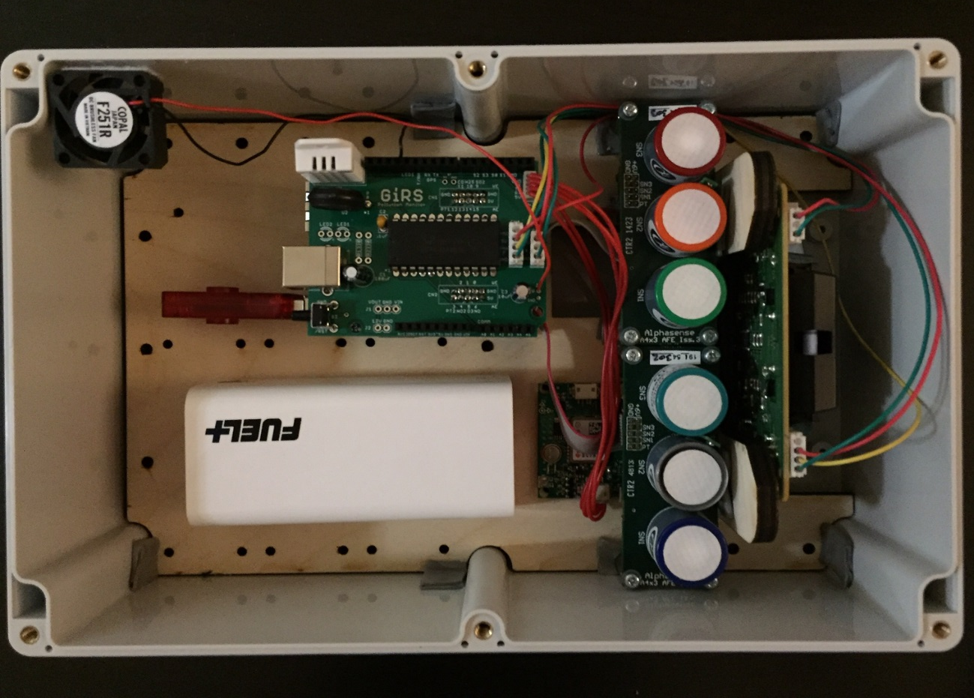
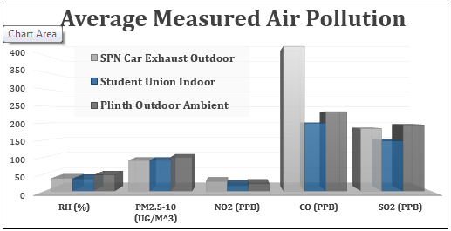
Compact Sensor Node for Localized Air Quality Monitoring
Global Intelligent Remote Sensing
Erik Jonsson School of Engineering & Computer Science
The University of Texas at Dallas
UTDesign II: Spring 2015
Mentors: Trey Kasling, Dr. David Lary,
Dr. Lawrence Overzet
Marshall McCracken (EE), André Rosete (CE), Erick Flores (EE), Paul Winkler (EE)
Marshall.McCracken@utdallas.edu, Andre.Rosete@utdallas.edu, Erick.Flores@utdallas.edu, Paul.Winkler@utdallas.edu
Background
World Health Organization: Air pollution exposure responsible for 1 in 8 global deaths
According to the World Health Organization (WHO), exposure to air pollution has been linked to significant health issues such as cardiovascular disease and cancer leading to “7 million… global deaths” in 2012, making air pollution “the world’s single largest environmental health risk” [WHO, 7 Million Premature Deaths Annually Linked to Air Pollution, (2012)].
Problem
What’s in the air you breathe every day?
Traditional pollution monitoring stations are remotely located and sparsely placed due to their size and deployment costs. These station networks provide little information to the public about outdoor air pollution in their immediate surroundings and reveal nothing about indoor air quality. To make health decisions regarding pollution exposure, one needs data about the air nearby rather than the air miles away.
Objectives
Compact; to facilitate indoor placement
Low cost; to allow for a more dense network of monitors
Relevant data; including date/time, location, weather and pollution statistics
Customizable; to enable future development and additional sensors
Connectivity; for data transmission and IoT applications
Hardware Design
Figure 1: Block Diagram
SDII Goal: Design PCB to decrease size of prototype concept proven in Senior Design I while allowing for customization and development, on platform supporting Wi-Fi, Ethernet, and storage
Air Quality Sensors: particulate matter (PM2.5 - 10 µg), CO, O₃, NO, NO₂, SO₂, and H₂S sensors; temperature, pressure and humidity sensors
MCU: Atmega32U4 (28KB flash, 2.5 KB RAM) for polling sensors
Wi-Fi/Ethernet: AR9331 Wireless System on Chip (WiSoC) for transmitting data
Data Storage: SD card or flash drive for data storage
Software Design
SDII Goal: Develop program to get as many sensor readings as possible while simultaneously storing the data to a web database
Data collection implemented in C code, controlled by Atmega32U4
ADC: 10-bit, 4.9 mV resolution
Increasing accuracy: utilize internal bandgap voltage reference to back-calculate VCC (default AREF) to increase conversion accuracy
Watchdog: timer ensures program runs continuously
Results
System Testing Figure 2: Assembled PCB
Figures 3 & 4: System with Weather-Resistant Enclosure
Figure 5: System Test Results
Air Quality Sensors
MCU
Printed Circuit Board
Compact; custom PCB integrates all major components
Expandable; available input and
power ports built-in for addition of
new sensors for qualification
Flexible; compatible with many
Arduino development boards
Data Storage
GPS
Wi-Fi, Ethernet
Conclusions
The ability to monitor air quality data throughout a city, campus or personal route is essential to minimizing exposure to pollution. Our design collects data at a rate up to 1 Hz and is compact (under 250 in³) and low-cost (less than $1500 prototype cost) compared to traditional monitors, providing a basis for denser sensor networks. The design is also versatile, allowing for indoor and outdoor air quality monitoring as well as personal applications for route-planning and governmental/public applications such as smart city planning and pollution source identification.
Ethics Statement: We used only original designs and verified open-source software and hardware resources in the development of this project.
Organization
Marshall McCracken: PCB CAD Design Andre Rosete: Software Development
Erick Flores: Hardware Assembly Paul Winkler: Sensor Validation
Special Thanks To
Trey Kasling, Dr. David Lary, Dr. Lawrence Overzet and UTDesign Faculty and Staff

