Slide 1
Food Identification System
Omar Resendiz, Mariela Ramirez, Karthik Gopan, Jordan Rider, Chujie Guan

Slide 2

Mission Statement and Logo
Mission Statement:
“Identifying food items with high accuracy at low power.”
The Identifiers

Slide 3
Team Composition
Team Members:
Omar Resendiz - Team Lead
Karthik Gopan - Software Team Member
Jordan Rider - Software Team Member
Mariela Ramirez - Hardware Team Member
Chujie Guan - Hardware Team Member
Mentors:
UTD Mentor: Marco Tacca
Industry Mentor: Brian Rush (MAXIM)

Slide 4
Brief Description of Project Idea
Our project is a Machine Learning AI that can identify at least 10 different foods from camera footage. The project must be able to run on the MAX78000 MCU, utilizing the boards onboard CNN accelerator and VGA camera.

Slide 5
Scope of the Project
What will be done:
Create and train our own AI Neural Network with our own augmented dataset of food images
Synthesize the neural network and verify functionality
Run trained model on MAX78000FTHR board

Slide 6
Background, Context, and Impact
With important applications of image processing in the field of science and technology such as computer vision, face detection, augmented reality, X-rays, and Ultrasonic scanning, they all stand to benefit being able to operate on a low cost and power efficient board design. This project means to pave the way.
The board is primarily intended to be used for students and professionals to implement small-scale proof-of-concepts and early software development in the machine learning space, and to show that machine learning can be utilized on a small footprint device, with even the potential to run on battery power.
Anyone that wants to get started with machine learning will be able to use this device, and our project will be a great showcase for the capabilities it can possess, with it being one of the smallest boards with an onboard CNN.

Slide 7
Prior Attempts
There are already neural networks that exist to identify different food types, but there are none that work on the MAX78000 board, which is the key component of our project. Since the MAX78000 is such a low-power part compared to the much more powerful computers machine learning is normally ran on, this is the primary challenge we face as a team.

Slide 8
Deliverables List
A neural network trained on a custom dataset, augmented to increase the amount the images we train it on.
It being able run on the MAX78000 featherboard and also identify 10 different food types and output the result to either a display board or computer terminal.

Slide 9
Constraints and Requirements
The main constraint of this project is to work with the limited power of the Maxim board, and the requirements are to be able to identify at least 10 different foods from images taken from the camera on the board itself.

Slide 10
Performance Specifications
We are limited to an ARM Cortex M4F processor
Running at a max of 100 mHz
512 kB of flash memory
128 kB of SRAM
The camera onboard has a VGA resolution (640x480)
The board can handle images up to 180x180
The CNN accelerator has:
64 parallel processors
32 - 64 layers
Can handle weights of up to 432² kB

Slide 11
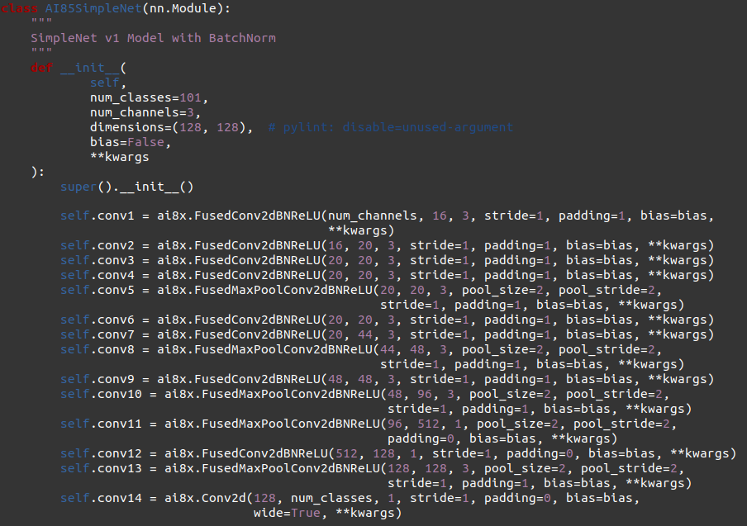
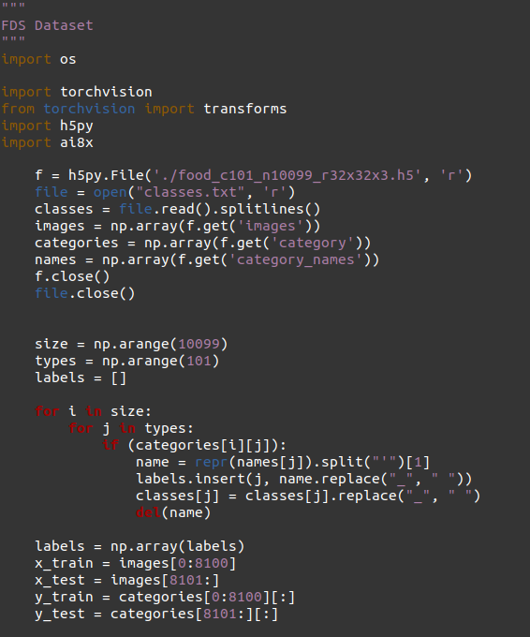
Preliminary Design of Concept
First iteration of Neural Network Model for project
First iteration of data loader

Slide 12
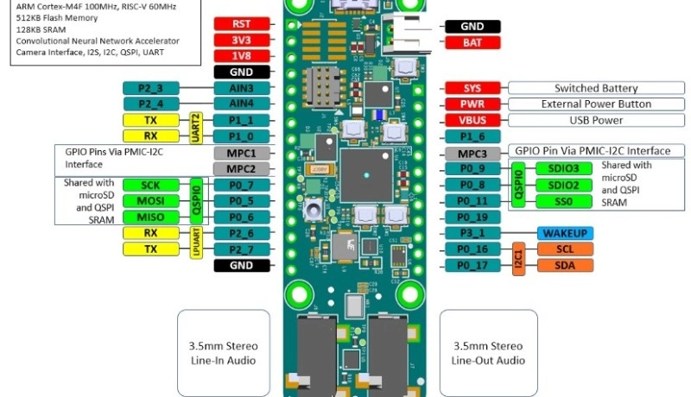
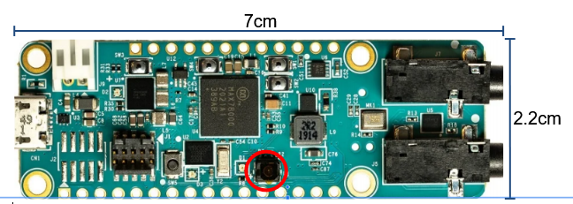
Detailed Working Diagram of the Project

Slide 13
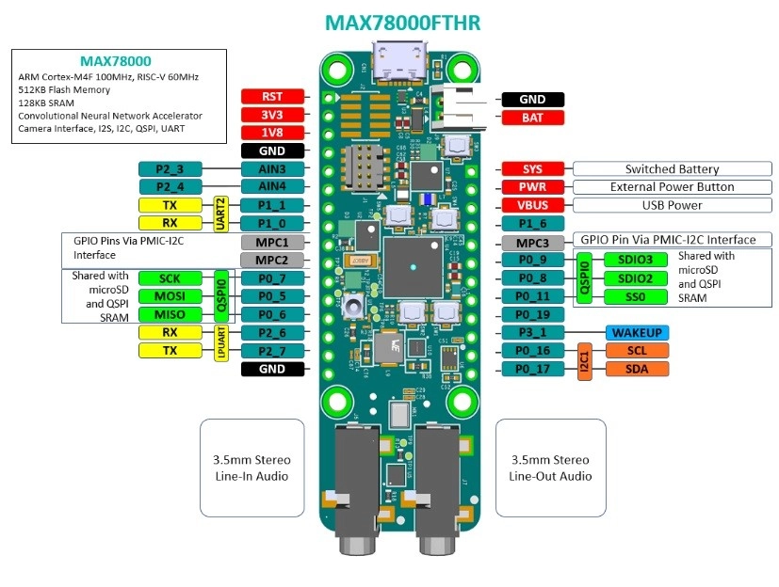
Diagram of the MAX78000

Slide 14
Task Distribution among Project Members
Omar Resendiz, Karthik Gopan, and Jordan Rider
Chujie Guan and Maribela Ramirez
Software Development Team
AI Neural Network Development
Data Augmentation
Hardware Development Team
Code Execution, Error Checking, Testing

Slide 15
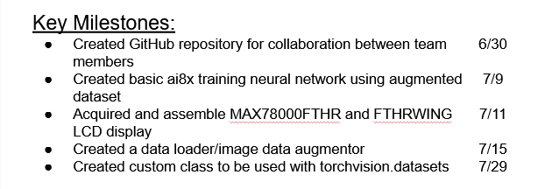
Project Timeline – Goals and Milestones

Slide 16
Challenges -
The code we are working off of is MAXIM proprietary code, it can be difficult to parse the code and modify it to actually work and this has been the primary roadblock for development. Since the board is so new, there are no beginner-grade tutorials that can teach us how to develop from scratch.
Many different software bugs that can be a hindrance for development, as well as needing a strong GPU to run code in a reasonable amount of time.

