Slide 1


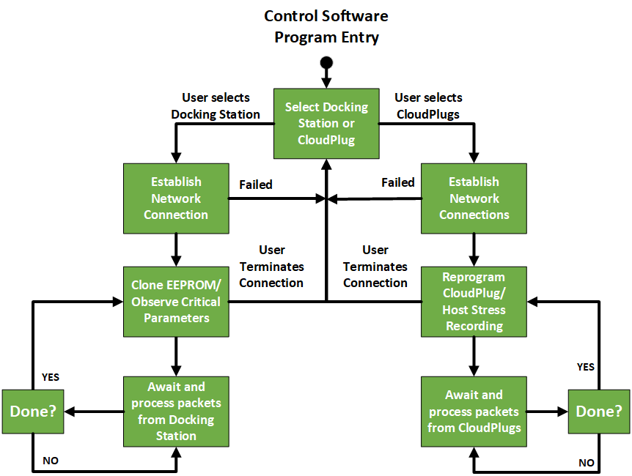
UTDesign I: CloudPlug
Brandon Bearden (EE), Connor DeCamp (CE), Elizabeth Estrada (EE),
Eduardo Hervert (EE), Jason Kim (EE), Nguyen Nguyen (EE), Donghyun Seo (EE)
Faculty Advisors: Dr. Marco Tacca, Dr. Andrea Fumagalli
Corporate Mentors: Gert Grammel, JJ Jamison
Project Description
System testing for SFP+ modules is time consuming and requires physical intervention. Is there a device that can be wirelessly reprogrammed to mimic vendor SFP+ control logic in a way that network switches accept it as a genuine vendor SFP+?
A diagram representing the project concept or a well stated block diagram
Objectives
Design a CloudPlug to:
Be wirelessly programmed using Control Software to mimic individual vendor SFP+ control logic (“Persona”)
Host stress-recordings to simulate impairments in order to stimulate the network switch
Design a Docking Station to:
Clone control logic from EEPROM of SFP+ modules
Monitor critical parameters under stress of SFP+ modules
Design Control Software to:
Detect and control Docking Station and CloudPlugs on LAN
Reprogram CloudPlugs to behave as different SFP+ modules
Specifications and Requirements
Fabricate PCB, test components and circuits
Construct prototype Docking Station and CloudPlug
Write, integrate, and test microcontroller programs and Control Software
Design Related Details
Raspberry Pi 4B for Docking Station MCU
Raspberry Pi Zero W for CloudPlug MCU
Fast-mode I2C used to communicate with SFP+ EEPROM and network switch
Timeline and Milestones
Provides connection to mySQL database to retrieve CloudPlug personas for reprogramming
Supports auto-discovery of Docking Station and CloudPlugs on LAN
Team #1282, Senior Design I
Erik Jonsson School of Engineering and Computer Science
Spring 2021

