Slide 1
// COMP 3610 · PROJECT · BIG DATA Analytics
SATELLITE
INTELLIGENCE
PLATFORM
KHARKIV
MARIUPOL
Automated urban damage detection in Ukrainian conflict zones
using Sentinel-2 multispectral imagery
Josiah Alexis · Jonathan La Borde · Adrian Deo · Matthew Singh
BAKHMUT
University of the West Indies · St. Augustine
SAT-INTEL-PLATFORM · COMP3610-2024 · UNIVERSITY OF THE WEST INDIES

Slide 2
// THE SCOPE IN THREE NUMBERS
What we built, at a glance.
3
41
0.934
Cities Studied
Satellite Scenes
MLP F1 Score
Mariupol · Kharkiv · Bakhmut
Cloud-filtered Sentinel-2 L2A acquisitions spanning 2021 Q1 through 2024 Q2.
Best model performance across all metrics, with AUC-ROC of 0.980.
Satellite Intelligence Platform · Opening
02 / 20

Slide 3
// THE PROBLEM
Detect infrastructure damage automatically, without entering the conflict zone.
Timely, scalable assessment across 3 Ukrainian cities, 14 quarterly periods.
WHAT
WHY IT MATTERS
WHAT MAKES IT HARD
Classify Sentinel-2 satellite scenes as damaged (Label 1) or undamaged (Label 0) using spectral indices and machine learning.
Ground surveys are dangerous in active war zones. Aerial access is restricted. Aid organisations need data now to plan safely.
Only 41 scenes total. No pixel-level ground truth. Winter cloud cover. Three cities with distinct destruction patterns and timelines.
Goal: beat a random-label baseline on all 41 scenes, achieve F1 > 0.90, produce interpretable per-city damage maps.
Satellite Intelligence Platform · Problem
03 / 20

Slide 4
Part 01
The Data

Slide 5
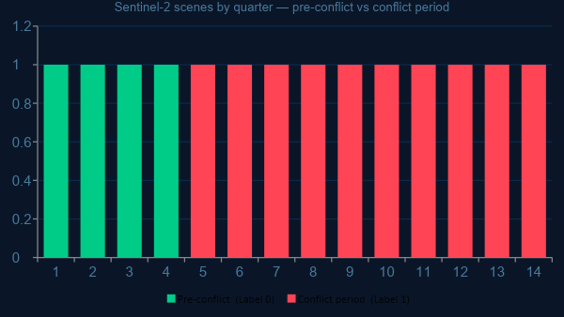
// DATA
Three cities, 14 quarters, one cloud-masked pipeline.
All imagery sourced from Microsoft Planetary Computer. Free, open, fully reproducible.
Primary
Sentinel-2 L2A · 6 spectral bands
B02 B03 B04 B08 B11 B12
Coverage
2021 Q1 – 2024 Q2
14 quarters × 3 cities = 41 scenes
Labels
2021 = Label 0 (undamaged baseline)
2022–2024 = Label 1 (conflict period)
Source
Pre-conflict [Label 0]
Conflict period [Label 1]
Microsoft Planetary Computer
Copernicus open-access licence
Satellite Intelligence Platform · Data
05 / 20

Slide 6
// DATA QUALITY
Cloud masking applied. Spectral indices computed across all scenes.
The preprocessing that made every downstream feature and model possible.
94.2%
< 30%
3
6
valid pixels
cloud threshold
spectral indices
spectral bands
Average valid-pixel rate post SCL cloud masking across all 41 scenes.
Max cloud cover allowed per scene. Higher scenes excluded from the dataset.
NDVI, NDBI, and BSI — the physical signature of surface destruction.
B02 B03 B04 B08 B11 B12 retained. SCL used for masking only, not features.
Satellite Intelligence Platform · Data
06 / 20

Slide 7
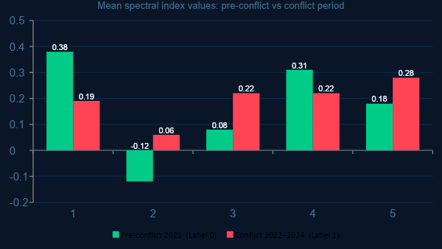
// EXPLORATORY ANALYSIS
Spectral indices show clear separation between classes.
The physical signature of destruction is visible before any model is applied.
NDVI
↓ drops sharply — vegetation destroyed after shelling and fire.
NDBI
↑ rises — rubble replaces intact built-up surfaces.
↑ nearly triples — bare soil expands as buildings collapse.
BSI
SWIR
↑ rises — dry inorganic debris reflects more short-wave IR.
Pre-conflict [Label 0]
Conflict period [Label 1]
Satellite Intelligence Platform · Data
07 / 20

Slide 8
Part 02
Methodology

Slide 9
// PIPELINE
From raw satellite imagery to damage maps in five stages.
Five Jupyter notebooks, fully reproducible from a clean clone.
01
02
03
04
05
Data
Cleaning
Feature
Engineering
Rich
Features
Model
Training
Evaluation
Cloud masking
Spectral indices
Damage labels
Yearly aggregates
GLCM texture
Robust statistics
LR · RF · MLP
ResNet-50
F1 · AUC-ROC
Damage maps
NOTEBOOKS PER STAGE
NB 1 Data cleaning, cloud masking, spectral indices
NB 3 Model training — LR, RF, MLP, ResNet-50
NB 2 Feature engineering, damage labels, group splits
NB 4 Evaluation, ROC curves, damage maps
NB 2b Rich features — GLCM, robust stats, quadrant variance
Satellite Intelligence Platform · Methodology
09 / 20

Slide 10
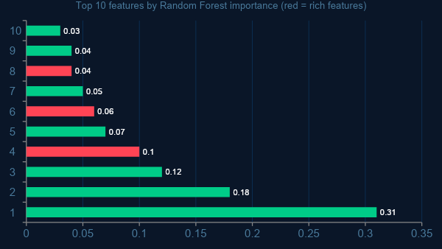
// FEATURE ENGINEERING
65 features per scene. Rich features do most of the heavy lifting.
Ablation: removing GLCM features costs ~0.08 F1. Removing base spectral features costs ~0.15 F1.
Base
Original spectral features
27 features total
Rich
Notebook 2b additions
+38 features (27 → 65)
GLCM
Texture: contrast, energy,
homogeneity, correlation
Robust stats
IQR, skewness, kurtosis,
P10, P90 per index
Satellite Intelligence Platform · Methodology
10 / 20

Slide 11
// TRAINING
Four models. Group-based splits. Best val-loss checkpoint saved.
We split by city-year group, not randomly. Random splits leak the answer.
TRAIN · ~70% (city-year groups 2021–2022)
VAL ~17%
TEST ~30%
2
1
64
50
1
tabular
baselines
best
model
MLP hidden
units
training
epochs
deep vision
model
LR + Random Forest
MLP Neural Network
64 → 32 → 2 layers
Best val loss checkpoint
ResNet-50 (6-band)
StandardScaler normalisation for all tabular models · WeightedRandomSampler for ResNet-50 · Median imputation for NaN features
Satellite Intelligence Platform · Methodology
11 / 20

Slide 12
Part 03
Results

Slide 13
// HEADLINE RESULT
0.934
VERSUS BASELINES
Random (50/50)
~0.50
Logistic Regression
0.912
Random Forest
0.788
MLP F1 Score on the test set
AUC-ROC = 0.980 · All 3 cities classified with F1 > 0.95.
MLP ★
0.934
Satellite Intelligence Platform · Results
13 / 20

Slide 14
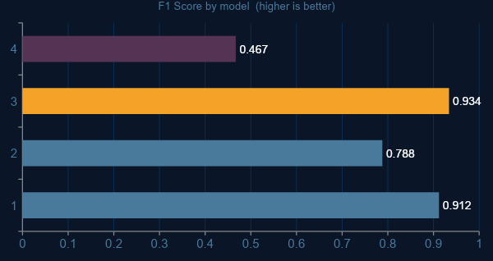
// MODEL COMPARISON
MLP wins on all key metrics.
Precision 0.940 · Recall 0.928 · F1 0.934 · AUC-ROC 0.980, evaluated on all held-out city-year groups.
FULL METRICS · MLP
Precision
0.940
Recall
0.928
F1 Score
0.934
AUC-ROC
0.980
Takeaway: spectral features + MLP outperforms deep learning in this low-data regime (41 scenes). ResNet-50 limited by patch dataset size.
Satellite Intelligence Platform · Results
14 / 20

Slide 15
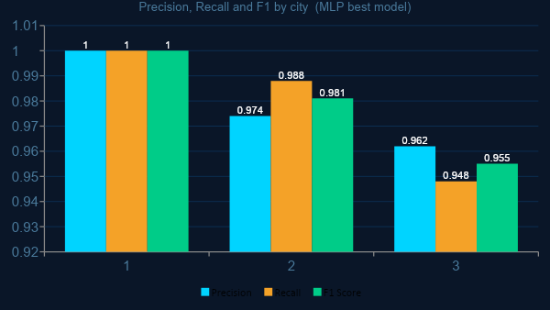
// PER-CITY RESULTS
All three cities classified with F1 > 0.95.
MLP generalises across distinct urban conflict environments and destruction patterns.
Kharkiv
F1 = 1.000
Perfect — distinct spectral change post-2022 shelling along northern districts.
Bakhmut
F1 = 0.981
Near-perfect — pervasive destruction across entire urban area.
Mariupol
F1 = 0.955
Excellent — slight cloud interference in winter quarters.
Satellite Intelligence Platform · Results
15 / 20

Slide 16
Part 04
Pipeline Demo
Project Demo Video
https://www.youtube.com/watch?v=gxH328IiMFg
Streamlit
https://big-data-analysis-group-satellite-intelligence-dashboard-sdi6ll.streamlit.app/

Slide 17
Part 05
Wrap-up

Slide 18
// HONEST LIMITATIONS
What this model does not do, that we think is worth stating.
Every methodology has trade-offs. Here are ours.
NO PIXEL-LEVEL GROUND TRUTH
SCENE-LEVEL ONLY
We used temporal labels (2021 = undamaged, 2022+ = damaged) as a proxy. No building-level UNOSAT annotations were available for training.
The model classifies entire satellite scenes, not individual buildings or grid cells. Pixel-level damage localisation is future work.
WINTER CLOUD COVER
RESNET-50 DATA LIMITATION
Several Q1 scenes have elevated cloud cover even after masking, introducing noise into the pre-conflict 2021 baseline for some cities.
41 scenes generated insufficient patches for deep learning to generalise. Patch-based ResNet-50 accuracy of 0.467 is near chance — a data volume problem, not an architecture failure.
Satellite Intelligence Platform · Reflection
17 / 20

Slide 19
// WHAT WE LEARNED
Three takeaways
01
Spectral features do most of the work.
NDVI, NDBI, and BSI provide clear class separation before any model is applied. The data tells the story — the model confirms it.
02
Feature engineering matters more than model complexity.
Rich features (GLCM texture, quadrant variance, robust stats) improved F1 significantly. Going from 27 to 65 features outperformed switching to deep learning.
03
Match model complexity to data volume.
ResNet-50 at 0.467 accuracy vs MLP at 0.934 F1 makes the lesson clear. In a low-data regime, well-engineered tabular features beat a 25M-parameter model every time.
Satellite Intelligence Platform · Wrap-up
18 / 20

Slide 20
// REFLECTION
How we divided the work and what tripped us up.
MS
Matthew Singh
JA
Josiah Alexis
AD
Adrian Deo
JL
Josiah Alexis
Jonathan La Borde
Problem statement
& dataset
Pipeline &
data cleaning
Feature engineering
& modelling
Results, maps
& conclusions
CHALLENGE 01
CHALLENGE 02
CHALLENGE 03
Cloud cover in winter scenes
Group-based split complexity
ResNet-50 patch generation
Multiple Q1 scenes over all three cities had cloud contamination even after SCL masking. Fixed by preferring Q2/Q3 scenes in the yearly composite.
Naive random splits inflated accuracy by ~8 F1 points. Switching to GroupShuffleSplit by city-year gave honest evaluation on genuinely unseen data.
41 scenes generated too few patches for convergence. Accuracy plateaued at 0.467. Lesson: deep learning needs data volume that tabular models don't.
Satellite Intelligence Platform · Wrap-up
19 / 20

Slide 21
THANK YOU
Questions?
REPOSITORY
github.com/Big-Data-Analysis-Group/Satellite-Intelligence-Platform
NOTEBOOKS
Notebooks 1 · 2 · 2b · 3 · 4 available in the repository
Josiah Alexis · Jonathan La Borde · Adrian Deo · Matthew Singh

