Slide 1
Fundamentals of deep learning
Using PyTorch to train models
Terence Parr
MSDS program University of San Francisco

Slide 2
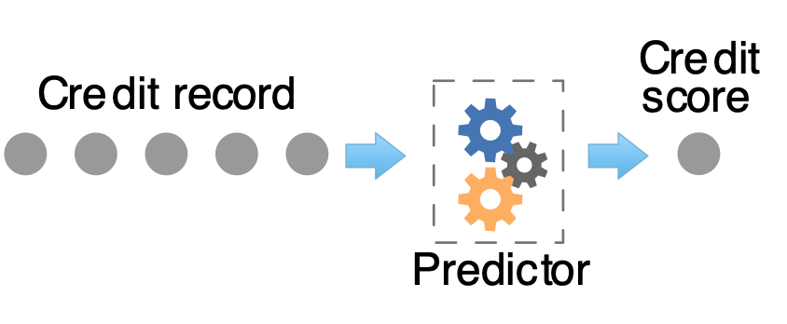
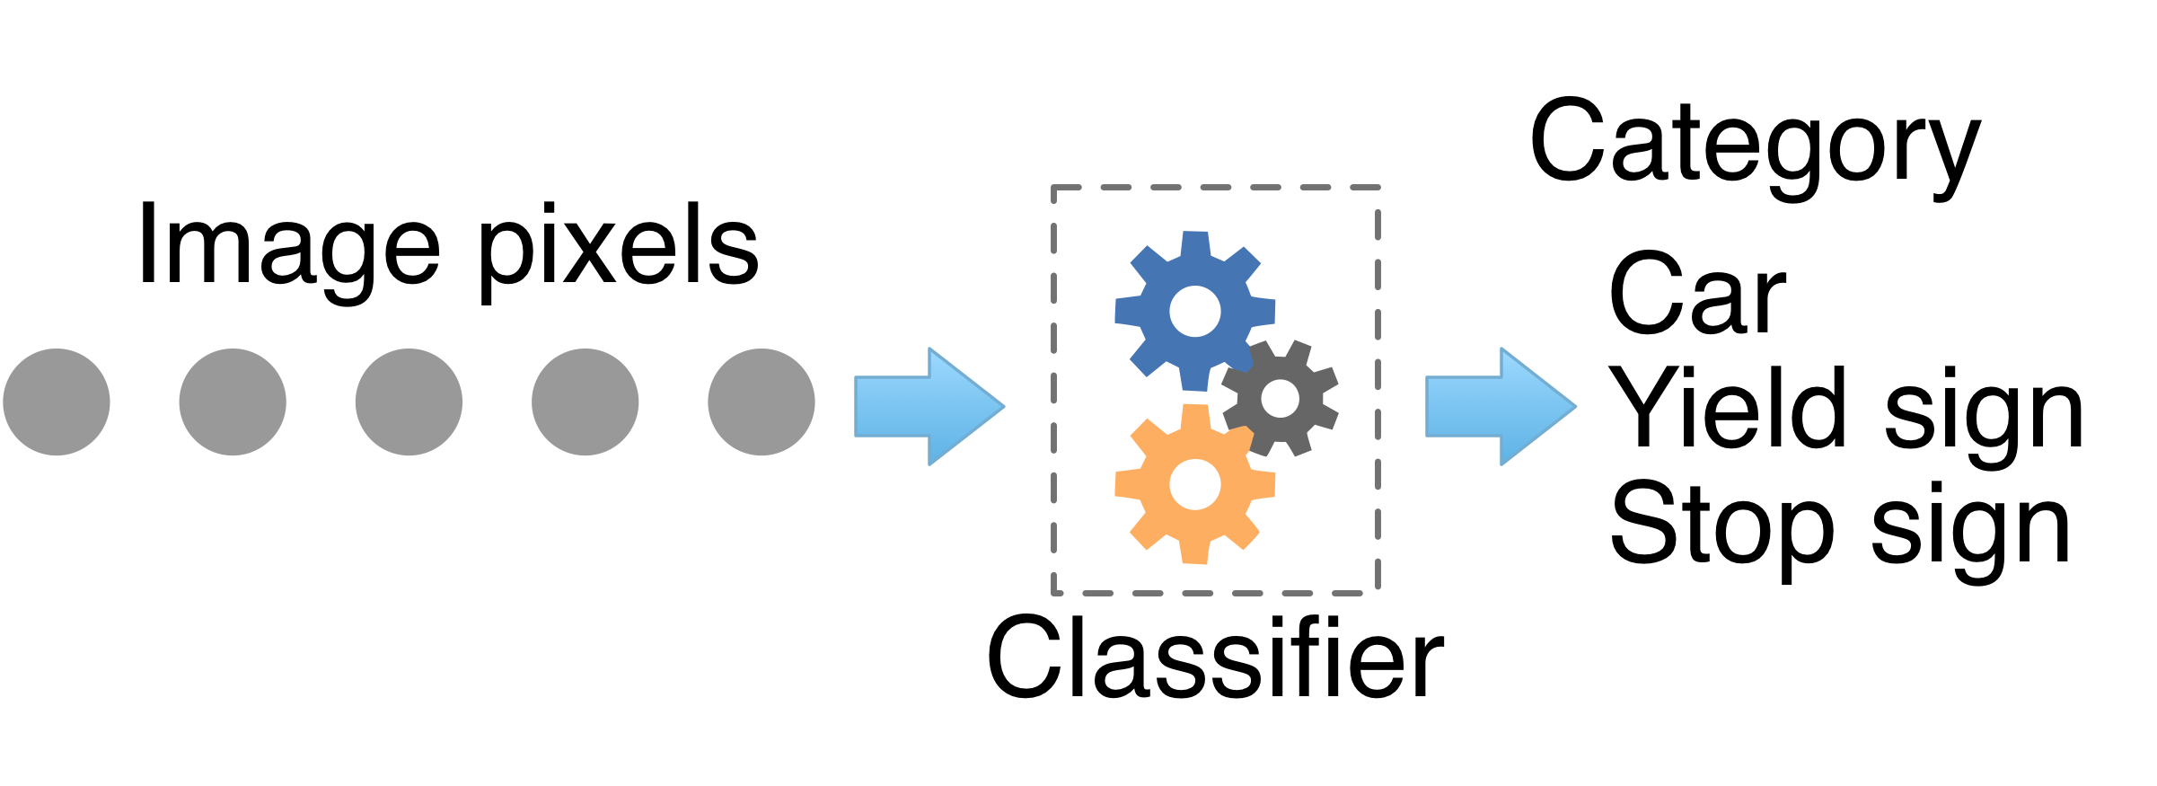
The goal of machine learning
Obtain a model that predicts numeric values (regressor) or categories (classifier) from information about an entity:

Slide 3
The abstraction
Training a model means capturing relationship between feature vectors and some target variables given a training data set
Feature vector x: set of features or attributes characterizing an entity, such as square footage, num of bedrooms, bathrooms
Target y: either a scalar value like rent price (regressor), or it's an integer indicating “creditworthy” or “it's not cancer” (classifier)
Model capture this relationship: x_i -> y_i

Slide 4
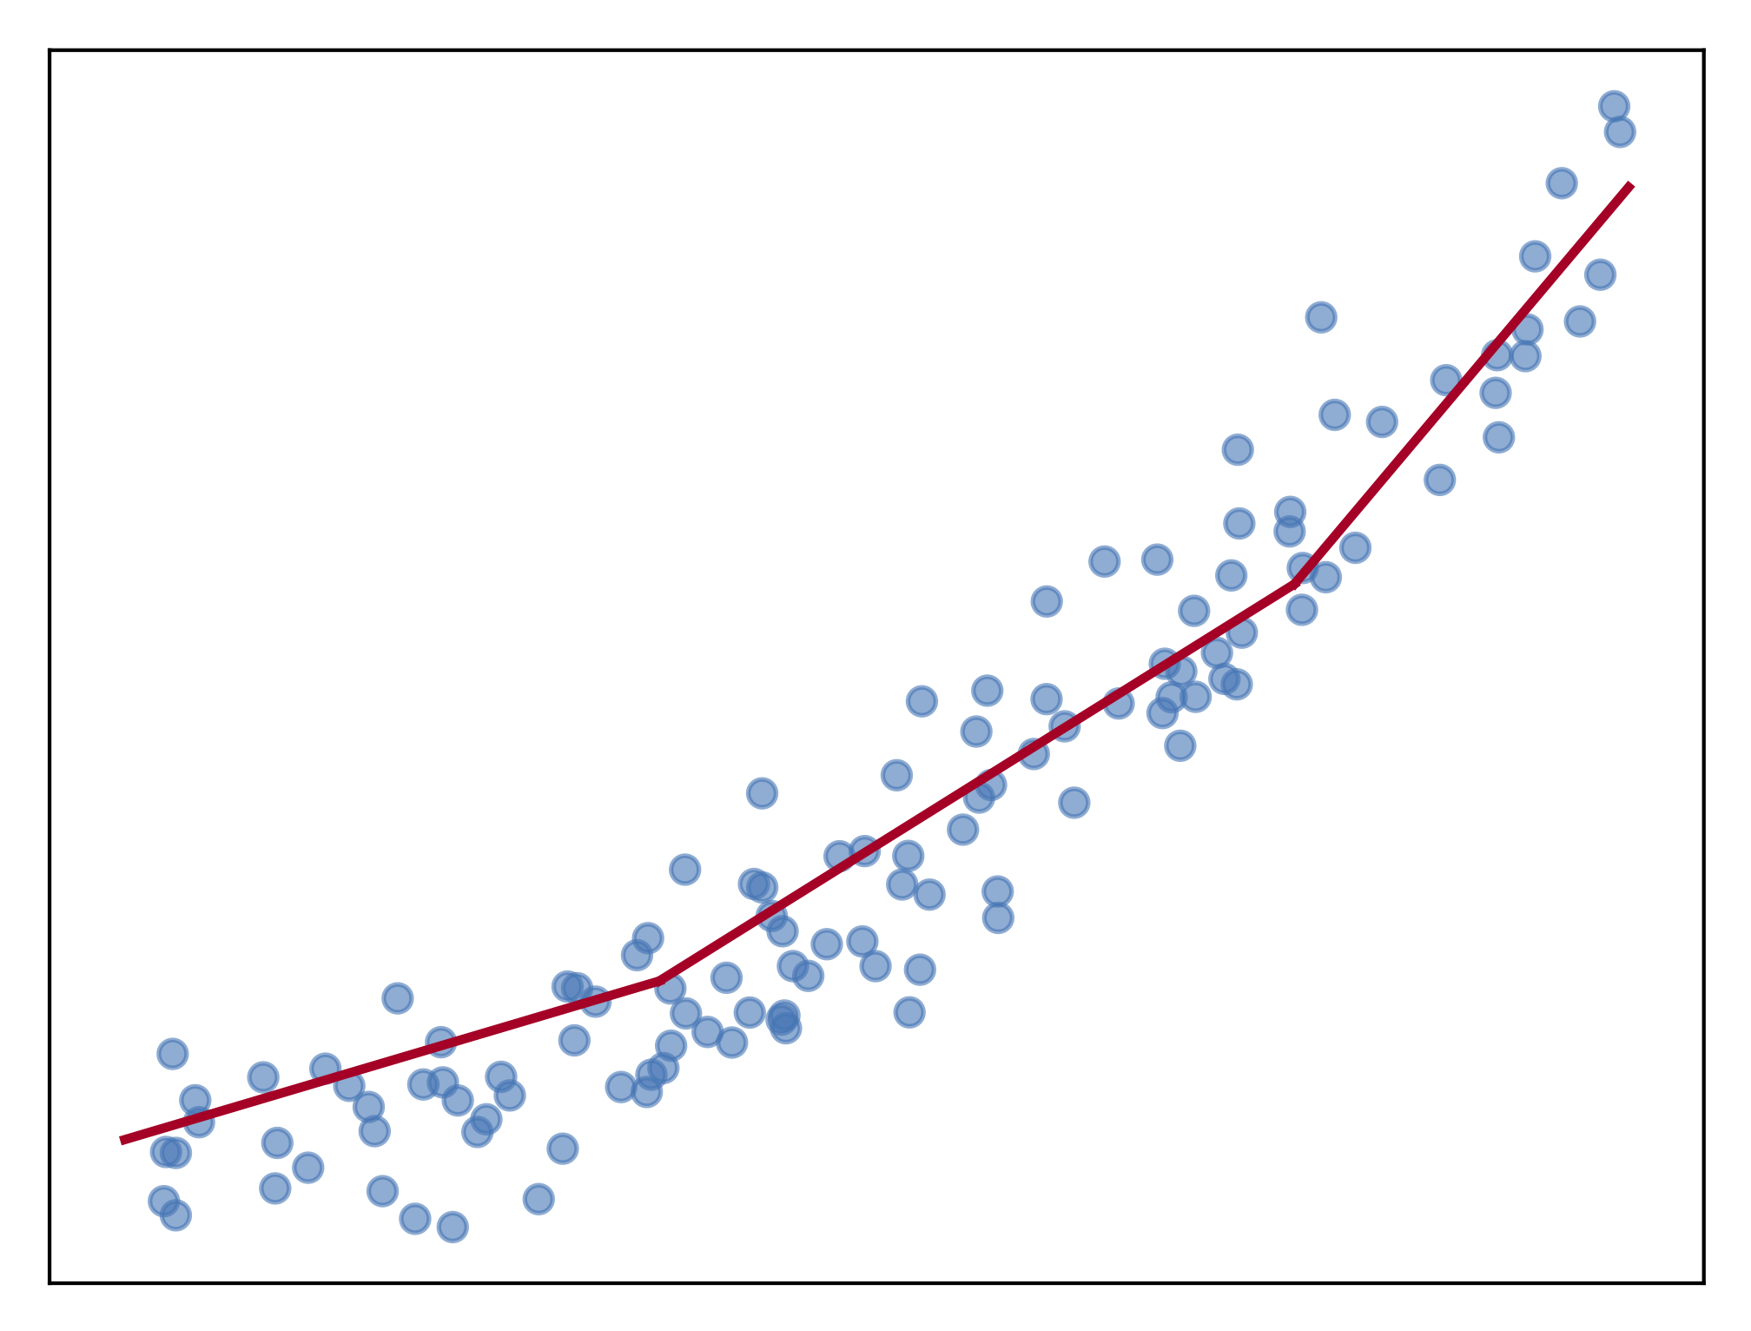
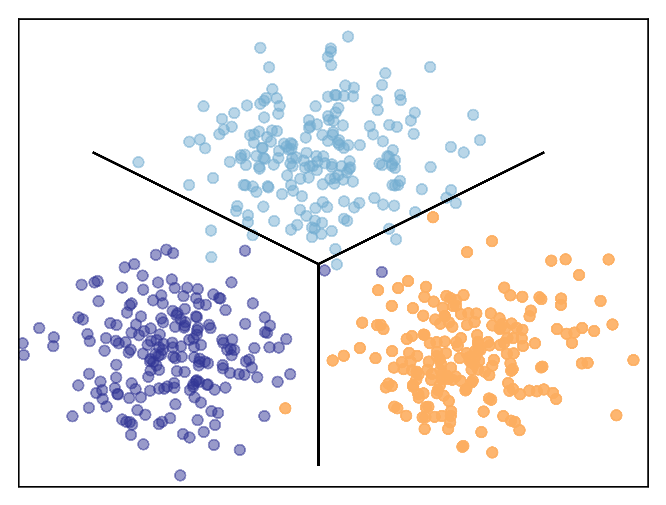
Regression versus classification
Predictors fit curves to data and classifiers draw decision boundaries between data points in different categories
Two sides of the same coin

Slide 5
Models
Models have architecture: deep learning: number of layers, number of neurons per layer, which nonlinearity
Models also have hyper-parameters, which dictate the overall architecture or other aspects of the model.
Hyper-parameters are specified by the programmer, not computed from the training data
Deep learning training greatly affected by learning rate, and even things like parameter initialization
Must be tuned

Slide 6
Training
Underfitting: model unable to capture relationship (assuming there is a relationship to be had)
Overfitting: model is too specific to the training data and doesn't generalize well
To generalize means we get accurate predictions for feature vectors not found in the training set

Slide 7
Train, validate, test
This might be the most important slide!
We always need 3 data sets with known answers:
training
validation (as shorthand you’ll hear me / others call this test set)
testing (put in a vault and don’t peek!!)
Validation set: used to evaluate, tune models and features
Any changes you make to model tailor it to this specific validation set
Test set: used exactly once after you think you have best model
The only true measure of model’s generality, how it’ll perform in production
Never use test set to tune model
Production: recombine all sets back into a big training set again, retrain model but don’t change it according to test set metrics

Slide 8
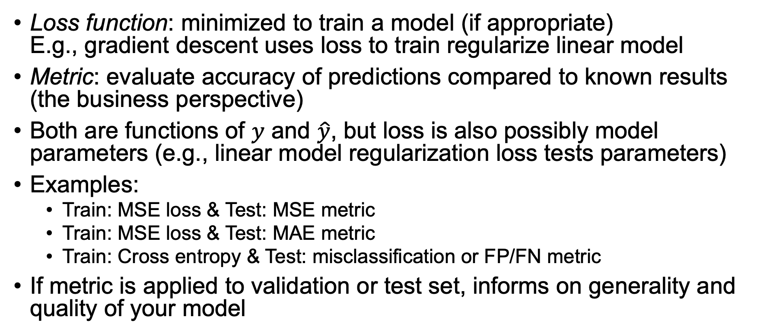
Terminology: Loss function vs metric
Loss function: minimized to train a model (if appropriate) E.g., gradient descent uses loss to train regularize linear model
Metric: evaluate accuracy of predictions compared to known results (the business perspective)
Both are functions of $y$ and $\hat{y}$, but loss is also possibly model parameters (e.g., linear model regularization loss tests parameters)
Examples:
Train: MSE loss & Test: MSE metric
Train: MSE loss & Test: MAE metric
Train: Cross entropy & Test: misclassification or FP/FN metric
If metric is applied to validation or test set, informs on generality and quality of your model
See also stackoverflow post by Chstiros Tsatsoulis: https://goo.gl/T5AmrT

Slide 9

building blocks
$y=wx+b=w_{1}x_{1}+w_{2}x_{2}+ …+w_{m}x_{m}$

Slide 10
def walk(A,nrows,ncols):
for i in range(nrows):
for j in range(ncols):
# process A[i][j]

