Slide 1
Fundamentals of deep learning
Crash course in using PyTorch to train models
Terence Parr
MSDS program University of San Francisco

Slide 2
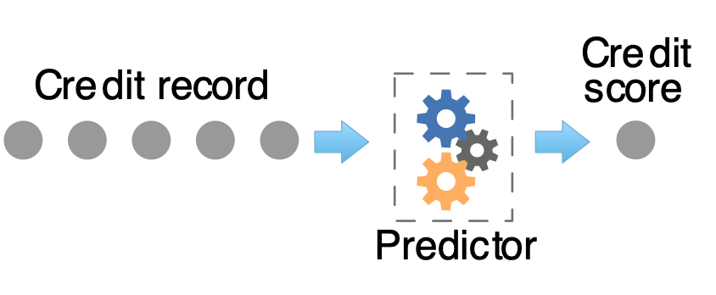
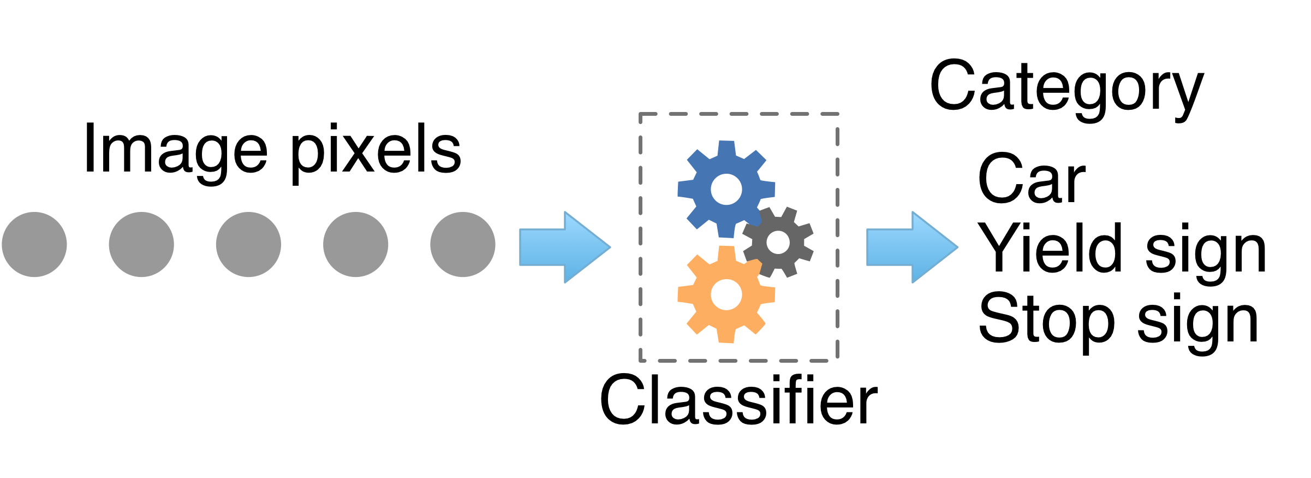
The goal of machine learning
Obtain a model that predicts numeric values (regressor) or categories (classifier) from information about an entity:

Slide 3
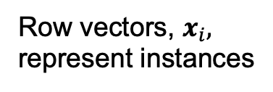
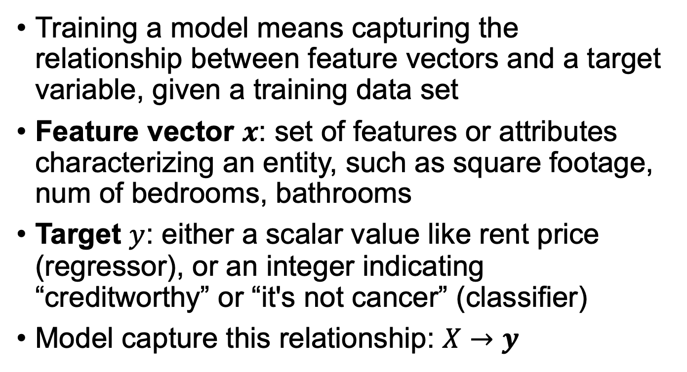
The abstraction
Training a model means capturing the relationship between feature vectors and a target variable, given a training data set
Feature vector $x$: set of features or attributes characterizing an entity, such as square footage, num of bedrooms, bathrooms
Target $y$: either a scalar value like rent price (regressor), or an integer indicating “creditworthy” or “it's not cancer” (classifier)
Model capture this relationship: $X→y$
Row vectors, $x_{i},$ represent instances

Slide 4
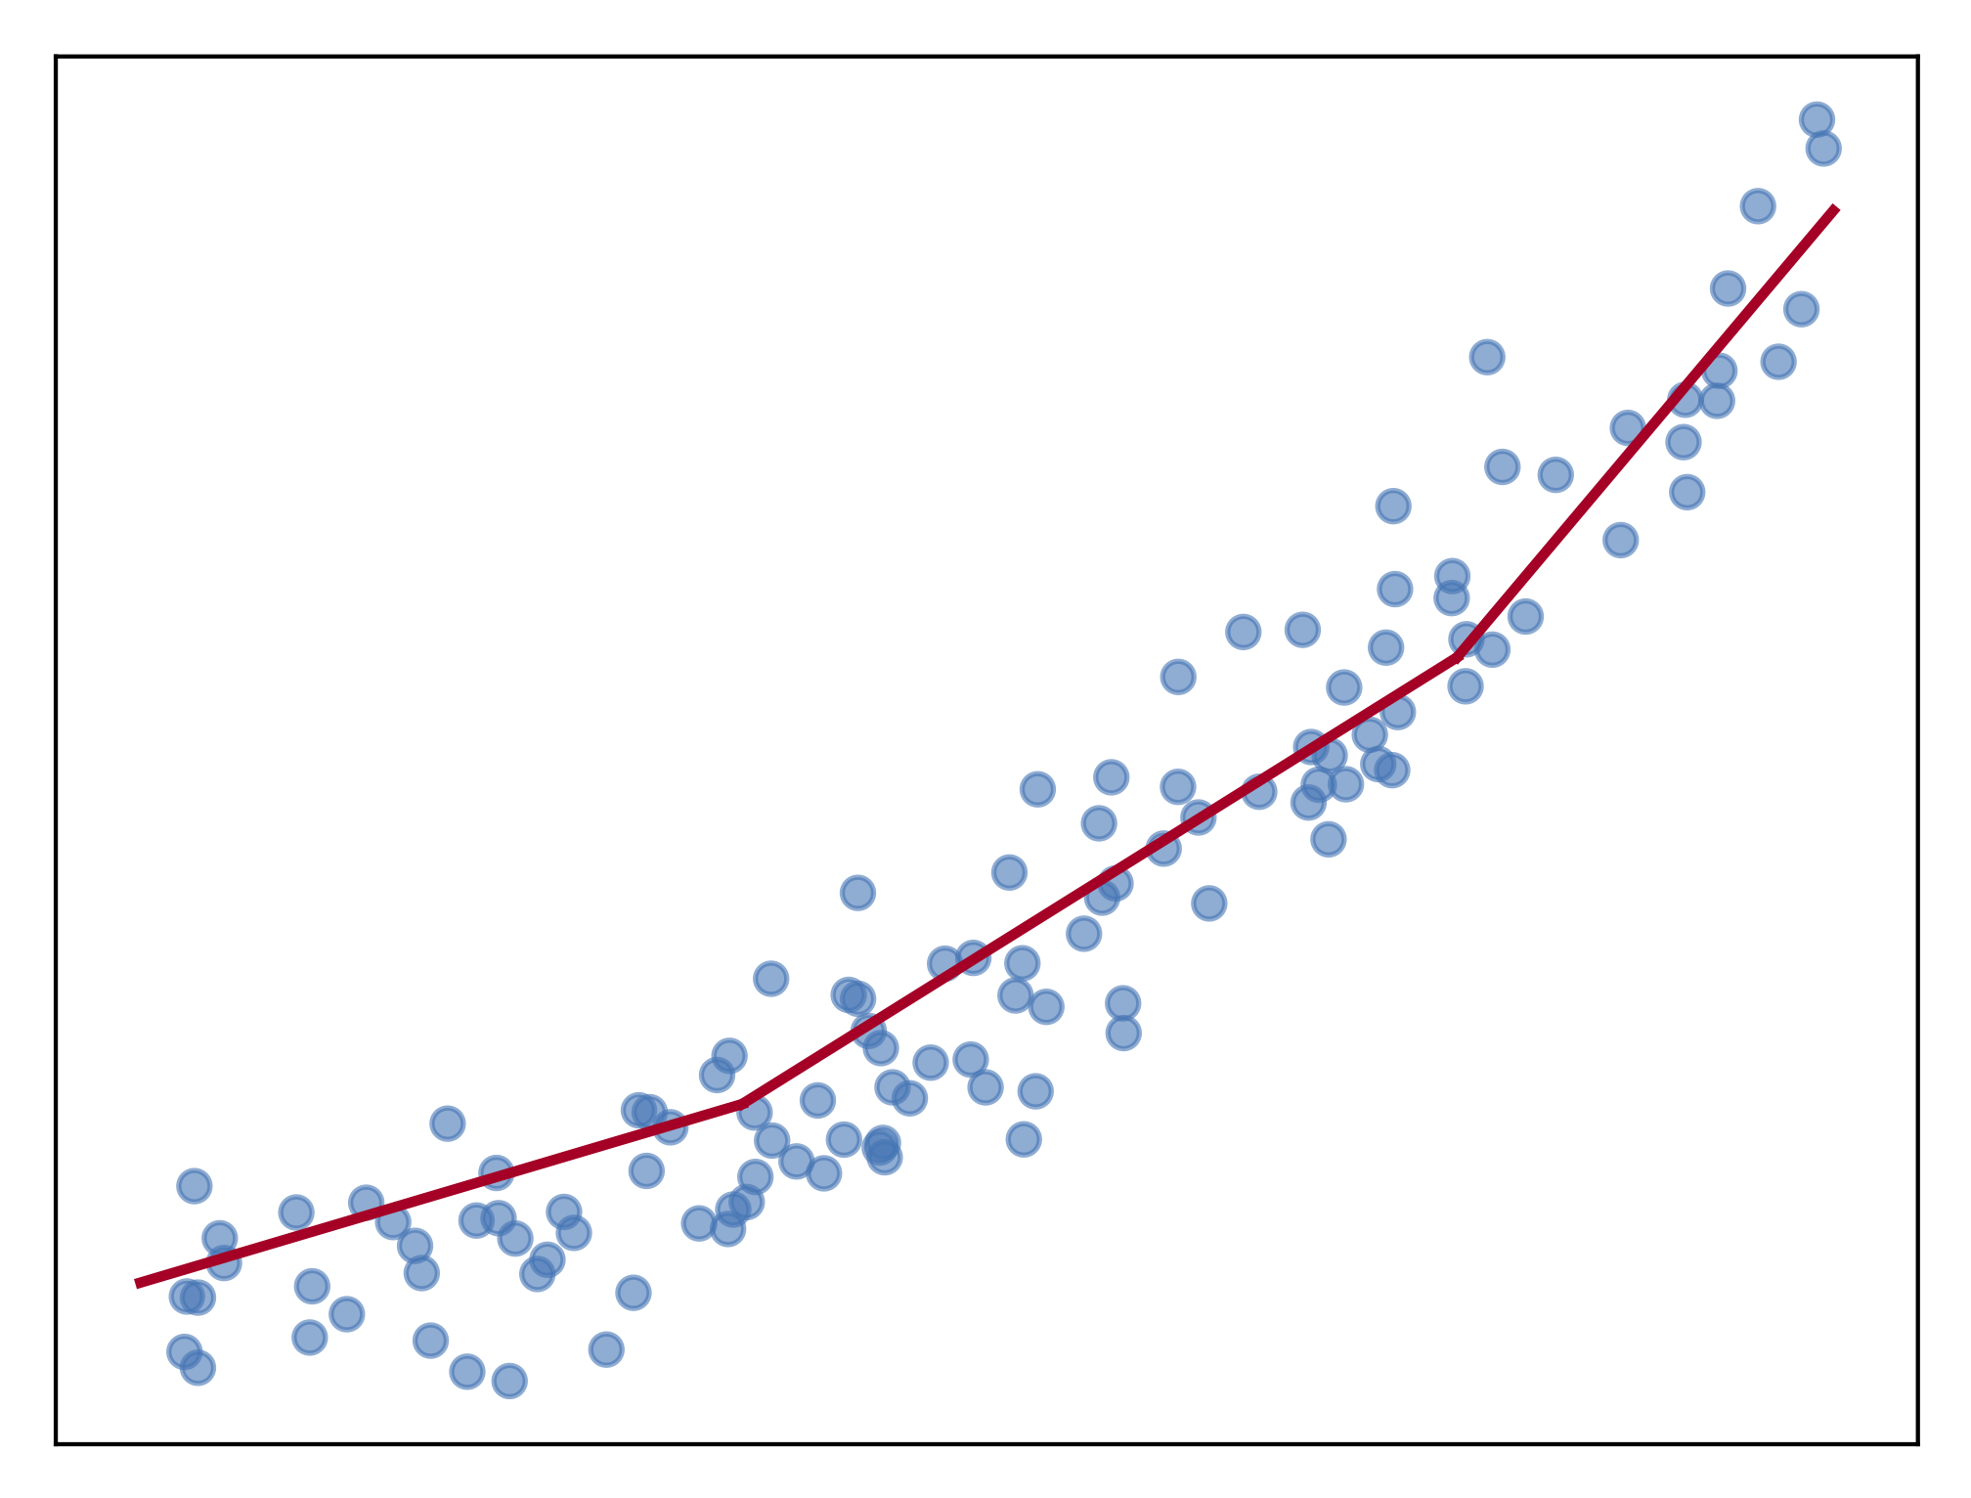
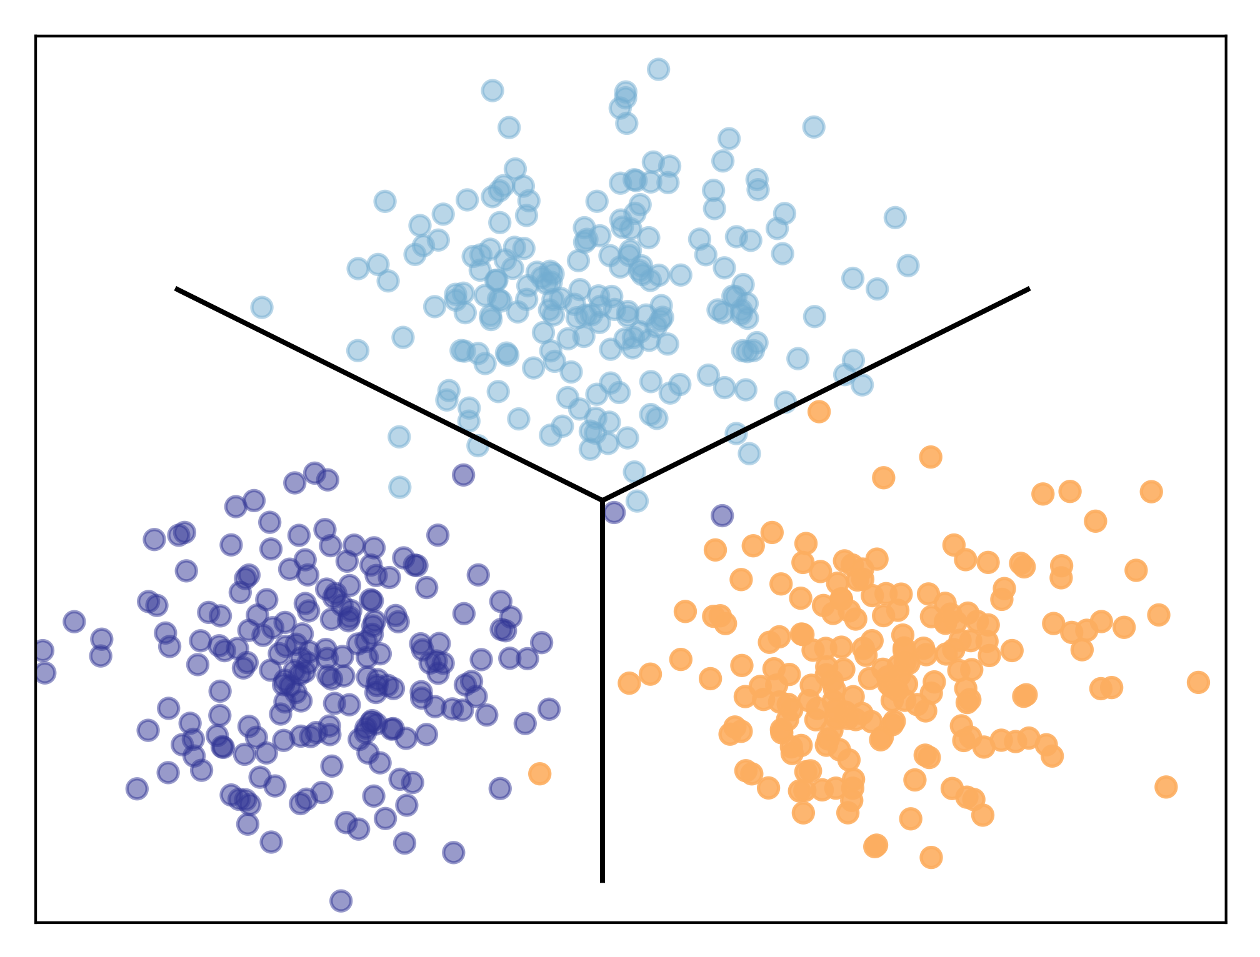
Regression versus classification
Predictors fit curves to data and classifiers draw decision boundaries between data points in different categories
Two sides of the same coin in implementation typically

Slide 5
Models
Models are composed of parameters; predictions are a computation based upon these parameters
Models have architecture; e.g., number of layers, number of neurons per layer, which nonlinearity
Models have hyper-parameters that govern architecture and the training process; e.g., learning rate, weight decay
Hyper-parameters are specified by the programmer, not computed from the training data; must be tuned
Deep learning training greatly affected by learning rate, and even things like parameter initialization

Slide 6
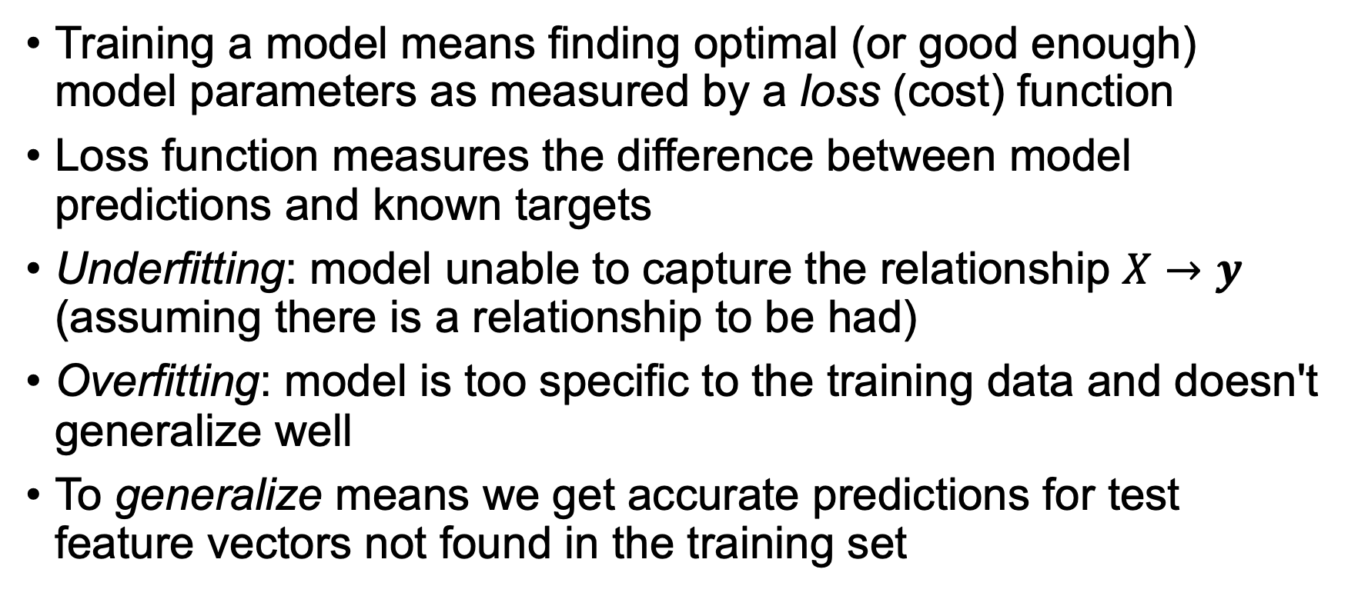
Training
Training a model means finding optimal (or good enough) model parameters as measured by a loss (cost) function
Loss function measures the difference between model predictions and known targets
Underfitting: model unable to capture the relationship $X→y$ (assuming there is a relationship to be had)
Overfitting: model is too specific to the training data and doesn't generalize well
To generalize means we get accurate predictions for test feature vectors not found in the training set

Slide 7
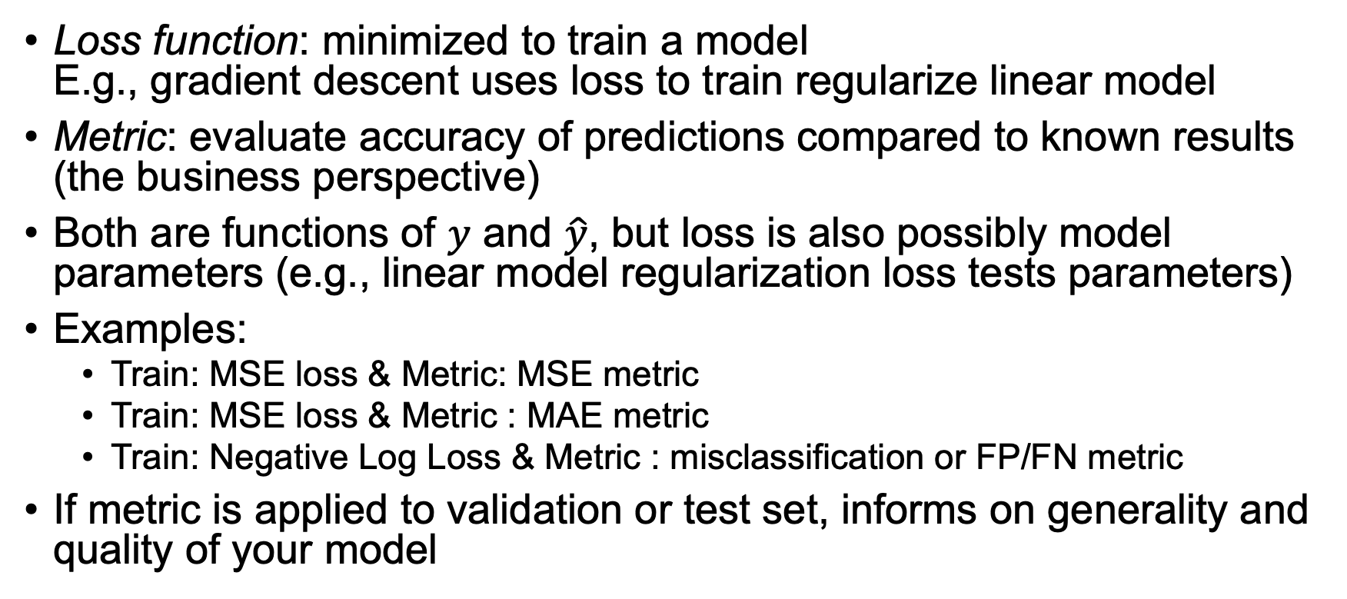
Terminology: Loss function vs metric
Loss function: minimized to train a model E.g., gradient descent uses loss to train regularize linear model
Metric: evaluate accuracy of predictions compared to known results (the business perspective)
Both are functions of $y$ and $\hat{y}$, but loss is also possibly model parameters (e.g., linear model regularization loss tests parameters)
Examples:
Train: MSE loss & Metric: MSE metric
Train: MSE loss & Metric : MAE metric
Train: Negative Log Loss & Metric : misclassification or FP/FN metric
If metric is applied to validation or test set, informs on generality and quality of your model
See also stackoverflow post by Chstiros Tsatsoulis: https://goo.gl/T5AmrT

Slide 8
Train, validate, test
We always need 3 data sets with known answers:
training
validation (as shorthand you’ll hear me & others call this test set)
testing (put in a vault and don’t peek!!)
Validation set: used to evaluate, tune models and features
Any changes you make to model tailor it to this specific validation set
Test set: used exactly once after you think you have best model
The only true measure of model’s generality, how it’ll perform in production
Never use test set to tune model
Production: recombine all sets back into a big training set again, retrain model but don’t change it according to test set metrics

Slide 9

Preparing data
Everything must be numeric
No missing values
Dummy encode categoricals
Should normalize numeric features in $X$ to zero-mean, variance one ("whitening")
Speeds up training
Compare regression equations, loss function surfaces

Slide 10
Deep learning regressors

Slide 11
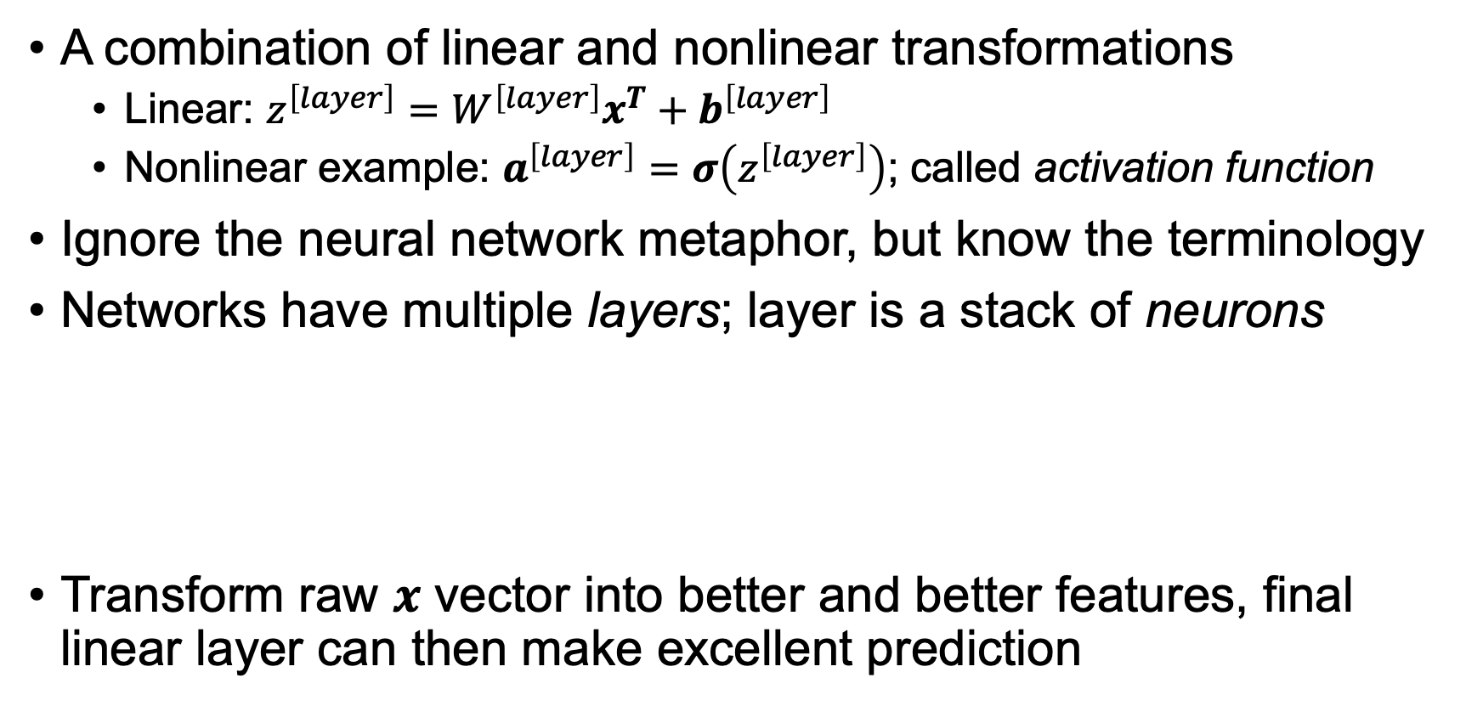
What's a neural network?
A combination of linear and nonlinear transformations
Linear: $z^{\left[layer\right]}=W^{\left[layer\right]}x^{T}+b^{\left[layer\right]}$
Nonlinear example: $a^{\left[layer\right]}=σ\left(z^{\left[layer\right]}\right)$; called activation function
Ignore the neural network metaphor, but know the terminology
Networks have multiple layers; layer is a stack of neurons
Transform raw $x$ vector into better and better features, final linear layer can then make excellent prediction

Slide 12

DL Building blocks
linear
sigmoid
ReLU (rectified linear unit)
$y=w_{1}x_{1}+w_{2}x_{2}+ …+w_{m}x_{m}+b=wx^{T}+b$ for $n$ x $m$ dim $X$
Linear/logistic regression equivalents (one $x$ instance)
Assume we magically know $w$ and $b$
Regressor
Regressor
Two-class Classifier
Underfitting a bit here
(need more of a quadratic)

Slide 13

Try adding layers to get more power
But, sequence of linear models is just a linear model ($w′$ is scalar since $wx^{T}+b$ is scalar)
PyTorch code
model = nn.Sequential(
nn.Linear(m, 1), # m features
nn.Linear(1, 1)
)
Still just a line
(For simplicity, I'm using proper $wx^{T}$ in math but omitting transpose in diagrams)

Slide 14
Must introduce nonlinearity
model = nn.Sequential(
nn.Linear(m, 1),
nn.ReLU(),
nn.Linear(1, 1)
)
ReLU idea here: Draw two lines then clip at intersection

Slide 15

Stack linear models for more power
Stack gives layer: $W$ matrix and $b$
$a^{\left[1\right]}=relu\left(W^{\left[1\right]}x^{T}+b^{\left[1\right]}\right)$
$y={a^{\left[2\right]}=W}^{[2]}a^{\left[1\right]}+b^{[2]}$
model = nn.Sequential(
nn.Linear(m, 5),
nn.ReLU(),
nn.Linear(5, 1)
)

Slide 16
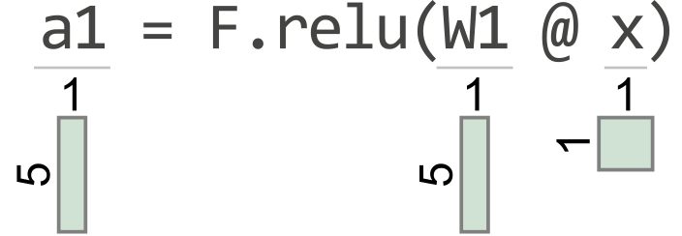
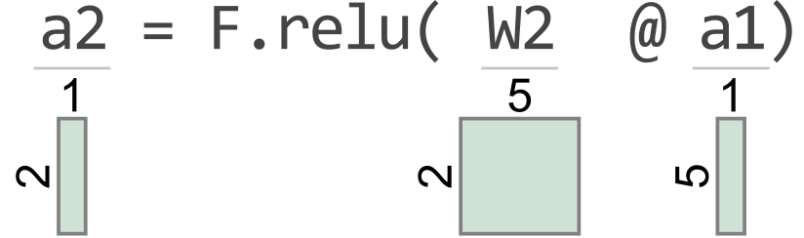
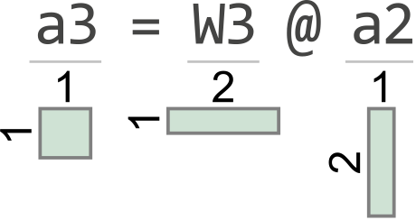
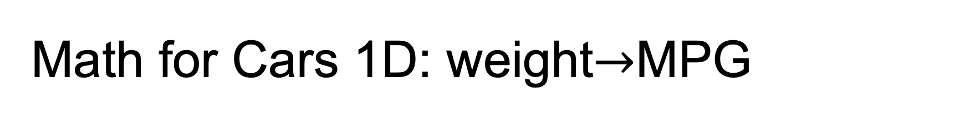
Math for Cars 1D: weight$→$MPG
model = nn.Sequential(
nn.Linear(1, 5),
nn.ReLU(),
nn.Linear(5, 2),
nn.ReLU(),
nn.Linear(2, 1)
)
(courtesy of TensorSensor)

Slide 17
Too much strength can lead to overfitting
Models with too many parameters will overfit easily
We'll look at regularization later
model = nn.Sequential(
nn.Linear(1, 1000),
nn.ReLU(),
nn.Linear(1000, 1)
)

Slide 18
Classifiers

Slide 19
Binary classifiers
Add sigmoid to regressor and we get a two-class classifier
One-layer network with sigmoid activation function is just a logistic regression models
Provide hyper-plane decision surfaces
# 2 input vars: proline, alcohol model = nn.Sequential(
nn.Linear(2, 1),
nn.Sigmoid(),
)

Slide 20
Stack neurons, add layer
model = nn.Sequential(
nn.Linear(2, 3),
nn. Sigmoid(),
nn.Linear(3, 1),
nn.Sigmoid()
)

Slide 21
More neurons: more complex decision surface
model = nn.Sequential(
nn.Linear(2, 10),
nn.Sigmoid(),
nn.Linear(10, 1),
nn.Sigmoid()
)
Likely overfit

Slide 22
Even ReLUs can get curved surfaces
model = nn.Sequential(
nn.Linear(2, 10),
nn.ReLU(),
nn.Linear(10, 10),
nn.ReLU(),
nn.Linear(10, 1),
nn.Sigmoid()
)
(Last activation function still must be sigmoid)

Slide 23
def walk(A,nrows,ncols):
for i in range(nrows):
for j in range(ncols):
# process A[i][j]

