Slide 1
WHAT IS SPARK
ONLY FOR PROCESSING
UC BERKLEY’S AMP LAB
WRITTEN IN SCALA
GITHUB
MESOS
OPEN SOURCED IN 2010
FUNDED BY DATABRICKS,IBM,HUAWEI

Slide 2
WHY SPARK WAS DEVELOPED
LOT HAS CHANGED FROM 2000-EVOLUTION
HARDWARE IN 2000-disk,network,ram,single core
SOFTWARE IN 2000-no open framework for distributed storage and processing,sql
Eg-4 years to assemble hdfs and mapR
SOFTWARE NOW-hdfs,yarn,nosql like mongodb,cassendra
BIG DATA IN 2000-
Very few companies had big data issue
Batch processing ruled,volume was concern

Slide 3
2004-FB,blogging-user explosion of data
big data necessity now(what’sapp example)
intro to hadoop and its ecosystem
velocity more concern(twitter,ipl)
need of real time processing(transactions,website off time)
need of something complimentary

Slide 4
WHY SPARK
1-unified platform for big data apps
Batch,streaming,interactive-spark-hadoop,mesos,nosql
Abstraction b/w any kind of storage and any kind of processing
Instead of diff platforms 1 platform for everything
All systems share one abstraction rdd
2-runs everywhere

Slide 5
3-SMALL AND SIMPLE
Original version-1600 lines of code
Small can be easily expanded
MAPR-120000 lines of java code,spark batch-8-9000 lines of scala code
Storm-65000,streaming-400
Impala-85000,shavy-1500
4-in memory

Slide 6
WHO USES SPARK
IBM,HUAWEI,STARTUPS
MAJOR HADOOP VENDORS-MAPR,CLOUDERA,HORTONWORKS
PHARMACEUTICAL COMPANIES LIKE NOVARTIS

Slide 7
WHAT IS APACHE SPARK USED FOR
1-STREAM PROCESSING-eg-financial transactions
2-MACHINE LEARNING-repeatitive
3-INTERACTIVE ANALYSIS
4-DATA INTEGRATION-definiton of DT,ETL

Slide 8
DEVELOPMENT LANGUAGE SUPPORT
API’S FOR-
JAVA
SCALA
PYTHON
R
SPARK SQL(familarity)

Slide 9
DEPLOYMENT OPTIONS
1-running spark on yarn or mesos(resource managers)
2-SPARK BUILT ON HADOOP
-STANDALONE
-HADOOP YARN(spark runs on yarn without any preinstallation required,helps to integrate spark into hadoop ecosystem)
-SIMR(users can start spark and use its shell without any administrative access)

Slide 10
STORAGE OPTIONS
GOOGLE CLOUD
AMAZON S3
CASSANDRA
HDFS

Slide 11
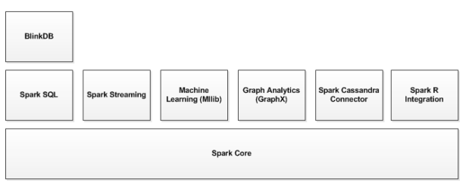
SPARK ECOSYSTEM

Slide 12
Spark core-responsible for management functions such as task scheduling,implements RDD
SPARK SQL-jdbc,odbc integration with databases such as DRILL
SPARK STREAMING(eg-60 million record/s in a 100 node cluster at sub sec process latency,kafka,flume)
MLIB-sparks machine learning lib which implements commonly used machine learning and statistical algorithms
GRAPHX
BLINKDB
SPARK CASSANDRA CONNECTOR
TACHYON(data sharing eg,on heap,gc overhead)

Slide 13
SPARK AND MAP REDUCE
1-ITERATIVE AND SPARK’S WORKING
2-requires integration of several tools for different big data use cases(mahout,storm)
WHAT HADOOP GIVES SPARK
-yarn,hdfs,security

Slide 14
DIFFERENCE B/W THEM
1-PERFORMANCE-iterative(spark),one pass jobs(MR)
2-EASY MANAGEMENT-streaming,batch,machine all in 1 cluster
3-STREAMING DATA-its possible to modify data in real time
4-CACHING
5-EASE OF USE-comfortable api’s for java,scala,python,R
Hadoop mapR difficult to code(150 lines hello world)
Pig and hive make it easier though

Slide 15
6-COST-memory should be as large as data-costlier
But less hardware can perform the same task much faster especially on cloud where power is paid per use
Staffing can be more costly in spark
Spark reduces no of systems so there are less number of systems which cost more
7-COMPATABILITY
Standalone,hadoop yarn,mesos or cloud
Supports data sources that support hadoop input format
Hive and pig integration on the way

Slide 16
8-DATA PROCESSING
Graphs,use machine learning lib,real as well as batch
One platform for everything
9-FAILURE TOLERANCE
Hadoop-process crash,can continue from where it left
Spark has to spark from beginning
10-SECURITY
Spark is a bit bare at the moment
Spark can run on yarn and use hdfs so it can enjoy kerberos authentication,hdfs file permissions and encryption between nodes

Slide 17
MR enjoys all hadoop security benefits and integrate with hadoop security projects like knock gateway and sentry
11- SCALABILITY
Yahoo 42000 nodes in hadoop clusters
Spark largest cluster is 8000

Slide 18
COMMON APPLICATIONS OF SPARK
Real time marketing campaings
Online product recommendations
Cybersecurity analytics
Machine log monitoring

Slide 19
What is RDD?
R stands for Resilient
D stands for Distributed
D stands for Datasets

Slide 20
Resilient Distributed Dataset
A big collection of data having following properties
Immutability
Distributed
Lazily evaluated
Type inferred
Cacheable
Fault Tolerant
Created by coarse grained operations
Can be persisted

Slide 21
Immutability
Immutability means once created it never changes
Big data by default immutable in nature
Immutability helps to
Parallelize
Caching

Slide 22
Immutability in action
const int a = 0 //immutable
int b = 0; // mutable
Updation
b ++ // in place
c = a + 1
Immutability is about value not about reference

Slide 23
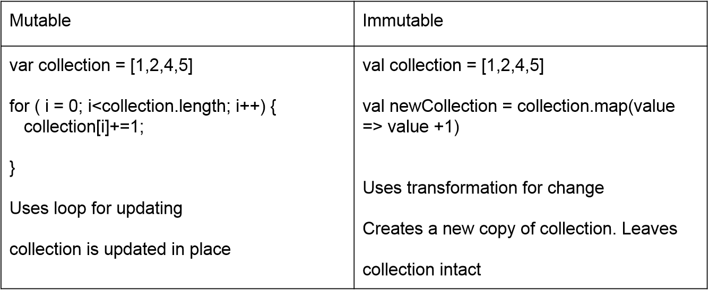
Immutabilty in collections

Slide 24
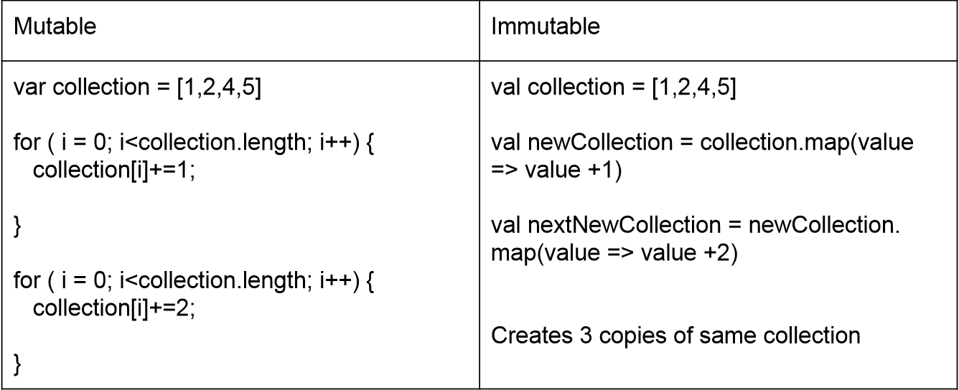
Multiple Transformations

Slide 25
Challenges of Immutability
Immutability is great for parallelism but not good for space
Doing multiple transformations result in
Multiple copies of data
Multiple passes over data
In big data, multiple copies and multiple passes will have poor performance characteristics.
For Ex- In Map/Reduce

Slide 26
Solution for this problem is lazziness
Laziness means not computing transformation till it’s need
Laziness defers evaluation
Laziness allows separating execution from evaluation

Slide 27
Lazziness in action
val c1 = collection.map(value => value +1)
//do not compute anything
val c2 = c1.map(value => value +2)
// don’t compute
print c2
// Now transform into

Slide 28
Transformation in action
val c2 = collection.map ( value => {var result = value +1 result = result + 2 } )
Multiple transformations are combined to one

Slide 29
Challenges to Lazziness
Laziness poses challenges in terms of data type
If laziness defers execution, determining the type of the variable becomes challenging
If we can’t determine the right type, it allows to have semantic issues
Running big data programs and getting semantics errors are not fun

Slide 30
Type Inference
Type inference is part of compiler to determining the type by value
As all the transformation are side effect free, we can determine the type by operation
Every transformation has specific return type
Having type inference relieves you think about representation for many transforms.

Slide 31
Type inference in action
val collection = [1,2,4,5]
// explicit type Array
val c1 = collection.map( value => value + 1)
// Array only
val c2 = c1.map( value => value +2 )
// Array only
val c3 = c2.count( )
// inferred as Int
val c4 = c3.map(value => value+3)
//gets error.
As you cannot map over an integers

Slide 32
Caching
Immutable data allows you to cache data for long time
Lazy transformation allows to recreate data on failure
Transformations can be saved also
Caching data improves execution engine performance

Slide 33
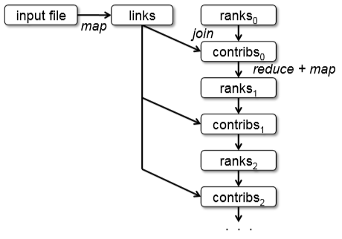
Lineage Graph

Slide 34
Partitions
Logical division of data
Derived from Hadoop Map/Reduce
All Input, Intermediate and output data will be represented as partitions
Partitions are basic unit of parallelism
RDD data is just collection of partitions

Slide 35
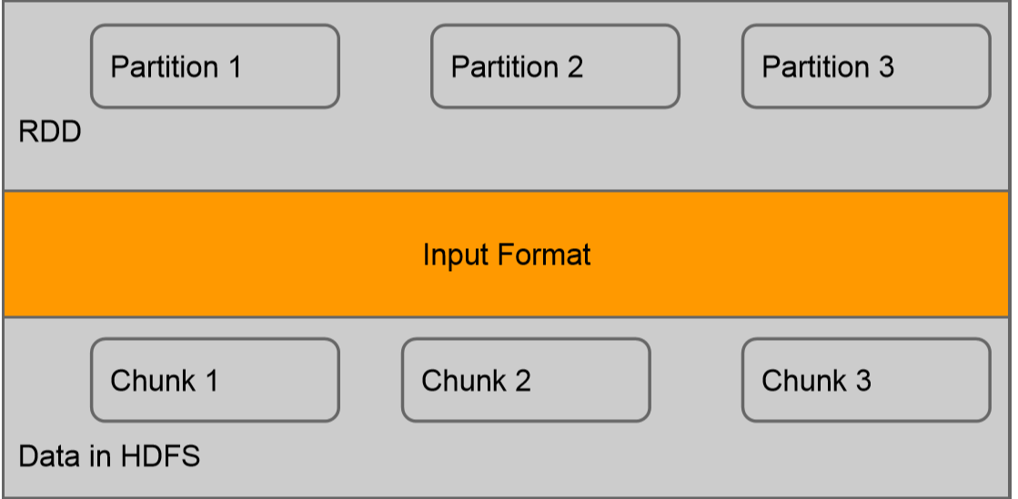
Partition from input data

Slide 36
Look up Operations
Partitioning allows faster lookups
Lookup operation allows to look up for a given value by specifying the key
Using partitioner, lookup determines which partition look for
Then it only need to look in that partition
If no partition is specified, it will fallback to filter

Slide 37
RDD Transformations
map(func) :- Returns a new distributed dataset, formed by passing each element of the source through a function func.
filter(func) :- Returns a new dataset formed by selecting those elements of the source on which func returns true.
union(otherDataset) :- Returns a new dataset that contains the union of the elements in the source dataset and the argument.
intersection(otherDataset) :- Returns a new RDD that contains the intersection of elements in the source dataset and the argument.
distinct([numTasks]) :- Returns a new dataset that contains the distinct elements of the source dataset.

Slide 38
cartesian(otherDataset) :- When called on datasets of types T and U, returns a dataset of (T, U) pairs (all pairs of elements).
coalesce(numPartitions) :- Decrease the number of partitions in the RDD to numPartitions. Useful for running operations more efficiently after filtering down a large dataset.
repartition(numPartitions) :- Reshuffle the data in the RDD randomly to create either more or fewer partitions and balance it across them. This always shuffles all data over the network.

Slide 39
RDD Actions
reduce(func) :- Aggregate the elements of the dataset using a function func (which takes two arguments and returns one). The function should be commutative and associative so that it can be computed correctly in parallel.
collect() :- Returns all the elements of the dataset as an array at the driver program. This is usually useful after a filter or other operation that returns a sufficiently small subset of the data.
count() :- Returns the number of elements in the dataset.
first() :- Returns the first element of the dataset (similar to take (1)).
take(n) :- Returns an array with the first n elements of the dataset.

Slide 40
Types of RDD
ParallelCollectionRDD
CoGroupedRDD
HadoopRDD
MapPartitionsRDD
CoalescedRDD
ShuffledRDD
PipedRDD
PairRDD
DoubleRDD

Slide 41
Basics of GraphX
Spark API for graphs and graph parallel computation
Features of GraphX :
1)Flexibility
a)unifies ETL , exploratory analysis ,iterative computation
b)transform and join graph with RDD’s
c) readability both as data and graphs
2)speed
3)Algorithms
a) PageRank
b)TriangleCount

Slide 42
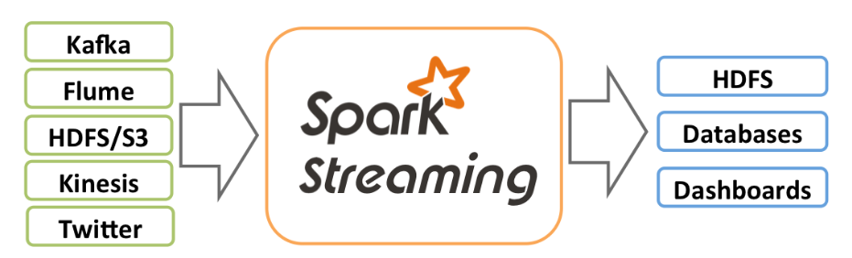
Spark Streaming
What is Spark Streaming
It’s Features :
a. high processing speed
b. ease of use
c. fault tolerance
d. Spark Integration
e. Deployment Options

Slide 43
DStreams
What is DStream?
Example of DStream using Program

Slide 44
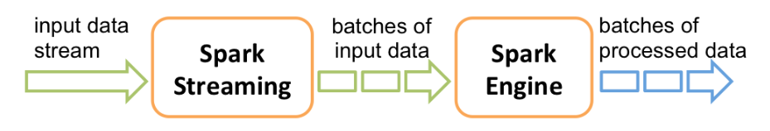

Slide 45
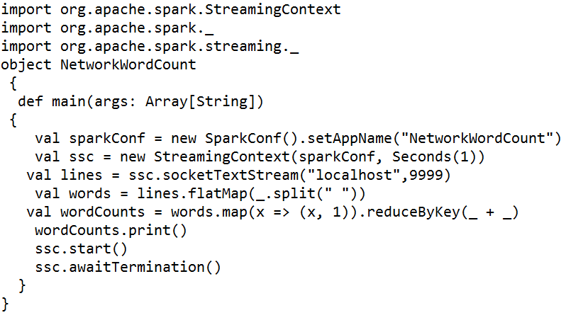

Slide 46
