Slide 1
基于Spark/hbase的数据分析平台及 SparkSQl使用经验分享
黄涧石@PayPal (@huangjianshi)
2014/12/13
Beijing Spark Meetup

Slide 2
BUILD FOR ANALYTICS
We built a Distributed Graph Database for analytical use cases
Fast traversal + Range query + Batch processing
Need to take care of the interfaces to users (Analysts)
Query Language? (Analysts says SQL please!)
Interactive data exploration?
Visualization? Dynamic charts?
And be flexible to do all sorts of powerful things

Slide 3
BUILD FOR SCALABILITY
Need to be fully scalable and optimized for
Data size (100TB planned, 1PB next year)
Ingestion speed (parallel insertion + dynamic splits)
Parallel and Batch queries
Offline + Online processing
Mining

Slide 4

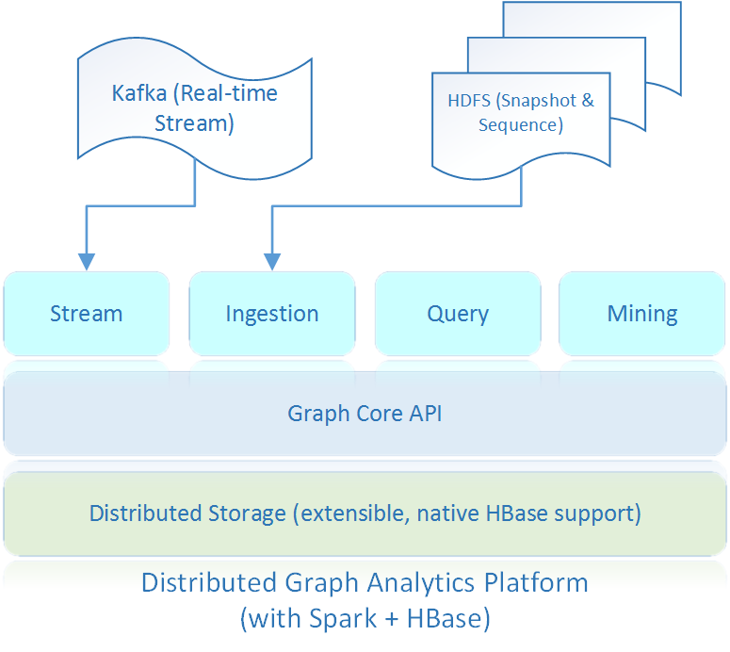



ARCHITECTURE

Slide 5
DEMO

Slide 6
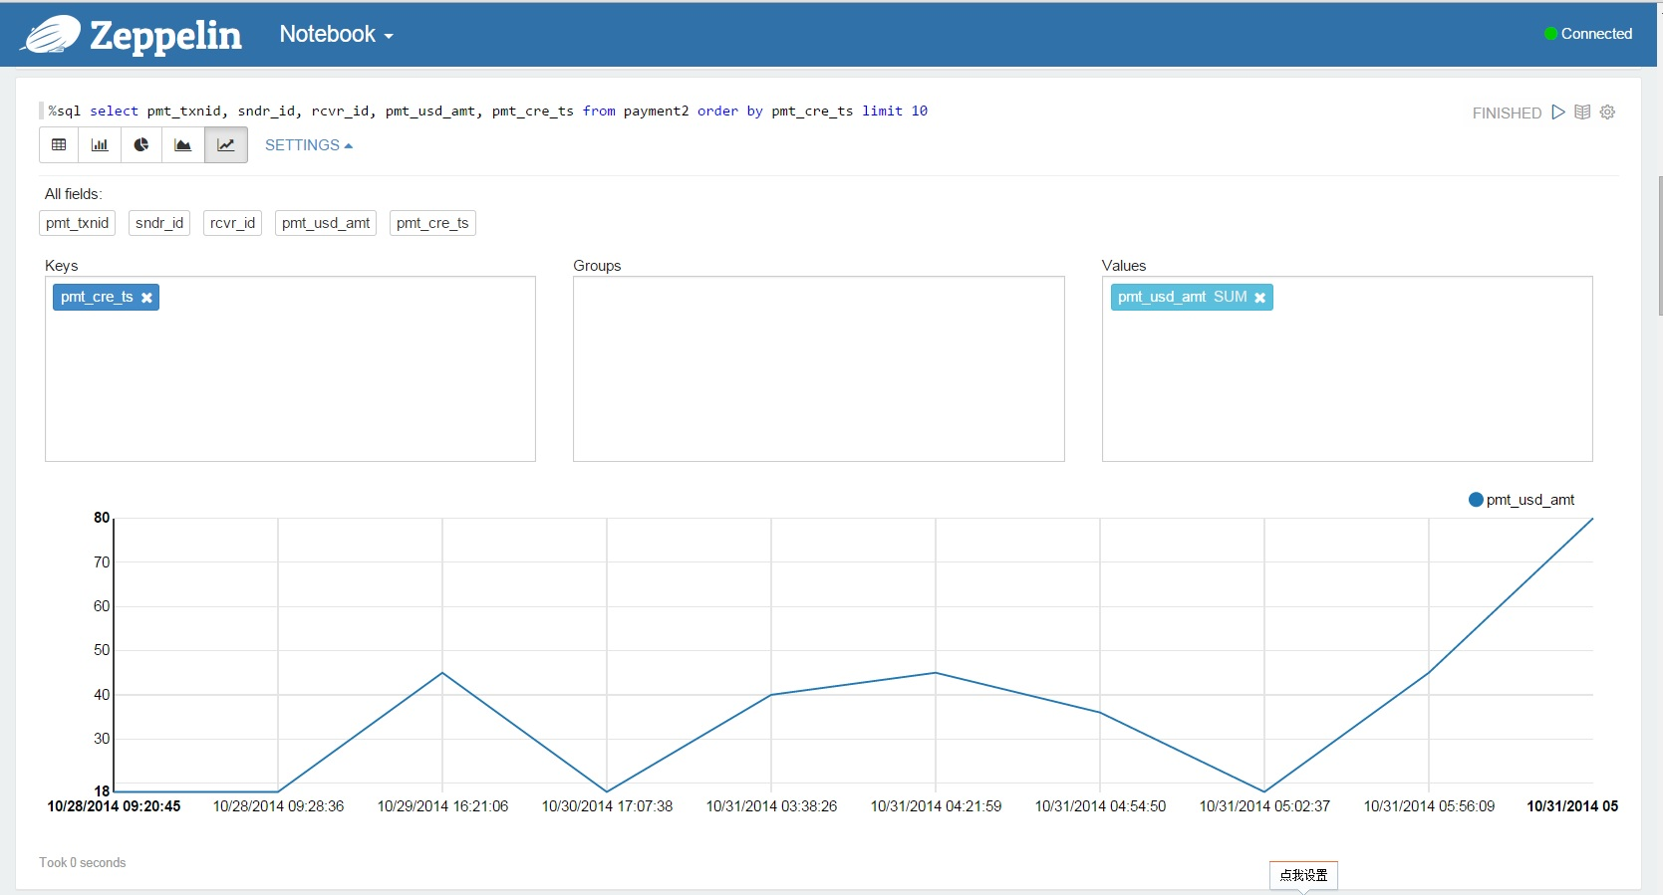

Slide 7
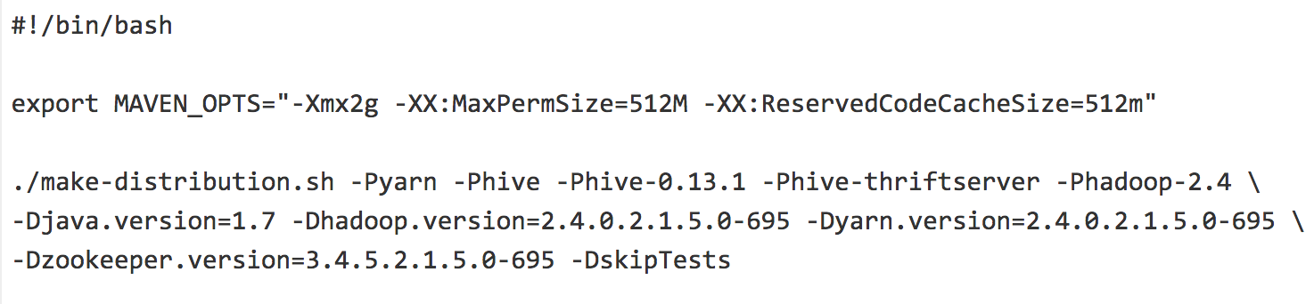
SPARKSQL 经验分享： Before You Start
Build a latest Spark from branch-1.2!
Lots of new features, bug fixes
Parameters are set to a better default
Join optimizations!

Slide 8
SPARKSQL 经验分享： 数据格式
Use Parquet (Columnar format, dictionary encoding, compression)
Data size dropped 40%! when converting from old SequenceFile (supposed to be highly compressed)
Columnar format avoids unnecessary IO and deserialization
vs
(30s vs 25min)

Slide 9
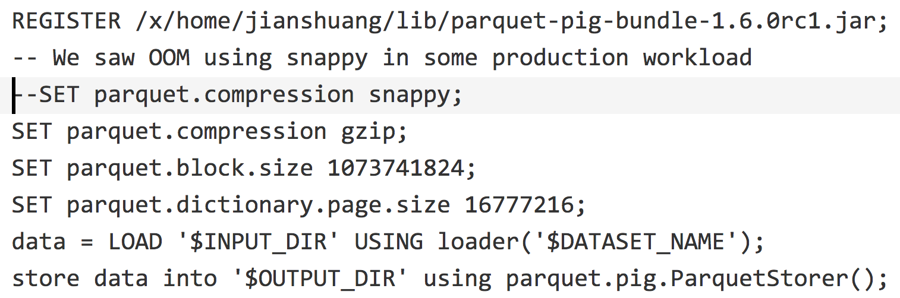
SPARKSQL 经验分享： 数据格式
Conversion is easy if you already have a Pig/Hive loader for your old data

Slide 10
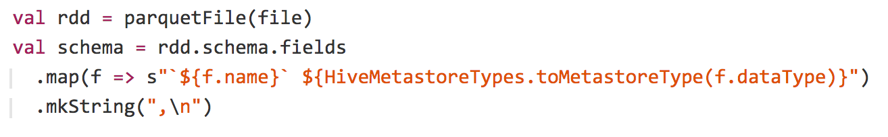
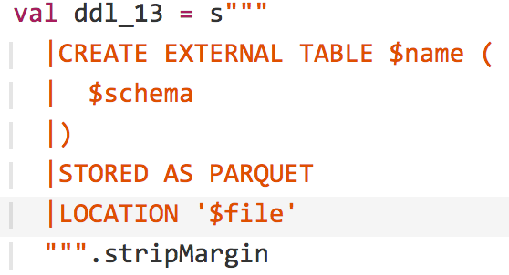
SPARKSQL 经验分享： Load Parquet in HiveContext
Note: Column names has to match Parquet schema.
Tip: Use CTAS (View) for Column renaming.
Try setting spark.sql.hive.convertMetastoreParquet to false to use Hive’s Parquet implementation if not working
https://gist.github.com/huangjs/683a4c85ae14e9ae205b#

Slide 11
SPARKSQL 经验分享： Broad-cast Join Optimization
Biggest headache ☺:
Join optimization support is still far from mature
Cannot specify which join algorithm to use
In Hive, we can add /*+ MAPJOIN(…) */
Not supported in SparkSQL HiveContext
It relies on table metadata retrieved by
Use “DESC EXTENDED <table>” to check metadata

Slide 12
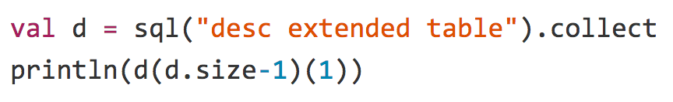
SPARKSQL 经验分享： Broad-cast Join Optimization
If…{EXTERNAL=TRUE, transient_lastDdlTime=1417763591, totalSize=56166}…works!
If…{numFiles=0, EXTERNAL=TRUE, transient_lastDdlTime=1417763892, COLUMN_STATS_ACCURATE=false, totalSize=0, numRows=-1, rawDataSize=-1}…not working…
Use “

Slide 13
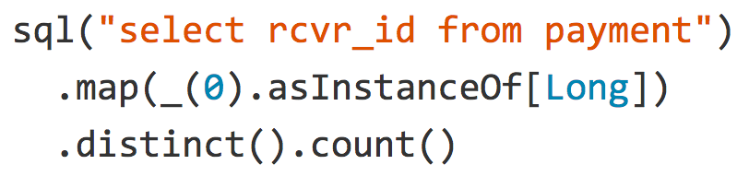
SPARKSQL 经验分享： Do not forget Spark core!
Sometimes ‘simple’ things like this might fail
Try using Spark core APIs
No window function support? Do it in Spark!

Slide 14
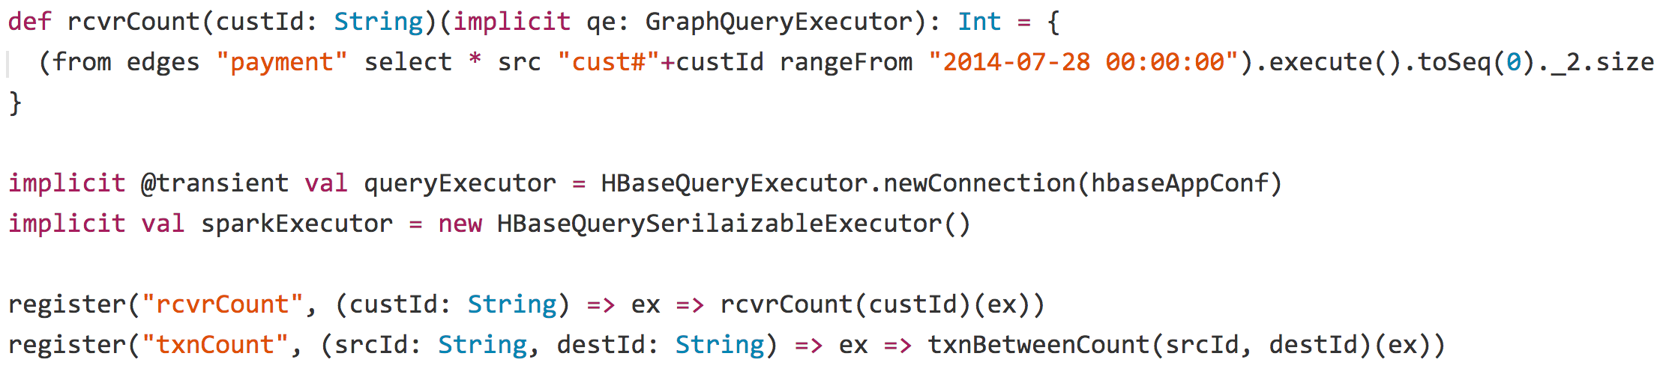
SPARKSQL 经验分享： UDF with Lazy ExecutionContext
There’s no mapPartition/foreachPartition
Use lazy instantiation! (Not lazy val in Scala, too tricky when using implicit with lazy)

Slide 15
THANK YOU! Q&A

