Slide 1

A gentle introduction to
Apache Zeppelin
Anthony Corbacho
Software engineers - NFLAbs
anthony@nflabs.com
anthonycorbacho@apache.org
Notes:
Intro myself
Happy to be here

Slide 2
What is Apache Zeppelin?
A web based notebook
Integrated with Spark and Hadoop
Multiple backends
Apache incubating project
Notes:
Apache Zeppelin is
A web-based notebook for interactive analytics Deeply integrated with Spark and Hadoop
Supports multiple language backends
An Apache incubator project
More details at https://zeppelin.incubator.apache.org/

Slide 3
What is NOT!!
Open source version of Databricks cloud!
Concurrent of Python notebooks!

Slide 4
Zeppelin used for ..?
Data exploration and discovery
Visualisation
Collaboration and publishing
“Modern Data Science Studio”

Slide 5
What zeppelin support?
Driven by the community - thank you!
Scala, pyspark, spark sql
Hive, Tajo, Ignite, Mysql, ….
Apache Flink
Markdown, shell
Your project?

Slide 6
Integration with Spark
Support for scala, python and spark sql
SparkContext injected automatically
Supports 3rd party dependencies
Spark-on-YARN and Spark standalone modes
Full Spark interpreter configuration
Multiple Spark interpreter profiles

Slide 7
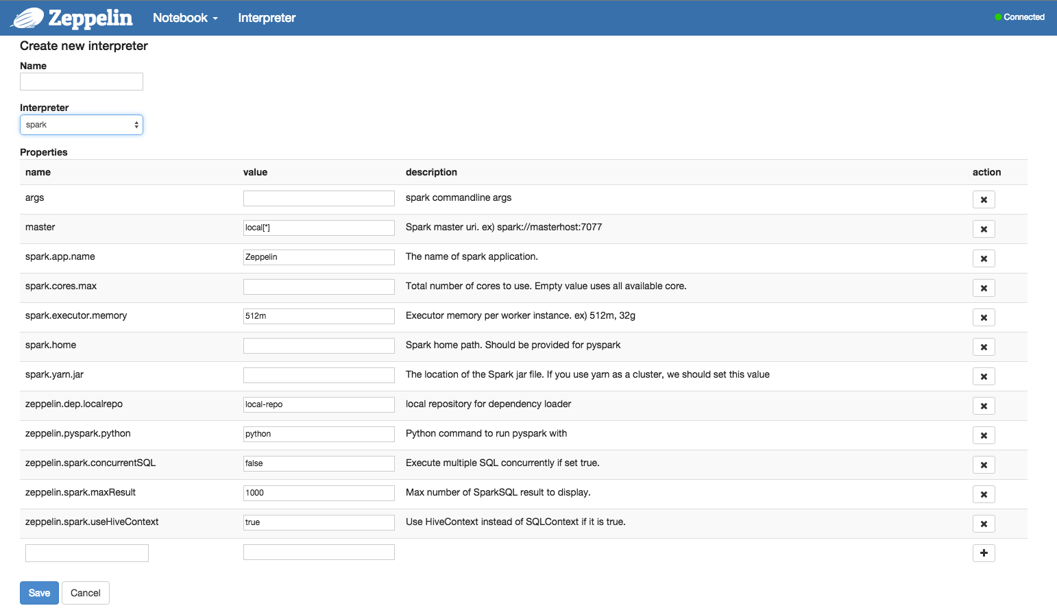
Integration with Spark

Slide 8
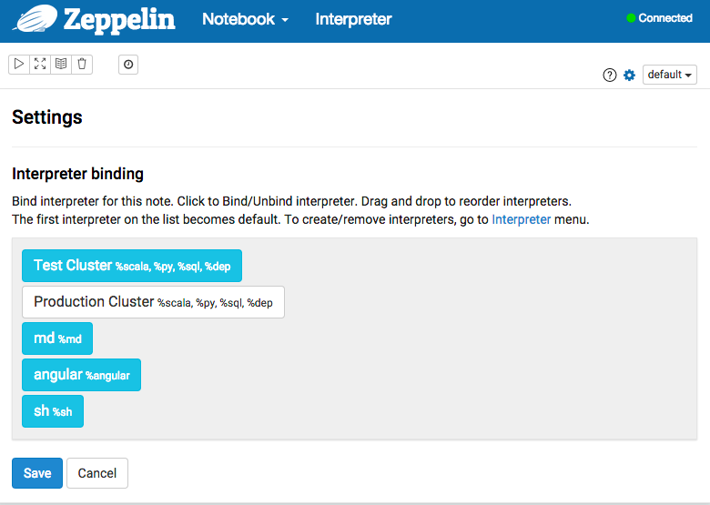
Integration with Spark
Binding
Bind interpreter configuration
to note.
SparkContext is injected.

Slide 9

Integration with Spark
Job control
Get information and control of the job
Cancel
Progress

Slide 10
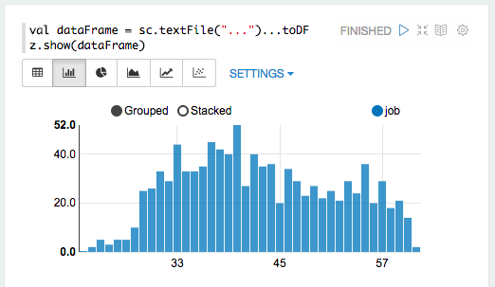
Integration with Spark
Displaying DataFrame

Slide 11
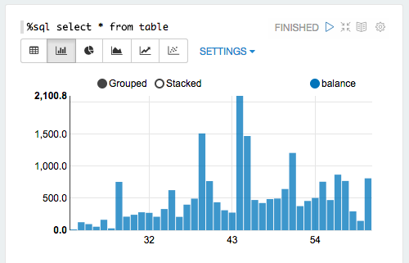
Integration with Spark
Displaying SparkSQL

Slide 12
How easy is to integrate your backend
with Zeppelin?

Slide 13


Interpreter
Interpreter is a connector between Zeppelin and Backend.
ZeppelinServer
Thrift
InterpreterGroup
Spark
Interpreter
Interpreter
Interpreter
Spark
PySpark
SparkSQL
Dep
Separate JVM process
Load libraries
Share single SparkDriver
Spark cluster
Maven repository

Slide 14
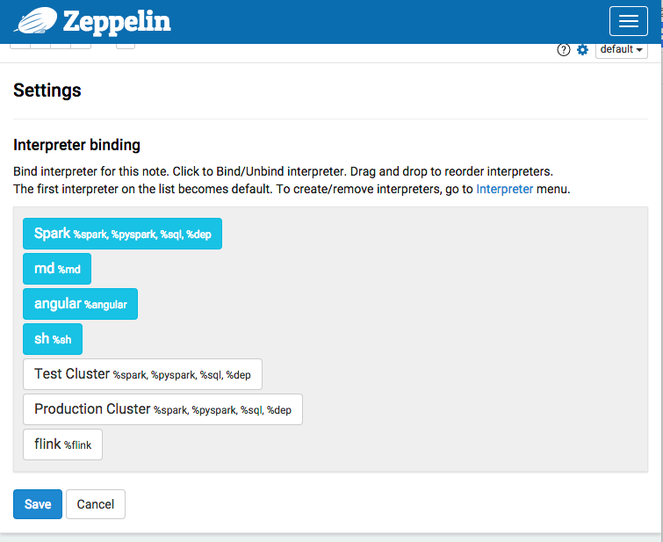

Interpreter
Spark
spark
pyspark
sql
dep
Load libraries
Share single SparkDriver
Spark cluster
Maven repository

Slide 15


Interpreter
Enables use multiple clusters
Large cluster
Small cluster

Slide 16
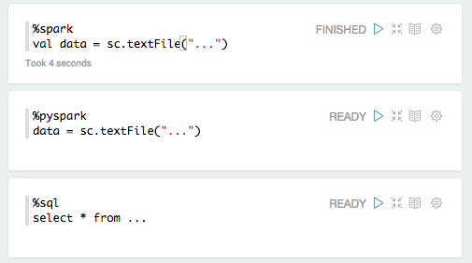
Interpreter
%[NAME] selects interpreter

Slide 17
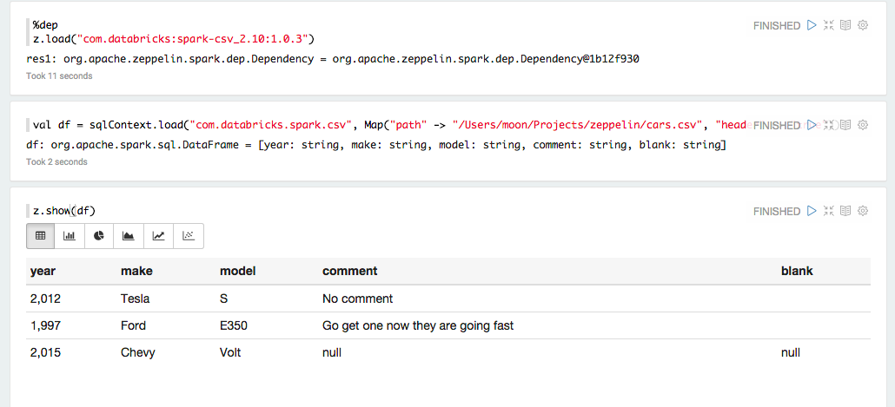
Interpreter
%dep Load libraries, Spark package

Slide 18
Interpreter
Create your own interpreter
by extending org.apache.zeppelin.interpreter.Interpreter
Must have
Good to have
Advanced
open()
close()
interpret()
cancel()
getProgress()
completion()
getScheduler()
getFormType()

Slide 19
Displaying your backend output
in Zeppelin

Slide 20
Display System
%[Display system] selects how your output going to be handled
text
table
html
angular
ZeppelinServer
input code
output data
spark
pyspark
sql
dep
%[Interpreter] selects how your input going to be handled

Slide 21
Display System
%[display system]
text (default)
table
html
angular (experimental) make zeppelin runs analytic application

Slide 22
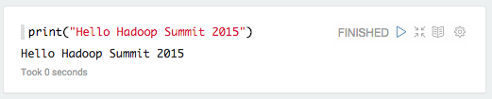
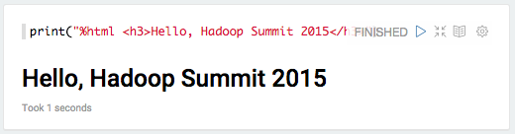
Display System
text
html

Slide 23
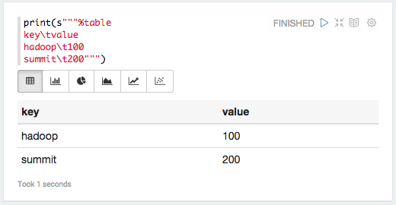
Display System
table

Slide 24
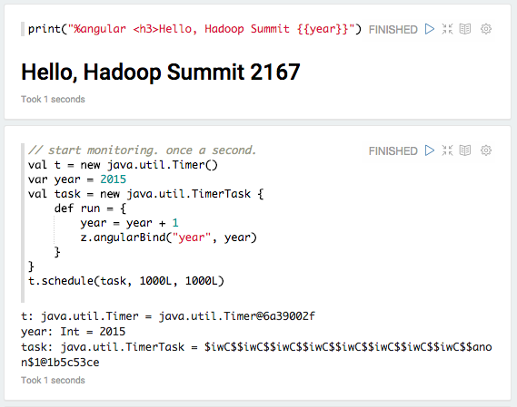
Display System
angular

Slide 25
Sharing your notebooks
with Zeppelin

Slide 26
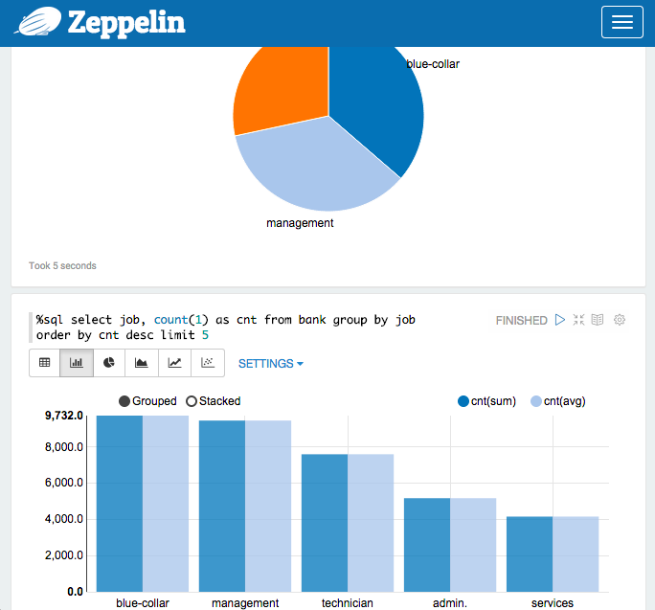
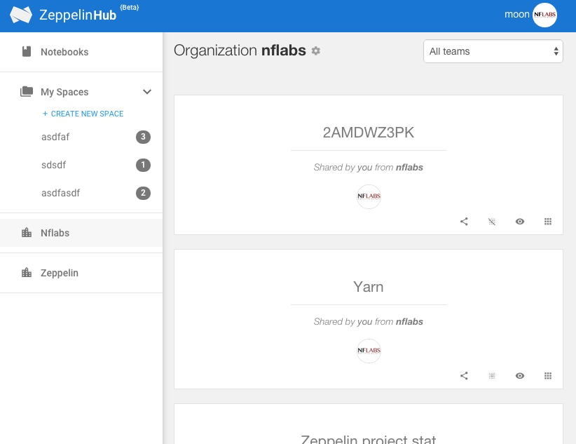
Sharing
Sharing notebook URL
Access control, Team sharing via ZeppelinHub by NFLabs
synchronised
synchronised by web socket

Slide 27
Pluggable persistence layer
Zeppelin abstracts notebook persistence layer
Local FS
Github? S3? NoSql?

Slide 28













Who are using Zeppelin

Slide 29
















Eco system
Collaboration, Sharing
Packaging & Deployment
ZeppelinHub
Zeppelin + Full stack on a cloud
Z-Manager
Backend integration
Package registry
Coming soon ...
More every weeks!!!!

Slide 30

Question?

