Slide 1

Hush Hush Recruiter
BORKAR, AADISHREE
SHARMA, SOUMYA
KIONGERA, MERCY
HANIF, ABDULLAH

Slide 2
Agenda
01
Project Architecture
04
Selection Algorithm Overview
02
Data Sources & Cleaning
05
Code Evaluation Overview
03
05
Database ER
06
Demo

Slide 3

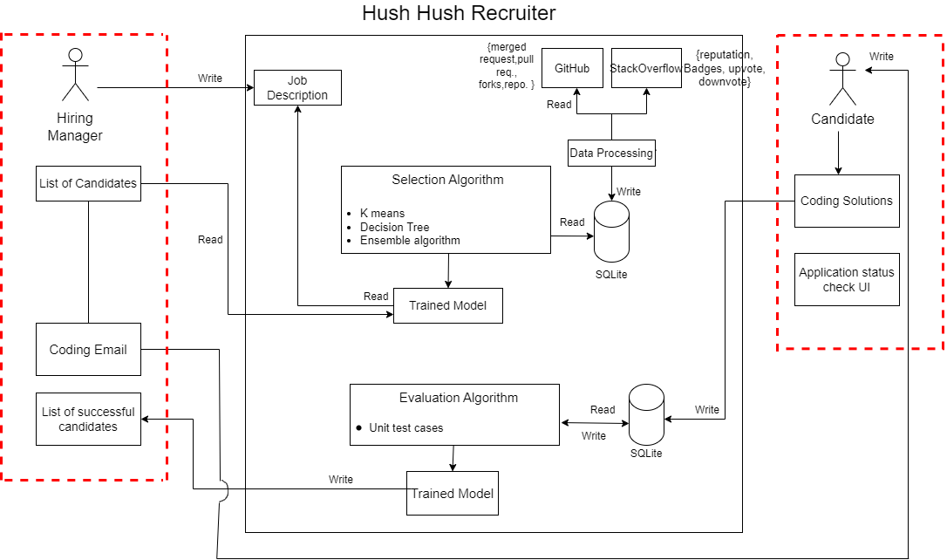
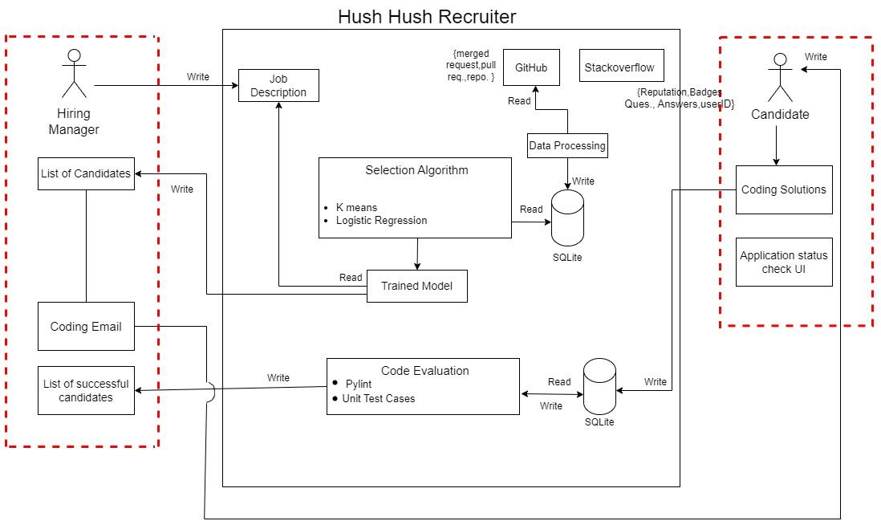
Project Architecture
What we promised
What we achieved
03
01
Notes:
Betika has grown even though there were challenges that influenced performance.
“Being a long standing partner, Betika has continued to be hugely popular with the Opera audience”

Slide 4
Data Sources, Technologies & Cleaning
Data Sources
Technologies Used
Data Cleaning
Removed null values for required fields.
Converting data types
Replacing Null values with 0
Stack Overflow
Async IO, Requests
Github
PyGithub, AIOHTTP, Time
Stack exchange API
02

Slide 5
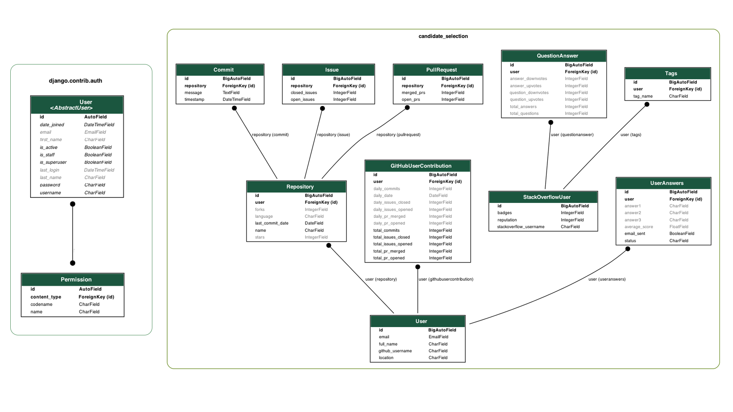
ER DIAGRAM
03
Notes:
Notes📝 👀
1. Clicks by month with all countries combined (ascending)
2. Marketshare combined across all countries
3. Indicate the percentages that increased and decreased over the period with lines

Slide 6


Candidate Selection Algorithm
Input data
ML library used
Github user dataframe , 5 datapoints (commits, opened pull requests, merged pull requests, issues opened, issues closed)
WHY?
Simple & efficient.
Includes wide range of algorithms.
Integrates seamlessly with computing libraries such as Numpy.
Open source.
04
*Images taken from Google.

Slide 7

Candidate Selection Algorithm
ML algorithms implemented
K means clustering -
Defined number of clusters as 2 (1 -good , 0 –bad).
Trained model using kmeans.fit()
Used Pickle library to serialize the trained model into a .pkl file.
Logistic regression-
Taking the user dataframe along with cluster labels and validating the good & bad candidates.
Trained model using logreg.fit()
Used Pickle library to serialize the trained model into a .pkl file.
Printed accuracy and confusion matrix (Accuracy was 0.96).
05
Image source-https://www.interviewquery.com/p/data-science-memes

Slide 8

Candidate Selection Algorithm
Testing the model
Depending on user requirement, new data is scaled & passed through model.
Both models are loaded using pickle.load
Output list of candidates is seen on the UI.
06

Slide 9
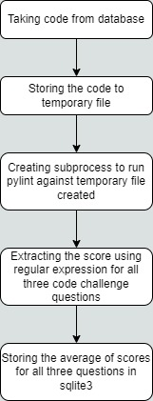
Code Evaluation: Pylint Score
Libraries used: a) Pylint b) re c) Subprocess
We are using Pylint to check code and its quality.
We are using 're' package to extract the evaluation score from the output report.
We are running pylint in the subprocess because we can isolate pylint issue with main python code.
Refrence: https://pylint.pycqa.org/en/latest/development_guide/api/pylint.html
07

Slide 10
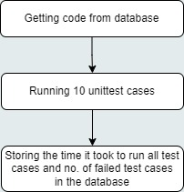
Code Evaluation: Unittest Cases
Libraries used: a) Unittest b) re c) sys d) io
The primary motive behind using unittest is to verify the behavior and correctness of individual units of code.
It is also implemented to give us idea about the time complexity of the code submitted by the applicant.
08

Slide 11
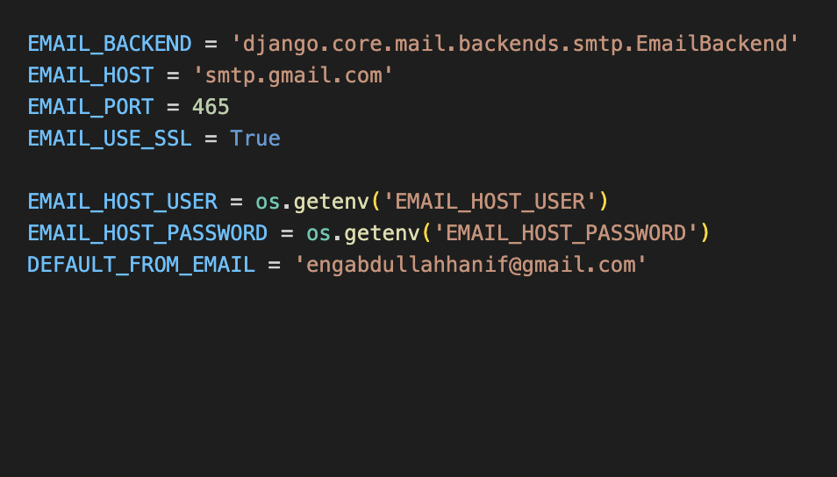
Email Executions
Email to invite selected candidates to an interview
Email to rejected candidates
Email to invite selected candidates for an interview
Technology Used:
09

Slide 12
Live Demo
10

Slide 13
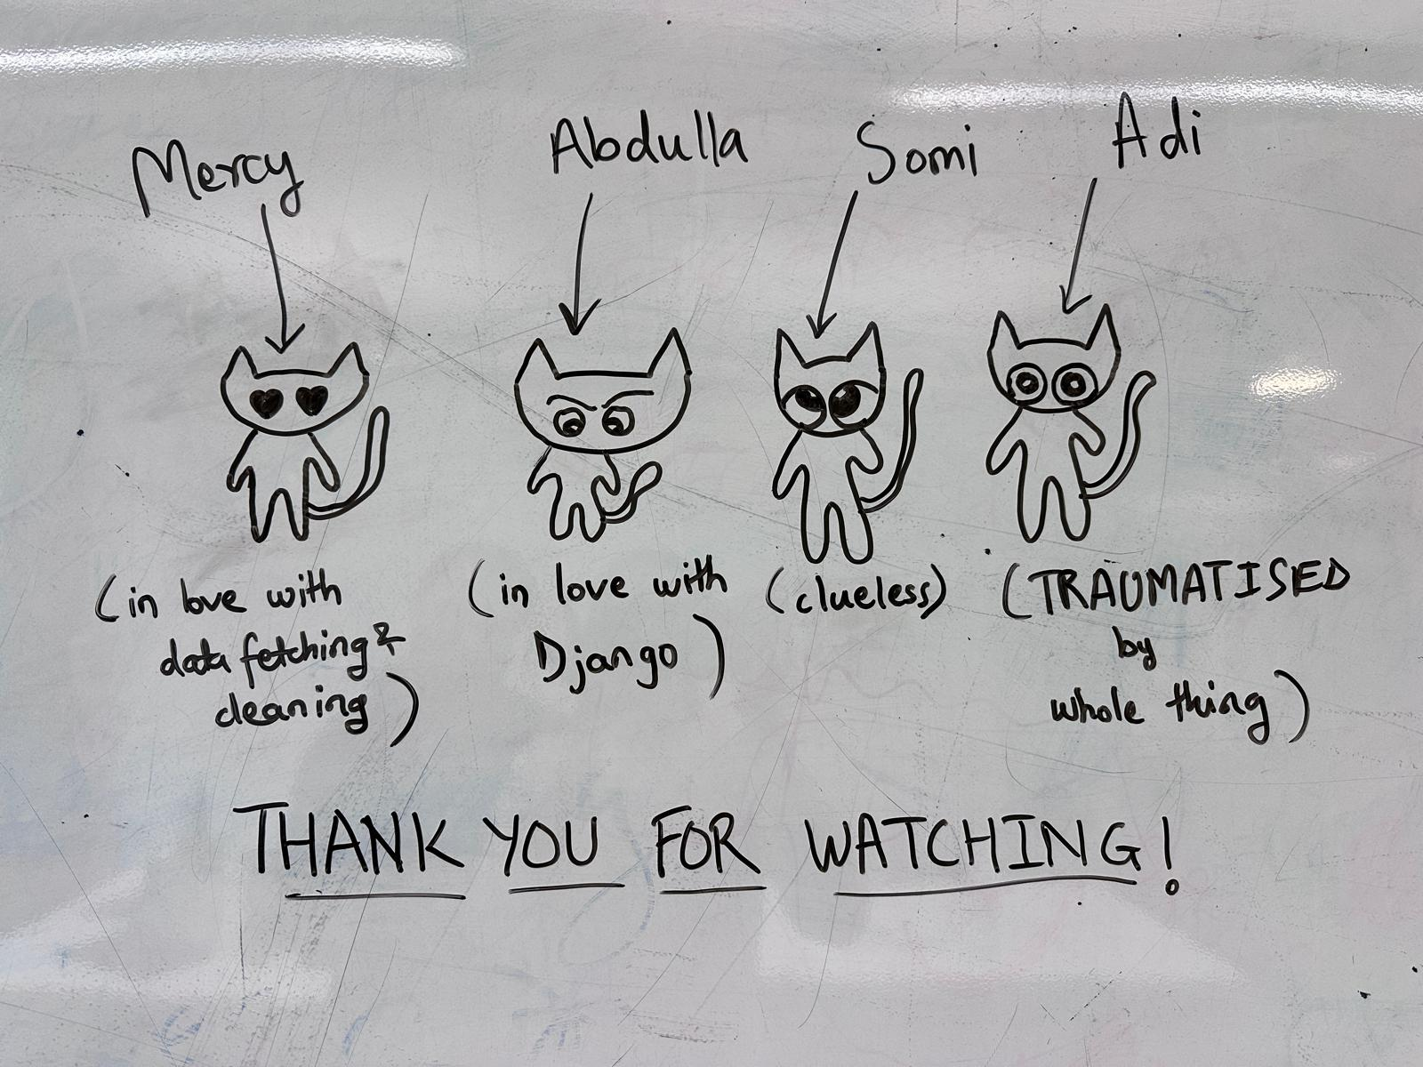
Q & A

