Slide 1
Canadian smoking history generator
Maikol Diasparra

Slide 2
AGENDA
Intro
Decisions
Questions

Slide 3
Introduction
First part of the project
Use CCHSFLOW r package to harmonize the annual CCHS master cycles from 2001 to 2023
Variable Formats between cycles were compared using app Data Dictionary Builder
Variables of interest : demographic (sex, province, age, survey weight) , smoking behaviour (smoking type, initiation age, years since quit, pack-years, etc. ). Do not include household income
Notes:
1) 2021 CCHS won't include respondents in the Territories
2) 2022 CCHS file in the "Territories" folder includes respondents from the territories
3) For 2023 and 2024 CCHS, the respondents from the territories will be released with the 24-month file

Slide 4
List of variables (47 harmonized vars)

Slide 5
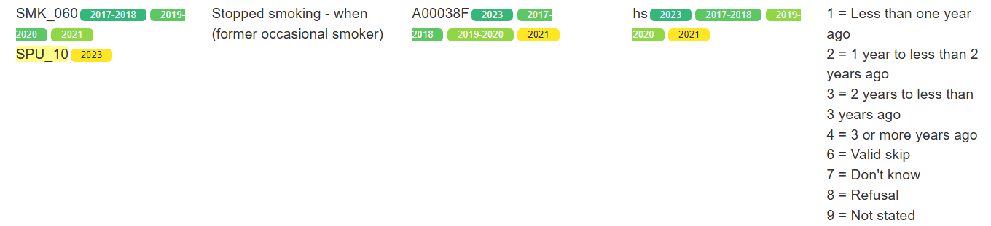
Decisions from previous meetings
Maintain continuous variable structure whenever possible
Smoker type was completed using smoker type 2 (Rochelle)
Type of smoker: daily, occasional, former daily, former occasional, experimental, never:
Cycles 2022 & 2023 were added to SMKDSTY_B
When did you stop smoking daily - former daily:
Cycle 2022 was added to SMK_09A_cont (pending question!)
SMK_060 replaced SMK_100 in cycles 2017-2018:2021

Slide 6
Question 1:
When did you stop smoking daily - former daily:
Cycle 2022 was added to SMK_09A_cont
If SPU_25_A_I is missing, can we calculate the difference in years between the year of the interview and the year of the quit date?

Slide 7
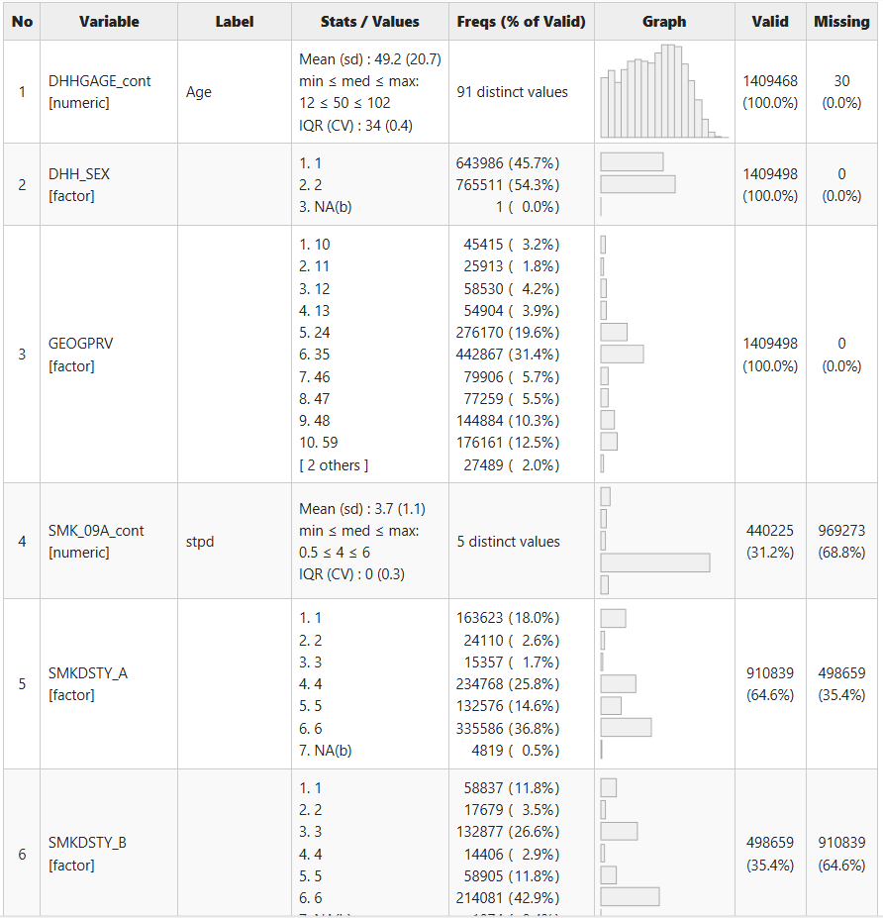
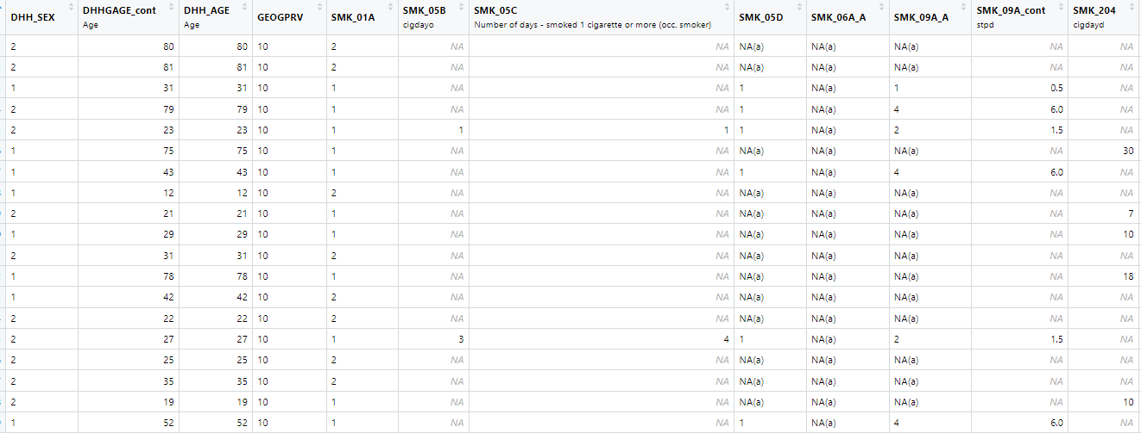
Question 2: I wonder if it is important to recode the NAs

Slide 8
Question 3: CCHSFLOW bounds
Could we extend the ranges?
For example, derived variables related to “the age at which the first whole cigarette was smoked” started at age 5. But 14 people from CCHS 2023 have values in [0,4].
I wonder if I should reassign values in [0,4] to 5 years (as the lowest possible value) or extend the range to include the values

Slide 9
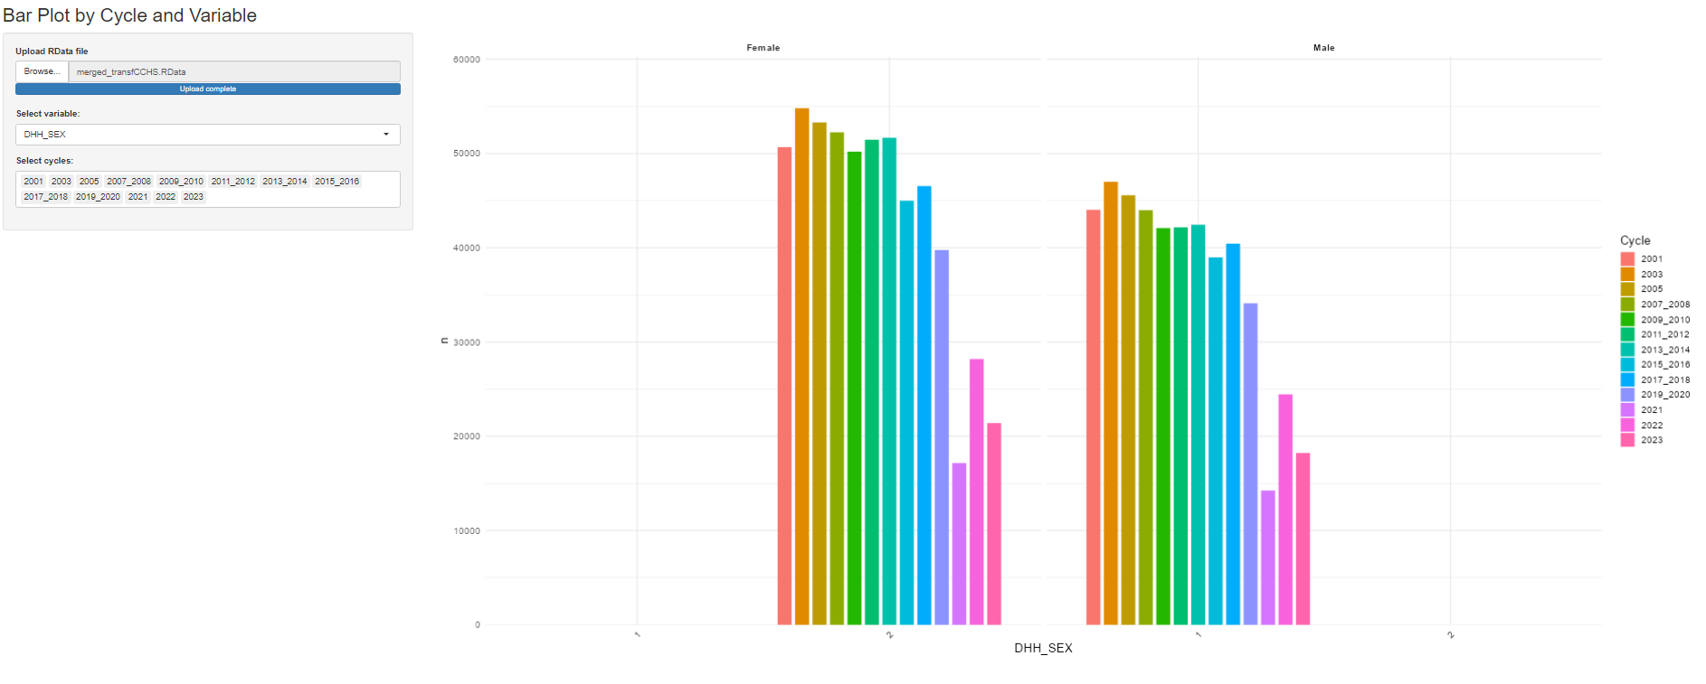
Issues with some Cycles
1) 2021 CCHS won't include respondents in the Territories
2) 2022 CCHS file in the "Territories" folder includes respondents from the territories (pending task!)
3) For 2023 and 2024 CCHS, the respondents from the territories will be released with the 24-month file (I have no access to 2024 data)
Question 5: Can we include incomplete cycles?

Slide 10
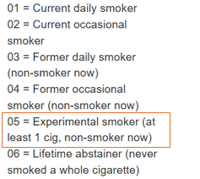
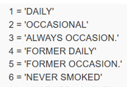
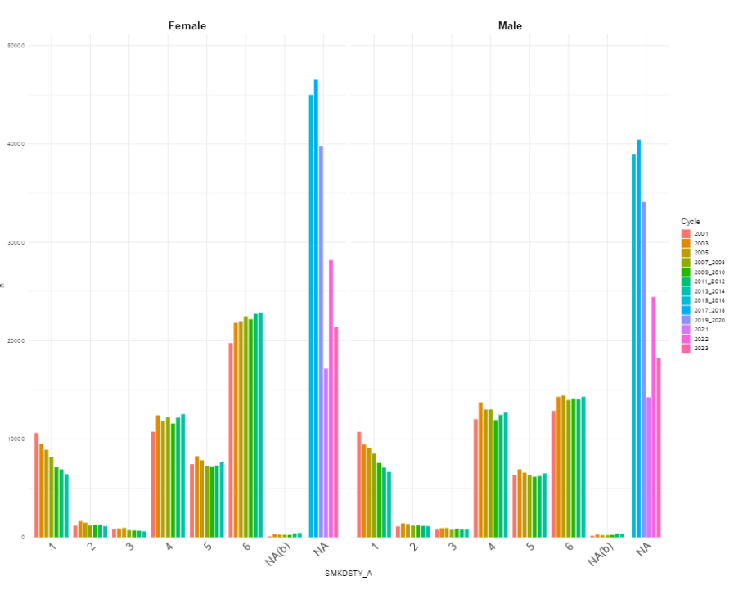
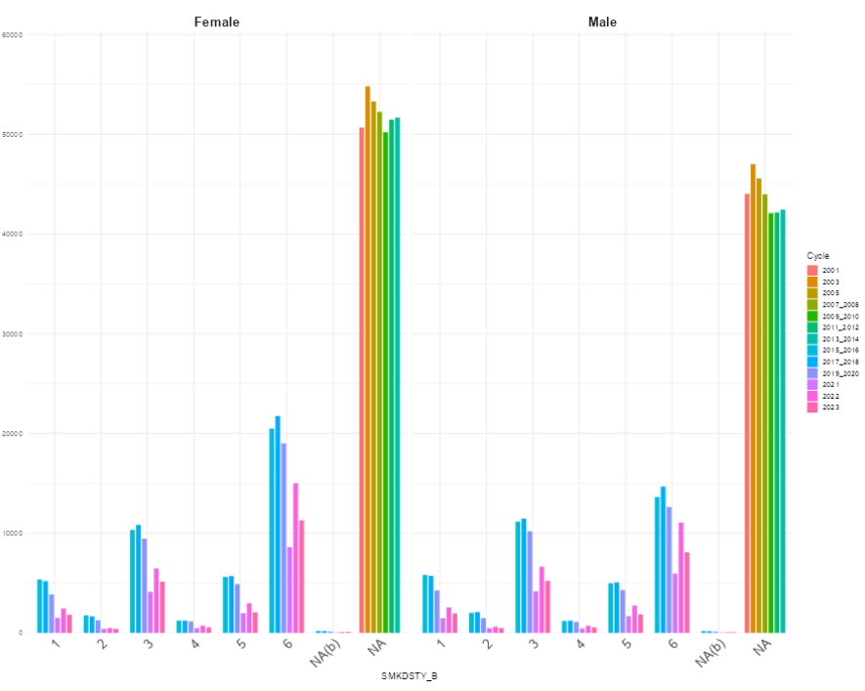
Question 6: recode derived vars
I will provide more detail about this question next week
Smoking status (type 2)

Slide 11
Questions about CCHSFLOW
Notation convention for variable names and labels. I just added a “_I” at the end of the name
How to keep track of decisions, new functions, typos and errors

Slide 12
Work in progress
Derived variable graphical timeline
Age started to smoke daily - daily/former daily smoker (SMKG040_cont)

Slide 13
Thanks!

