Slide 1
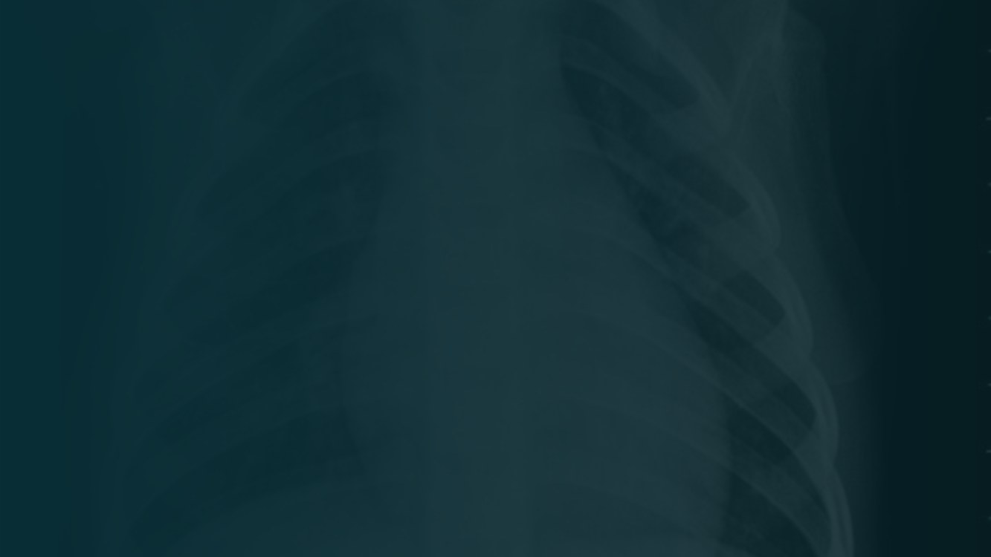
AI-POWERED
Pneumonia Screening from Chest X-Rays
Deep Learning, Dual Explainability & a Full-Stack Web App
Group 7 • NITDA Data Science Advanced (Machine Learning) • In collaboration with NCAIR
Okoli Praise Daniel (Group Leader) • Fatimat Ismaila(Assistant) • Faruk Muhammed • Muhammad Abdulazeez • Sefinatu Abdulai • Kammaluchuckwu Amah
Notes:
Our project: an AI tool that screens chest X-rays for pneumonia, classifies them, and explains its decision visually. I'm Praise, group leader.

Slide 2

THE CLINICAL NEED
Introduction & Problem Statement
High X-ray volume
“
Radiologists reviewing many chest X-rays can miss early or subtle pneumonia.
A decision-support tool — not a replacement for the radiologist's judgment.
Time matters
In acute care, turnaround time directly affects patient outcomes.
A first-pass filter helps
An automated flag — with a visual a clinician can verify — speeds triage.
Notes:
High volume plus time pressure means subtle pneumonia gets missed. An automated first-pass flag with a visual explanation helps triage. Crucially, it supports the clinician, it doesn't replace them.

Slide 3
WHAT WE SET OUT TO DO
Objectives
01
Classify
Label a chest X-ray as NORMAL or PNEUMONIA.
02
Prioritise recall
Catch real pneumonia — a missed case costs more than a false alarm.
03
Explain
Make decisions visible with a Grad-CAM heatmap over the lung.
04
Package
Wrap the model in a working review app — not just a notebook.
05
Report honestly
Present real metrics and known limitations.
Notes:
Five objectives: classify; prioritise recall because missing a sick patient is the costly error; explain via Grad-CAM; package into an app; and report honestly.

Slide 4
BOUNDARIES OF THE PROJECT
Scope
IN SCOPE
OUT OF SCOPE
Binary classification: pneumonia vs normal
Confidence score per prediction
Visual explanation (Grad-CAM overlay)
Upload-and-review application
Documented limitations & dataset bias
Localization / bounding boxes (data is folder-labelled)
Bacterial vs viral subtypes
Other modalities (CT, MRI, ultrasound)
Clinical diagnosis or treatment advice
Notes:
The data is folder-labelled, not box-annotated, so this is correctly classification, not detection. We exclude subtypes, other scan types, and any actual diagnosis.

Slide 5
WHY MOBILENETV2 — CHOSEN ON EVIDENCE
Model Comparison
We benchmarked three CNNs under identical conditions. MobileNetV2 won on accuracy, recall, and AUC — and is the smallest model.
Model
Params
Accuracy
Pneu Recall
AUC
MobileNetV2
~2.2M
0.913
0.956
0.968
DenseNet121
~7.0M
0.892
0.907
0.953
ResNet50
~23.5M
0.765
0.891
0.851
MobileNetV2 is simultaneously the lightest and the best-performing — ideal for web deployment.
Notes:
We didn't just pick MobileNetV2 for speed — we benchmarked it against DenseNet121 and ResNet50 under identical conditions. It won on accuracy (91.3%), pneumonia recall (95.6%), and AUC (0.968), while being far smaller. ResNet50 underperformed because deep models need more epochs to converge with a frozen base.

Slide 6
HOW WE BUILT IT
Dataset & Methodology
~5,800
224×224
4,412 / 794 / 618
images, 2 classes
image size, batch 32
train / valid / test
PIPELINE
1
Audit & re-split, class weights for imbalance
2
Augment (rotate, brightness, zoom — no flips)
3
Benchmark 3 CNNs: MobileNetV2 / DenseNet121 / ResNet50
4
Grad-CAM + LIME dual explainability
5
Full-stack app (Next.js + FastAPI), deployed
Notes:
~5,800 images at 224x224. We fixed a too-small validation set, augmented with rotation, brightness, zoom — NO horizontal flips because chest anatomy has a fixed orientation. Imbalance handled with class weights, not deleting data. MobileNetV2 transfer learning, 5 epochs.

Slide 7
RESULTS & FINDINGS
Strong Recall On Pneumonia
91.3%
95.6%
0.968
Overall accuracy
Pneumonia recall
AUC-ROC score
Pred NORMAL
Pred PNEU
Why recall matters
True NORMAL
194
37
MobileNetV2 won the benchmark: highest accuracy, recall, and AUC — while being the smallest model (~2.2M params vs 7M / 23.5M).
True PNEU
17
370
Diagonal = correct. Only 17 pneumonia cases missed (of 387).
Notes:
Headline. 90% accuracy, but recall matters most for screening. 96% pneumonia recall — caught 373 of 387, missed 14. Normal recall improved to 81 percent, meaning fewer false alarms (45). This is a deliberate trade-off versus the earlier version.

Slide 8
BEING HONEST ABOUT THE MODEL
Interpretation & Limitations
!
Weaker on normal cases
81% recall on normal — some healthy patients are still flagged. The trade-off of tuning for pneumonia sensitivity.
!
Dataset bias
Likely pediatric and single-hospital — may not generalise. We state this openly.
!
Possible shortcut learning
Explainability showed heatmaps sometimes land outside the lungs — the model may use non-clinical cues. Our app flags this honestly; the fix is lung segmentation + diverse data.
Notes:
We name our weaknesses first. Still flags some normal cases (81% recall). Dataset likely pediatric/single-source. The app runs on a temporary ngrok link, so it is not permanently hosted.

Slide 9
FROM BASELINE TO FULL SYSTEM
Next Steps
1
Fix shortcut learning
2
Adult + multi-site data
Lung segmentation before training so the model attends to pulmonary fields, not borders.
Validate on adult, multi-hospital cohorts to improve generalisation.
3
Permanent hosting
4
Batch triage
Move from the tunnel to managed cloud hosting (Cloud Run / HF Spaces).
Multi-file upload ranking cases by urgency for emergency prioritisation.
Notes:
Grad-CAM and the app are already built. Remaining work: tune the decision threshold to rebalance recall; move from the temporary ngrok link to permanent hosting; add a batch triage view; and test other backbones like DenseNet on more diverse data.

Slide 10
CONCLUSION
A working, explainable, deployed screening tool
Best model (MobileNetV2): 91.3% accuracy, 95.6% recall, 0.968 AUC
Dual explainability (Grad-CAM + LIME) + a deployed full-stack web app (Next.js/FastAPI)
Honest reporting — including a shortcut-learning finding surfaced by our own explainability
“Flags likely pneumonia, explains its reasoning, and respects the radiologist's final judgment.”
Group 7 — NITDA Data Science Advanced (ML)
Notes:
To conclude: a working tool at 90% accuracy and 96% pneumonia recall; Grad-CAM explainability and a live Streamlit app deployed via ngrok; and honest reporting of the trade-offs. It flags pneumonia, explains itself, and leaves the final call to the radiologist. Thank you.

