Slide 1
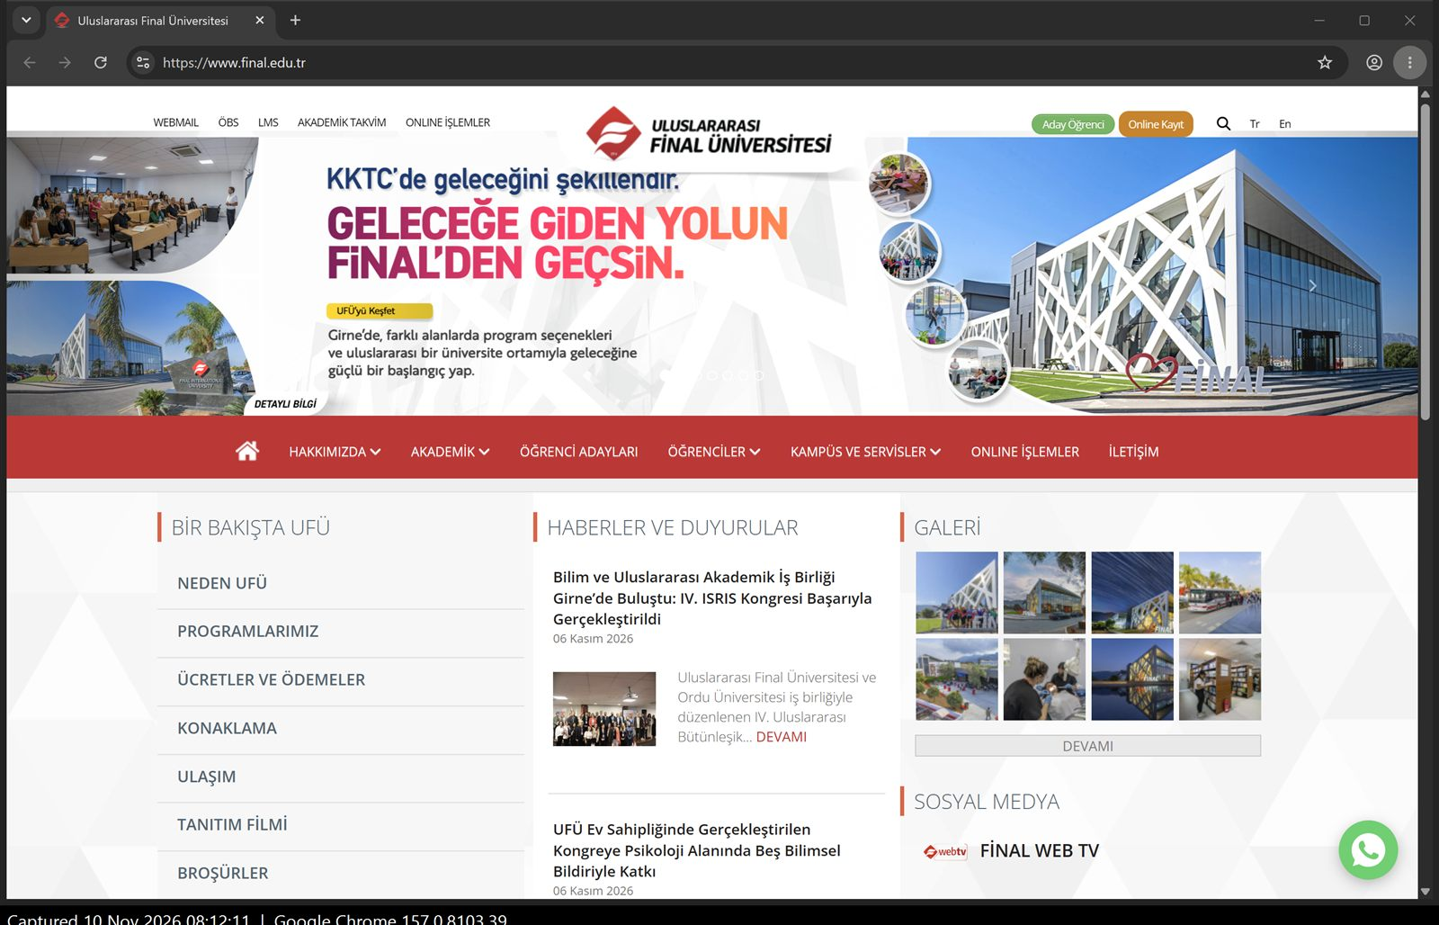
Website Field Study
www.final.edu.tr — Final International University
Abdalla Ali · 2103060186
SFWE475 Advanced Web Programming · Assignment 2
Audit date: 10 November 2026
Notes:
Hello. For this assignment I audited our own university's public website, final.edu.tr. I looked at it like a normal visitor, using only Chrome and its developer tools, and I will show what works, what does not, and the three things I would fix first.

Slide 2
What I checked and how
1
Under the hood (A1–A7)
Ground rules
HTTPS, URLs, network requests, missing pages, caching, how the page is built, SEO tags — Chrome DevTools
Viewer only, like any visitor
No logins, scanners or hidden pages
No form was sent — the contact form is marked “not tested safely”
27 screenshots, each with the address bar and a time stamp
2
The experience (B1–B8)
Slow 3G and offline, empty search, forms and labels, keyboard only, Lighthouse, link text
3
Recommendations (Part C)
Two strengths, three ranked fixes, and a one-page summary for the owner
Notes:
I split the work into three parts, exactly like the assignment. Part A is what happens under the hood, Part B is how the site feels, and Part C is my advice. I stayed a viewer the whole time: I never logged in, never used a scanner, and I did not send the contact form, because it has no checks and an empty press would really send it.

Slide 3
The home page in four numbers
24 MB
64
7.8 MB
63/100
downloaded for one visit to the home page
requests to show one page
for one news photo shown at 104 × 75 px
Lighthouse accessibility score
[A3]
[A3]
[A3]
[B7]
Notes:
Here is the site in four numbers. One visit to the home page downloads 24 megabytes, in 64 requests. One single news photo is almost 8 megabytes, but on the page it is shown the size of a stamp. And the automatic accessibility check gives 63 out of 100.

Slide 4
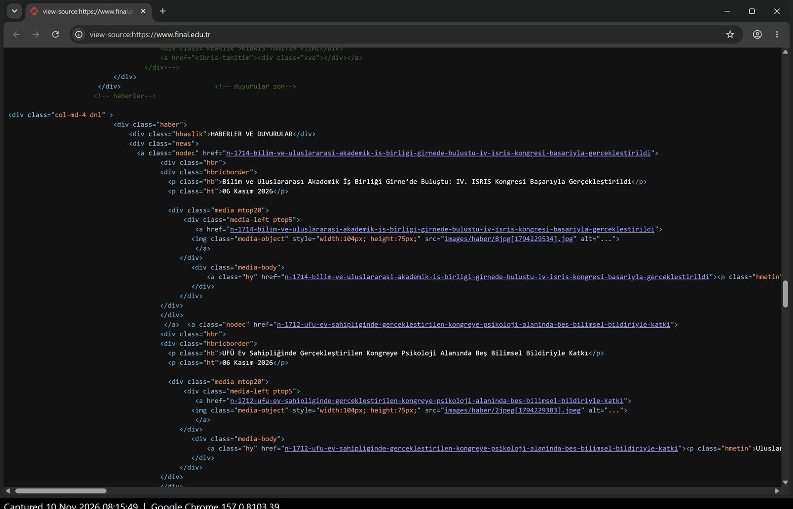
Under the hood: what works
✓
Secure by default
Typing http:// ends on https://www.final.edu.tr. TLS 1.3, and every file loads securely.
[A1]
✓
Built on the server
The raw HTML already holds the menu and every news headline, so text and search engines get content at once.
View source: news headlines are already in the HTML [A6]
[A6]
Notes:
First the good news. The site forces a secure connection: even if you type http, you end up on https, and every file loads securely. Second, the page is built on the server. When I opened the page source, all the news titles were already there. That means text appears fast and Google can read it.

Slide 5
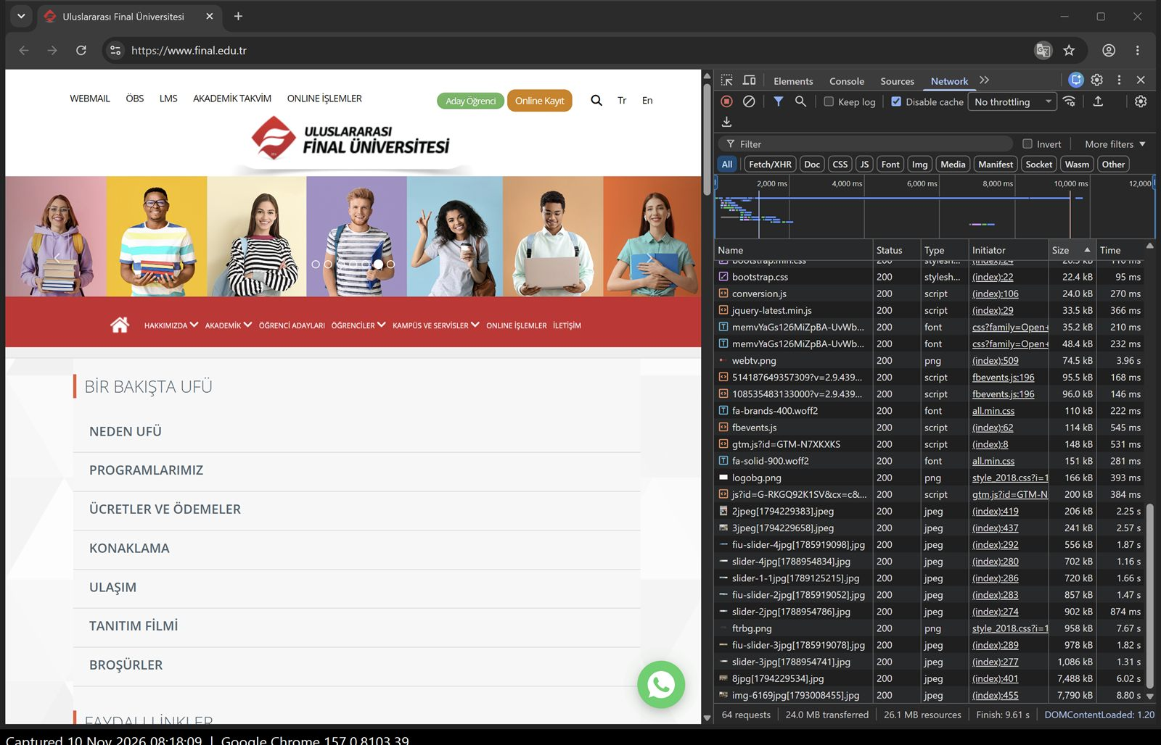
Camera photos used as tiny thumbnails
Two news photos: 7.79 MB and 7.49 MB — about 64% of the whole page
Each is 6000 × 4000 pixels but shown at 104 × 75 pixels
Page HTML is never cached; images only for 4 hours, so return visits pay again
Fix: resize thumbnails to their real size (~20 KB each) and load images on scroll
Network panel sorted by size [A3, A5]
Notes:
This is the biggest problem. I sorted the network requests by size. At the bottom are two news photos, each almost 8 megabytes. They are full camera photos, 6000 by 4000 pixels, but the page shows them at 104 by 75 pixels. So visitors download a huge photo just to see a small picture. Resizing them is cheap and would cut most of the page weight.

Slide 6
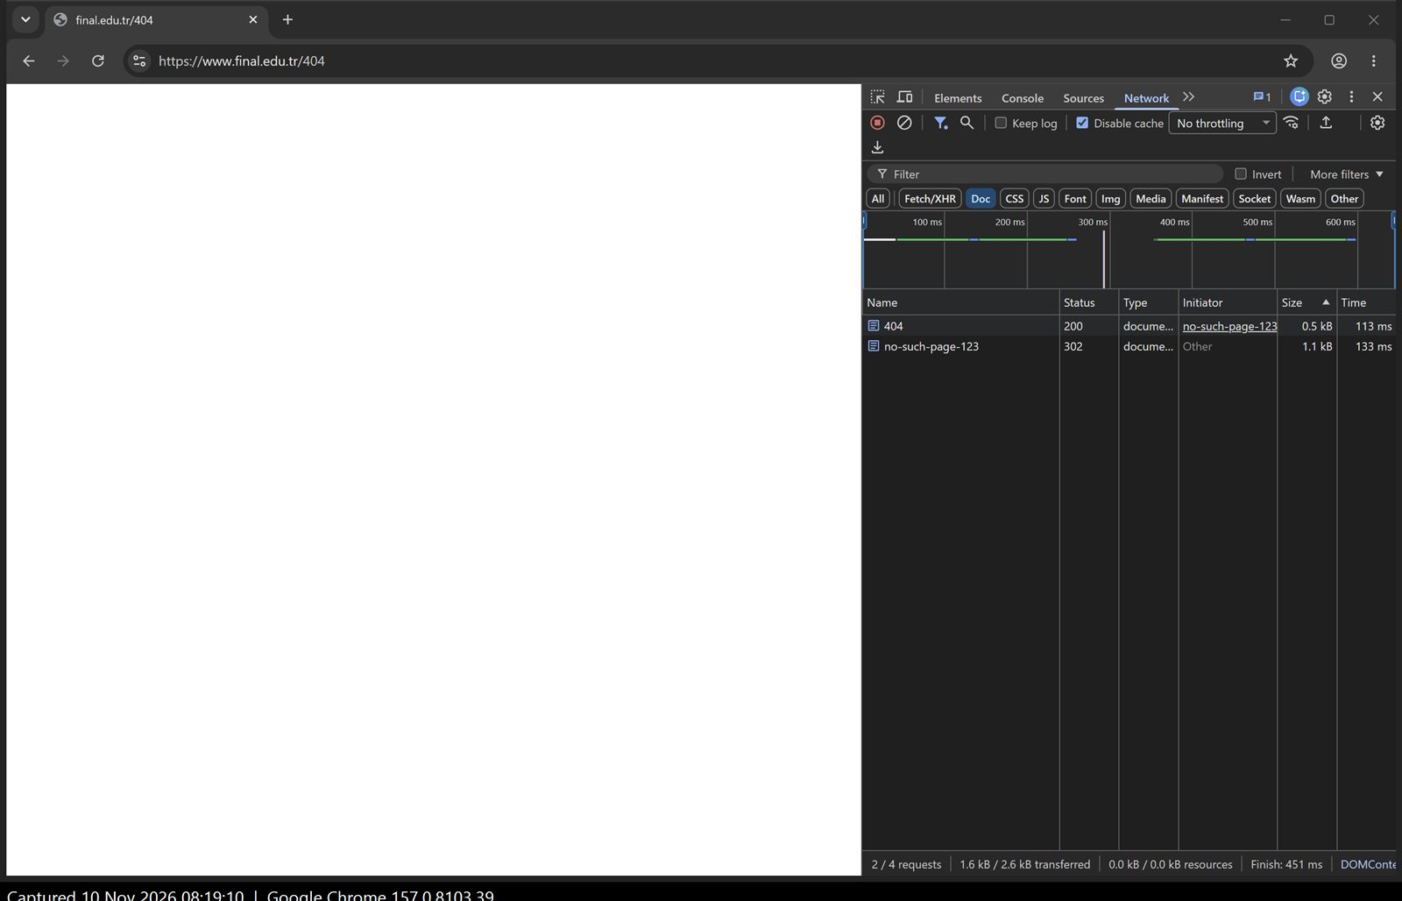
A missing page is a blank white screen
SEO basics on the home page [A7]
Item | Result
Title | Same on every page
Description | Only repeats the name
Canonical | Missing
lang | Missing
h1 headings | 0
Visitors see no logo, no menu, no message. Status 200 also tells Google the page exists.
/no-such-page-123 → 302 → /404 → 200, empty page [A4]
Notes:
When I typed an address that does not exist, the site redirected to a page called 404, but that page returns status 200 and is completely empty. A visitor just sees white, with no menu and no way back. On the right are the SEO basics: no language tag, no main heading, no canonical link, and the same title on every page.

Slide 7
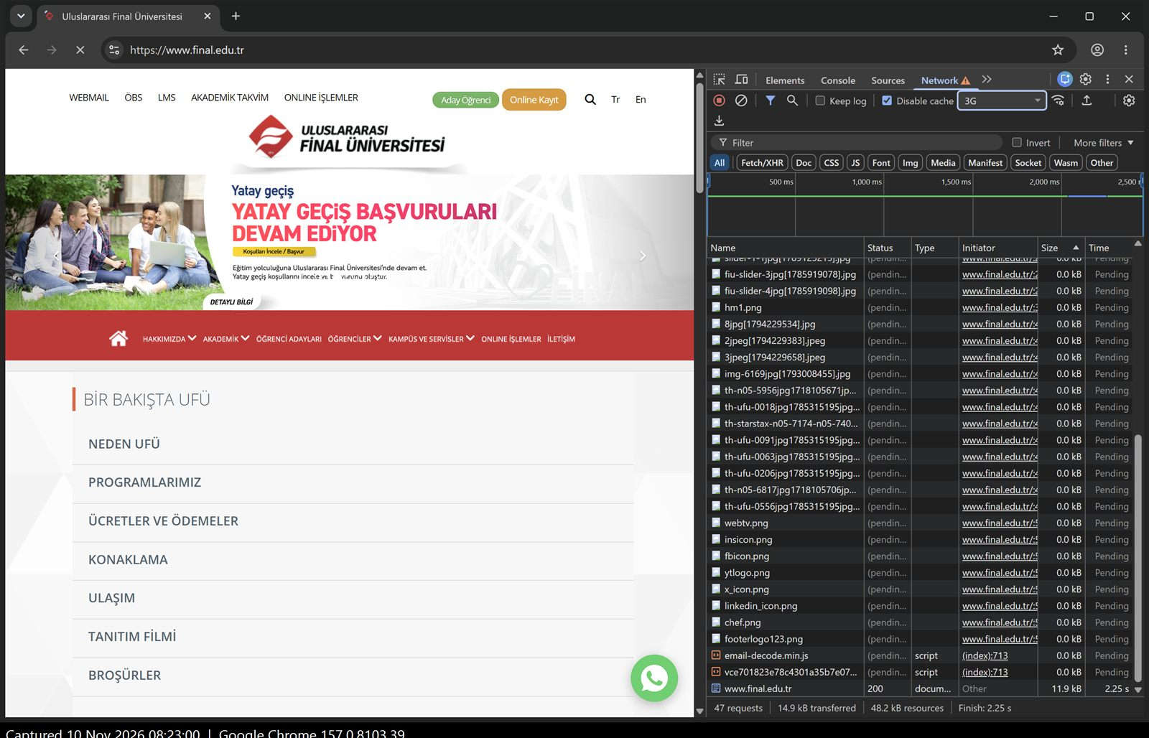
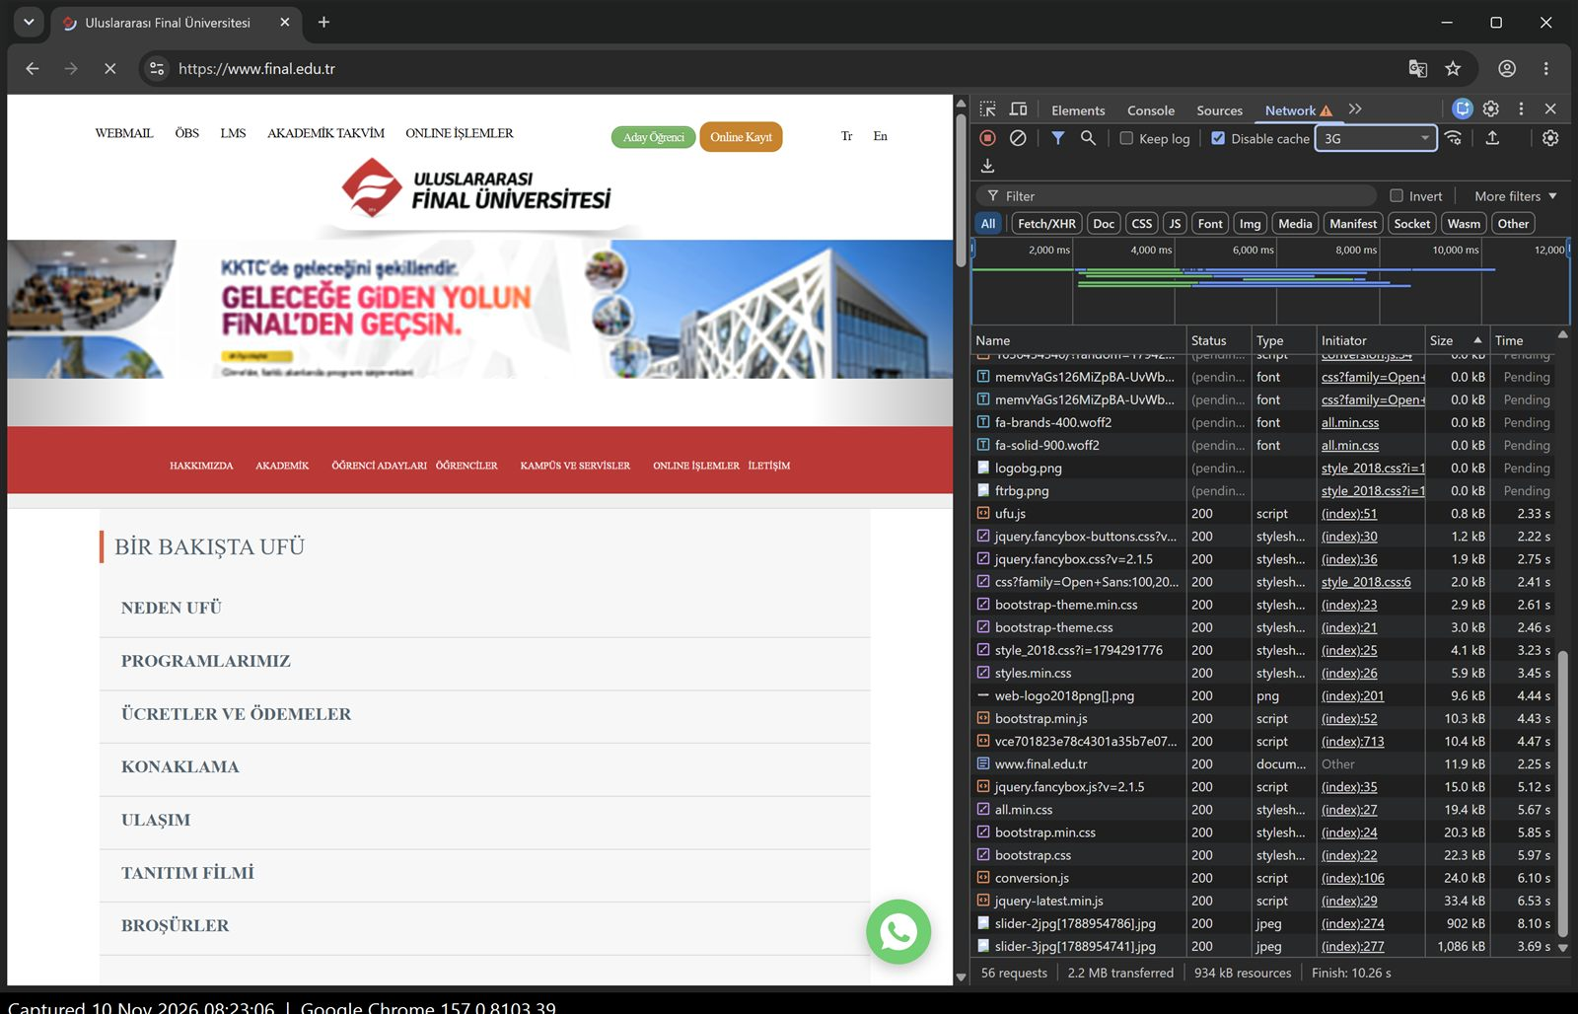
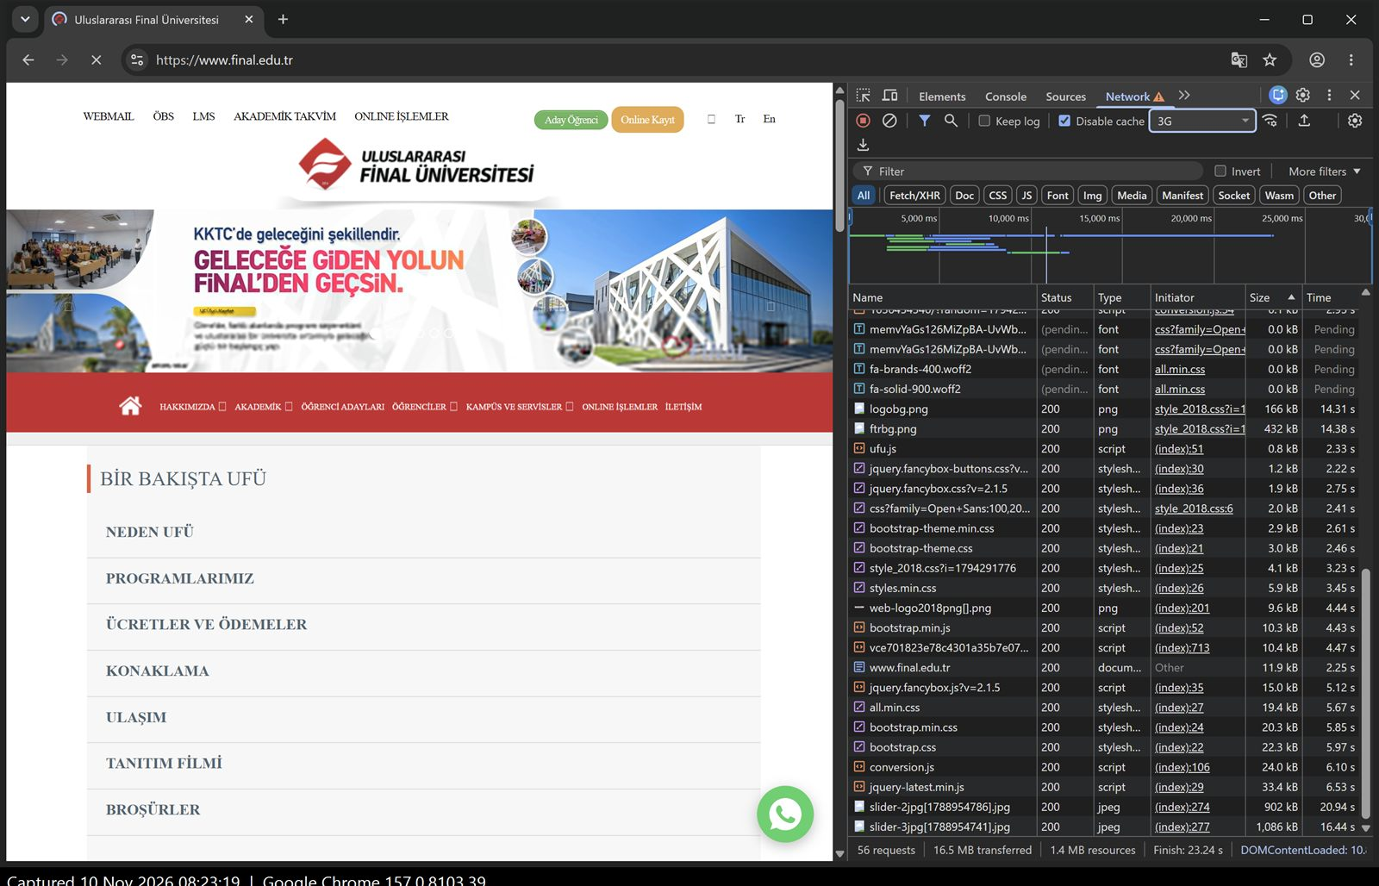
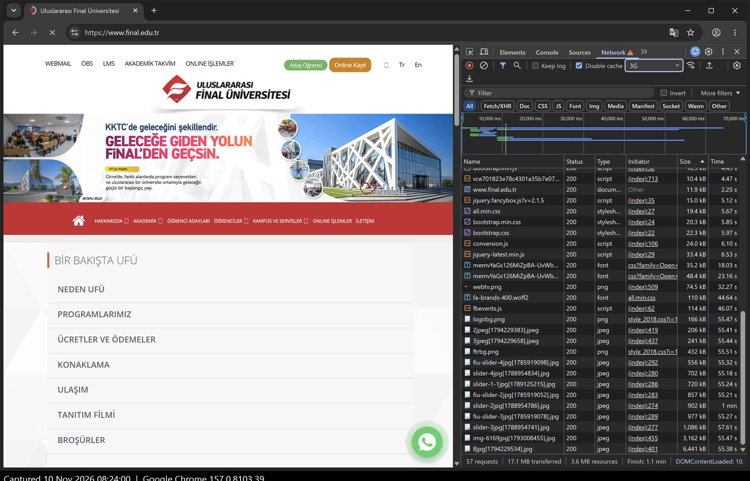
Loading on a slow 3G connection
2 s
8 s
20 s
60 s
Old page still shown, only the tab spinner moves
New text appears in a fallback font
Usable, but icons still empty boxes
Still loading — the two big photos
Chrome “3G” preset, cache off. No spinner or placeholders from the site — but text arrives early because the page is built on the server. [B1]
Notes:
Here I slowed the network to 3G and took a screenshot at 2, 8, 20 and 60 seconds. For the first seconds you still see the old page. At 8 seconds text appears. At 20 seconds the page is usable. But after a full minute it is still loading, because of those two big photos.

Slide 8
Accessibility: 63 and 65 out of 100
Keyboard only: find the phone number [B6]
17 Tabs to “İLETİŞİM”, then 26 more to the phone number
Dropdown menus and the search icon are skipped — they cannot be opened
No “skip to content” link; slider buttons show no focus outline
Contact form: labels not tied to fields, all four share one id [B5]
35 links with no name, 10 images with no alt text, no lang [B7, B8]
Notes:
The automatic accessibility check gives 63 for the home page and 65 for the contact page. I also tried the site with the keyboard only. I reached the phone number after 43 Tab presses, but the dropdown menus like Akademik and Öğrenciler are skipped completely, so a keyboard user can never open them. And on the contact form, clicking a label does not move the cursor into the box.

Slide 9
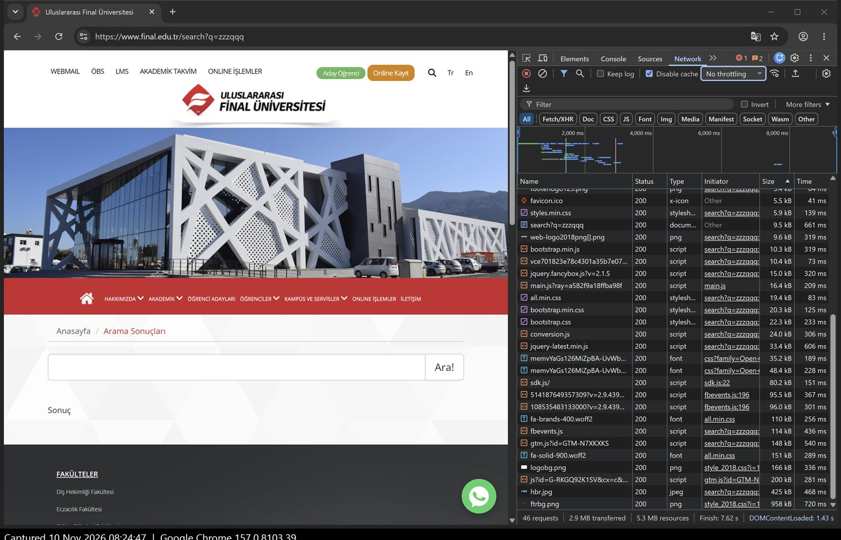
Dead ends: search and forms
No results [B2]
Just “Sonuç” — no message, no tip, and the typed word is cleared
Short search [B4]
Fewer than 3 letters: the button silently does nothing
Contact form [B4, B5]
No checks at all — marked “not tested safely”
Offline [B3]
Only Chrome’s own no-internet page
Search for “zzzqqq”: only the word “Sonuç” [B2]
Notes:
When something goes wrong, the site does not help. A search with no results shows only the word Sonuç. A search with one or two letters does nothing, with no message. The contact form has no checks at all, which is why I did not press send. And offline you only get Chrome's own error page.

Slide 10
Three things to fix first
1
2
3
Shrink the photos
Open to everyone
No more dead ends
Resize thumbnails and slider images; load images on scroll; cache images longer.
Tie labels to fields, add lang="tr", keyboard-friendly menus, skip link, names for icons.
Real 404 page with menu and search; clear “no results” and form messages.
Effort: Low Impact: High
Effort: Medium Impact: High
Effort: Low–Med Impact: Medium
[A3, A5, B1]
[B5–B8, A7]
[A4, B2, B4]
Order: #1 slows every visitor on every visit; #2 fully blocks some visitors; #3 hurts fewer visits but leaves people stuck.
Notes:
So these are my three fixes, in order. First, shrink the photos — it is cheap and helps every visitor. Second, make the site usable for keyboard and screen-reader users. Third, replace the dead ends with helpful messages. I put the photos first because they slow down everyone, every time.

Slide 11
Faster, friendlier, open to everyone
The full report, owner summary and all 27 screenshots are in the GitHub repository fieldstudy-2103060186.
Thank you — questions?
Notes:
With these three changes the website would be faster, friendlier and open to everyone. Everything I showed is in my GitHub repository with the full report and all screenshots. Thank you, and I am happy to take questions.

