Slide 1

HAWatcher: Semantics-Aware Anomaly
Detection fo r Appified Smart Homes
Chenglong Fu, Qiang Zeng, Xiaojiang Du

Slide 2
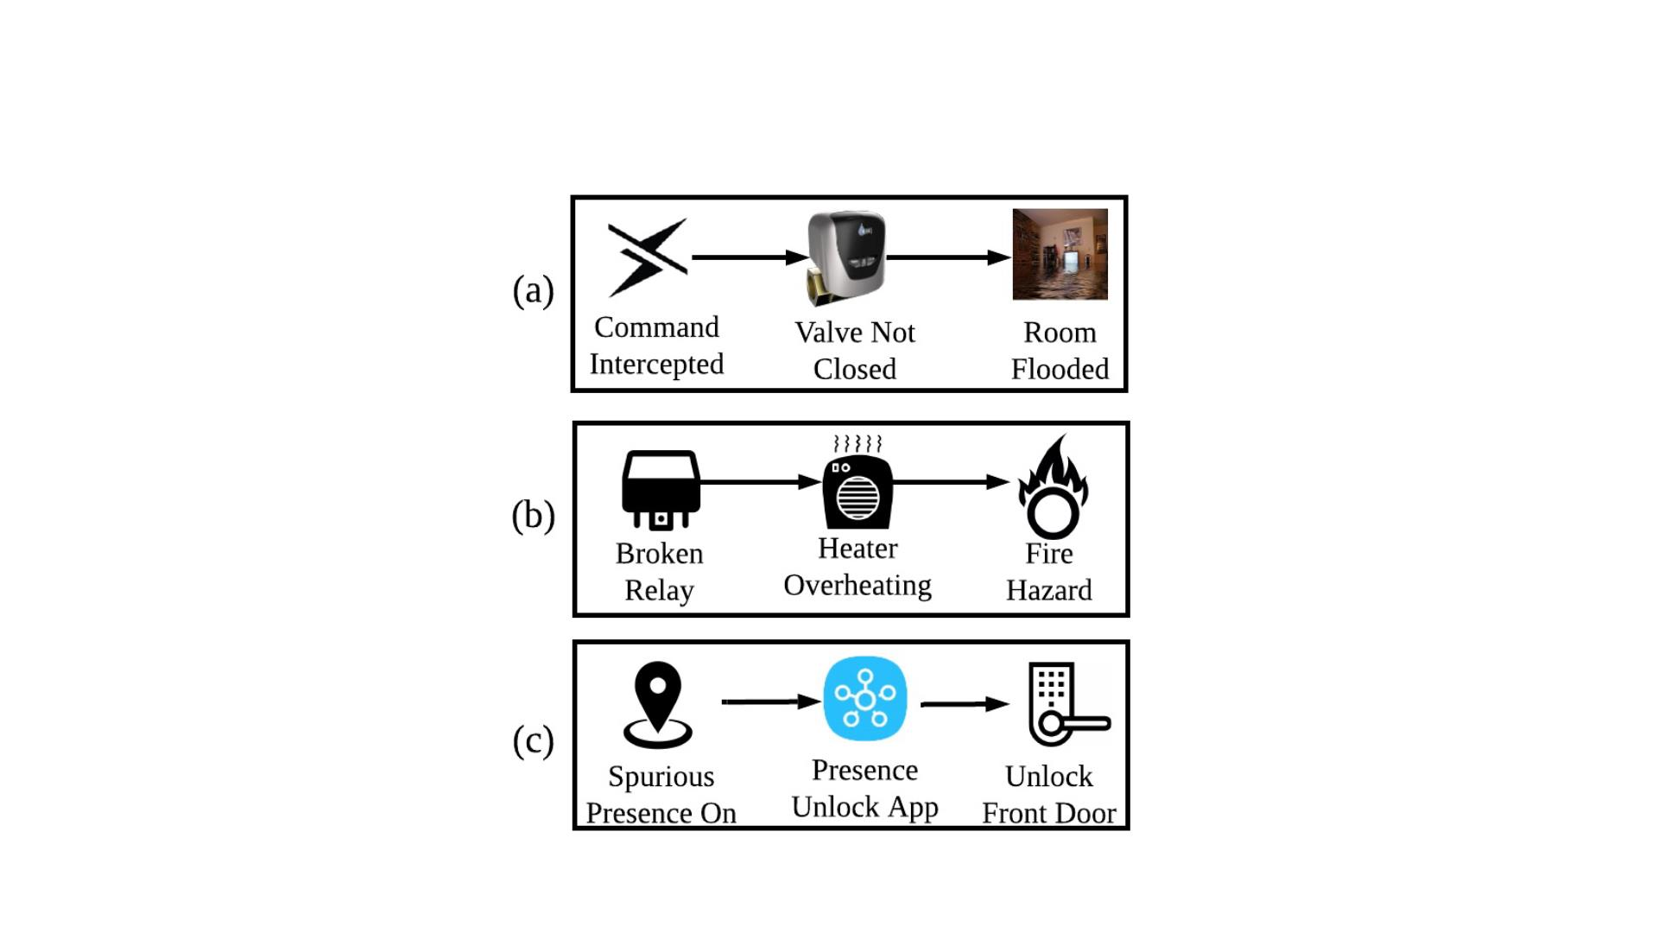
Smart Home Device Anomalies
2

Slide 3
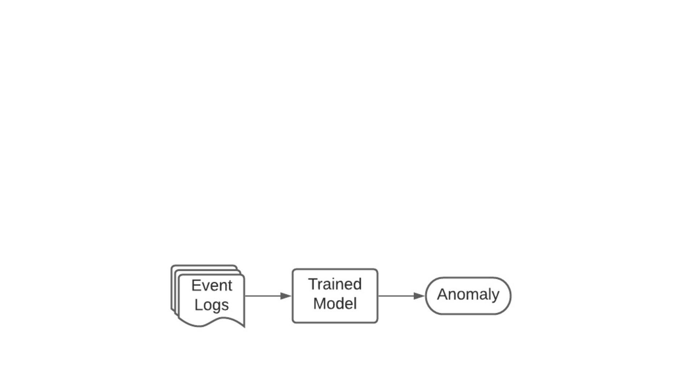
Traditional Data Mining-based Solution
• Missing semantic information
• Needs a large amount of data
• Difficult to learn complex patterns
• Blackbox model
• Unexplainable
• False alarms
3

Slide 4
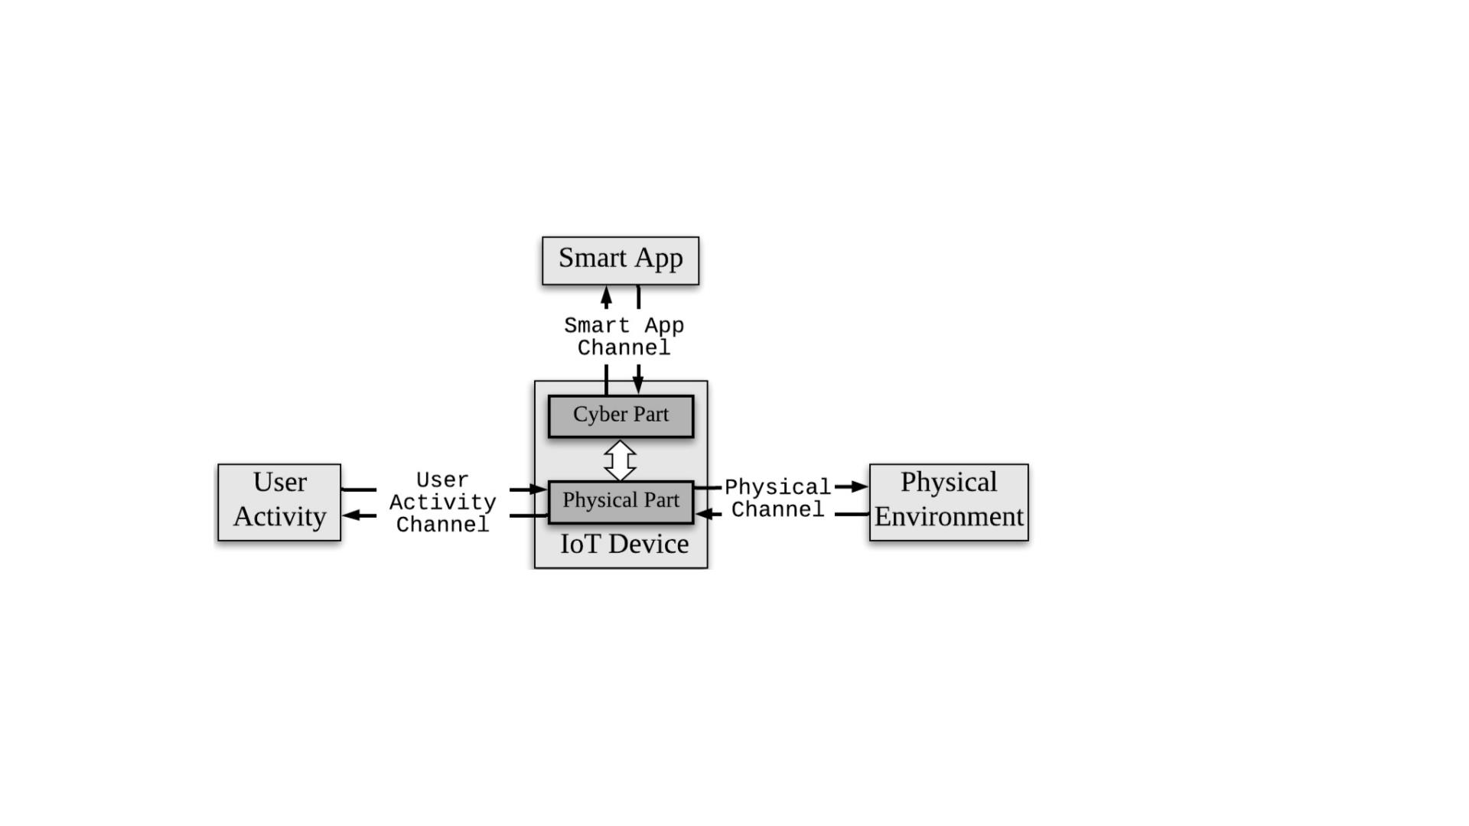
Our Idea
Device states are correlated via multiple semantic channels
4

Slide 5

Research Questions
• RQ1: What semantic information can be used?
• RQ2: How to capture and represent semantic information?
• RQ3: How to make use of the semantic information for anomaly detection?
5

Slide 6
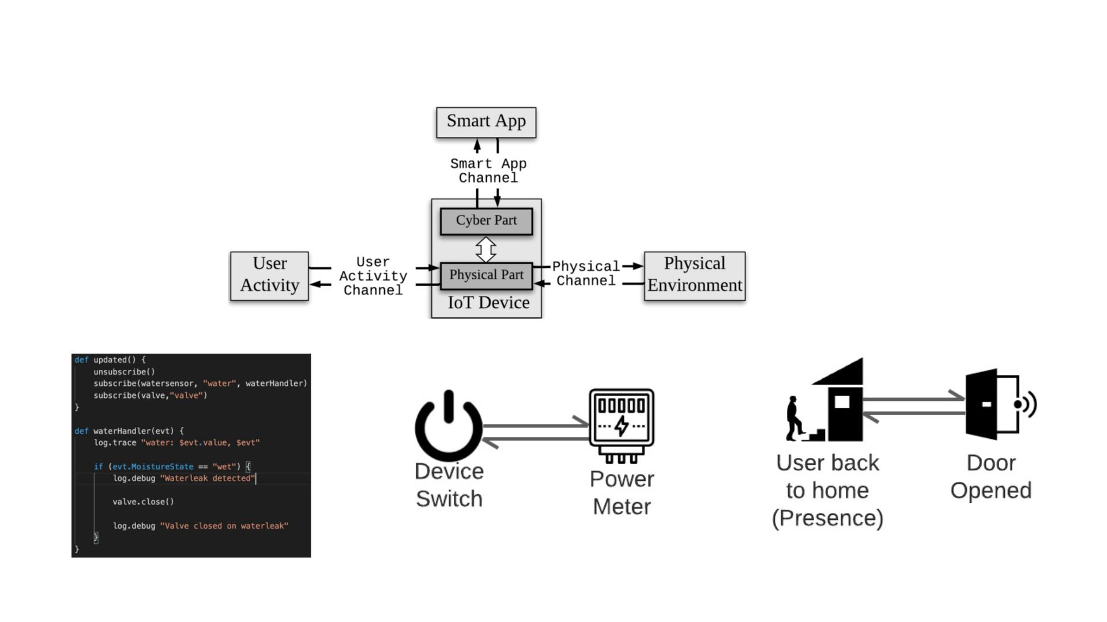
Semantic Information in Smart Home
Smart Apps Code
Meaning of Attributes
Users’ Activities Status
6

Slide 7
Research Questions
• What semantic information can be used?
• How to capture and represent semantic information?
• How to make use of the semantic information for anomaly detection?
7

Slide 8
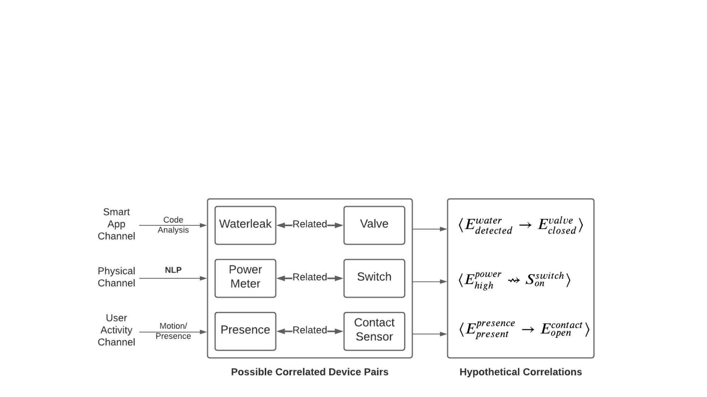
Correlation-based Representation
• Challenges
• Semantic information is diverse
• Semantic information has different format
• Correlations: uniform representation of semantic information
8

Slide 9
Research Questions
• What semantic information can be used?
• How to capture and represent semantic information?
• How to make use of the semantic information for anomaly detection?
9

Slide 10
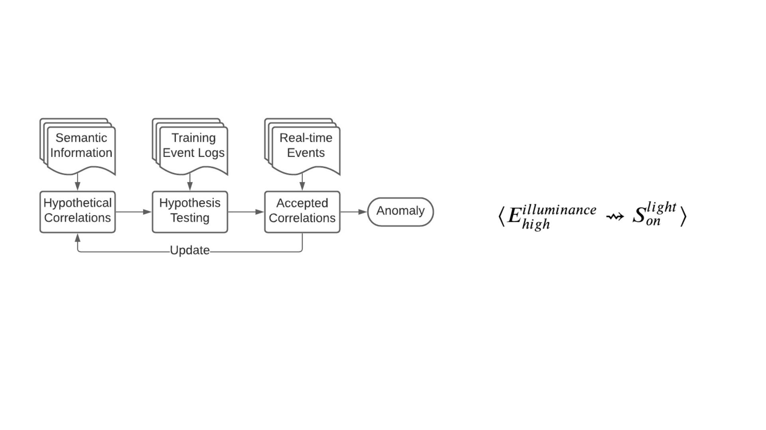
Correlation Verification
• Hypothetical correlations are verified by event logs
• Inferred hypothetical correlations are not necessarily true
10

Slide 11
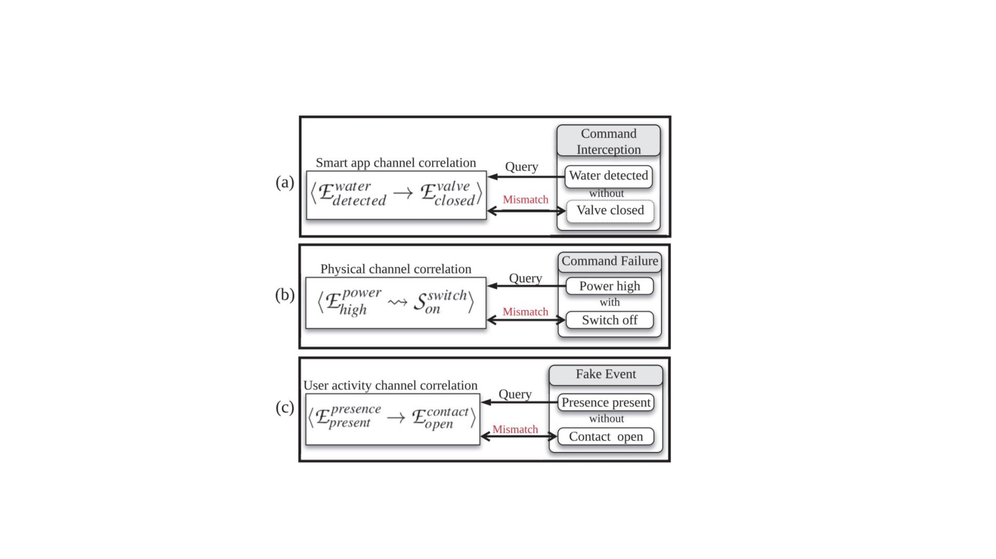
Anomaly Detection
Raise alarms on detecting violations of correlations
11

Slide 12
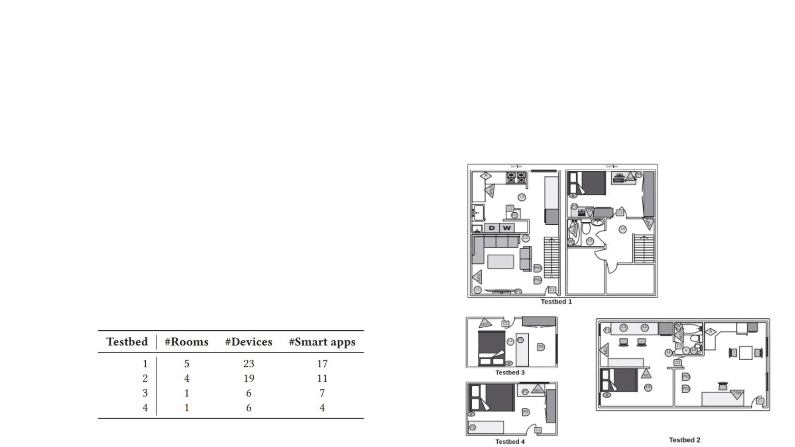
Evaluation Setup
• 4 real-world testbeds
• 6 participants
• 1 month experiment
• 3 weeks training
• 1 week testing
12

Slide 13
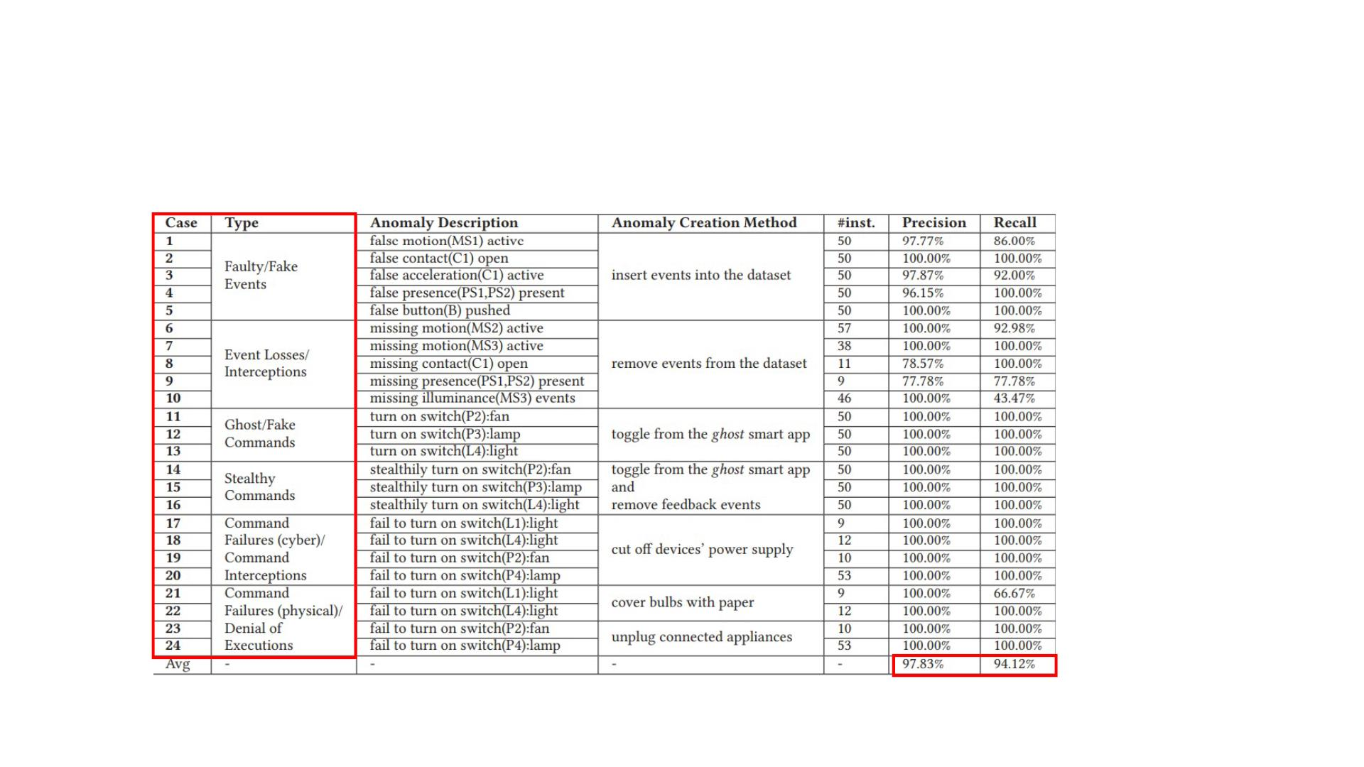
Testing Results on Testbed1
13

Slide 14
Performance Comparison
HAWatcher
Association Rule Mining
(Baseline1)
• 221 rules
• 2.03%precision
• 7.79% recall
• 722 false alarms
(103 per day)
One-class SVM
• 130 correlations
• 97.83% precision
• 94.12% recall
• 4 false alarms
(0.57 per day)
(Baseline2)
• Blackbox model
• 17.15% precision
• 45.19% recall
• 1116 false alarms
(159 per day)
14

Slide 15
Contributions
• The first accurate non-black-box IoT anomaly detection system
• Precision 97.8%, recall 94.1%
• Explainable
• Propose to use semantic information from multiple channels for anomaly detection
• App, physical, user-activity
• Capture and represent diverse semantic information as Correlations
• Code analysis + NLP + hypothesis testing
15

Slide 16
Thanks !
Q&A
Email: chenglong.fu@temple.edu
16

