Slide 1

COVID19 SYMPTOMS ANALYSIS USING TWITTER DATA
An end-to-end data science project
Naïla EL HAOUARI
09/12/2020

Slide 2
Presentation of this session
Giving you technical tools and basic understanding of how they work on a concrete example: a Twitter analysis of COVID19 symptoms.
→ We want to analyze the reception of the global pandemic on social media, and more specifically, COVID19 symptoms people might mention on Twitter.
Overview of this session
Tweets collection | How to use the Twitter API and code example
Data preparation | Preprocessing and filtering of textual data
Data visualization | Interactive graphs using plotly
Modelization | Building a machine learning classifier
All ressources and notebooks: https://github.com/Naila-elh/CRI_BigDataCourse_2020

Slide 3

TWITTER API
Requirements: create a developer’s account on https://developer.twitter.com/en
Ressources:
Official API documentation: https://developer.twitter.com/en/docs/twitter-api
Python package tweepy: http://docs.tweepy.org/en/latest/index.html
Some requests examples:
Get user timeline: get historical data, up to the 3,200 last tweets of a user (ref: API | tweepy )
Streaming: get real-time sampled data (1%) + filter (ref: API | tweepy )
Lookup user: get information – screen name, description, profile picture – on a user (ref: API | tweepy )
Followers_ids: get a user’s followers (ref: API | tweepy )

Slide 4
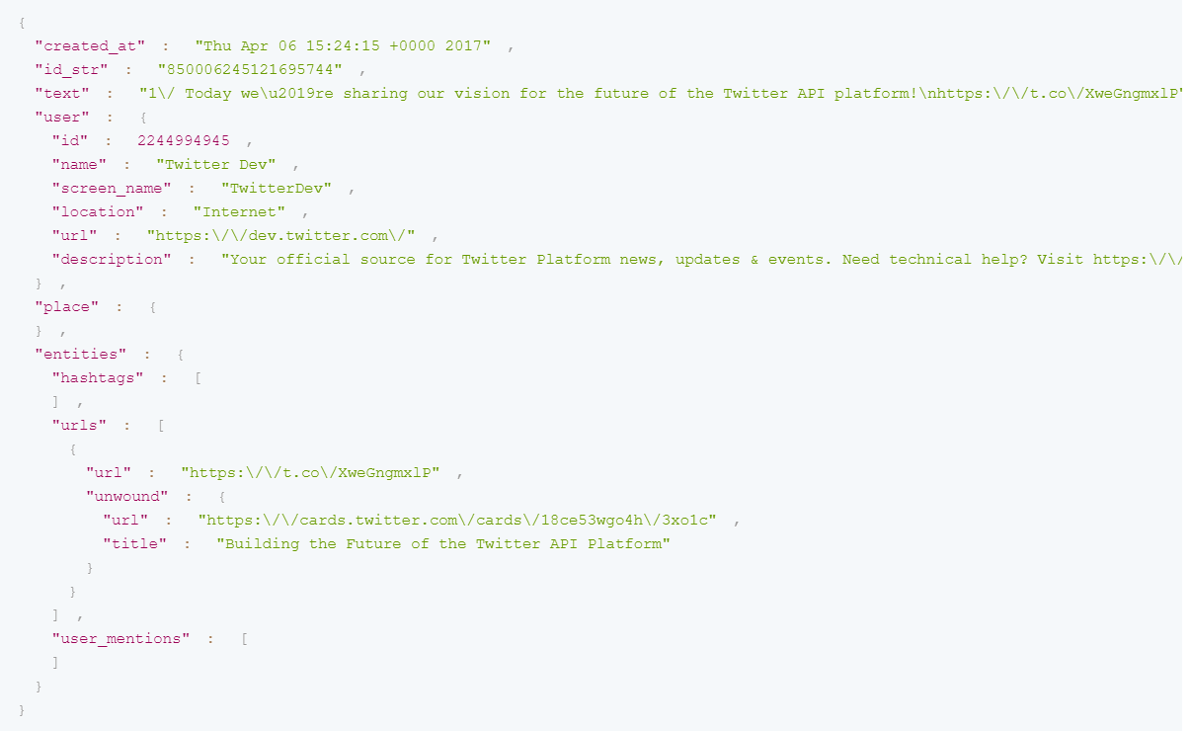
TWITTER API
→ Tweets as json objects

Slide 5
TWITTER API
How we collected the tweets
Streaming
Filter : Île-de-France
Collecting 30 651 users
Timelines
On the 30,651 users
Historical data
Data cleaning
55M of tweets
Symptoms analysis
Updating timelines
On the 30,651 users
Dernière actualisation: 26/10/2020
SOME CODE EXAMPLE: streaming api ; get_timeline api

Slide 6
DATA ANALYSIS
Aim: getting the tweets of people talking about their symptoms.
Preprocessing:
Remove retweets (half of the dataset)
Remove mentions (@mention) and url ([url])
Dictionary of symptoms
Symptoms:
Cough (toux, tousse)
Fever (fièvre)
Sore throat (maux de gorge, mal à la gorge)
Headache (mal de tête, mal à la tête, mal de crâne)
Breathing difficulties (difficultés à respirer, difficultés respiratoires, mal à respirer)
Loss of taste and smell (perte du goût, perte de l’odorat)
Symptom (symptôme)
HANDS ON! Notebook 3 - Data analysis and visualization

Slide 7
CITIZEN SCIENCE
Issue: many false positives in our tweets mentioning symptoms
Symptom before
« @mention J\'ai eu beaucoup de symptômes.. fin Février debut Mars, fin Mars (essoufflement quoi que je fasse) je suis donc allée chez le medecin, "c\'est le stress" 😫 je me reconnais dans ce Tread..’ »
General news
« En cas de fièvre, privilégiez le paracétamol. En effet, les anti-inflammatoires comme l’ibuprofène, de part leur mécanisme d’action, peuvent aggraver l’infection ! 🦠 En cas de doute, demandez conseil à un professionnel de #santé 👨\u200d⚕️👩\u200d🔬 #COVIDー19 [url] »
NOT a symptom
« Jcrois j’ai trop rigoler ojd j’ai mal à la gorge »

Slide 8
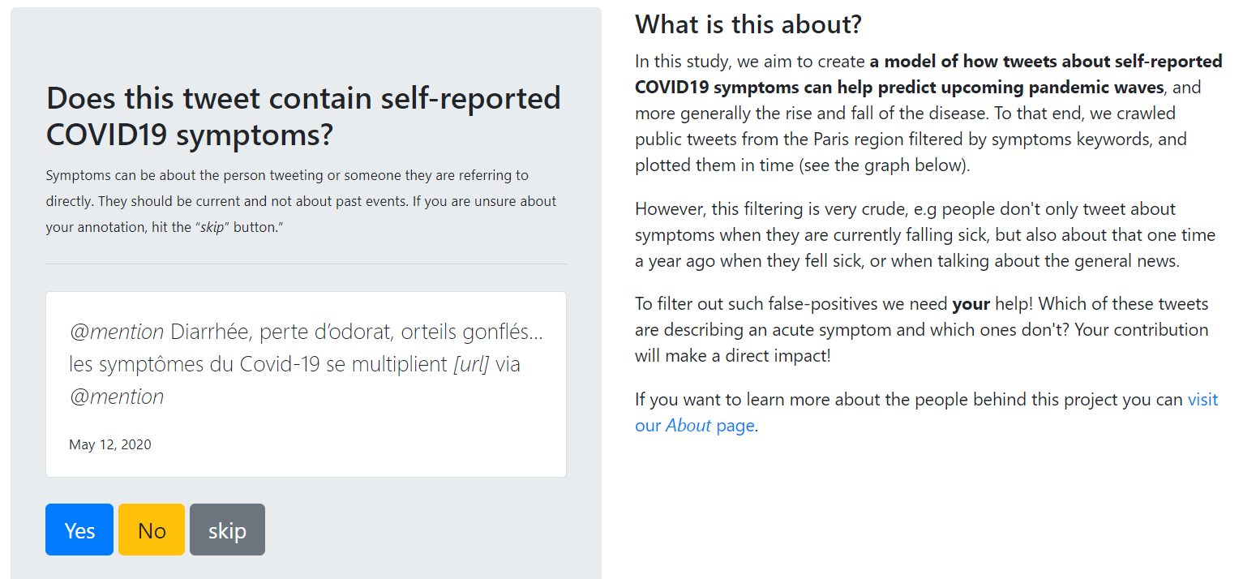
CITIZEN SCIENCE
Citizen science platform: https://covid-twitter.thecommons.science/

Slide 9
CLASSIFICATION
Based on the 7,300 annotations from the platform, can we predict which tweets are true positive?
Steps:
Clean the labels: only consider tweets that have been labelled similarly several times
Build the features from the textual data
Train a classifier
Define metrics to evaluate the results
Refine the classifier with hyperparameters tuning and cross-validation
Plot the corrected curve
HANDS ON! Notebook 4 - Classification

Slide 10
THANK YOU!
Any questions, clarifications? → naila.elhaouari@cri-paris.org

