Slide 1

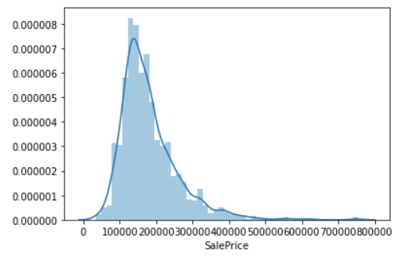
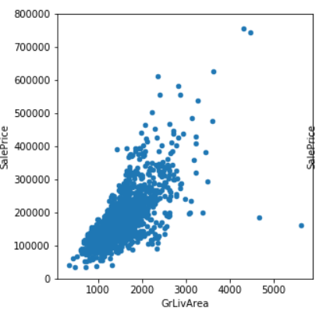
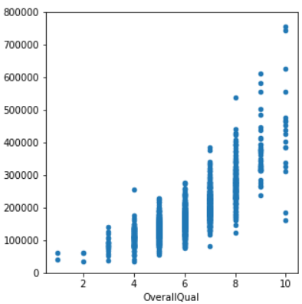
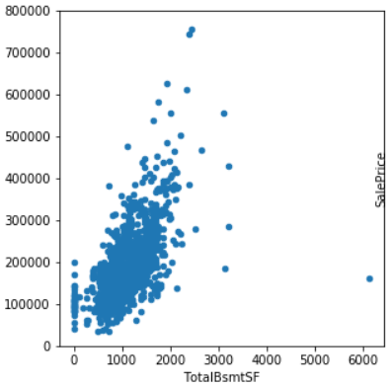
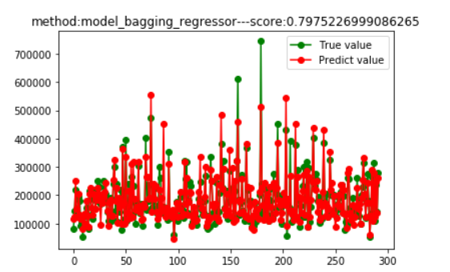
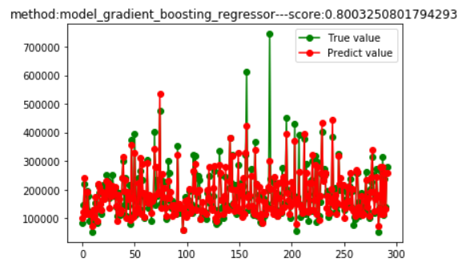
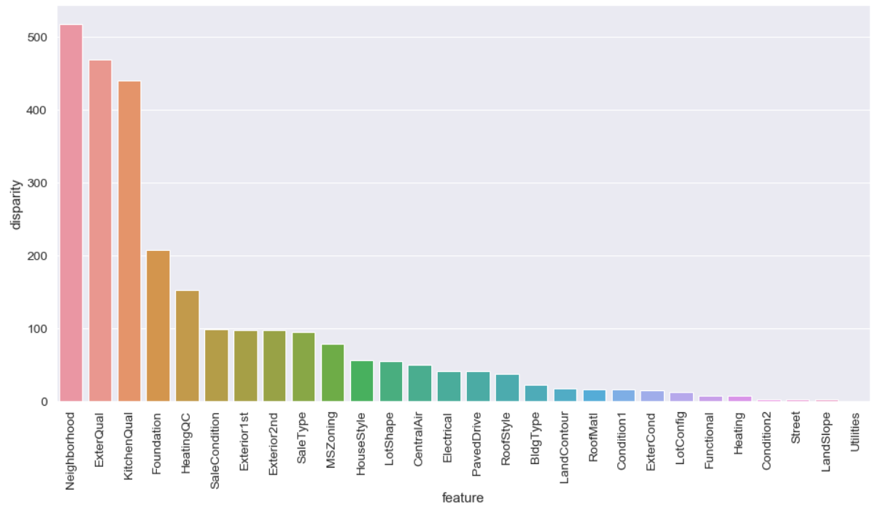
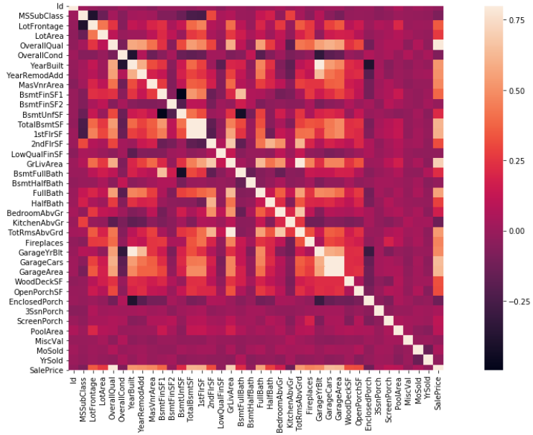
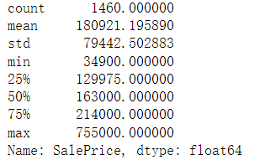
House Prices
- Advanced Regression Techniques
Fangying Xiong
School of Computing, University of South China
Introduction
.
Literature Cited
Introduction
Modle Fitting
Ask a home buyer to describe their dream house, and they probably won't begin with the height of the basement ceiling or the proximity to an east-west railroad. But this playground competition's dataset proves that much more influences price negotiations than the number of bedrooms or a white-picket fence.
With 79 explanatory variables describing (almost) every aspect of residential homes in Ames, Iowa, this competition challenges you to predict the final price of each home.
LASSO Regression
It can reduce the deviation and improve the accuracy of linear regression model
Elastic Net Regression
Trade off between arbitrarily selecting an independent variable or a group of independent variables
Kernel Ridge Regression
For complex data, it is suitable for complex fitting
Gradient Boosting Regression
The model has strong explanation and good application effect
Purpose
Literature Cited
Purpose
Data Cleaning
Fitting results
The 79 variables given in the title are considered comprehensively.
First, comprehensive data analysis, image display.Then data cleaning, model establishment and analysis are carried out.
Finally, the prediction data are obtained by using the model.
The data were processed by univariate analysis of variance. Judge the variables with high correlation with house prices in the data, namely characteristic variables.
Delete the variables with little correlation with house prices from the data, reduce the judgment dimension of the data, delete the missing values and error values from the data set, and finally form an updated judgment data set.
Disclosure
Summary
Expected Results
Display the data, analyze the distribu
-tion of the sales price data, and
analyze the characteristics and find
that it clearly deviates from the normal
distribution.
Data analysis is the basic part of prediction, otherwise it will have a serious impact on prediction. It is necessary to deeply analyze and mine the relationship between data
Model selection and parameter adjustment is the key part of machine learning. It is not only a difficulty, but also a challenge and learning opportunity
The first mock exam is based on the basic process of forecasting, and the effects of various models are better than that of single models. Only by actively practicing, consulting materials and constantly trying and making mistakes can we make progress.
Data Visualization
Delete the first 18 features after processing. After processing, 1459 samples and 63 features remained

