Slide 1
Draco: 3D Data Compression
[1] Draco 3D Data Compression. https://google.github.io/draco/.

Slide 2
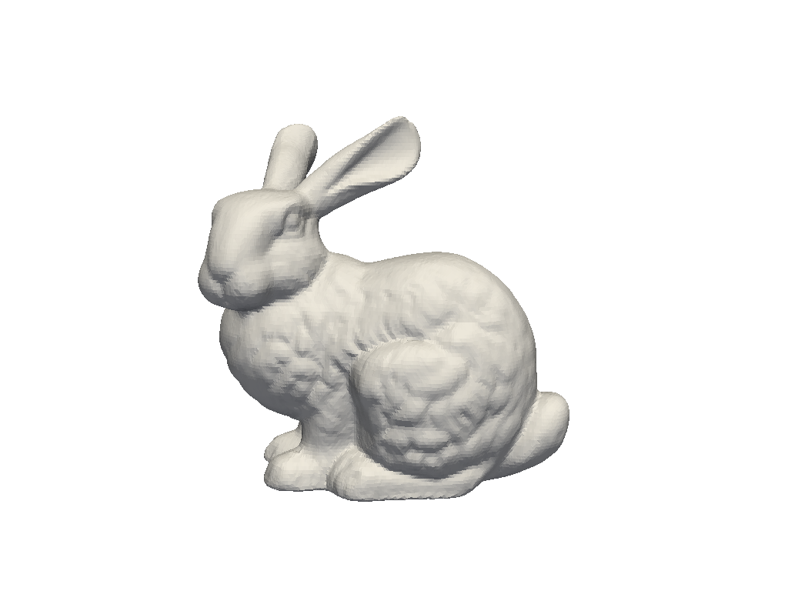
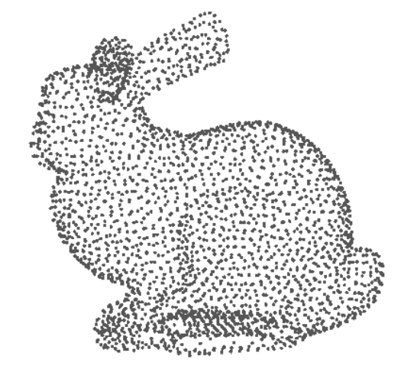
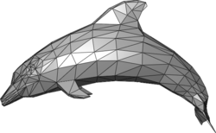
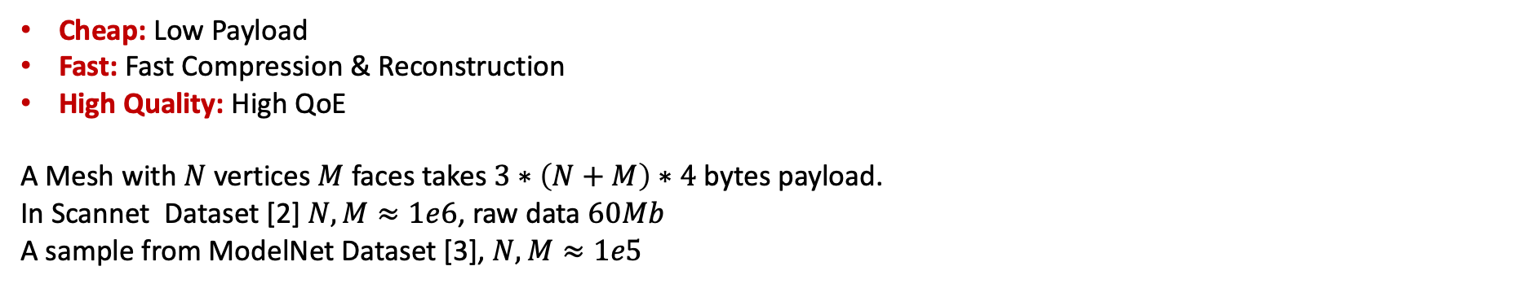
Problem
Server
Client
Cheap: Low Payload
Fast: Fast Compression & Reconstruction
High Quality: High QoE
A Mesh with $N$ vertices $M$ faces takes $3∗\left(N+M\right)∗4$ bytes payload.
In Scannet Dataset [2] $N,M≈1e6$, raw data $60Mb$
A sample from ModelNet Dataset [3], $N,M≈1e5$
[2] Dai, Angela, et al. "Scannet: Richly-annotated 3d reconstructions of indoor scenes." CVPR 2017
[3] Wu, Zhirong, et al. "3d shapenets: A deep representation for volumetric shapes." CVPR. 2015.

Slide 3
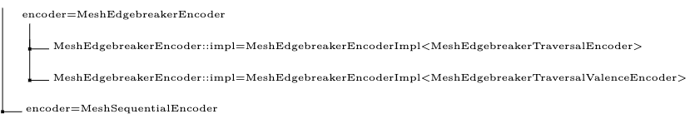
Draco
Header
MetaData
Connectivity
Attribute
Draco Encoding
Draco Decoding
What is Draco? A compress & decompress 3D object (Mesh/PointCloud) library.
Compare with Gzip? Better and faster [1]
How does it work? Upper Level Algorithms & Under Level Algorithms
Connectivity
Attribute
Upper Level Algorithms 算法分支

Slide 4
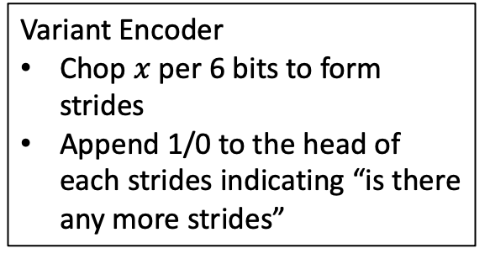
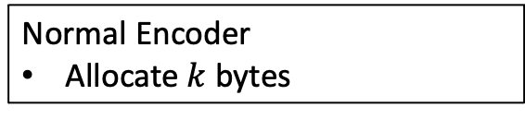


Under-Layer Encoding Algorithms
Given a variable $x$ of type $T$ with $k$ bytes
Normal Encoder
Allocate $k$ bytes
Variant Encoder
Chop $x$ per 6 bits to form strides
Append 1/0 to the head of each strides indicating “is there any more strides”
rANS Encoder
More optimization, will discuss later…
Upper-Layer Encoding Algorithms
Given a mesh $ℳ$ of $N$ vertices and $M$ faces
Connectivity Encoder
Encode Face Information
Attribute Encoder
Encode Geometry/Color/…
Differential Encoding
Parallelogram Prediction [4]
[4] Isenburg et al. Compressing polygon mesh geometry with parallelogram prediction. IEEE Vis 2002.

Slide 5


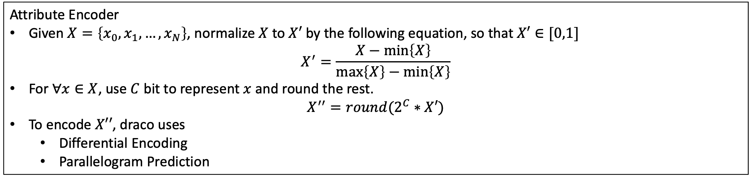


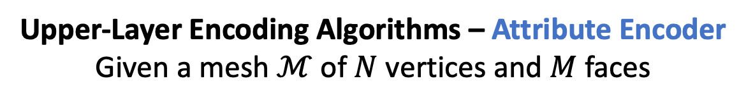







Upper-Layer Encoding Algorithms – Attribute Encoder
Given a mesh $ℳ$ of $N$ vertices and $M$ faces
Attribute Encoder
Given $X=\left\{x_{0},x_{1},…,x_{N}\right\}$, normalize $X$ to $X′$ by the following equation, so that $X′∈[0,1]$ $X^{′}=\frac{X−\min\left\{X\right\}}{\max\left\{X\right\}−\min\left\{X\right\}}$
For $∀x∈X$, use $C$ bit to represent $x$ and round the rest.
$$X^{′′}=round(2^{C}∗X′)$$
To encode $X′′$, draco uses
Differential Encoding
Parallelogram Prediction
$$offset_{0}$$
$$offset_{1}$$
$$offset_{2}$$
$$offset_{3}$$
$$offset_{4}$$
Differential Encoding
0
$$x_{0}^{′′}$$
$$x_{1}^{′′}$$
$$x_{2}^{′′}$$
$$x_{3}^{′′}$$
$$x_{4}^{′′}$$
Parallelogram Prediction
$$offset$$

Slide 6




Upper-Layer Encoding Algorithms – Connectivity Encoder
Given a mesh $ℳ$ of $N$ vertices and $M$ faces
Connectivity Encoder – Sequential算法
Directly Encode Face Indices (v0, v1, v2)
$$v_{0}$$
$$v_{1}$$
$$v_{2}$$

Slide 7






Upper-Layer Encoding Algorithms – Connectivity Encoder
Given a mesh $ℳ$ of $N$ vertices and $M$ faces
Connectivity Encoder – EdgeBreaker算法
核心思路是dfs face
传输过程传输的就是dfs序
$$v_{0}$$
$$v_{0}$$
$$c_{p}$$
$$c$$
$$c$$
$$c_{n}$$
$$c_{n}$$
Topology_C
Topology_S
Visited
Current
Unvisited

Slide 8









Upper-Layer Encoding Algorithms – Connectivity Encoder
Given a mesh $ℳ$ of $N$ vertices and $M$ faces
Connectivity Encoder – EdgeBreaker算法
核心思路是dfs face
传输过程传输的就是dfs序
$$v_{0}$$
$$v_{0}$$
$$v_{0}$$
$$c_{p}$$
$$c_{p}$$
$$c_{p}$$
$$c$$
$$c$$
$$c_{n}$$
$$c$$
$$c_{n}$$
Topology_R
Topology_E
Topology_L
Visited
Current
Unvisited

Slide 9

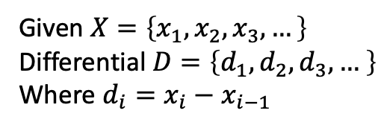










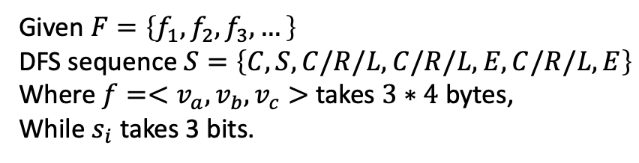
Upper-Layer Encoding Algorithms
Given a mesh $ℳ$ of $N$ vertices and $M$ faces
$$d_{1}$$
$$d_{2}$$
$$d_{2}$$
$$d_{2}$$
$$d_{2}$$
$$d_{2}$$
Given $X=\left\{x_{1},x_{2},x_{3},…\right\}$
Differential $D=\left\{d_{1},d_{2},d_{3},… \right\}$
Where $d_{i}=x_{i}−x_{i−1}$
0
$$x_{1}$$
$$x_{2}$$
$$x_{3}$$
$$x_{4}$$
$$x_{5}$$
$$x_{6}$$
C
Given $F=\left\{f_{1},f_{2},f_{3},…\right\}$
DFS sequence $S=\left\{C,S,C/R/L,C/R/L,E,C/R/L,E\right\}$
Where $f=<v_{a},v_{b},v_{c}>$ takes $3∗4$ bytes,
While $s_{i}$ takes 3 bits.
S
C/R/L
C/R/L
C/R/L
E
E

Slide 10

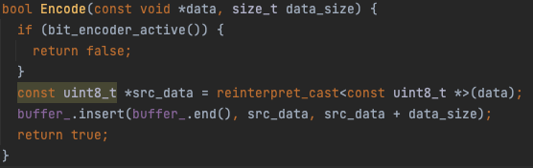
Under-Layer Encoding Algorithms
Given a variable $x$ of type $T$ with $k$ bytes
Normal Encoder
Allocate $k$ bytes

Slide 11
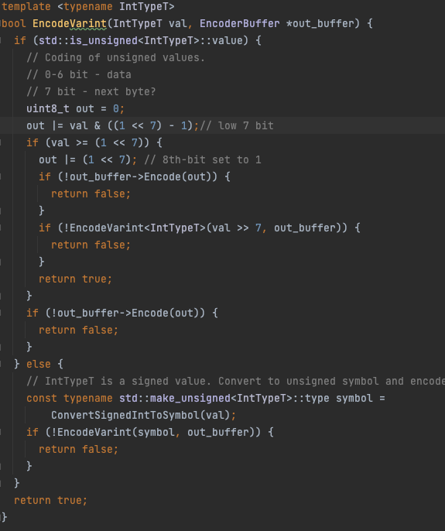
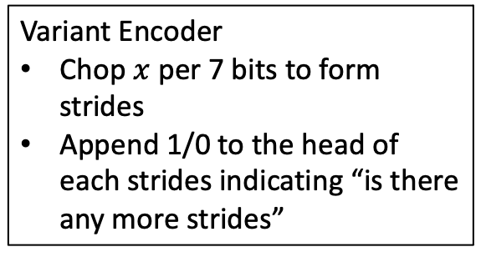
Under-Layer Encoding Algorithms
Given a variable $x$ of type $T$ with $k$ bytes
Variant Encoder
Chop $x$ per 7 bits to form strides
Append 1/0 to the head of each strides indicating “is there any more strides”

Slide 12
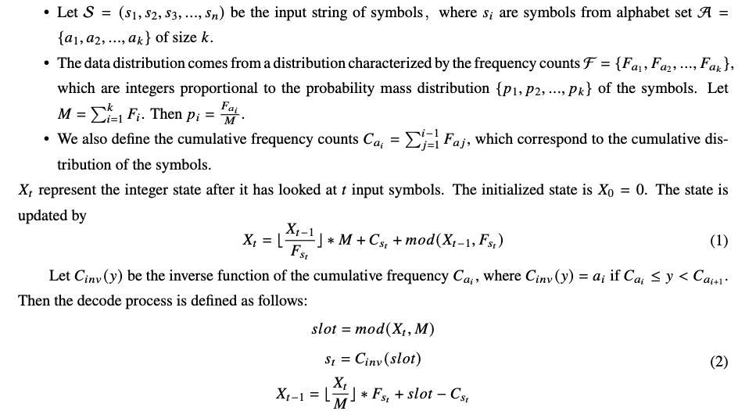

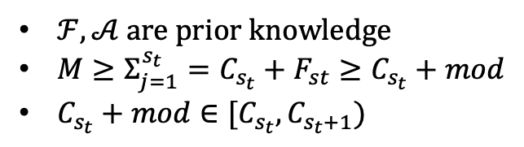
Under-Layer Encoding Algorithms
Given a variable $x$ of type $T$ with $k$ bytes
range Arithmetic Numeral Systems (rANS) Encoder
Input: 0,1,0,2,2,0,2,1,1,2
(With rANS) Output: 17466 ( 5-bit decimal)
(Without rANS) Output: 2112022010 (10-bit decimal)
$ℱ,𝒜$ are prior knowledge
$M≥Σ_{j=1}^{s_{t}}=C_{s_{t}}+F_{st}≥C_{s_{t}}+mod$
$C_{s_{t}}+mod∈[C_{s_{t}}, C_{s_{t}+1})$
$$Slot$$

Slide 13
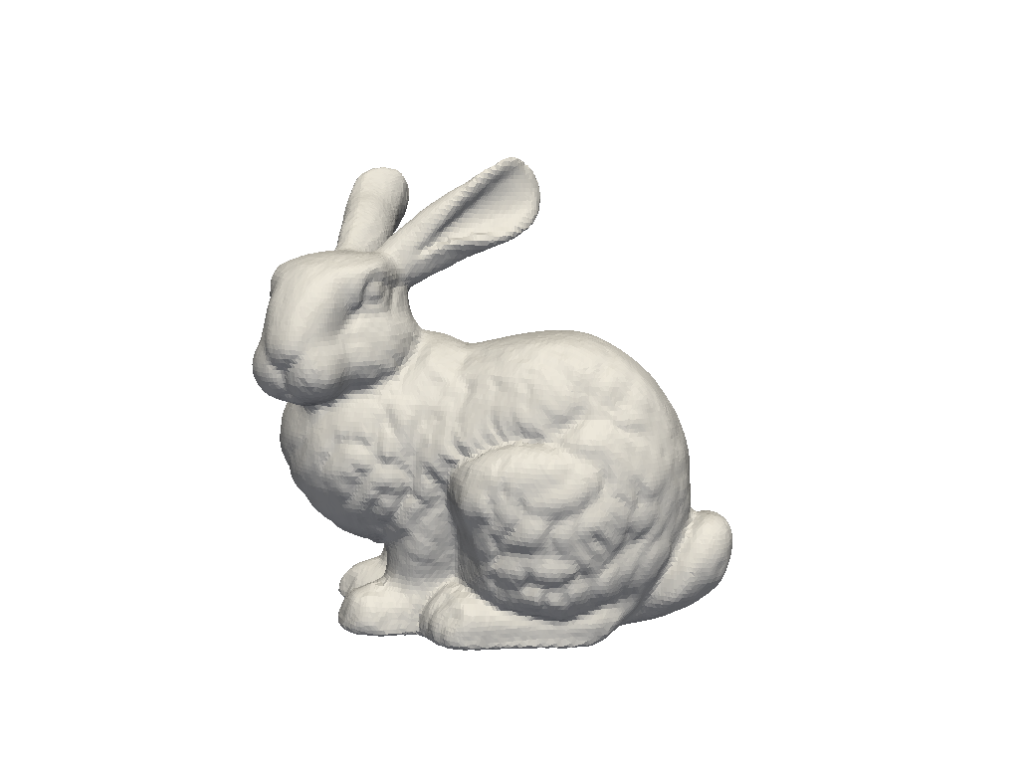
Some Experiment
010101…
Watermark-embedding
Draco-encoding
N vertices
M faces
Binary
010101…
Watermark-reconstruct
Draco-decoding
010101…
Byte Saved
Acc Drop
Distortion Made
Distortion Made: Average 0.04 euclidean distortion
Acc Drop: 0.1% drop
Byte Saved: X bytes → 0.3 X ~0.01X bytes

Slide 14
1

