Slide 1
Draco: 3D Data Compression
Google

Slide 2
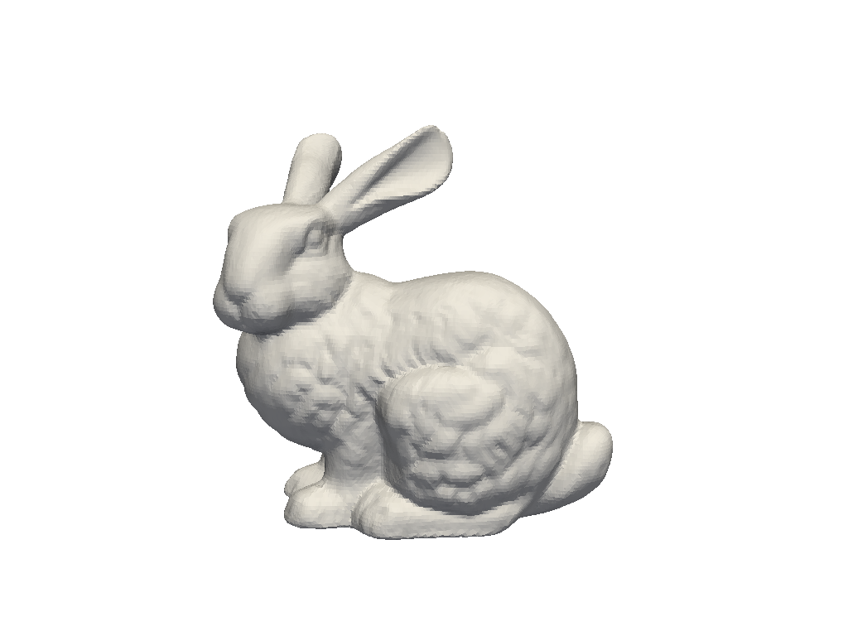
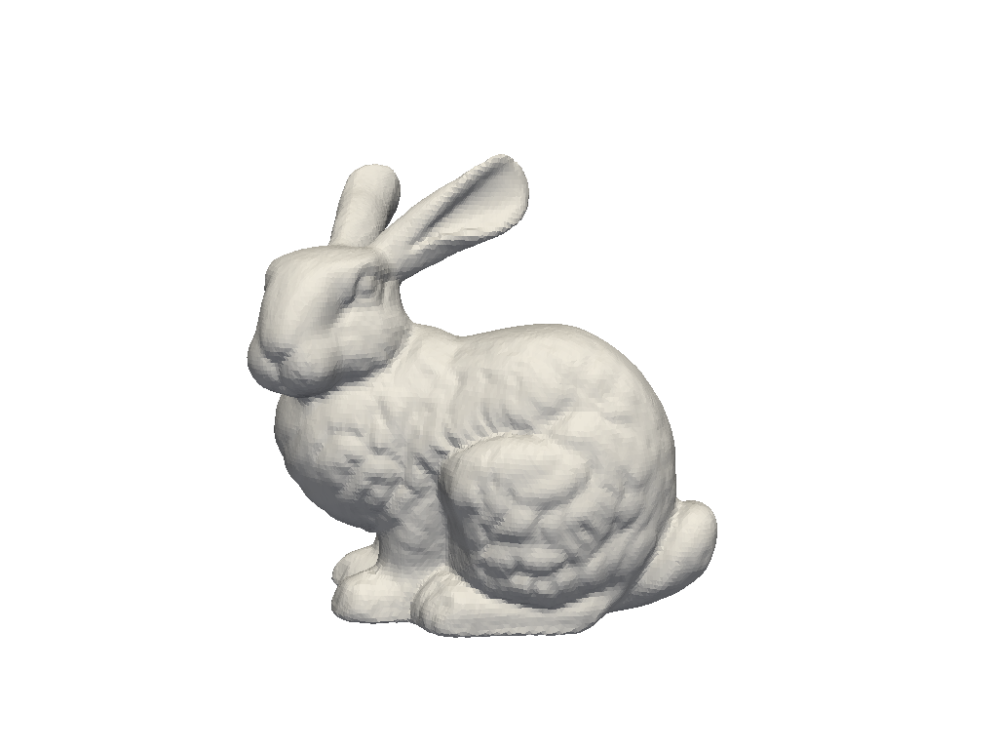
Draco: Some experiment before diving into it
010101…
Normalize to unit sphere
Watermark-embedding
Draco-encoding
N vertices
M faces
Binary
010101…
Watermark-reconstruct
Draco-decoding
010101…
Byte Saved
Acc Drop
Distortion Made
Distortion Made: Average 0.04 euclidean distortion
Acc Drop: 0.1% drop
Byte Saved: X bytes → X/7 ~X/10 bytes
RQ1: The workflow of Draco
RQ2: How does it adapted to different meshes? In size/speed/compression ratio

Slide 3
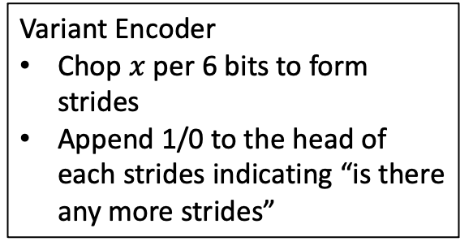
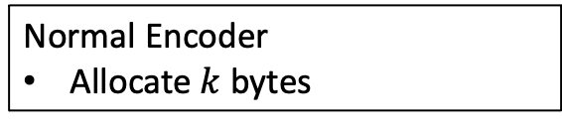


Under-Layer Encoding Algorithms
Given a variable $x$ of type $T$ with $k$ bytes
Normal Encoder
Allocate $k$ bytes
Variant Encoder
Chop $x$ per 6 bits to form strides
Append 1/0 to the head of each strides indicating “is there any more strides”
rANS Encoder
More optimization, will discuss later…
Upper-Layer Encoding Algorithms
Given a mesh $ℳ$ of $N$ vertices and $M$ faces
Connectivity Encoder
Encode Face Information
Attribute Encoder
Encode Geometry/Color/…
Differential Encoding
Parallelogram Prediction [1]
[1] Isenburg et al. Compressing polygon mesh geometry with parallelogram prediction. IEEE Vis 2002.

Slide 4

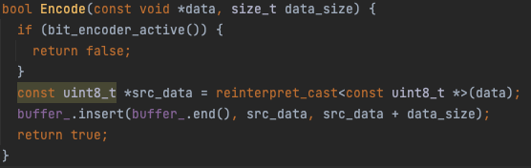
Under-Layer Encoding Algorithms
Given a variable $x$ of type $T$ with $k$ bytes
Normal Encoder
Allocate $k$ bytes

Slide 5
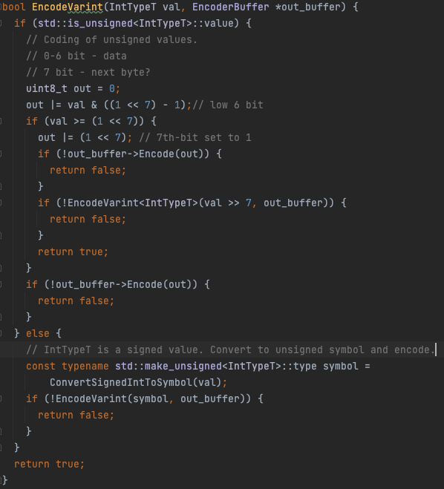
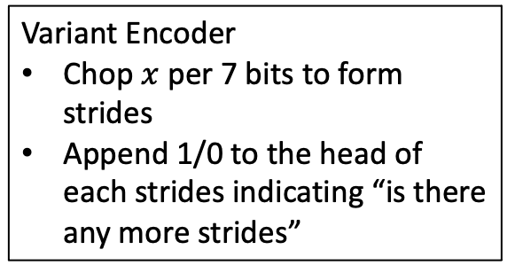
Under-Layer Encoding Algorithms
Given a variable $x$ of type $T$ with $k$ bytes
Variant Encoder
Chop $x$ per 7 bits to form strides
Append 1/0 to the head of each strides indicating “is there any more strides”

Slide 6
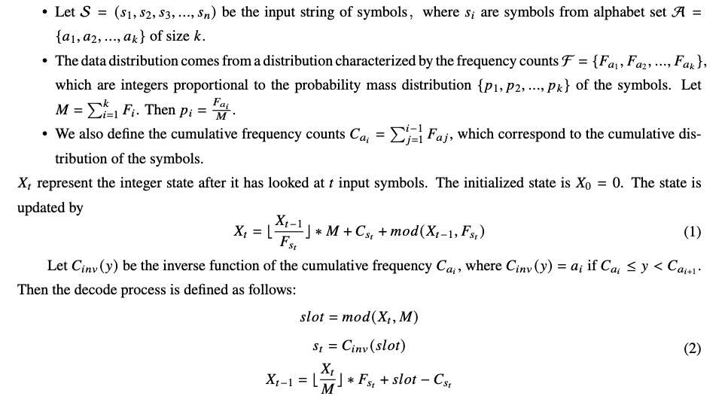
Under-Layer Encoding Algorithms
Given a variable $x$ of type $T$ with $k$ bytes
range Arithmetic Numeral Systems (rANS) Encoder
Input: 0,1,0,2,2,0,2,1,1,2
(With rANS) Output: 17466 ( 5-bit decimal)
(Without rANS) Output: 2112022010 (10-bit decimal)

Slide 7


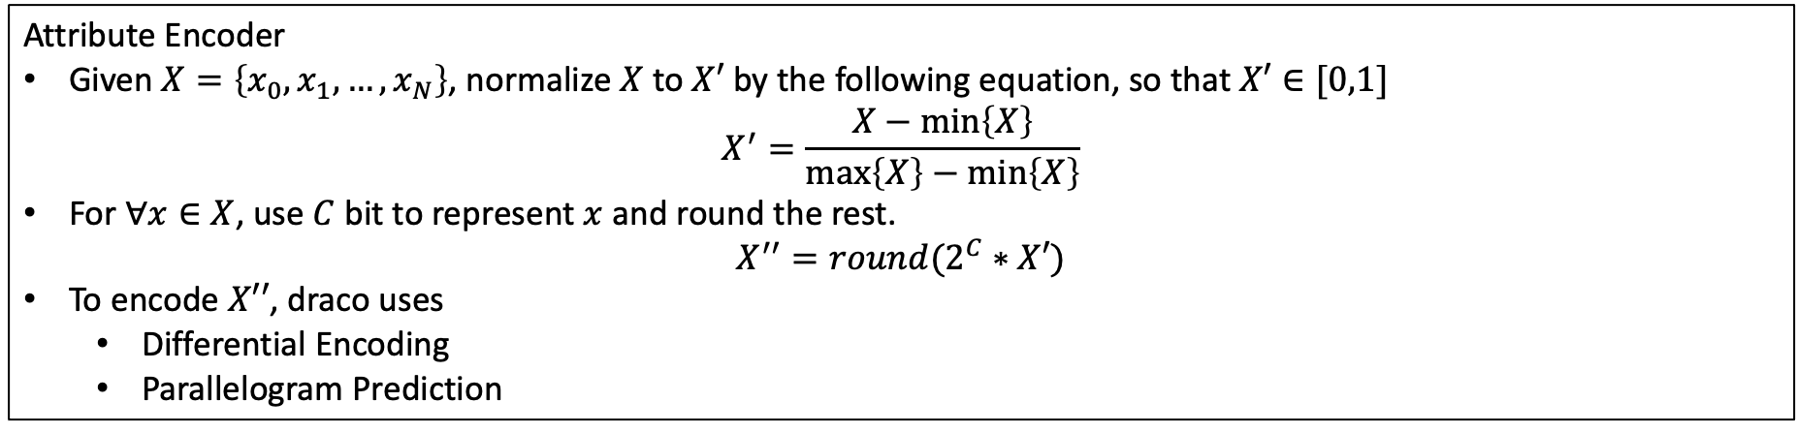









Upper-Layer Encoding Algorithms
Given a mesh $ℳ$ of $N$ vertices and $M$ faces
Attribute Encoder
Given $X=\left\{x_{0},x_{1},…,x_{N}\right\}$, normalize $X$ to $X′$ by the following equation, so that $X′∈[0,1]$ $X^{′}=\frac{X−\min\left\{X\right\}}{\max\left\{X\right\}−\min\left\{X\right\}}$
For $∀x∈X$, use $C$ bit to represent $x$ and round the rest.
$$X^{′′}=round(2^{C}∗X′)$$
To encode $X′′$, draco uses
Differential Encoding
Parallelogram Prediction
$$offset_{0}$$
$$offset_{1}$$
$$offset_{2}$$
$$offset_{3}$$
$$offset_{4}$$
Differential Encoding
0
$$x_{0}^{′′}$$
$$x_{1}^{′′}$$
$$x_{2}^{′′}$$
$$x_{3}^{′′}$$
$$x_{4}^{′′}$$
Parallelogram Prediction
$$offset$$

Slide 8







Upper-Layer Encoding Algorithms
Given a mesh $ℳ$ of $N$ vertices and $M$ faces
Connectivity Encoder – EdgeBreaker算法
核心思路是dfs face
传输过程传输的就是dfs序
$$v_{0}$$
$$v_{0}$$
$$c_{p}$$
$$c$$
$$c$$
$$c_{n}$$
$$c_{n}$$
Topology_C
Topology_S
Visited
Current
Unvisited

Slide 9









Upper-Layer Encoding Algorithms
Given a mesh $ℳ$ of $N$ vertices and $M$ faces
Connectivity Encoder – EdgeBreaker算法
核心思路是dfs face
传输过程传输的就是dfs序
$$v_{0}$$
$$v_{0}$$
$$v_{0}$$
$$c_{p}$$
$$c_{p}$$
$$c_{p}$$
$$c$$
$$c$$
$$c_{n}$$
$$c$$
$$c_{n}$$
Topology_R
Topology_E
Topology_L
Visited
Current
Unvisited

Slide 10
Draco: Encoding
Encoding Header
Mesh
Optimization
Encoding Connectivity
Encoding Attributes
V, F set to V table
V table to O table
Breaking Non-manifold edges
Breaking Non-manifold vertices
…
FindHoles
EncodeTraversalSymbols
EncodeStartFaces
EncodeAttributeSeams

Slide 11
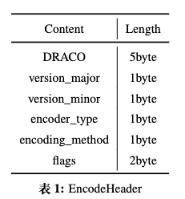
Draco: Encoding
Encoding Header
Mesh
Optimization
Encoding Connectivity
Encoding Attributes

Slide 12





























































Draco: Mesh Optimization
$$v_{4}$$
$$v_{0}$$
$$c_{11}$$
$$c_{9}$$
$$c_{0}$$
$$c_{3}$$
$$c_{6}$$
$$c_{7}$$
$$c_{5}$$
$$v_{3}$$
Header Encoding
Mesh
Optimization
$$c_{10}$$
$$c_{8}$$
$$c_{14}$$
$$c_{1}$$
$$c_{13}$$
$$c_{12}$$
$$v_{1}$$
$$c_{2}$$
$$c_{4}$$
$$v_{2}$$
Turn Non-maniford vertices into maniford vertices
V, F set to V table
V table to O table
Breaking Non-manifold edges
Breaking Non-manifold vertices
…
$$v_{4}$$
$$v_{0}$$
$$v_{0}$$
$$v_{4}$$
$$v_{5}$$
$$c_{11}$$
$$c_{9}$$
$$c_{9}$$
$$c_{3}$$
$$c_{11}$$
$$c_{3}$$
$$c_{0}$$
$$c_{0}$$
$$c_{6}$$
$$c_{6}$$
$$c_{7}$$
$$c_{5}$$
$$c_{7}$$
$$c_{5}$$
$$v_{3}$$
$$v_{3}$$
$$c_{10}$$
$$c_{8}$$
$$c_{14}$$
$$c_{10}$$
$$c_{8}$$
$$c_{14}$$
$$c_{1}$$
$$c_{13}$$
$$c_{12}$$
$$c_{1}$$
$$c_{13}$$
$$c_{12}$$
$$v_{1}$$
$$c_{2}$$
$$c_{4}$$
$$v_{6}$$
$$v_{1}$$
$$c_{2}$$
$$c_{4}$$
$$v_{2}$$
$$v_{2}$$

Slide 13
1

