Slide 1
GLOBAL High Yield Beta Plus FUND Proposal
NOVEMBER 2017
Representing MacKay Shields
DAN ROBERTS, PhD
Executive Managing Director
Chief Investment Officer
Head of Global Fixed Income Division
ALEXANDRA WILSON-ELIZONDO
Associate Director
Global Fixed Income Division
SCOTT DOLPH
Managing Director
Global Fixed Income Division
BRIAN FAGAN
Associate Director
Global Fixed Income Division

Slide 2
MacKay Shields Enhanced Indexing Process
This presentation provides a high-level overview of our enhanced index process. Our goal is to generate alpha while maintaining reasonable tracking error.
In order to manage the portfolio’s total return and tracking error we have identified key risk factors and established tolerance bands. MacKay will apply its active credit expertise in the context of these risk tolerance bands to achieve the dual mandate of low tracking error and alpha generation.

Slide 3
Our Enhancement Strategy
Our current enhancements are based on our investment philosophy for actively managed accounts.
The current process will be expressed through an underweight to sectors & companies which are exposed to disruption and idiosyncratic risk, and an overweight to sectors & companies that are benefitting from these risks.
Enhancements will be managed within the prescribed bands for each portfolio characteristic.
Credits that are large DTS contributors to the index should be matched to reduce tracking error.
Our current investment themes include the following:
Underweight the energy sector given the significant impact on both supply & demand coming from technological innovation.
Sectors that are negatively impacted by disruption where we will be underweight include: Telecom wirelines (cord cutting, 5G, etc.), Package Foods (branded companies ad spend model disrupted by internet & home delivery), Electric producers (environmental concerns, distributive generation from solar/wind), Car Rentals (Uber impact on Hertz & Avis), and Hospitals (increased competition from outpatient centers).
Sectors being positively impacted by disruption where we will be overweight include: Healthcare services (Inventiv, Quintiles, Multiplan) which are benefiting from various outsourcing trends including R&D, manufacturing, distribution, billing, and sales, and Technology (Zayo, Gartner, Nokia, CDK, Tempo) which are benefiting from various trends ranging from data management to dark fiber to data centers.
We plan to be overweight our highest conviction ideas including Sprint & Valeant.
We plan to be underweight cyclical businesses that still have meaningful leverage late in the business cycle. These would include Wynn Gaming, MGM Resorts, Olin Chemicals, and Huntsman.

Slide 4
Our Enhancement Strategy
Example of Portfolio Enhancement
Our current preference is to maintain an index weighting to Charter Communications by owning the secured bonds that are not in the index and avoiding the unsecured bonds that are in the index. We will hold this position with a duration that is longer then the index to offset part of the yield drag.

Slide 5
Our Risk Factors and Tolerance Bands
The first column in the chart displays all of the factors that we use to manage the account and monitor tracking error.
For each factor, we have set specific tolerance bands which prevent the portfolio from deviating too far from the benchmark while providing enough cushion to generate alpha.
In order to set the tolerance bands, we calculated and displayed the distribution of each factor’s monthly total return contribution from 1/31/1998 – 12/31/2016. This information is displayed on the following two pages in table 2a and table 2b.
Using +/- 2 Standard Deviations from the average historical relative return, we ran different scenario tests to determine what the annualized impact on performance would be. Analyzing these factors over time gave us a reasonable idea of worst case outcomes. We used this information to establish the tolerance bands.
Source: MacKay Shields

Slide 6
Risk Factor Selection Criteria (Part 1)
Source: MacKay Shields, ICE Bank of America Merrill Lynch

Slide 7
Risk Factor Selection Criteria (Part 2)
Source: MacKay Shields, ICE Bank of America Merrill Lynch

Slide 8
Tracking Error
Source: MacKay Shields, ICE Bank of America Merrill Lynch

Slide 9
Appendix
Historical Analysis of Total Return Dispersion in the Developed Markets High Yield Constrained Index

Slide 10
How Has the Shape of the Distribution Changed over the Course of the Past Few Business Cycles?
Historical Price Distribution of the Developed Markets High Yield Constrained Index
December 31, 1998 ─ December 31, 2016
Chart 1 displays the historical price distribution of the developed markets high yield constrained index from 12/31/1998 – 12/31/2016.
Using constituent level month end prices to plot the index’s price distribution at each point in time, this chart stitches all of the month end price distribution curves to create a 3-D price distribution along the z-axis.
Time, as depicted along the z-axis, is shown using a look back method with the most recent month end price distribution displayed visually closest on the z-axis and the latest month end period displayed visually farthest away on the z-axis.
Over the past two business cycles, the shape of the distribution curve is typically negatively skewed and leptokurtic. Large left tails are common during periods of idiosyncratic or systematic market distress. Given the structural nature of how a corporate bond is priced and traded over it’s life (i.e., issued at par with theoretically a 100% downside and limited upside because it matures or is called at it’s par price), this historical distribution intuitively makes sense.
In order to use both quantitative and qualitative techniques to replicate the index, we need to understand the relative importance of idiosyncratic risk relative to systematic risk for bonds whose prices are in the left tail of the distribution.
Chart 1
Source: MacKay Shields, ICE Bank of America Merrill Lynch

Slide 11
Total Return Distribution over Time
How asymmetric is the total return distribution over time? Are the negative tails larger than the positive ones?
To understand what factors are contributing the most to the index’s tails, we divided the index into rating cohorts and plotted the frequency distribution of monthly total returns from 01/31/1998 – 12/31/2016. To see how each rating cohorts total return distribution compares to a normal distribution, we overlaid each distribution curve with a normal distribution curve implied by the index’s mean and standard deviation. This information was useful to see which rating cohort contributes the most to the index’s tails. In charts 2a, 2b,and 2c, the BB & B rating cohorts have relatively asymmetrical tails skewed towards the downside. Both of these rating cohort’s distributions have a higher kurtosis relative to their fitted normal distribution. This tells us that relative to the CCC rating cohort, BB & B rated bonds have a tighter total return distribution and are less susceptible to idiosyncratic risk.
Developed Markets Constrained High Yield Total Return Frequency Distribution by Rating Cohorts
From January 31, 1998 ─ December 31, 2016
Chart 2a
Chart 2b
Chart 2c
BB Rating
B Rating
CCC Rating
BB Rated From 01/31/1998 - 12/31/2016
Source: MacKay Shields, ICE Bank of America Merrill Lynch

Slide 12
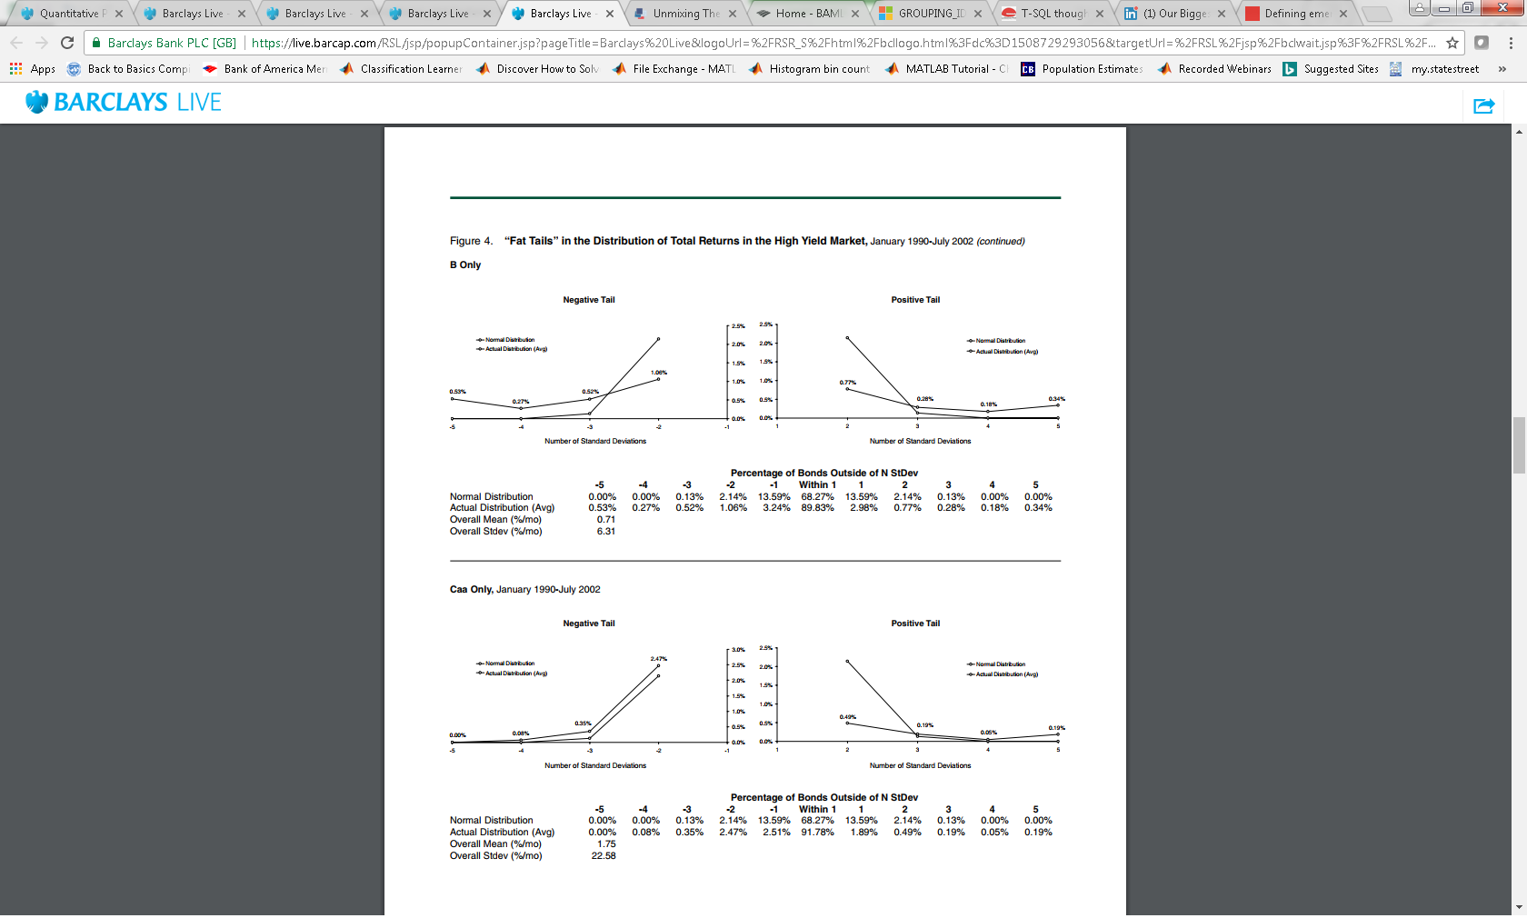
Examination of the Tails
Closer examination of each rating cohort’s tails vs. the index’s implied normal total return distribution tails
Chart 3a
To normalize and compare each rating cohorts total return distribution tails over time, each chart displays the percentage of monthly total returns that are greater than +/- 1 standard deviation from it’s mean and how it compares to the tails of the index’s fitted normal distribution.
With the decrease in quality, systematic risk becomes gradually less important, with idiosyncratic or issuer-specific risk becoming the main source of total return volatility. However, given that ratings are not a forward-looking indicator is there a market measure of risk that can be used to capture majority (>= 90%+) of the index’s tails total return variance?
What if we split up beginning of month DTS (Effective Duration x Option Adjusted Spread) into deciles in order to dissect the index’s monthly total return dispersion? Are there any DTS deciles which consistently explain more of the index’s tails total return variance than others?
BB
Rating
Chart 3b
B
Rating
Chart 3c
CCC
Rating
Source: MacKay Shields, ICE Bank of America Merrill Lynch

Slide 13
DTS as the Primary Factor for Global High Yield Developed Market Corporate Bond Tail Replication
Standard Deviation of Trailing 12 Month Total Returns by Beginning of Month DTS Percentile
December 31, 1998 ─ December 31, 2016
DTS Percentile Index Weights
December 31, 1998 ─ December 31, 2016
Chart 4a
Chart 4b
Source: MacKay Shields, ICE Bank of America Merrill Lynch

