Slide 1

Index Tracking
Yihan Li & Yang Liu

Slide 2
What is Index Tracking
Index Tracking is a passive portfolio management method[1]
It generates a certain portfolio which is a subset of the universe
The goal is to make the performance of the generated portfolio follow the index to which it is benchmarked
[1] R. Jansen and R. van Dijk. Optimal Benchmark Tracking with Small Portfolios. The Journal of Portfolio Management, Winter 2002, pages 33-39.

Slide 3
Two types of Index Tracking
Full replication: buying all the constituents at their actual weights.
Partial replication: buying a subset of the universe at weights which allow the portfolio to perform as closely as possible to the index.

Slide 4
Why important
Index fund managers want their portfolios to have minimal relative risk w.r.t. an index
Holding limited numbers of stocks limits the administration and transaction cost.[1]
……
[1] R. Jansen and R. van Dijk. Optimal Benchmark Tracking with Small Portfolios. The Journal of Portfolio Management, Winter 2002, pages 33-39.

Slide 5
How to evaluate
Several ways to evaluate the portfolio, one of them using Tracking Error
Tracking Error is a measurement of how closely a portfolio follows the index to which it is benchmarked[1]
Generally defined as the root-mean-square of the difference between the portfolio and index returns
[1] http://en.wikipedia.org/wiki/Tracking_error

Slide 6
Mathematical Form of Tracking Error
h: vector containing the proportion of capital to be invested in each stock in the index
w: vector containing the capitalization weight of each stock in the index
Q: Covariance matrix of the stock returns
Tracking Error:

Slide 7
Mathematical Form of Tracking Error
Suppose we have a set of assets with return difference vector R
Difference between the return of the portfolio of weights h and that of the universe h^{T}R-w^{T}R=(h-w)^{T}R
The square of the difference is (h-w)^{T}RR^{T}(h-w)
The expected value of the difference will be E[(h-w)^{T}RR^{T}(h-w)]= (h-w)^{T}E[RR^{T}](h-w)=(h-w)^{T}Q(h-w)
where Q is the covariance matrix of the stock returns

Slide 8
Optimization Problem
With additional constraints
Sequential Optimization[1]
Diversity Optimization[1]
Binary Variables Optimization[2]
[1] R. Jansen and R. van Dijk. Optimal Benchmark Tracking with Small Portfolios. The Journal of Portfolio Management, Winter 2002, pages 33-39.
[2] F. Charpin and D. Lacaze. Using Binary Variables to Obtain Small Optimal Portfolios. The Journal of Portfolio Management, Fall 2007, pages 68-72.

Slide 9
Sequential Optimization
Intuitively, to choose m assets out of N, select m assets with the largest weights in the index and min the T.E. using only these stocks
To apply sequential optimization, first select m1 largest weights out of N, min the T.E., then select m2 largest weights out of m1,……., select m out of mk, min the T.E.
K steps

Slide 10
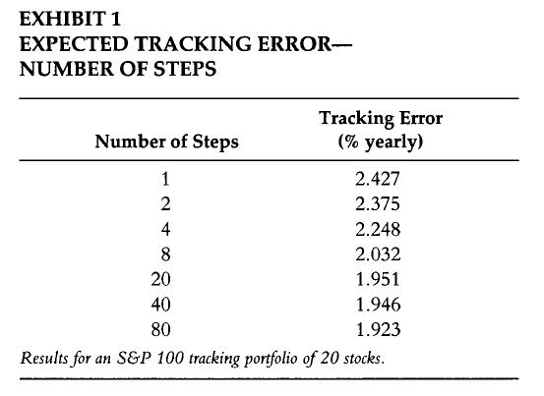
Sequential Optimization
R. Jansen and R. van Dijk. Optimal Benchmark Tracking with Small Portfolios. The Journal of Portfolio Management, Winter 2002, pages 33-39.

Slide 11
Diversity Method
Sequential Optimization: time consuming
One can optimize the portfolio under continuous constraints, but in the follwing

Slide 12
Diversity Method
is not a continuous constraint
New optimization problem

Slide 13
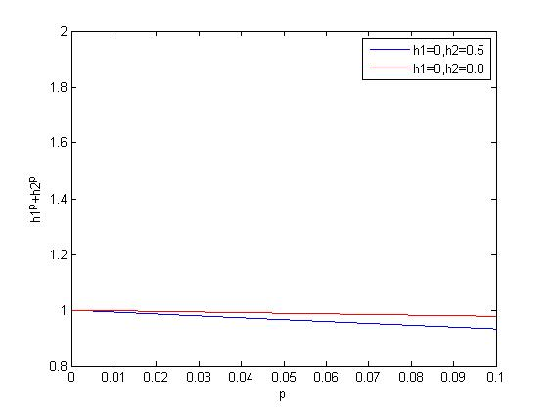
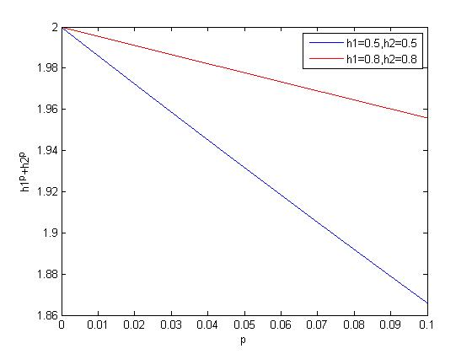
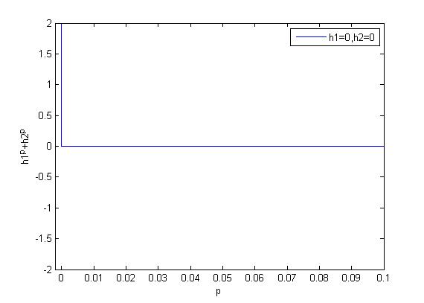
Diversity Method

Slide 14
Diversity Method
Rewrite the problem as

Slide 15
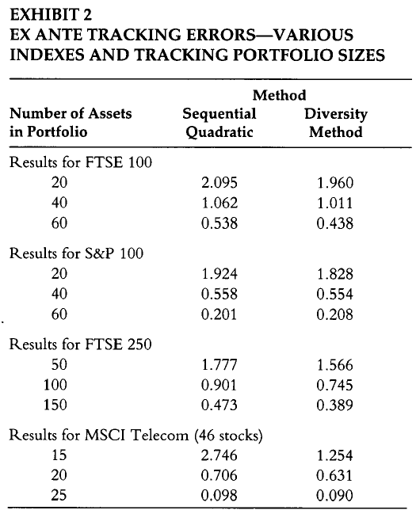
Diversity Method
R. Jansen and R. van Dijk. Optimal Benchmark Tracking with Small Portfolios. The Journal of Portfolio Management, Winter 2002, pages 33-39.

Slide 16
Diversity Method
Faster computation speed: i.e. 10^3 faster
c & p are to be determined
Not able to fix the number of assets

Slide 17
Binary Variable Method
Based on Diversity Method
For each assets i , assign a binary variable

Slide 18
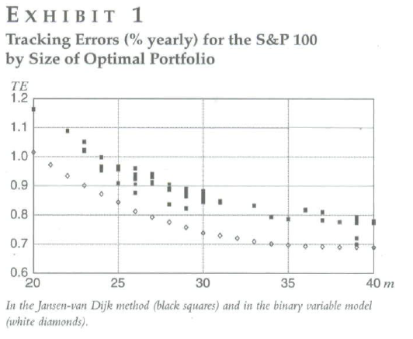
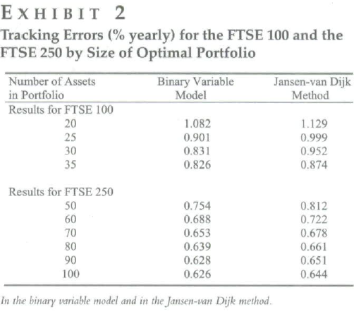
Binary Variable Method
F. Charpin and D. Lacaze. Using Binary Variables to Obtain Small Optimal Portfolios. The Journal of Portfolio Management, Fall 2007, pages 68-72.

Slide 19
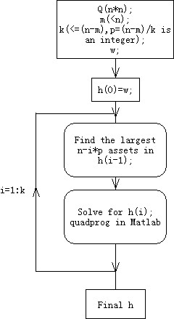
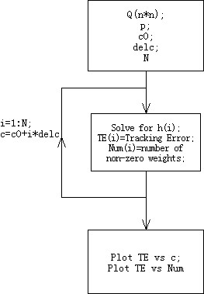
Programming Flow Chats

Slide 20
Summary
Several methods for minimizing the tracking error of partial replication portfolio were proposed
Binary Variable Method seems to be the best one (smallest T.E., ability to limit the number of assets, etc.)
Need to be further explored

