Slide 1
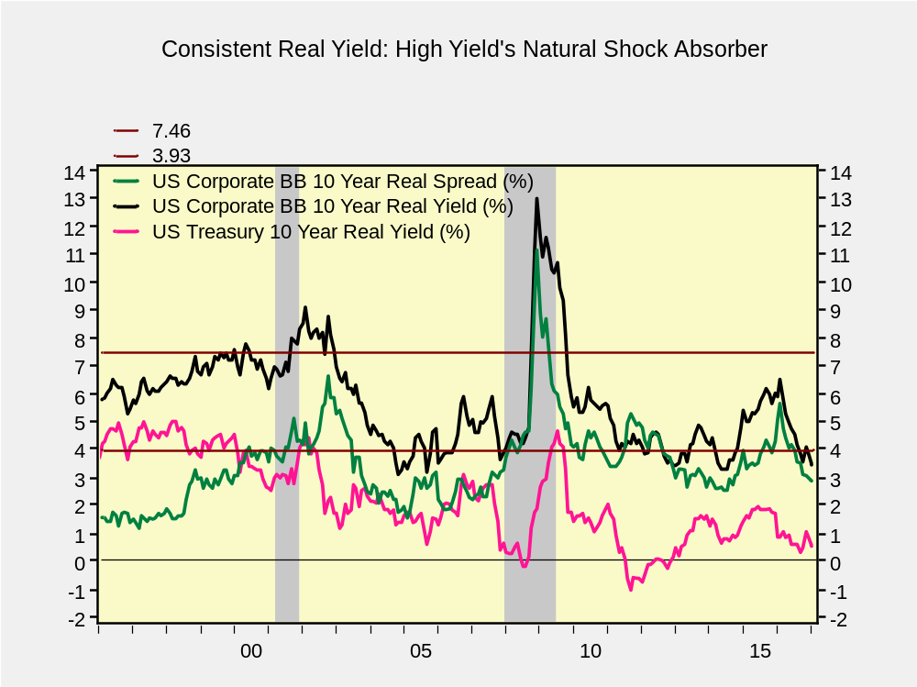
Extraneous Shock:
Financial Crisis
Extraneous Shock:
911, Enron, Worldcom
Extraneous Shock:
Drop in Commodity Prices

