Slide 1
Structured Product Total return structured product opportunistic
January 2019
Representing MacKay Shields
NEIL MORIARTY
Senior Managing Director
Global Fixed Income Division
STEPHEN CIANCI, CFA
Senior Managing Director
Global Fixed Income Division
STEVEN E. BUCKLEY
Managing Director
Global Fixed Income Division

Slide 2
Executive Summary
As part of MacKay’s efforts to build out its solutions-based business and expand the global fixed income team’s product array, MKS is proposing the launch two Structured Products – Total Return and Opportunistic
These new products will be a pure focus on the US securitized market, utilizing the same philosophy and process adopted by the Global Fixed Income Team
Structured Products capabilities have been a growing part of our discussions with clients and consultants as a means to further diversify and enhance our Multi-Sector/Unconstrained strategies which are viewed by some as being too narrow in breath/market segments utilized
The US securitized AUM market is substantial with the institutional market just over $500B
The strategy will be distributed to US institutional investors
The Funds are expected to generate sales of $300 million over next 5 years in the institutional marketplace
The strategy, delivered through an institutional separately managed account, is expected to generate approximately $1.0 million in revenue by year 5, charging a management fee of up to 0.35% / 0.50% per annum
MacKay’s proposal is seeking $25 million of seed capital for each fund to develop an investment track record
Notes:
Changed Graph to show split between NYL Investors and NYLIM by strategy
Changed footnotes

Slide 3
Product Rationale

Slide 4
Market Opportunity & Competitive Landscape
The Structured Product Total Return Strategy is an expansion of the structured products portion of the MainStay Total Return Fund.
The Structured Product Opportunistic Strategy is an expansion of the structured products portion of the MainStay Unconstrained Bond Fund.
Steve Cianci and Neil Moriarty, both of whom possess very strong structured product experience, can leverage MacKay Shields’ Global Fixed Income Team’s existing resources, including infrastructure and people to support the two proposed strategies.
This difference provides an opportunity to offer a product that appeals to investors looking for an opportunity to gain more exposure to higher yielding securities while still focused on managing quality.
Category overview
As seen on the next page, the AUM for the US Securitized Fixed Income category is substantial with the institutional market just over $500B
Market flows for 2017 through Q3 2018 have been positive with net inflows of 6.2%
MacKay has identified 14 competitors with over 270B in product AUM

Slide 5
Market Opportunity
Institutional by AUM | Total eVest AUM: $14.1Tr
As of September 2018, $Bn
 | % of Flows vs. AUM
US Core Fixed Income/Core Plus | 2.8%
Global Fixed Income – Unhedged | -0.1%
US Passive Fixed Income | 5.8%
US Long Duration Fixed Income | 6.2%
US Corporate Fixed Income | -3.5%
Global Fixed Income – Hedged | 2.2%
US Short Duration Fixed Income | -8.4%
US Securitized Fixed Income | 6.2%
US High Yield Fixed Income | -7.0%
Liability Driven Fixed Income | 2.2%
US Passive Core Fixed Income | 4.0%
Europe Fixed Income | 10.1%
US Interm Duration Fixed Income | 3.4%
US Floating-Rate Bank Loan Fixed Income | 1.9%
Global Emerging Mkts Fixed Income – Unhedged | 3.4%
$1,655.0
Source: eVestment

Slide 6
Fixed Income Net Flows
eVestment Net Flows | As of September 30, 2018 ($ in Bn)
2015-3Q18
4Q17-3Q18
US Core Fixed Income/Core Plus
US Long Duration Fixed Income
Global Emerging Mkts Fixed Income – Hedged
Global Fixed Income – Hedged
Global Unconstrained Fixed Income
US Long Duration - Gov/Cred Fixed Income
US Passive Core Fixed Income
US Passive Short Duration Fixed Income
Global Aggregate Fixed Income
Global Emerging Mkts Fixed Income - Blended Currency
US Securitized Fixed Income
US TIPS / Inflation Fixed Income
Global High Yield Fixed Income
US High Yield Fixed Income – Short Duration
Global Emerging Mkts Fixed Income - Hard Currency
US High Yield Quality Bias Fixed Income
US Stable Value (Book Value) Fixed Income
US STABLE VALUE FIXED INCOME
US CORPORATE FIXED INCOME
US SHORT DURATION FIXED INCOME
US HIGH YIELD FIXED INCOME
ALLCAPS indicates MKS capabilities today.

Slide 7
Institutional Competitive Landscape
Product Name | Product AUM 2018 Q2 | Asset Flows 2015 - 2018 Q3 | Asset Flows 2017 - 2018 Q3 | Product Views 2017 2018 Q2 | 1 YR Rank | 3 YR Rank | 5 YR Rank
DOUBLELINE | 56,855 | 288 | (5,918) | 1,180 | 39 | 45 | 37
PIMCO | 51,348 | 8,008 | 7,129 | 137 | 43 | 20 | 28
GSAM | 30,172 | (5,792) | (4,292) | 101 | 61 | 53 | 47
FIAM | 28,664 | 6,612 | 2,505 | 94 | 60 | 66 | 58
WELLINGTON | 28,566 | (7,822) | (4,244) | 145 | 39 | 31 | 32
VANGUARD | 21,924 | (5,143) | (3,076) | 28 | 73 | 87 | 89
FRANKLIN TEMPLETON | 12,029 | (1,897) | 288 | 61 | 31 | 25 | 21
JPMIM | 11,316 | 6,339 | 7,214 | 89 | 64 | 59 | 61
BLACKROCK | 8,360 | (1,979) | (793) | 92 | 57 | 46 | 49
CAPITAL GROUP | 4,976 | 3,220 | 1,623 | 186 | 98 | 93 | 91
LOOMIS SAYLES | 4,474 | 623 | 869 | 34 | 26 | 35 | 26
FIDELITY | 4,184 | (1,976) | (1,044) | 53 | 83 | 95 | -
UBS | 3,300 | 38 | 29 | 38 | 44 | 50 | 72
WAMCO | 2,929 | - | - | 89 | 25 | 17 | 17
PRINCIPAL GLOBAL | 1,980 | (766) | (282) | 66 | 90 | 91 | 67
Total $271,077 ($247) $8

Slide 8
Securitized Product Post the Global Financial Crisis

Slide 9
Market Structure Has Changed
US Universal Index | Sector Distribution
$11.7 Trillion
$23.5 Trillion
Source: Bloomberg Barclays U.S. Universal.

Slide 10
Since the Financial Crisis the Overall Securitized Market Has Contracted as a % of GDP
Historical Change in US Nonfinancial Corporate Debt vs US Securitized Debt as a % of GDP¹
Recent Change in US Nonfinancial Corporate Debt vs US Securitized Debt as a % of GDP
US Non-financial Business Sector Outstanding Debt as a % of GDP (SAAR)
US Mortgage Backed, Commercial Mortgage Backed, & Asset Backed Debt Outstanding as a % of GDP (SAAR)
Source: Federal Reserve Board, Haver Analytics.

Slide 11
Growth in the Securitized Market by Asset Type
Source: JP Morgan

Slide 12
US Consumers De-Levered whereas US IG Corporates Re-Levered Post-Crisis
December 31, 1996 - June 30, 2018
Source: ICE BofA Merrill Lynch, MacKay Shields

Slide 13
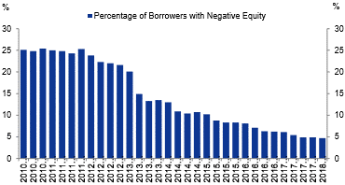
Consumers Can Once Again Access Home Equity
Under 5% of Mortgages Are Underwater on Their Mortgages, Down from 25% in 2011

Slide 14
Issuance Trends
CONSISTENT PERIODS OF NET NEGATIVE ISSUANCE PROVIDE A TAILWIND FOR TOTAL RETURN
Gross Issuance ($mm)
Net Issuance ($mm)
Year | Agency MBS | Non-Agency MBS | CMBS | ABS | CLO
2002 | $1,362 | $350 | $59 | $228 | $15
2003 | 2,039 | 544 | 86 | 254 | 19
2004 | 957 | 792 | 99 | 239 | 30
2005 | 913 | 1,142 | 171 | 314 | 53
2006 | 856 | 1,118 | 206 | 327 | 95
2007 | 1,082 | 685 | 232 | 299 | 91
2008 | 1,132 | 11 | 16 | 142 | 21
2009 | 1,684 | 3 | 11 | 140 | 1
2010 | 1,337 | 3 | 39 | 106 | 4
2011 | 1,145 | 3 | 67 | 136 | 14
2012 | 1,662 | 8 | 99 | 196 | 56
2013 | 1,534 | 22 | 145 | 175 | 86
2014 | 870 | 44 | 140 | 193 | 124
2015 | 1,206 | 62 | 142 | 179 | 99
2016 | 1,447 | 43 | 150 | 188 | 72
2017 | 1,271 | 65 | 181 | 222 | 118
YTD 2018 | 873 | 55 | 150 | 209 | 115
Year | Agency MBS | Non-Agency MBS | CMBS | ABS | CLO
2002 | $267 | $90 | $43 | $53 | $13
2003 | 348 | 135 | 52 | 51 | 17
2004 | 57 | 418 | 76 | 16 | 25
2005 | 149 | 598 | 115 | 59 | 42
2006 | 300 | 501 | 160 | 65 | 85
2007 | 528 | 202 | 171 | 65 | 75
2008 | 512 | -334 | -41 | -55 | 5
2009 | 460 | -364 | -41 | -31 | -17
2010 | -117 | -266 | -40 | -105 | -16
2011 | 32 | -191 | -30 | -60 | -14
2012 | 48 | -197 | -4 | -1 | 14
2013 | 249 | -154 | 37 | 29 | 16
2014 | 77 | -80 | 39 | 31 | 67
2015 | 187 | -69 | 30 | 3 | 57
2016 | 270 | -76 | -12 | 3 | 26
2017 | 338 | -63 | 38 | 29 | 55
YTD 2018 | 126 | -22 | 39 | 30 | 24
Source: JP Morgan

Slide 15
Structured Product Opportunities for the
Global Fixed Income Platform

Slide 16
Dynamic Strategies Across the Risk-Return Spectrum
Structured Product Portfolios Fill a Gap in the Global Fixed Income Team’s Product Set
Core Plus
Core Plus Opportunities
Structured Product Total Return
Credit
Unconstrained
Structured Product Opportunistic
High Yield
Bank Loans
Emerging Markets
Short Duration
Intermediate
Core
Long Duration
EXPECTED RETURN
RISK SPECTRUM

Slide 17
Low Correlation Benefits Structured Product
Legacy securitized assets exhibit a low (to negative) correlation to high quality interest rate sensitive assets such as Treasuries, Agencies and traditional RMBS/ABS, as well as credit sensitive assets (EMD, HY).
Source: Bloomberg Barclays Indices
Monthly data series from 1/2010 – 10/2018

Slide 18
Important Downside Protection
Upside and Downside Capture | January 2010 – October 2018 (%)
Gross of Fees. Performance based on monthly returns. Returns sourced from Citibank.
Past performance is not indicative of future results.

Slide 19
The Global Fixed Income Team
Investment Policy Committee
Dan Roberts, PhD | Head of Global Fixed Income
Joseph Cantwell
Stephen Cianci, CFA
Lou Cohen, CFA¹
Matthew Jacob
Neil Moriarty
Shu-Yang Tan, CFA
Macro (TBH)
Portfolio Management
Multi-Sector
Credit
Stephen Cianci, CFA
Senior Portfolio Manager
Neil Moriarty
Senior Portfolio Manager
Joseph Cantwell
Senior
Portfolio Manager
Matthew Jacob
Senior
Portfolio Manager
Shu-Yang Tan, CFA
Senior
Portfolio Manager
Steven Rich, PhD
Portfolio Manager
Claude Athaide, PhD, CFA
Associate
Portfolio Manager
Anthi Simotas
Associate
Portfolio Manager
Jakob Bak, PhD, CFA
Portfolio Manager
Alexandra Wilson-Elizondo
Portfolio Manager
Client Portfolio Management
Trading
Research
Risk Management
Steven Buckley
Client Portfolio Manager
Scott Dolph Head of Trading
Harel Sender Head of High Yield Trading
Andrew Ruskulis, CFA High Yield Trading
Matthew Florio Investment Grade Trading
Michael Starr Credit Analyst
Ryan Downey, CFA Credit Analyst
Brian Chiu Credit Analyst
TBH (2)
Seng Liew Credit Analyst
Nancy Poz Credit Analyst
Fran Schulman, CFA Credit Analyst
Brian Fagan Macro & Quantitative Analyst
Steven Rich, PhD Head of Risk
Susan Hutchison Quantitative Analyst
Sally Chan²
James Cardamone²
Regina Gavrilova²
1. Lou Cohen will transition to Senior Advisor effective 1/1/2019. Mike Kimble will be providing services until 12/31/2018; 2. Member of Firm’s Enterprise Risk Oversight Committee.

Slide 20


Investment Philosophy
Old Mean
New Mean
HIGH
Frequency
GOAL: Reduce Risk of Large Losses
Two key sources of risk
Economic risk
Issuer default risk
Outsized capital gains are rarer in bonds than they are in stock markets
LOW
LOW
Bond Returns
HIGH
This graph illustrates a stylized distribution of one-year historical returns for high yield bonds and does not represent the distribution of any given year. The universe of bonds for this analysis is the BofA Merrill Lynch High Yield Master II Index (H0A0) except for those bonds in the index for which data could not be ascertained.

Slide 21
Structured Product Return Continuum
Expected Return
Cut off the tails of excessive credit and convexity risk
Convexity Risk
Credit Risk
HIGH
LOW
LOW
HIGH
This graph illustrates a stylized distribution of expected return and risk for securitized assets and does not necessarily represent the actual distribution.

Slide 22
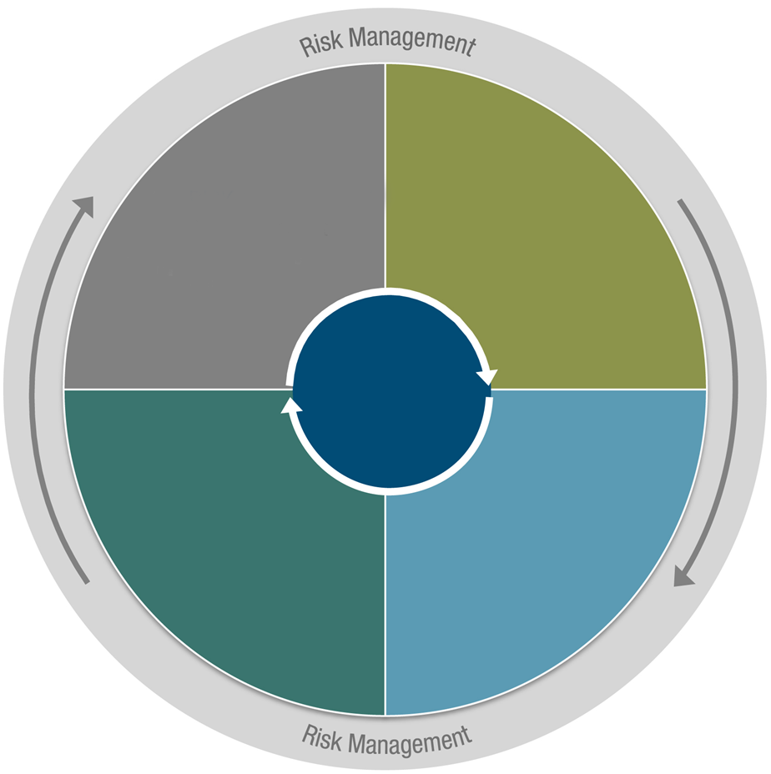
Four-Step Investment Process
4
1
ANALYSIS
RISK ASSESSMENT
Top Down
Monitoring
Macro Analytics ─ Market’s Risk-Cycle Phase
Relative Value Risk
Analytics
CLIENT
PORTFOLIO
3
SECTOR
ASSESSMENT
2
SECURITY
ASSESSMENT
Bottom Up
Bottom Up
Sector Valuation Assessment
Individual Security
Value Assessment

Slide 23
Top Down: Stages of the Macro Economic Cycle
UK
US
EUROPE
JAPAN
Real GDP
SELL RISK
BUY RISK
Trough
Expansion
Peak
Contraction
Central Bank Action | Easy monetary policy Low interest rates Wide credit spreads | On hold/tighter policy ⬆ Interest rates ⬇ Credit spreads | On hold/easing High interest rates, but falling Narrow credit spreads, but widening | Easing policy ⬇ Interest rates ⬆ Credit spreads
Asset Type Emphasis | Subordinated securitized credit | Premium RMBS Asset-Backed Securities Commercial Mortgage- Backed Securities | Agency Mortgage-Backed Securities CMOs | Discount RMBS
Duration | Shorten | Short | Lengthen | Long
Yield Curve | Steepener | Steepener to Flattener | Flattener to Steepener | Steepener
As of 3Q 2018
This document is for informational purposes only. Portfolios are actively managed and all expressions of opinion are subject to change without notice and are not intended to be a guarantee of future events.

Slide 24
Bottom Up: Eliminating Uncompensated Risk
Initial Screen | Structured Credit Research Approach | Relative Value Analysis | Monitoring Portfolio Construction |  | Sell Discipline
SECURITIZED SCREENS Loan specification (low loan balance, LTV, servicer, geography, seasoning) Structure through CMOs (PAC, VADM, Sequential) PRICE MATTERS Exploit mispriced convexity primarily in the agency mortgage market | ISSUER / UNDERWRITER Evaluate issuer’s underwriting standards and procedures SERVICER STRENGTH Loss mitigation techniques, staff quality and efficient use of Information technology Utilize GFI’s credit research team COLLATERAL / LOAN LEVEL DATA Stratify each security into collateral categories Assess potential for prepayment, default, loss recovery to determine base case/stressed IRR WATERFALL | Voluntary and Involuntary Analyze cash flow waterfall Loan performance triggers Credit enhancement changes Allocation of losses | POSITION THE PORTFOLIO Attempt to buy the “best bond” | POLICY COMMITTEE Investment philosophy adherence Top-down risk modulation Scenario analysis Portfolio Management Strategy implementation Client guideline adherence Investment team coordination Benchmark risk monitoring Portfolio Review MEETINGS Monthly |  | CREDIT DETERIORATION First disappointment MARKET VOLATILITY Sell, reduce, defend—not add RELATIVE VALUE Price/yield less compelling TOP-DOWN OUTLOOK Marginal risk
Each structured product bond is rigorously analyzed
MODEL PORTFOLIO

Slide 25
Risk Management
Tightly integrated with investment process
RISK MANAGEMENT IS EVERYONE’S BUSINESS
Monitor a variety of measures of valuation, price sensitivity, and risk
EXAMPLES: INTEREST-RATE DURATION, SPREAD DURATION, DURATION TIMES SPREAD (DTS)
Approaches of risk management
1
HORIZONTAL
2
VERTICAL
Prospective analysis
Real-time analysis
Ex-post analysis
Portfolio (highest level of aggregation)
Sector
Systematic
RISK
Industry class
Issuer
Issue (lowest level of aggregation)
Non-systematic

Slide 26
Technological Resources
YIELDBOOK | TREPP | RMBS CREDIT MODEL | INTEX SOLUTIONS
The team is skilled in customizing YieldBook to meet our research views. | Leading provider of information, analytics and technology to the CMBS market. Trepp is available through Bloomberg for CMBS trading, research and surveillance. | The credit needs of the team can be met most efficiently through a third party vendor. We identified three providers that offer a superior, customizable solution: Andrew Davidson & Co. Black Knight Financial Five Bridges Advisors | Provides deal cash flow models, analytics and software models for RMBS, ABS and other structured securities.

Slide 27
Proposed Structured Product Portfolios

Slide 28
New Product Concepts
 | Structured Product Total Return | Structured Product Opportunistic
DESCRIPTION | A benchmark aware fixed income portfolio investing in primarily structured product bonds across residential MBS, commercial MBS & asset-backed securities | An unconstrained fixed income portfolio investing in primarily structured product bonds across residential MBS, commercial MBS & asset-backed securities
OBJECTIVE | Total Return | Total Return
ALPHA TARGET | 75-125 bps | 200-300 bps
INFORMATION RATIO/SHARPE RATIO | 0.7-1.0 | 0.7-1.0
BENCHMARK | Bloomberg Barclays U.S. Securitized | 3mLibor
BENCHMARK DURATION | 5.20 years | 0.25 years
DURATION TARGET | Index duration; +/- 25% | 0-3 Years
RATINGS | Mostly investment grade with the ability to invest 20% in below investment grade & non-rated bonds | No security restriction but maintain overall portfolio investment grade rating
MATURITY RESTRICTIONS | None | None
NON U.S. | Yes | Yes
NON $ | Limited to 5% | Limited to 10%
DERIVATIVES | Futures, Swaps, CDX | Futures, Swaps, CDX

Slide 29
Structured Product Total Return Model Portfolio October 2018
 | Index | Portfolio
TOTAL 30 YEAR MBS¹ | 78.85% | 60.00%
Discount | 47.06% | 25.00%
Current Coupon | 19.45% | 30.00%
Premium | 12.34% | 5.00%
TOTAL 15 & 20 YEAR MBS¹ | 13.06% | 5.00%
Discount | 10.92% | 0.00%
Current Coupon | 4.53% | 0.00%
Premium | 0.10% | 5.00%
AGENCY CMO | 0.00% | 10.00%
NON-AGENCY CMO | 0.00% | 5.00%
OTHER (CREDIT RISK TRANSFER/SINGLE FAMILY RENTAL) | 0.00% | 2.00%
ASSET BACKED SECURITIES | 1.79% | 8.00%
Credit Card | 0.90% | 2.00%
Auto | 0.86% | 3.00%
Other | 0.03% | 3.00%
COMMERCIAL MORTGAGE BACKED SECURITIES | 6.29% | 10.00%
Non-agency CMBS | 3.85% | 5.00%
Agency CMBS | 2.45% | 5.00%
 | 100.00% | 100.00%
1. GNMA included in MBS totals at 27.2% of index, Model portfolio owns no GNMA.

Slide 30
Structured Product Total Return Model Portfolio October 2018
Portfolio Statistics
Quality Distribution
 | Securitized Index¹ | Model Portfolio
YIELD | 3.73 | 3.80
OAS | 36 | 44
EFFECTIVE DURATION | 5.38 | 5.38
CONVEXITY | -0.65 | -0.61
SECURITIZED INDEX
MODEL PORTFOLIO
1. Bloomberg Barclays Securitized Index

Slide 31
Structured Product Opportunistic Model Portfolio October 2018
Portfolio Composition
Portfolio Statistics
 | Sector |  |  | Sub-Sector
RMBS | Prime | 50.0% |  | Hybrid Arm | 50.0%
 | Alt-A | 20.0% |  | Fixed | 20.0%
 | Sub-Prime | 0.0%
 | Option Arm | 0.0%
CMBS | Senior | 10.0% |  | Conduit | 3.0%
 | Sub | 0.0% |  | SASB | 5.0%
 |  |  |  | Agency | 2.0%
ABS | Senior | 20.0% |  | Credit Card | 5.0%
 | Sub | 0.0% |  | Auto | 10.0%
 |  |  |  | Other | 5.0%
 |  | 100.0% |  |  | 100.0%
YIELD (LOSS ADJUSTED) | 4.2%
SPREAD¹ | 110
EFFECTIVE DURATION | 1.5
Quality Distribution
Capital Structure
SENIOR | 98%
SUB | 2%
1. Spread to swaps.
2. <BBB are legacy RMBS securities.

Slide 32
Appendix

Slide 33
Securitized Product Matrix
 | Residential MBS | Commercial MBS | Asset-Backed Securities
DEFINITION | RMBS market is best thought of as two sectors, agency mortgage bonds and non-agency mortgage bonds. Agency RMBS are issued by government sponsored entities like Fannie Mae, Freddie Mac and Ginnie Mae and carry the implicit or in the case of Ginnie Mae the explicit backing of the US Government. Non-agency RMBS or private label RMBS are issued by private institutions. | Commercial mortgage-backed securities (CMBS) are a type of mortgage-backed security that is secured by mortgages on commercial properties, instead of residential real estate. The CMBS market is segmented into agency CMBS (multi-family) issued by Fannie Mae, Freddie Mac and Ginnie Mae , conduit CMBS which is a diversified pool of commercial loans and single asset/single borrower (SASB) CMBS whose loans are a high quality portfolio of similar assets or large single properties. | An asset-backed security (ABS) is a bond collateralized by a pool of assets such as home equity loans, automobile loans, credit card receivables, student loans or other expected cash flows. Issuers of ABS can be as creative as they desire. Just about any cash-flow generating asset can be securitized into an ABS. ABS typically will have senior and subordinate tranches.
RISKS | Agency RMBS main risk is convexity while the dominant risk in non-agency RMBS is credit risk. | Agency CMBS have little credit risk. Conduit and SASB CMBS offer varying degrees of credit risk from senior through junior tranches. Convexity risk is less than the agency RMBS market. | Credit performance is typically strong while interest rate risk is minimal through short duration and/or floating rate structure.
LIQUIDITY | Agency RMBS is highly liquid while non-agency RMBS is less liquid. | Agency CMBS offer better liquidity than both SASB and conduit CMBS | High liquidity in senior tranches; less liquid in junior tranches
MARKET SIZE ($BN) | Agency RMBS = 6,108 Non-agency RMBS = 581 | CMBS = 879 | ABS = 786

Slide 34
Year to Date Total Return by Asset Class
Less interest rate sensitive and structured sectors dominate
As of Year to Date October 31, 2018. Gross of fees. Source: ICE BofA Merrill Lynch. Past performance is not indicative of future results.

Slide 35
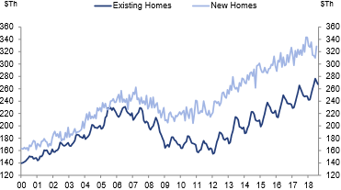
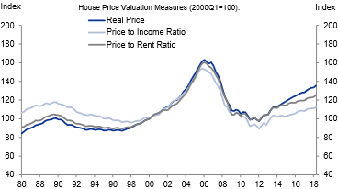
RMBS: Home Prices Elevated While Valuations Are High
Median Price of New and Existing Single-Family Home Sales¹
New home sale prices are substantially above those of existing homes
House Price Valuation Measures²
Real price, price-to-income ration, and price-to-rent ratio are at or above historical average levels
1. Source: NAR, Census Bureau, Goldman Sachs Global Investment Research
2. Source: CoreLogic, BLS, Census Bureau, Goldman Sachs Global Investment Research

Slide 36
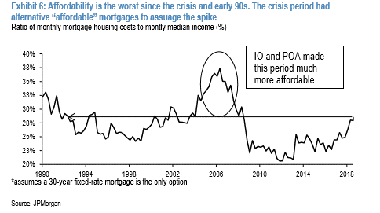
RMBS: Affordability Declining
Affordability Is the Worst Since the Crisis and Early 90s. The Crisis Period Had Alternative “Affordable” Mortgages to Assuage the Spike.
Ratio of monthly mortgage housing costs to monthly median income (%)
Assumes a 30-year fixed-rate mortgage is the only options.
Source: JP Morgan

Slide 37
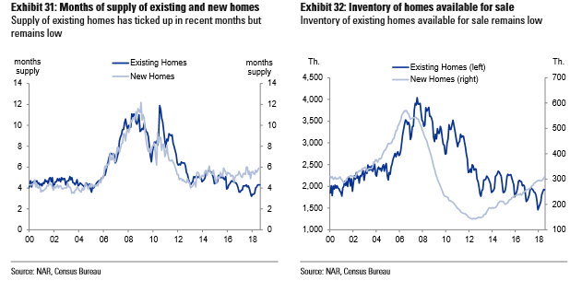
RMBS: Tight Supply
Months of Supply of Existing and New Homes
Supply of existing homes has ticked up in recent months but remain low
Inventory of Homes Available for Sale
Inventory of existing homes available for sale remains low
Source: NAR, Census Bureau

Slide 38
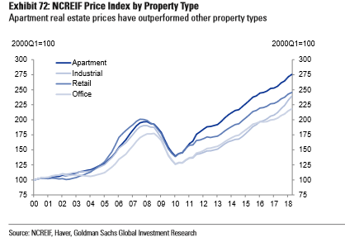
CMBS: Prices Recovered Above 2007 Peaks
Price Index by Property Type Apartment real estate prices have outperformed other property types
Source: NCRIEF, Haver, Goldman Sachs Global Investment Research

Slide 39
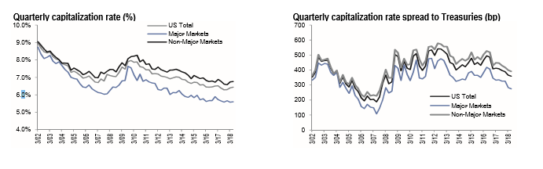
CMBS: Cap Rates and Spreads Tell a Different Story
Quarterly Capitalization Rate | (%)
Quarterly Capitalization Rate Spread to Treasuries | (bp)
Source:

Slide 40
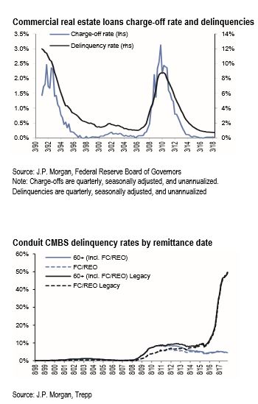
CMBS: Credit Performance is Strong
Commercial Real Estate Loans Charge-Off Rate and Delinquencies¹
Conduit CMBS Delinquency Rates by Remittance Date
1. Source: JP Morgan, Federal Reserve Board of Governors. Note: Charge-offs are quarterly, seasonally adjusted, and unannualized. Delinquencies are quarterly, seasonally adjusted, and unannualized.
2. Source: JP Morgan, Trepp

Slide 41
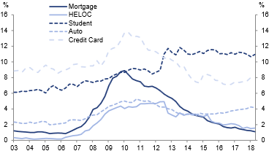
ABS: Credit Performance is Healthy, ex-Student Loans
Percentage 90+-Day Delinquent by Type of Debt
Source: FRBNY, Goldman Sachs Global Investment Research

Slide 42
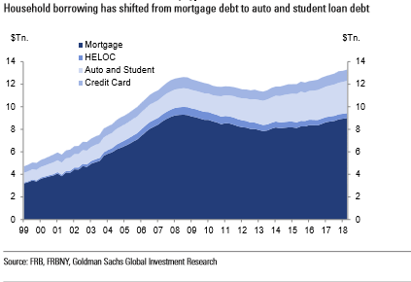
ABS: Households Shifted to Auto and Student Loans
Source: FRB, FRBNY, Goldman Sachs Global Investment Research

Slide 43
Distribution Strategy
The development of our Structured Products capabilities have been a growing part of discussions with clients and consultants as a means to further diversify and enhance our Multi-Sector/Unconstrained strategies which are viewed by some as being too narrow in breath/market segments utilized
Properly launched and introduced these strategies should be market ready for inclusion in existing portfolios in ~ 12 months and on a stand alone basis within the next 12 months thereafter
This product capability offers a strong foundation on which to strengthen/relaunch existing capabilities (i.e. Core Plus) into important consultant channels (i.e Mercer, Towers Watson) who have historically viewed the plus component of these strategies to be too reliant on high yield and, therefore, not warranting buy ratings
The introduction process will also provide a forum for Steve Cianci, Neil Moriarty and others to further establish their relationships with clients and consultants as the leadership transition within the GFI team continues
We further believe the addition of these capabilities will further extend the market interest of our strategies in Non US markets.

Slide 44
Fees, Seed Capital & Timing
Management Fees – the laddered Management Fee for the Structured Total Return Product is 35 basis points and 50 basis points for the Structured Opportunistic Product
The general account pays [XX] basis points
MacKay’s is seeking $25 million of seed capital from the General Account for each fund to develop an investment track record
Repatriation plan
It is expected to retain the capital through the initial commercial stages and to begin repatriation as the strategy assets exceed $100mm, repatriating a $1 for each $2 net new flows
Timing
A March 1 launch date is contemplated

Slide 45
P&L Projection
5 Year View
BASE CASE, UPSIDE CASE (SALES 2X BASE), DOWNSIDE CASE (MORE LIMITED EXTERNAL SALES)
Base case assumes sales of $320 million over next 5 years in the institutional marketplace
Management fees are assumed to remain at 35/50 basis points
Although margin expansion is expected, expenses have remained in line with MacKay’s compensation and distribution costs
Product - Structured Product
($ in Millions) | Base Case |  |  |  |  |  | Upside Case |  |  |  |  |  | Downside Case
BOY | 2019 | 2020 | 2021 | 2022 | 2023 |  | 2019 | 2020 | 2021 | 2022 | 2023 |  | 2019 | 2020 | 2021 | 2022 | 2023
SP Total Return EOP AUM | - | - | 10.2 | 61.8 | 166.8 |  | - | - | 20.5 | 123.6 | 333.7 |  | - | - | 3.4 | 20.6 | 55.6
Net flows | - | - | 10.0 | 50.0 | 100.0 |  | - | - | 20.0 | 100.0 | 200.0 |  | - | - | 3.3 | 16.7 | 33.3
Total Net Revenues | - | - | 0.0 | 0.1 | 0.4 |  | - | - | 0.0 | 0.3 | 0.8 |  | - | - | 0.0 | 0.0 | 0.1
bps of average AUM | 35.0 bps | 35.0 bps | 35.0 bps | 35.0 bps | 35.0 bps |  | 35.0 bps | 35.0 bps | 35.0 bps | 35.0 bps | 35.0 bps |  | 35.0 bps | 35.0 bps | 35.0 bps | 35.0 bps | 35.0 bps
SP Opportunistic EOP AUM | - | - | 10.2 | 61.8 | 166.8 |  | - | - | 20.5 | 123.6 | 333.7 |  | - | - | 3.4 | 20.6 | 55.6
Net flows | - | - | 10.0 | 50.0 | 100.0 |  | - | - | 20.0 | 100.0 | 200.0 |  | - | - | 3.3 | 16.7 | 33.3
Total Net Revenues | - | - | 0.0 | 0.2 | 0.6 |  | - | - | 0.1 | 0.4 | 1.1 |  | - | - | 0.0 | 0.1 | 0.2
bps of average AUM | 50.0 bps | 50.0 bps | 50.0 bps | 50.0 bps | 50.0 bps |  | 50.0 bps | 50.0 bps | 50.0 bps | 50.0 bps | 50.0 bps |  | 50.0 bps | 50.0 bps | 50.0 bps | 50.0 bps | 50.0 bps
Seed Capital EOP AUM | 51.7 | 54.0 | 56.4 | 59.0 | (0.0) |  | 51.7 | 54.0 | 56.4 | 38.1 | (0.0) |  | 51.7 | 54.0 | 56.4 | 59.0 | 61.6
TR Seed | 25.0 | - | - | - | (30.2) |  | 25.0 | - | - | (10.2) | (19.5) |  | 25.0 | - | - | - | -
Ops Seed | 25.0 | - | - | - | (30.2) |  | 25.0 | - | - | (10.2) | (19.5) |  | 25.0 | - | - | - | -
Total Revenues | 0.1 | 0.1 | 0.1 | 0.1 | 0.1 |  | 0.1 | 0.1 | 0.1 | 0.1 | 0.0 |  | 0.1 | 0.1 | 0.1 | 0.1 | 0.1
bps of average AUM | 19.0 bps | 19.0 bps | 19.0 bps | 19.0 bps | 19.0 bps |  | 19.0 bps | 19.0 bps | 19.0 bps | 19.0 bps | 19.0 bps |  | 19.0 bps | 19.0 bps | 19.0 bps | 19.0 bps | 19.0 bps
Total AUM | 51.7 | 54.0 | 76.9 | 182.6 | 333.7 |  | 51.7 | 54.0 | 97.3 | 285.3 | 667.3 |  | 51.7 | 54.0 | 63.3 | 100.2 | 172.9
Net Sales | - | - | 20.0 | 100.0 | 200.0 |  | - | - | 40.0 | 200.0 | 400.0 |  | - | - | 6.7 | 33.3 | 66.7
Total Revenues | 0.1 | 0.1 | 0.1 | 0.4 | 1.0 |  | 0.1 | 0.1 | 0.2 | 0.7 | 2.0 |  | 0.1 | 0.1 | 0.1 | 0.2 | 0.4
bps of average AUM | 19.0 bps | 19.0 bps | 22.7 bps | 32.0 bps | 39.8 bps |  | 19.0 bps | 19.0 bps | 22.7 bps | 32.0 bps | 39.8 bps |  | 19.0 bps | 19.0 bps | 22.7 bps | 32.0 bps | 39.8 bps

Slide 46
Key Risks
Performance Out of the Gate and Through the Cycle Will Be Key
Risks & Considerations | Comments / Mitigants
MARKET CONDITIONS | Looking for the markets to continue through the late cycle as expected
STRATEGY PERFORMANCE | Performance will need to be competitive through the incubation phase, however having onboarded an experienced team should mitigate novice
SOLUTIONS INTEGRATION | Will require a concerted effort to gain institutional marketplace penetration, but a good opportunity as part of our core plus offering and broader solutions based marketing

Slide 47
Strategy Specifications
PRODUCT NAME | MainStay MacKay Structured Product - Total Return
PORTFOLIO MANAGERS | Stephen Cianci, Neil Moriarty
VEHICLE | Separate account or CIT
BENCHMARK | Bloomberg Barclays U.S. Securitized
RETURN / VOLATILITY OBJECTIVES | Return: +0.75 – 1.25% relative to benchmark over a market cycle IR: 0.70 to 1.0
INVESTMENT GUIDELINES | A benchmark aware fixed income portfolio investing in primarily structured product bonds across residential MBS, commercial MBS & asset-backed securities
PERFORMANCE PEER GROUP | eVestment US Securitized Fixed Income – Mortgage / Non Traditional
NYL FEE LEVEL | [ ]
FUNDING DATE | February 28, 2019
EXPECTED REPATRIATION | February 28, 2022 or January 3, 2024 with commercial input

Slide 48
Strategy Specifications
PRODUCT NAME | MainStay MacKay Structured Product Opportunistic
PORTFOLIO MANAGERS | Stephen Cianci, Neil Moriarty
VEHICLE | Separate account or CIT
BENCHMARK | 3M Libor
RETURN / VOLATILITY OBJECTIVES | Return: +2-3% relative to benchmark over a market cycle IR: 0.70 to 1.0
INVESTMENT GUIDELINES | An unconstrained fixed income portfolio investing in primarily structured product bonds across residential MBS, commercial MBS & asset-backed securities
PERFORMANCE PEER GROUP | eVestment US Securitized Fixed Income – Mortgage / Non Traditional
NYL FEE LEVEL | [ ]
FUNDING DATE | February 28, 2019
EXPECTED REPATRIATION | February 28, 2022 or January 3, 2024 with commercial input

Slide 49
Portfolio Manager Biographies
Stephen Cianci, CFA Senior Managing Director | Steve Cianci, CFA, is a Senior Managing Director and Senior Portfolio Manager for the Global Fixed Income Team, joining MacKay Shields on January 2, 2018. Steve's focus is on multi-sector and core strategies. Prior to joining MacKay Shields, Steve was with Aberdeen for 7 years where his responsibilities included Head of US Core Plus and Opportunistic fixed income on the North American Fixed Income team. Before joining with Aberdeen, Steve worked as Co-Head of Core and Core Plus fixed income strategies, lead portfolio manager for Short Duration products and the Head of Structured Products at Logan Circle Partners. Previously, Steve held similar roles as a Senior Vice President and Senior Portfolio Manager at Delaware Investments. He is an adjunct professor of finance and a member of the Business Advisory Council at Widener University. Steve graduated with a MBA and BA from Widener University and is a CFA charterholder. He has been working in the investment industry since 1992.
Neil Moriarty Senior Managing Director | Neil Moriarty Ill is a Senior Managing Director and Senior Portfolio Manager for the Global Fixed Income Team, joining MacKay Shields on January 2, 2018. Neil's focus is on multi-sector and core strategies. Prior to joining MacKay Shields, Neil was with Aberdeen via the 2005 acquisition of Deutsche Asset Management's London and Philadelphia fixed income businesses. While at Aberdeen, his responsibilities included Head of US Core, Structured Products and Co-Head of US Core Short Duration. Neil joined Deutsche in 2002 from Swathmore/Cypress Capital Management where he worked in fixed income portfolio management. Previously, Neil worked for Chase Securities in fixed income trading and research. Prior to that, Neil worked for Paine Webber in fixed income trading and research. Neil graduated with a BA from University of Massachusetts, Amherst. He has been working in the investment industry since 1987.

Slide 50
Title

