Slide 1
30 Non-Financial Use Cases of Blockchain Technology
While financial use cases of blockchain technology are at the spotlight due to the significant interest of powerful parties – banks, investors, and even governments – non-financial use cases of DLT are of equally significant importance to a number of industries. Along with banks and FinTech startups, non-financial players have been paying attention and looking for ways to leverage the opportunities that DLT opens. A more comprehensive overview of financial and non-financial use cases of blockchain technology can be found in the MEDICI report titled Blockchain Use Cases: Comprehensive Analysis and Startups Involved. Information on over 400 blockchain-focused startups operating around the world can be found in MEDICI, FinTech’s global knowledge network. Let’s look at some interesting examples of the applications of blockchain technology beyond financial services:

Slide 2
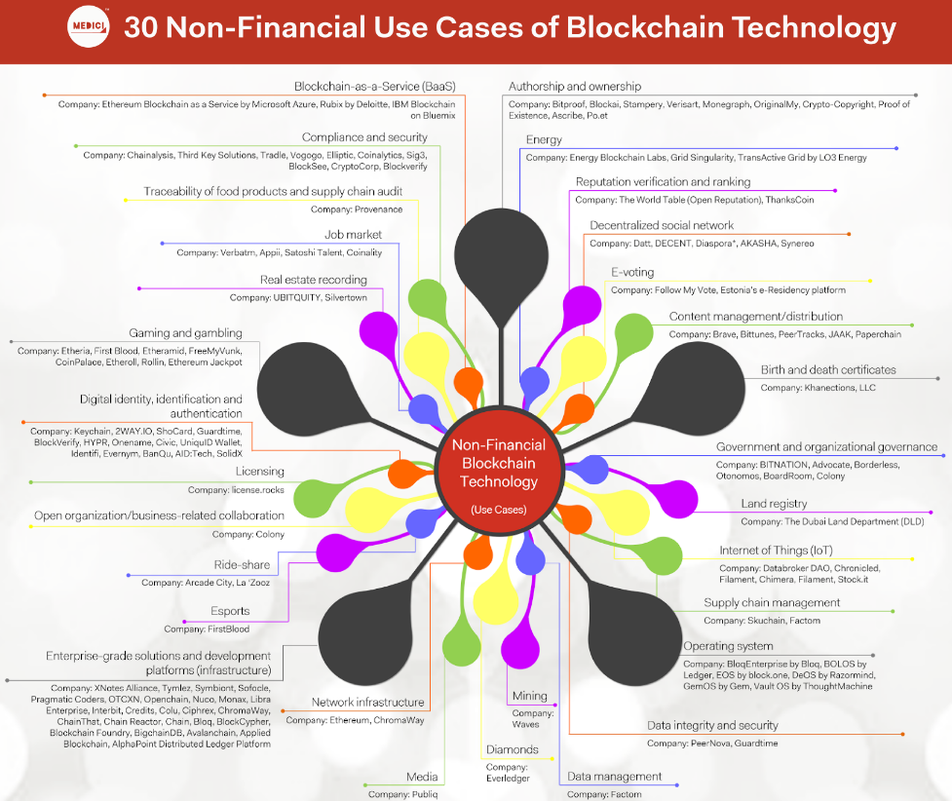

Slide 3
Infographic References
Authorship and ownership: Bitproof, Blockai, Stampery, Verisart, Monegraph, OriginalMy, Crypto-Copyright, Proof of Existence, Ascribe, Po.et
Birth and death certificates: Khanections, LLC
Blockchain-as-a-Service (BaaS): Ethereum Blockchain as a Service by Microsoft Azure, Rubix by Deloitte, IBM Blockchain on Bluemix
Compliance and security: Chainalysis, Third Key Solutions, Tradle, Vogogo, Elliptic, Coinalytics, Sig3, BlockSee, CryptoCorp, Blockverify
Content management/distribution: Brave, Bittunes, PeerTracks, JAAK, Paperchain
Data management: Factom
Data integrity and security: PeerNova, Guardtime
Decentralized social network: Datt, DECENT, Diaspora*, AKASHA, Synereo
Diamonds: Everledger
Digital identity, identification, and authentication: Keychain, 2WAY.IO, ShoCard, Guardtime, BlockVerify, HYPR, Onename, Civic, UniquID Wallet, Identifi, Evernym, BanQu, AID:Tech, SolidX
Energy: Energy Blockchain Labs, Grid Singularity, TransActive Grid by LO3 Energy
Enterprise-grade solutions and development platforms (infrastructure): XNotes Alliance, Tymlez, Symbiont, Sofocle, Pragmatic Coders, OTCXN, Openchain, Nuco, Monax, Libra Enterprise, Interbit, Credits, Colu, Ciphrex, ChromaWay, ChainThat, Chain Reactor, Chain, Bloq, BlockCypher, Blockchain Foundry, BigchainDB, Avalanchain, Applied Blockchain, AlphaPoint Distributed Ledger Platform
Esports: FirstBlood
E-voting: Follow My Vote, Estonia’s e-Residency platform
Gaming and gambling: Etheria, First Blood, Etheramid, FreeMyVunk, CoinPalace, Etheroll, Rollin, Ethereum Jackpot
Government and organizational governance: BITNATION, Advocate, Borderless, Otonomos, BoardRoom, Colony
Internet of Things (IoT): Databroker DAO, Chronicled, Filament, Chimera, Filament, Stock.it
Job market: Verbatm, Appii, Satoshi Talent, Coinality
Land registry: The Dubai Land Department (DLD)
Licensing: license.rocks
Media: Publiq
Mining: Waves
Network infrastructure: Ethereum, ChromaWay
Open organization/business-related collaboration: Colony
Operating system: BloqEnterprise by Bloq, BOLOS by Ledger, EOS by block.one, DeOS by Razormind, GemOS by Gem, Vault OS by ThoughtMachine
Real estate recording: UBITQUITY, Silvertown
Reputation verification and ranking: The World Table (Open Reputation), ThanksCoin
Ride-share: Arcade City, La ‘Zooz
Supply chain management: Skuchain, Factom
Traceability of food products and supply chain audit: Provenance

