Slide 1
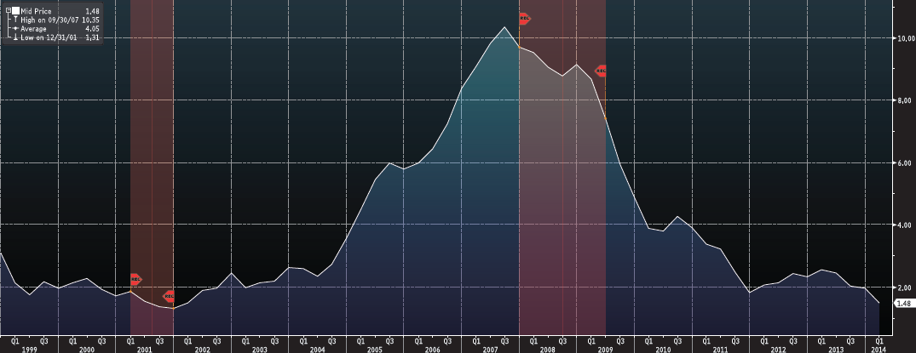
China’s Current Account Balance (% GDP)

Slide 2
N924NGPY
DATE REAL GDP Y/Y % CHANGE
2012 - Q1 8.1
2012 - Q2 7.6
2012 - Q3 7.4
2012 - Q4 7.9
2013 - Q1 7.7
2013 - Q2 7.5
2013 - Q3 7.8
2013 - Q4 7.7
2014 - Q1 7.4
China: Real GDP: Year-to-Year Percent Change
%
N924NGPY.EMF (EMERGEPR) N924NGPY 913-1141

Slide 3
N924PCXG
DATE CPI CORE CPI
2013 – Aug 1.6 2.6
2013 – Sep 1.7 3.1
2013 - Oct 1.8 3.2
2013 - Nov 1.8 3.0
2013 - Dec 1.8 2.5
2014 - Jan 2.0 2.5
2014 - Feb 1.7 2.0
2014 - Mar 1.7 2.4
2014 - Apr 1.6 1.8
China: CPI: excluding Food and Energy
NSA, Y/Y %Chg
China: Consumer Price Index
NSA, year/year % chg
N924PCXG.EMF (EMERGEPR) N924PCXG / N924PCY 10511-11404

Slide 4
A924NSVR
DATE SAVINGS RATE %
2003 33.94
2004 33.79
2005 35.38
2006 37.17
2007 39.24
2008 39.94
2009 40.38
2010 42.10
2011 40.88
China: Gross Household Savings Rate
%
A924NSVR.EMF (EMERGEPR) A924NSVR 90-111

