Slide 1

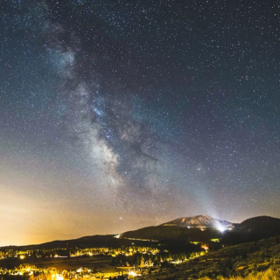
Astronomy: Exploring the Universe
GCSE Revision for Year 11

Slide 2

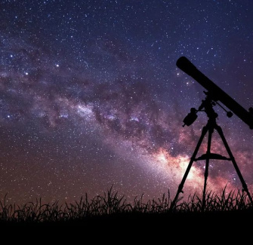
Learning Objectives
By the end of this lesson you will be able to:
Describe what a galaxy is and give examples.
Explain what a light-year measures in astronomy.
Understand the role of gravity in the universe.
Explain what an orbit is and give real-world examples.
Apply your knowledge to answer GCSE-style questions.

Slide 3
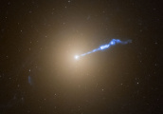
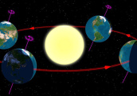
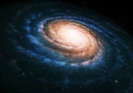
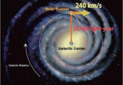
Key Vocabulary
Light-year
The distance light travels in one year, about 9.46 trillion kilometres. Used to measure vast distances in space.
Orbit
The curved path an object follows around a planet, star, or moon due to gravity.
Galaxy
Stars, planets, dust, gas bound by gravity form galaxies. Milky Way is our galaxy.
Gravity
Attraction between objects; keeps planets orbiting stars.

Slide 4
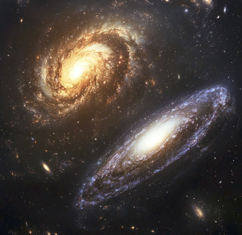
What is a Galaxy?
Understanding Galaxies
A galaxy is a vast collection of billions of stars, gas, dust, and dark matter, all held together by gravity.
The Milky Way, our galaxy, is just one of billions in the universe. Galaxies come in different shapes: spiral, elliptical, and irregular.
Fun Fact: The Andromeda Galaxy is the closest major galaxy to the Milky Way.

Slide 5
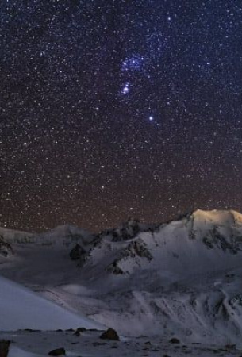
Measuring Space: Light-Years
Why Use Light-Years?
Distances in space are so large that kilometres are not practical. A light-year is the distance light travels in one year.
For example, the Sun is about 8 light-minutes from Earth, but the nearest star (Proxima Centauri) is over 4 light-years away.
Analogy: If the universe was a map, a light-year would be a giant step!

Slide 6
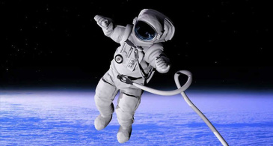
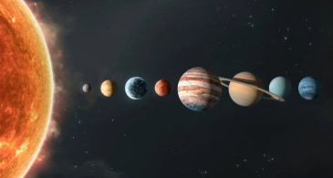
Gravity: The Cosmic Glue
Gravity pulls everything with mass towards each other. It keeps us on Earth and holds the Solar System together.
Without gravity, planets and stars would drift apart. It's why the Moon orbits Earth, and Earth orbits the Sun.

Slide 7
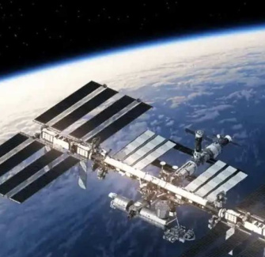
Orbits in Action
Real-World Orbits
Planets, moons, and satellites all move in orbits because of gravity. The International Space Station (ISS) orbits Earth at about 28,000 km/h!
Example: The Earth completes one orbit around the Sun every year, creating our seasons.

Slide 8
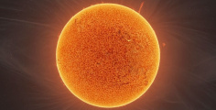
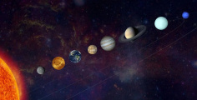
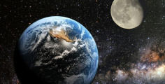
Case Study: The Solar System
1
2
3
The Sun
A star at the centre of our solar system, providing light and heat.
Planets
Eight planets, including Earth, orbit the Sun due to gravity.
Moons
Many planets have moons that orbit them, like our Moon or Jupiter’s many moons.

Slide 9

Astronomy Essentials Quiz
Question 1:
What fundamental force is responsible for holding galaxies together and keeping planets in orbit?
Question 2:
Explain why astronomers use 'light-years' instead of kilometres to measure distances between celestial objects.
Question 3:
Other than planets orbiting stars, provide one real-world example of an object orbiting another due to gravity.
Answers on the next slide...

Slide 10
Astronomy Essentials Quiz
​✅​
Answer 1:
Gravity is the attractive force that pulls objects with mass towards each other, holding astronomical structures together.
Answer 2:
Astronomers use light-years because distances in space are immensely vast, making kilometres impractical for such measurements.
Answer 3:
Satellites, such as the International Space Station, orbit Earth due to the planet's gravitational pull.

Slide 11
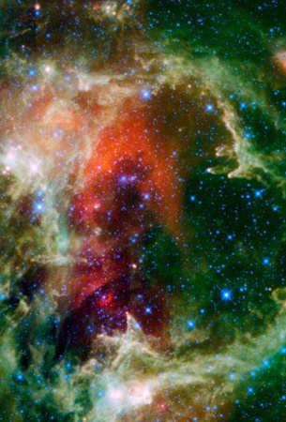
Summary: The Universe Awaits
Key Points
Galaxies are huge collections of stars, planets, and dust held together by gravity.
Light-years help us measure the vast distances in space.
Gravity is the force that shapes the universe, creating orbits and keeping everything together.
Orbits explain the movement of planets, moons, and satellites.
Remember: Our understanding of the universe is always growing – keep exploring!

