Slide 1
Ruby Programming Language
Ruby
By: Duy Hoang

Slide 2
What is Ruby?
• High-level programming language
• Dynamic typing
• Interpreted execution
• Object-oriented design
• Beginner friendly syntax

Slide 3
History of Ruby
• Created in 1995
• By Yukihiro Matsumoto
• Developed in Japan
• Ruby on Rails drove popularity

Slide 4
Goal of Ruby
• Programmer happiness
• Readable code
• Less repetitive coding
• Balance power and simplicity

Slide 5
How Ruby Works
• Interpreter executes code
• Dynamic variables
• Garbage collection
• Everything is an object

Slide 6
Key Features
• Clean readable syntax
• Less code required
• Fast development
• Thousands of gems
• Easy to learn

Slide 7
Disadvantages
• Slower than compiled languages
• Less popular than Python
• Smaller ecosystem
• Runtime errors possible

Slide 8
Why Use Ruby?
• Rapid software development
• Great for startups
• Readable maintainable code
• Strong web frameworks

Slide 9
When to Use Ruby
• Websites
• MVPs
• Prototypes
• Dashboards
• Internal business tools

Slide 10
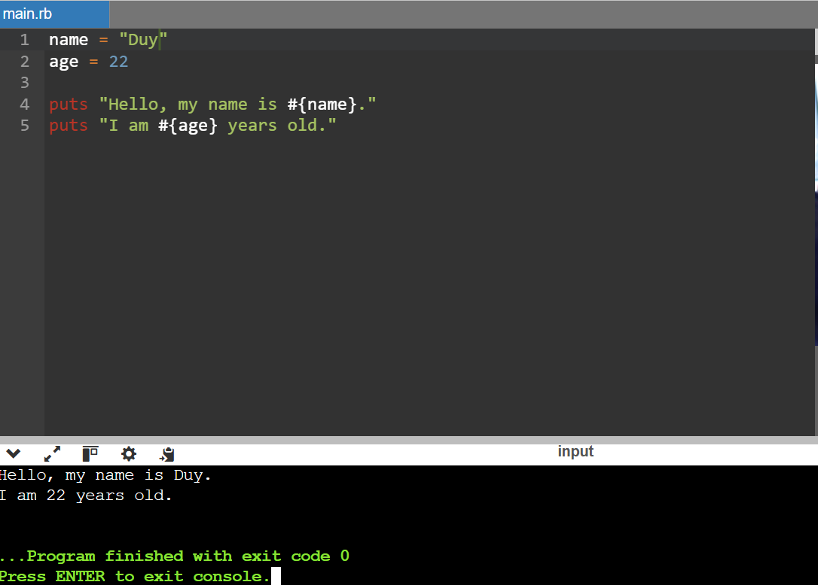
Code Example

Slide 11
Companies Using Ruby
• Shopify
• GitHub
• Airbnb
• Hulu

Slide 12
Conclusion
• Great for readability
• Excellent for rapid development
• Still relevant today
• Best in right context

Slide 13
Questions?
• Thank you for listening

