Slide 1
Introduction
Legal sites use professional CDNs and secure encrypted traffic
Illegal sites rely on weaker servers and unpaid hosting
Wanted to measure real differences, not assumptions
Illegal sites commonly include pop-ups, ads, and trackers

Slide 2
Comparing Legal vs Illegal Streaming Traffic
Tested Netflix, Amazon Prime Video, and HydraHD illegal site
Captured real network traffic using Wireshark and HAR logs
Compared data usage, stability, and security differences
Goal: show how legal and illegal streaming behave differently

Slide 3
Methodology Overview
Streamed each service for the same amount of time
Performed a scene jump during each test
Used Wireshark for illegal sites, HAR for legal services
Repeated tests to make results more accurate

Slide 4
Experiment Setup
MacBook Pro M2 on 500 Mbps fiber connection
All streams were 1080p quality
Used same Wi-Fi, same browser, same location for fairness
Nothing else was running on the network during tests

Slide 5
Metrics Collected
Total MB of data downloaded
Packet counts and packets per second
Bitrate calculations for video quality
Errors, retransmissions, and burst spikes
Security type: HTTPS, HTTP/3, or mixed traffic

Slide 6
Behavior & Stability
Illegal site had unpredictable packet spikes
Legal streams were smooth and consistent
Illegal traffic showed aggressive ads and trackers
•Legal platforms kept steady connections and no resets
Illegal streaming had more lag and buffering

Slide 7
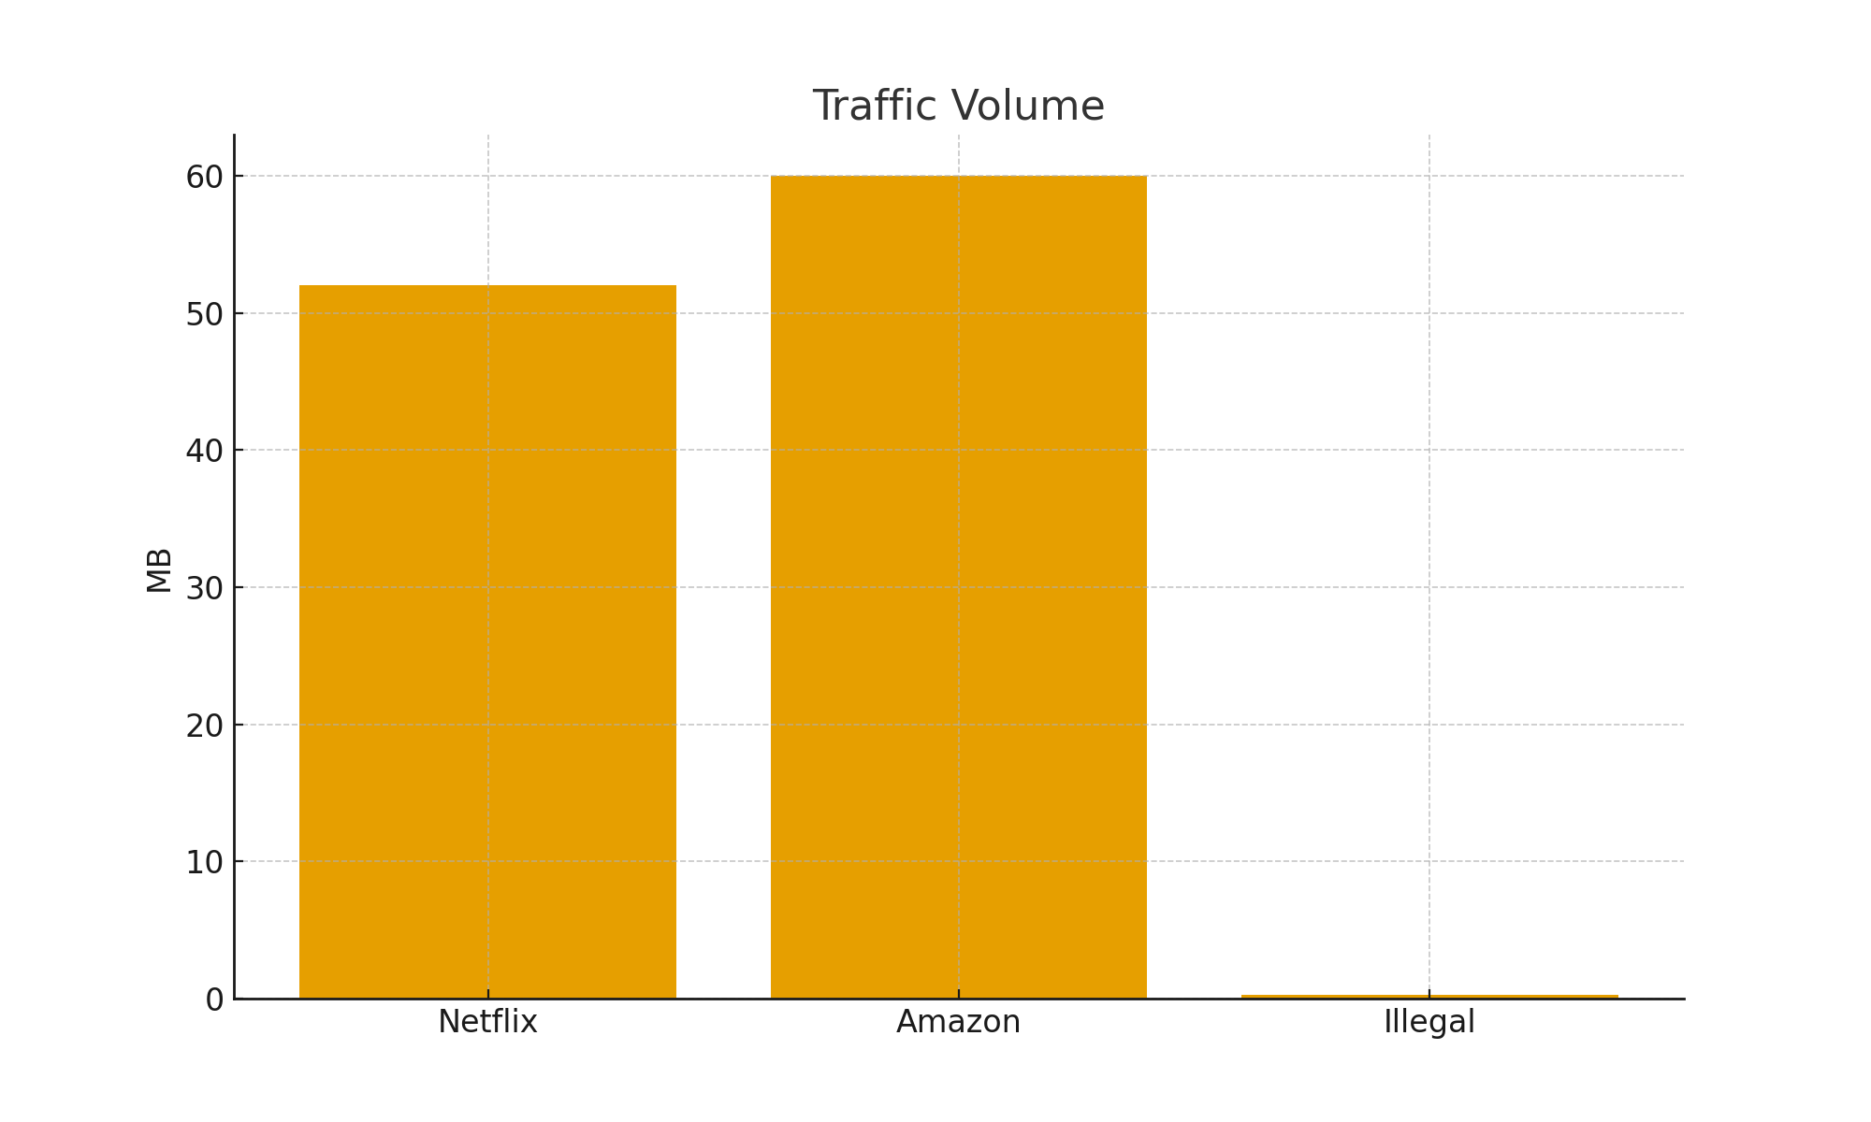
Traffic Volume Comparison

Slide 8
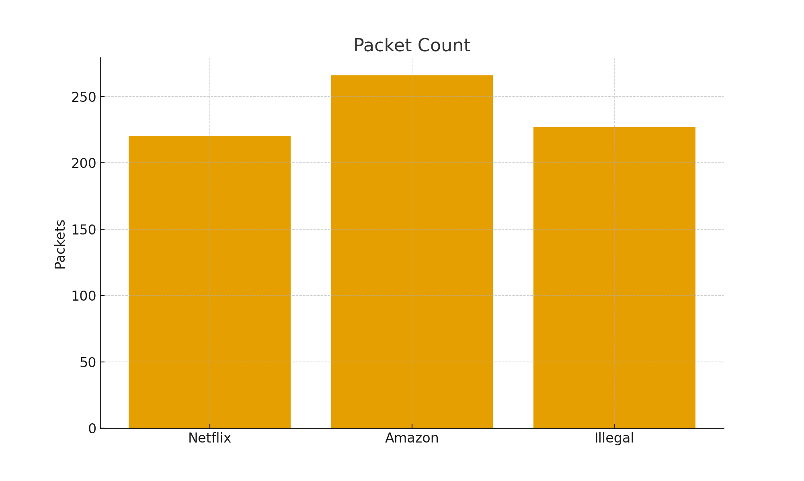
Packet Count Comparison

Slide 9
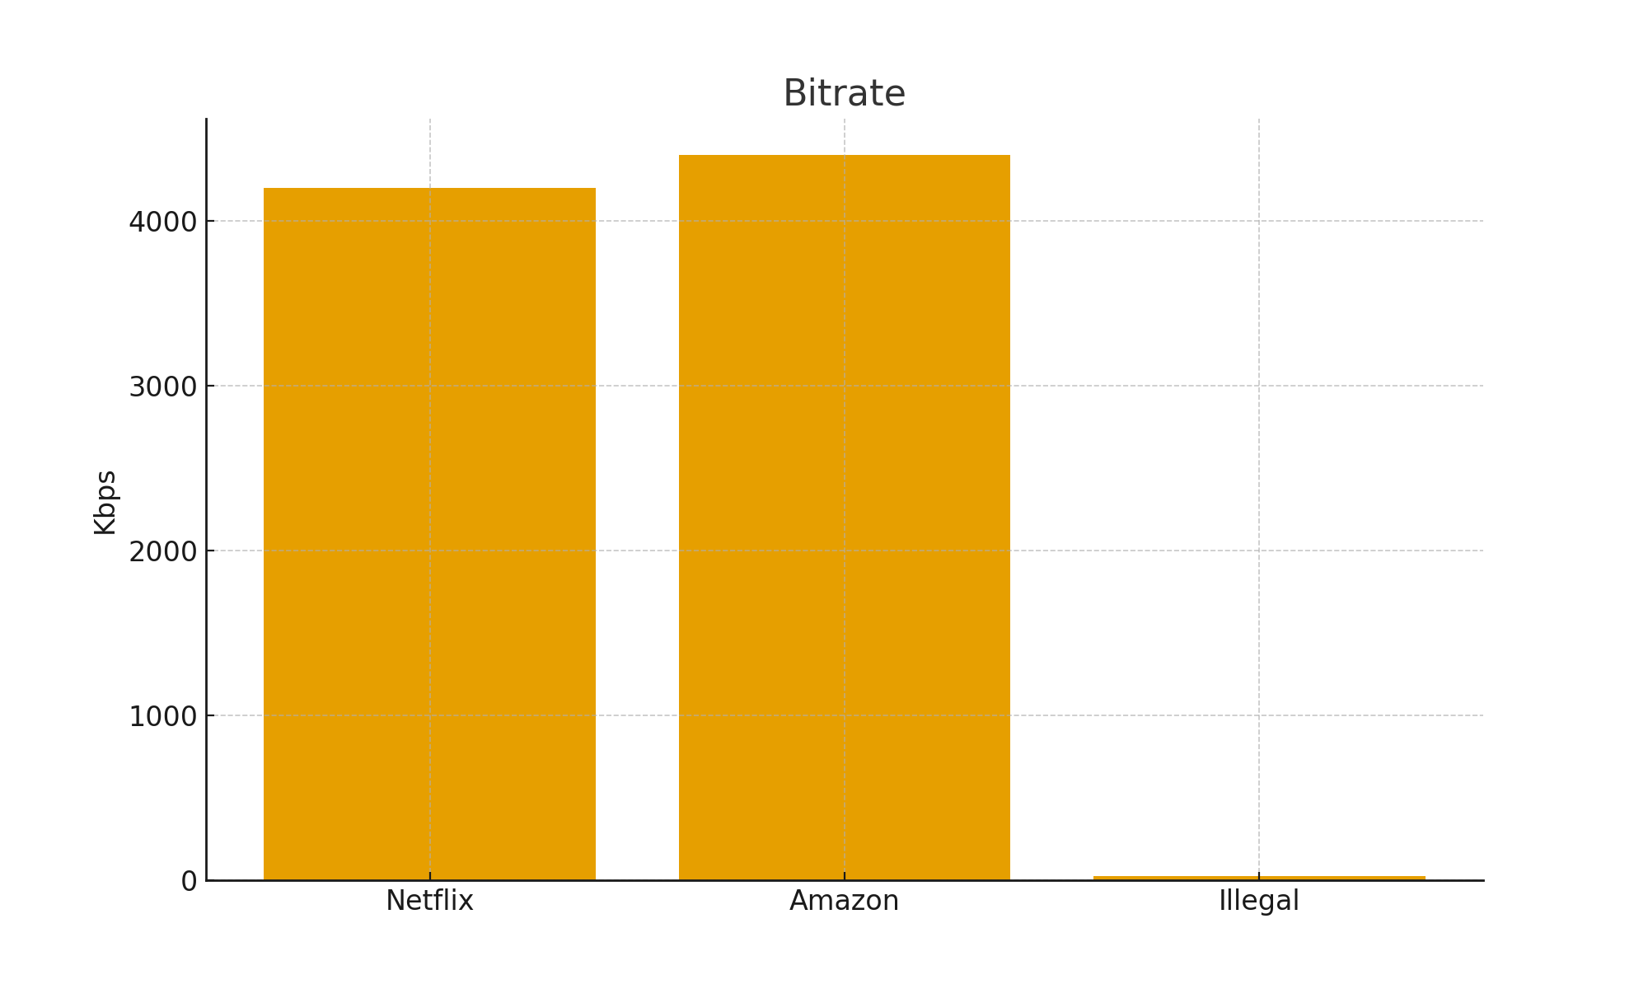
Bitrate Comparison

Slide 10
Conclusion
• Illegal streaming had poor stability and low bitrate
• Legal services were far more secure and reliable
• Illegal streams included unsafe redirects and scripts
• Legal platforms had better video quality with fewer issues

