Slide 1
Topics overview
Java I/O
  Streams
    Byte, character, Buffer
  Console I/O
  File I/O
Regular Expressions – “RegEx”
Finite State Machines (FSMs)

Slide 2
Streams
Byte Streams
  Raw data – no particular type of data
  Audio, video, binary files, images (PNG, JPEG), etc.
Character Streams
  For reading text data one character at a time
  Each character I/O access the file/stream – lots of overhead!
  There are character streams for the Console and separate ones for Files
Buffered Streams
  Optimized character streams – stores data in a buffer and only access the stream once
  Ex. used to read/write entire lines to files.

Slide 3
Streams
Byte Streams
  Abstract Classes: InputStream, OutputStream
  Examples: System.In (for console input), FileInputStream, FileoutStream
Character Streams
  Abstract Classes: Reader, Writer
  Examples: InputStreamReader(InputStream in), FileReader, …out equivalents
Buffered Streams
  Stores data in a buffer and only access the stream once - used to read/write entire lines
  Character Streams: BufferedReader(Reader in), BufferedWritter
  Byte Streams: BufferedInputStream, BufferedOutputStream
Scanners
  For dealing with formatted input text (from file or console)

Slide 4
Why are there so many different classes?
S.O.L.I.D. question!
  S: Single Responsibility Principle
  Yes, it makes things a bit more complicated to learn at first, but…
  This keeps the code base modular, flexible, and easy to maintain.

Slide 5
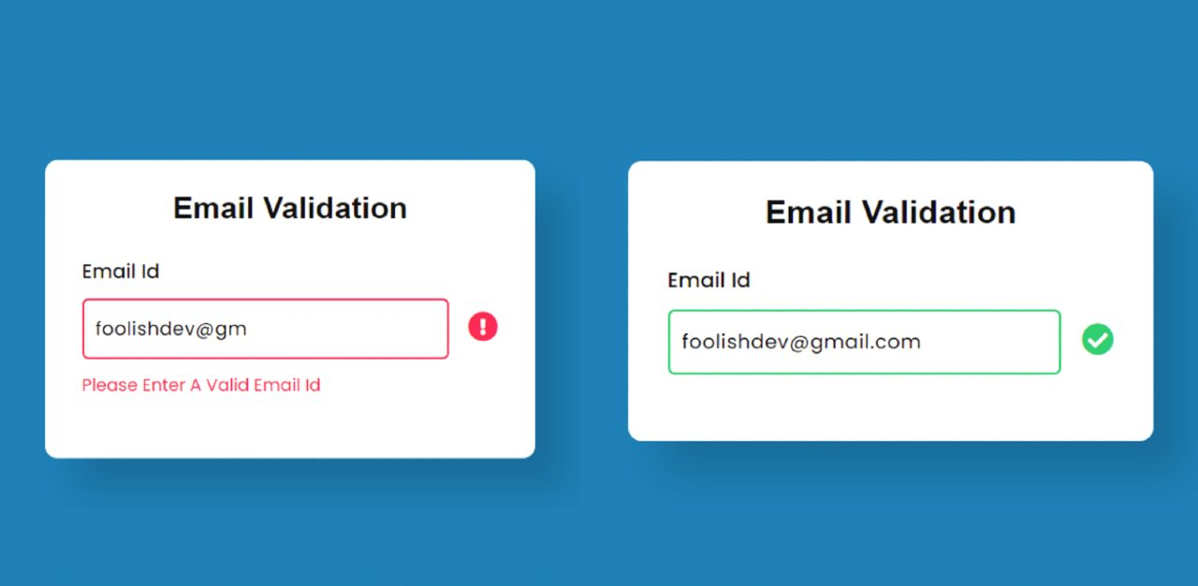
Regular Expressions
Used to help determine if input text conforms to a desired pattern

Slide 6
Regular
Expressions
RegEx Symbol | Description
A-Z, a-z | Individual alpha characters
. | Wild card (and non newline character)
\d, \D | Any digit [0-9], And non-digit [^0-9]
\w, \W | Any word character (alphanumeric, and “_”), a non-word character
\w | Any word character (alphanumeric)
\s, \S | Any whitespace character (space, \t, \n, \r, \f, vertical tab \v), Non-whitespace
\ | Escape character – used to match things like “^” (\^), or “$” (\$)
| | OR (Pipe character)
Anchors | Allows you to force the position of the match
^, $ | Looks for matches at the beginning/end of the string
Character Classes | Allows you do define your own set of characters to look for
[] | e.g. [abc] looks for either an “a”, “b” or “c”, [a-z&&[^bc]] any alpha except ”b” or “c”
Quantifiers | Specify the number
*, ?, +, {n}, {n,}, {n,m} | 0+ times, 0 or 1 times, 1+ times, exactly n times, at least n times, between n and m times
Grouping | ()
(\.com){1} | Look for exactly instance of “.com”
\.(com|ca){1} | Looks for either a ”.com” or “.ca” domain

Slide 7
RegEx - Example
RegEx for validating credit card numbers (just a 16 digit number)
  \d{16}
Postal Codes: ex L5L 1C6
Let’s come up with a RegEx for a Canadian phone number
  1-905-569-4455 vs 905-569-4455
  19055694455 vs 19055694455
  Can you try to make a single one to test all cases?

Slide 8
RegEx - Example
Parsing a CSV file with student marks:
  Name, Student Number, Grade
  Will this work?: (.*),(.*),(.*)

Slide 9
Finite State Machines (FSMs)

