Slide 1
Topics overview
Reminders
  Course Evaluations
  Assignment 3: Due next Tuesday (Dec 2nd)
Intro to FSMs
Floating Point Error
  Base 2 number system (ints, decimals, scientific notation)
  Representable numbers
  How numbers are stored in computers (IEEE 754 standard)
  Floating Point Error

Slide 2
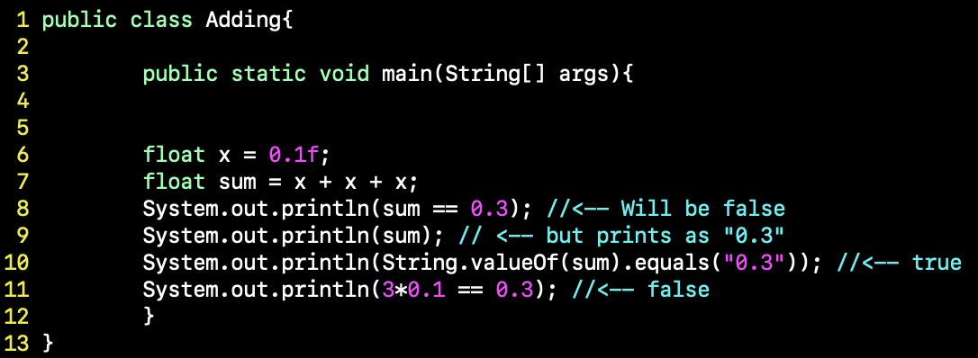
Java Mathemagic

