Slide 1
Laravel5.5 +
——By：Miko

Slide 2
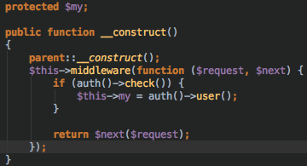
Middleware in controller:

Slide 3
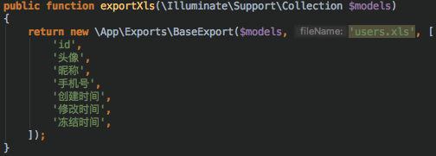
BaseExport:

Slide 4
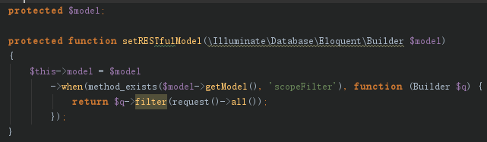
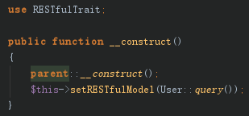
RESTfulTrait:setModel

Slide 5
RESTfulTrait:index
indexBefore
indexAfter
per_page or take

Slide 6
RESTfulTrait:show
showAfter

Slide 7

RESTfulTrait:delete
forceDelete
resotre
delete

Slide 8
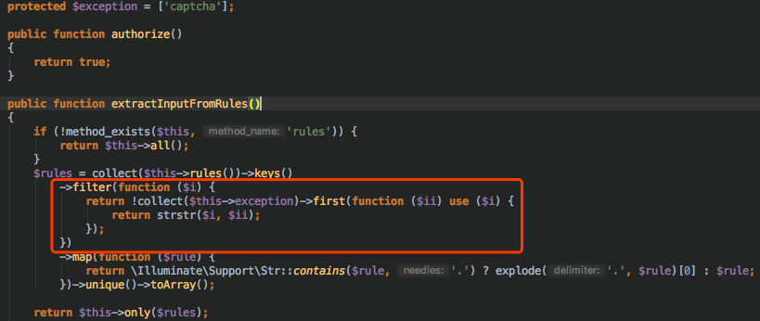
exception in request:

Slide 9
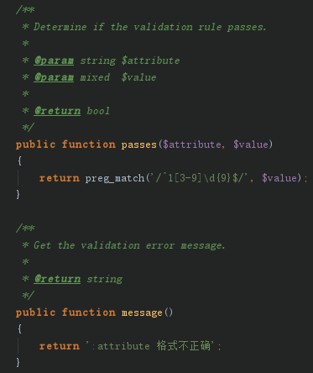
request:diy rules

Slide 10
filter:
model:
use \EloquentFilter\Filterable;
1.orderByDesc(‘id’)
2.id
3.ids(whereIn)
4.stringToArray
5.with
6.withCount
7.sortOrder
8.has
9.doesntHave
10. trashed
(with&without&only)

Slide 11
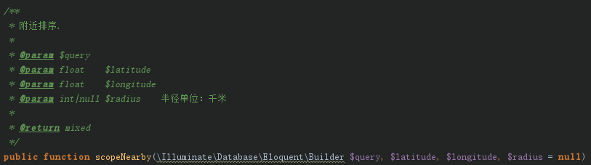

NearbyTrait:

Slide 12
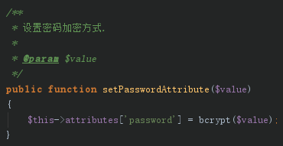
SafetyPassword:

Slide 13
Model:
protected $hidden = [ 'password', 'remember_token', 'api_token', ];
(visible)

Slide 14
others:
LeancloudService(push)
ClientAggregationUpload(upload)
Jsend(response)
JsonClient(client)
AggregationPay(pay)
Setting(no id in talbe)
Sms(send sms&check captcha)
Socialite(register&login)

Slide 15
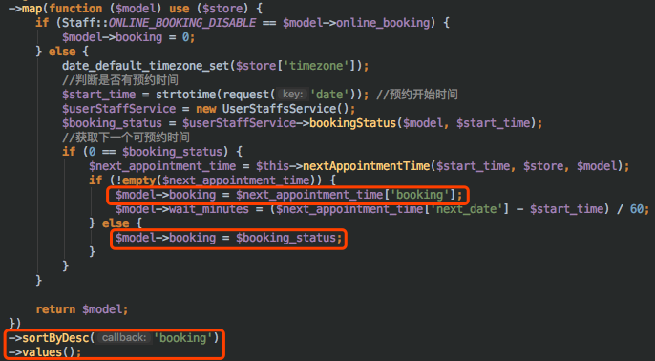
Tips: Sort():

Slide 16

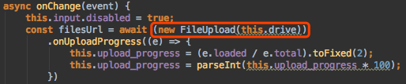
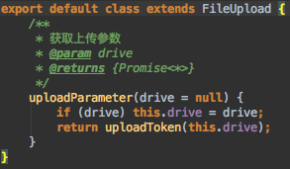
Tips:Upload （自定义）:

Slide 17
Tips:search thins
site: laravelacademy.org/ $hidden

Slide 18
return;

