Slide 1
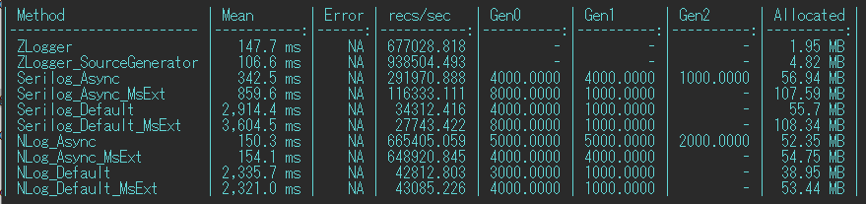
100000 logs(3 args)
File output benchmark
ZLogger less allocation
Default vs fastest(async-buffered) settings
The default settings are very slow(ZLogger default is tuned for fastest)
Plain Library vs with Microsoft.Extensions.Logging Bridge
Bridge has some overheads(especially Serilog impl)

Slide 2

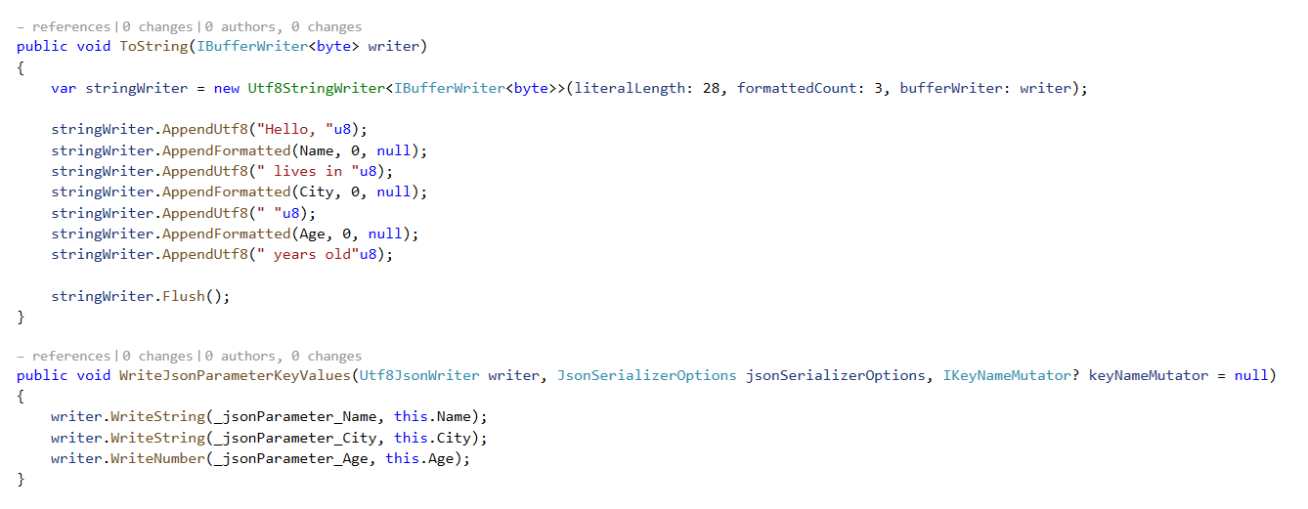
Log by StringInterpolation
for Text Log, write to UTF8 directly
for Structured(JSON) Log, write to Utf8JsonWriter directly
This code is specifically for the Source Generator version and,
while it differs slightly when using String Interpolation, the behavior is almost identical.

