Slide 1
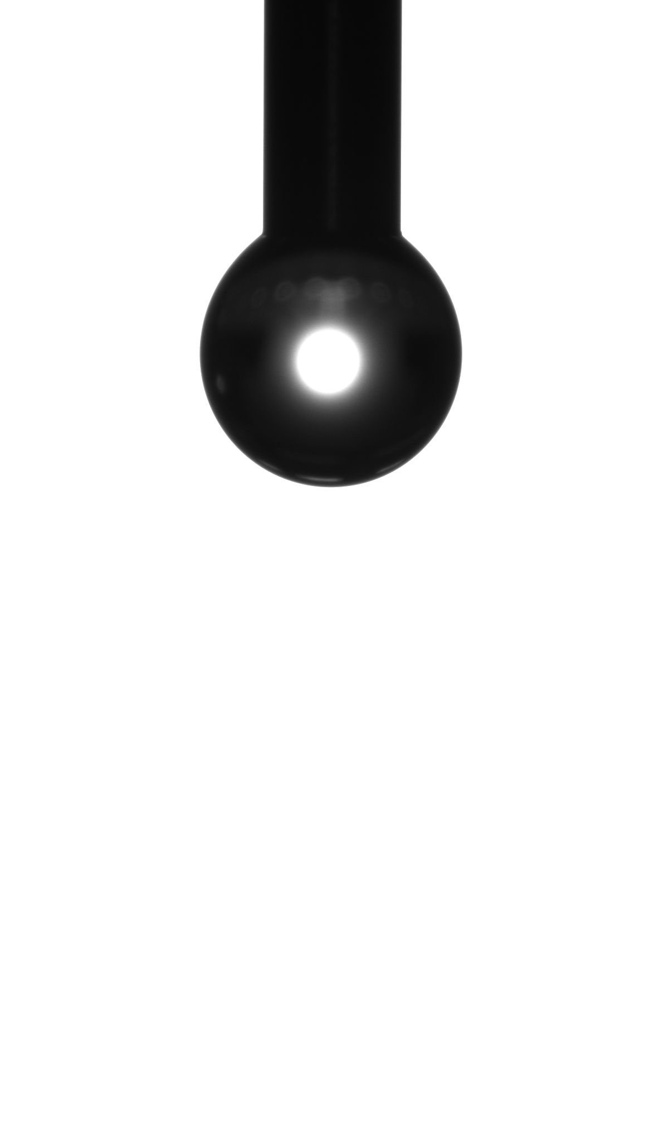
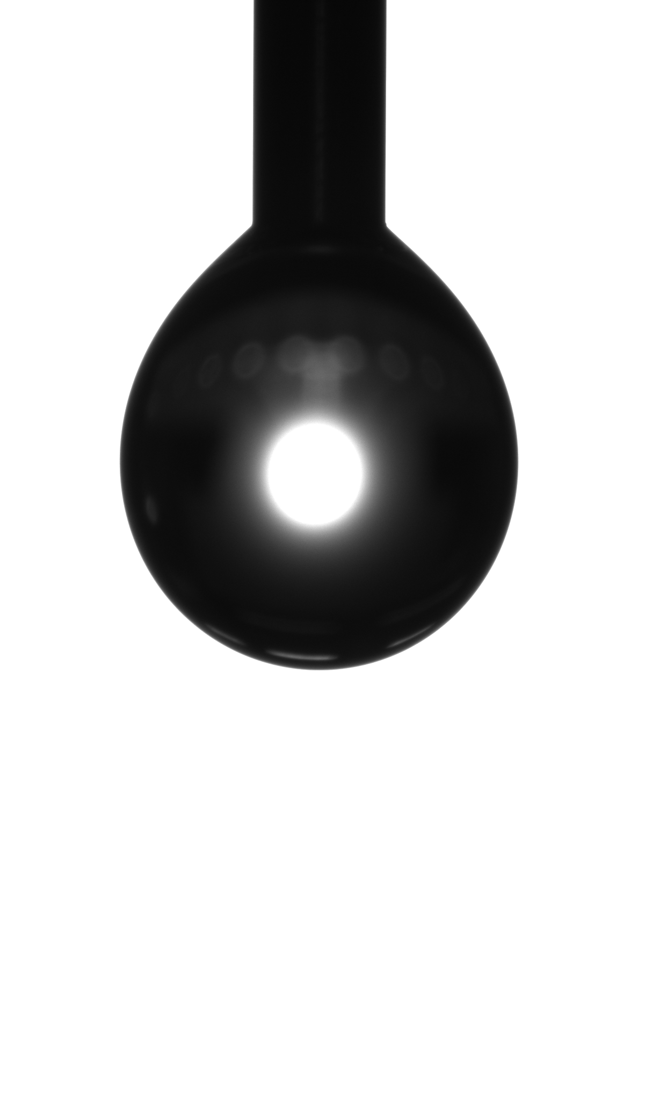
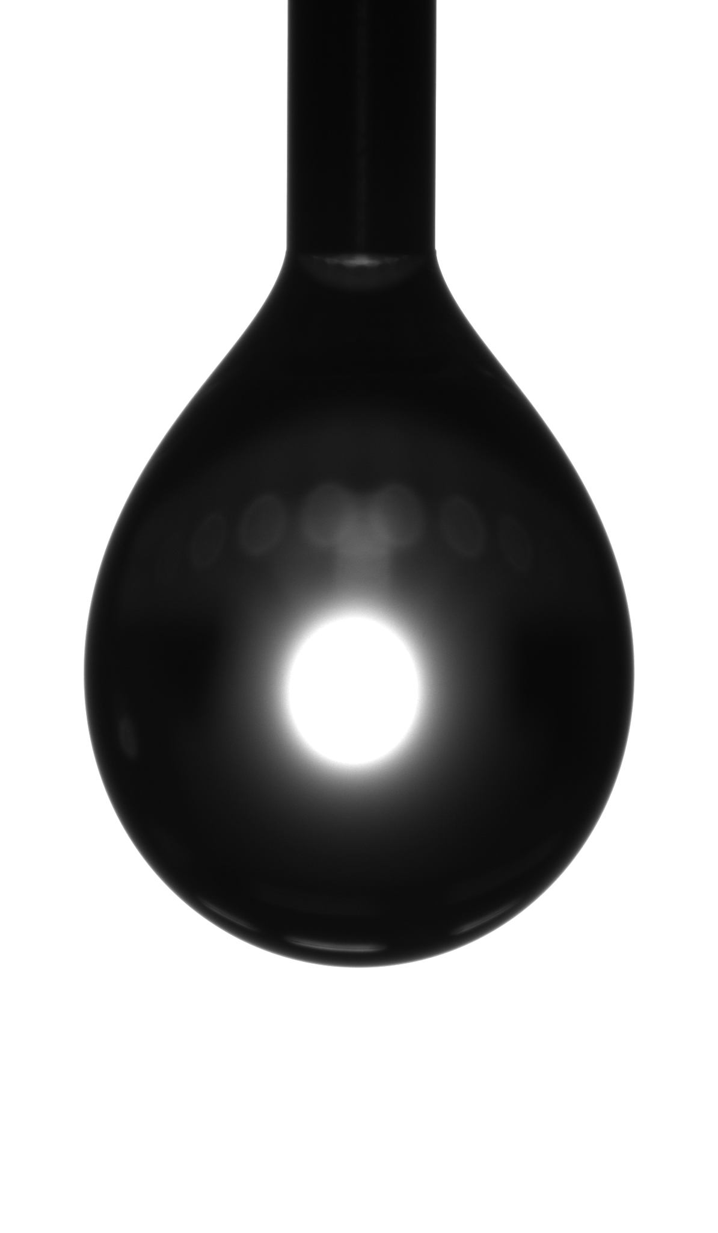
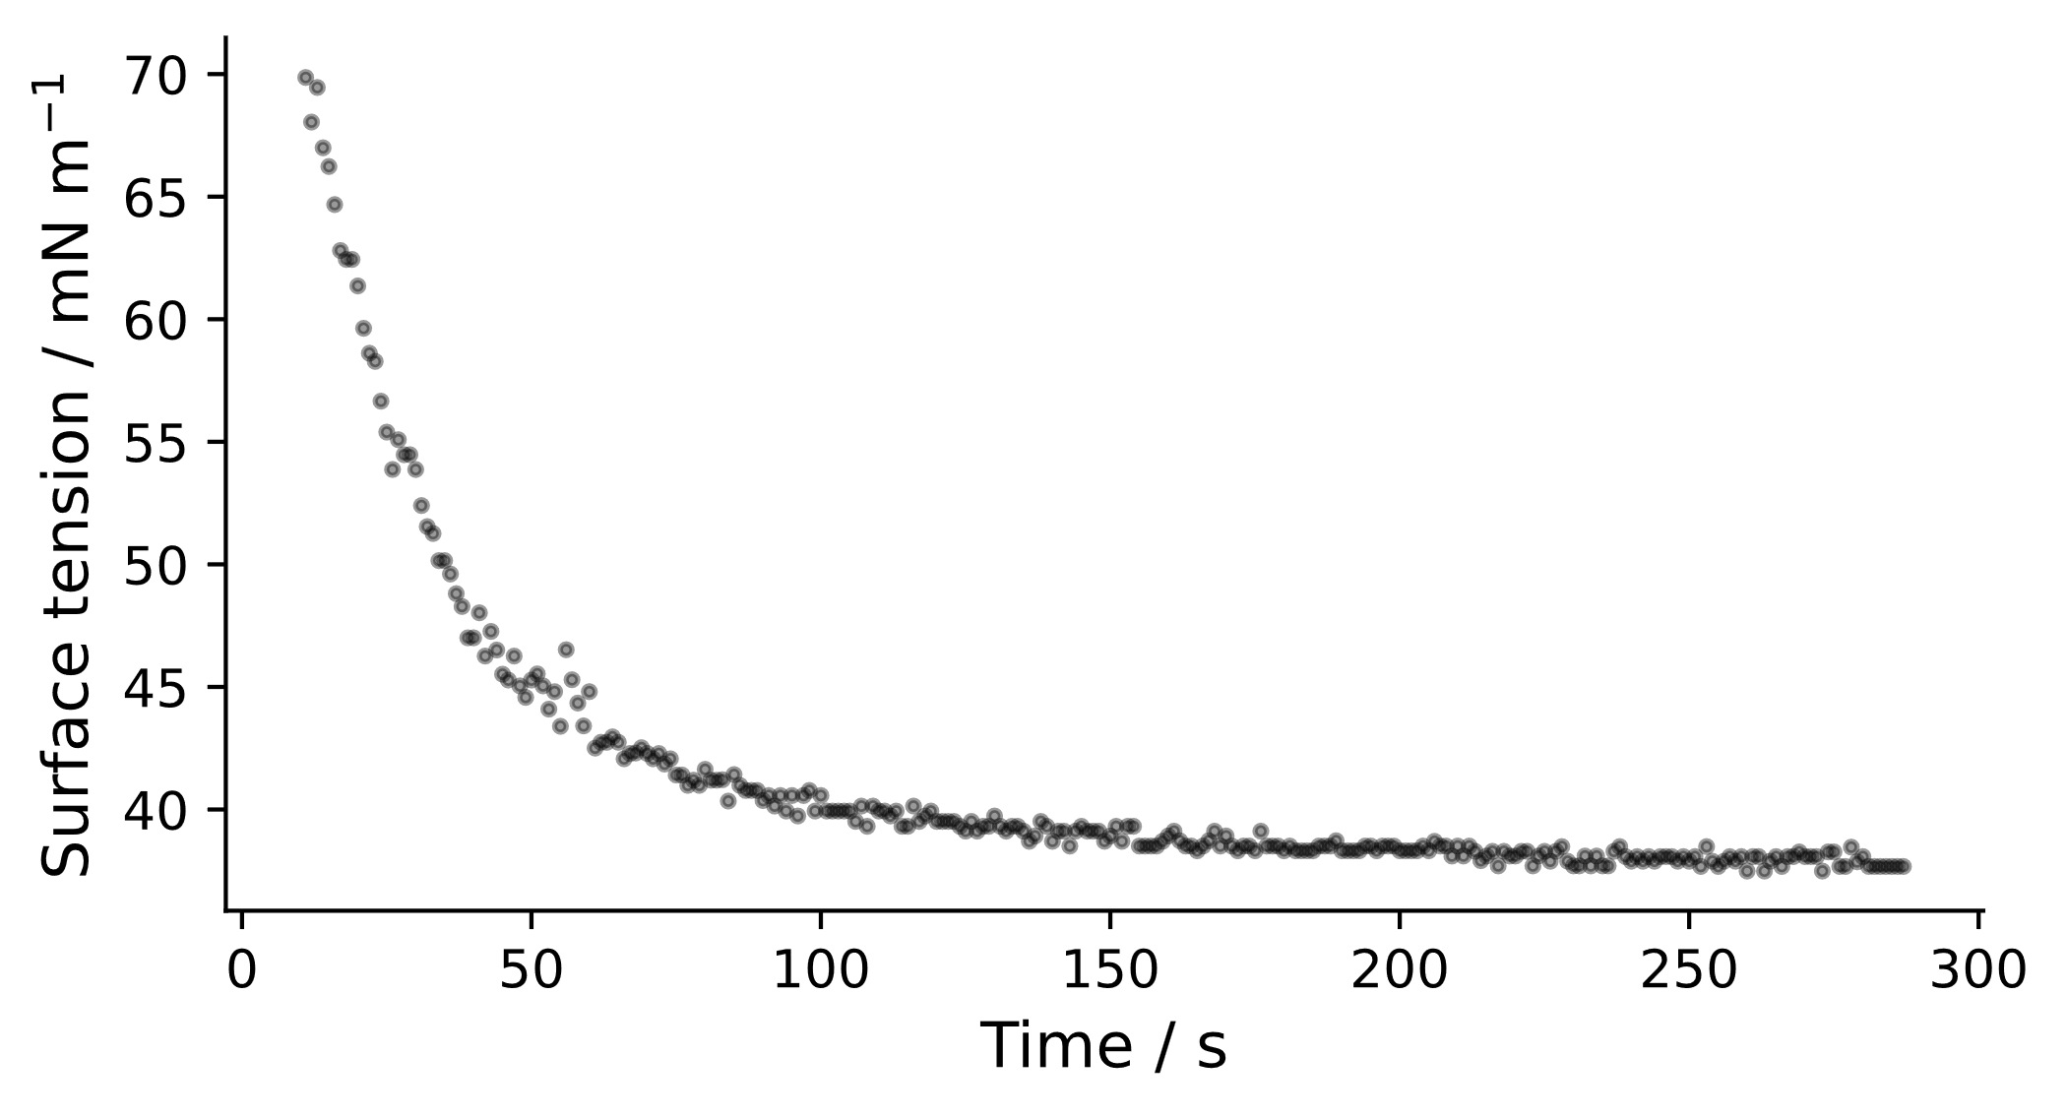
a
V_{d} = 1 μL
Wo = 0.23
V_{d} = 4 μL
Wo = 0.45
V_{d} = 8 μL
Wo = 0.85
Accuracy
b

