Slide 1

AMATH 102 · PROJECT ORAL DEFENSE
Vibrations in a Stretched String
Numerical Simulation, Matrix Formulation & Energy Preservation
Rania Lalami · Mohammed Mahzoul · Sara Loumir · Salma Haidara · Fadel Alah El Annid
University Mohammed VI Polytechnic (UM6P) · Vanguard Center · Applied Mathematics AMATH102
Notes:
Good [morning/afternoon] everyone. Thank you for being here. Today we present our AMATH102 project: a full numerical study of vibrations in a stretched string — from the physical model, to an implicit finite-difference solver, to energy conservation and an inverse problem that recovers a physical wave speed from a single sensor reading. My name is [X], and together with my teammates Mohammed, Sara, Salma and Fadel, we will walk you through five questions in about 20 minutes.

Slide 2




OVERVIEW
Presentation Agenda
Five questions, one continuous numerical pipeline — from the continuous PDE to a validated, physically consistent simulator.
Q1
Q2
Q3
Q4
Q5
Modeling & Discretization
Matrix Formulation
Simulation & Convergence
Mechanical Energy
Wave-Speed Identification
Governing forced wave equation and a second-order centered, implicit finite-difference scheme.
Tridiagonal system AU = b, its structure, and a single O(N) LU factorization.
LU-based solver, validation against an exact solution, animation, O(Δx²) convergence.
Composite Simpson's rule to track kinetic + elastic energy through time.
Bisection then Newton's method recover c from one sensor measurement.
AMATH102 · Project 9 · Vibrations in a Stretched String
Notes:
Our project is organized around the five questions of the assignment. First, we derive an implicit finite-difference scheme for the wave equation. Second, we cast it as a tridiagonal linear system and exploit an O(N) LU factorization. Third, we implement and validate the solver on an exact test case, including an animation and a convergence study. Fourth, we track the mechanical energy of the string using Simpson's rule. And fifth, we solve an inverse problem: recovering the wave speed from a single experimental measurement using bisection followed by Newton's method. Let's start with the physics.

Slide 3
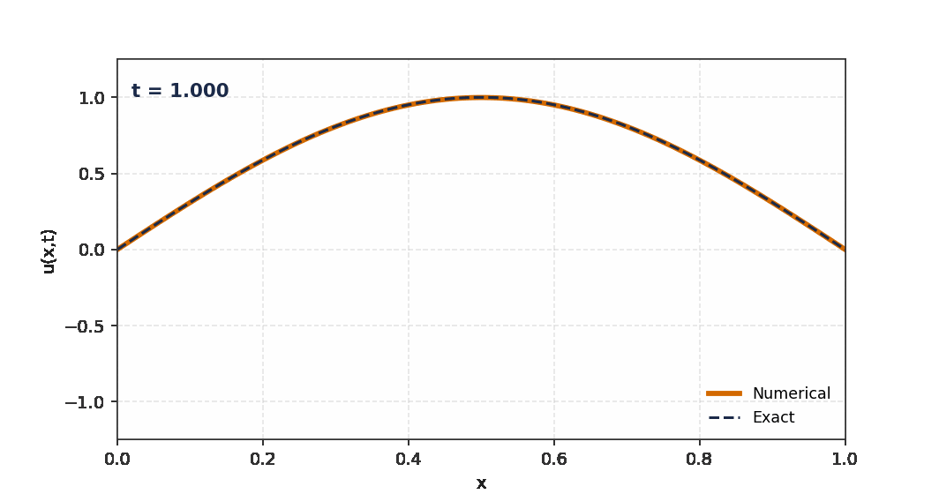
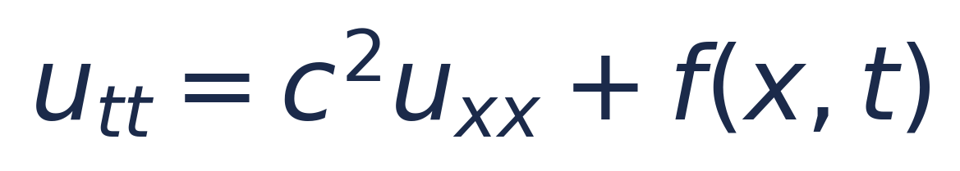
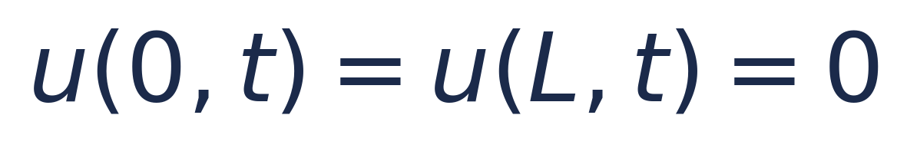
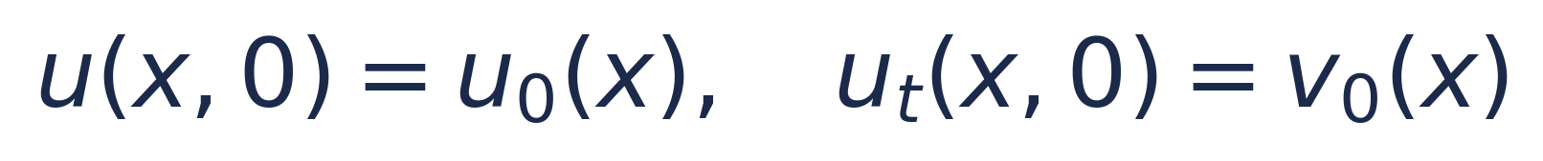
BACKGROUND
The Governing Physics
A string of length L, fixed at both ends, displaced and released. Newton's second law on an infinitesimal element gives the forced wave equation:
Wave speed: c = √(T/ρ) — tension over linear density
Boundary conditions (fixed ends):
The string oscillates between an upward and a downward arch — this is exactly what we reproduce numerically in Question 3.
Initial conditions (shape + velocity):
Four project goals:
discretize → assemble & solve → simulate & validate → extend (energy + inversion).
AMATH102 · Project 9 · Vibrations in a Stretched String
Notes:
Physically, we model the transverse displacement u(x,t) of a string under tension T with linear mass density ρ. Newton's second law on an infinitesimal element gives the forced wave equation you see here, with wave speed c equal to the square root of T over ρ. The string is fixed at both ends — Dirichlet boundary conditions — and we prescribe an initial shape and an initial velocity. This single PDE is the foundation for everything that follows: we will discretize it, assemble it into a linear system, solve it numerically, validate it against an exact solution, and then extend it to study energy conservation and to solve an inverse problem.

Slide 4
QUESTION 1
Finite Difference Discretization
Turning the continuous wave equation into a second-order accurate, implicit numerical scheme.
01 / 05

Slide 5
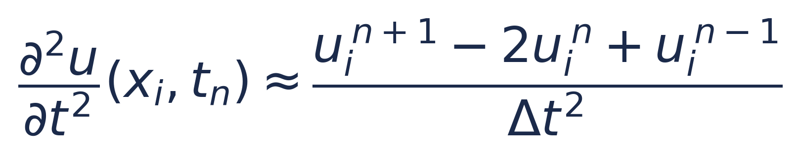
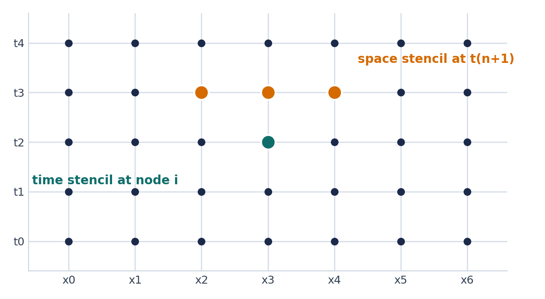
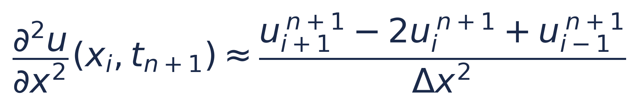
Q1 · DISCRETIZATION
Centered Differences on a Space-Time Grid
UNIFORM MESH
Time derivative — centered at level tn:
xi = i · Δx , i = 0 … N , Δx = L / N
tn = n · Δt , n = 0, 1, 2, …
Space derivative — centered at the FUTURE level tn+1 (this is what makes the scheme implicit):
Both approximations are O(Δt²) and O(Δx²).
Substituting into utt = c²uxx + f and evaluating the space term at tn+1 yields the implicit scheme (next slide).
AMATH102 · Project 9 · Vibrations in a Stretched String
Notes:
We discretize space and time on a uniform mesh: N intervals in space with step Delta x, and time steps of size Delta t. Using a centered Taylor expansion, the second time derivative at node i, time n is approximated by the usual three-point stencil, with truncation error of order Delta t squared. For the spatial second derivative, the key modeling choice is that we evaluate it at the FUTURE time level, n plus one, not at the current level. This single choice is what makes the scheme implicit: the three spatial neighbors at the new time step are coupled together, so we cannot update them independently — we must solve a linear system at every step. In exchange, as we'll see, we get unconditional stability.

Slide 6
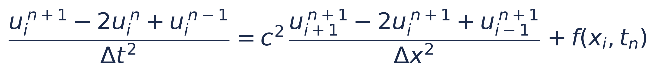
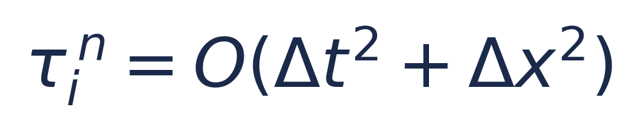
Q1 · IMPLICIT SCHEME
The Implicit Scheme — and Why It Is Implicit
SUBSTITUTING BOTH APPROXIMATIONS INTO utt = c² uxx + f
valid for i = 1, …, N − 1
Why “implicit”?
Truncation error
The three unknowns at t^{n+1} on the right-hand side are coupled — they cannot be updated one at a time.
A linear system must be solved at every single time step to advance the solution.
Second-order accurate in both space and time — by the Lax-Richtmyer theorem, consistency + unconditional stability ⇒ convergence.
Trade-off: unconditional stability.
AMATH102 · Project 9 · Vibrations in a Stretched String
Notes:
Putting both finite-difference formulas into the PDE gives this implicit equation for i from 1 to N minus 1. Why is it implicit? Because the three unknowns at the new time level — u at i minus 1, i, and i plus 1 — all appear on the right-hand side simultaneously. They're coupled, so we cannot isolate any one of them; we must solve a linear system at every time step. The reward for this extra work is unconditional stability: unlike an explicit scheme, there is no CFL restriction linking Delta t to Delta x. We are free to choose the time step based purely on accuracy needs. The local truncation error is O of Delta t squared plus Delta x squared, so by the Lax-Richtmyer equivalence theorem, consistency together with unconditional stability guarantees convergence.

Slide 7
QUESTION 2
Matrix Formulation & the LU Solver
Casting the implicit scheme as a tridiagonal linear system and exploiting its structure.
02 / 05

Slide 8
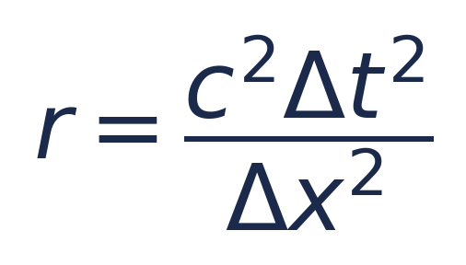
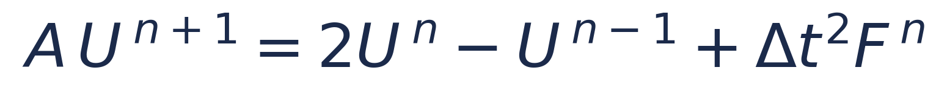
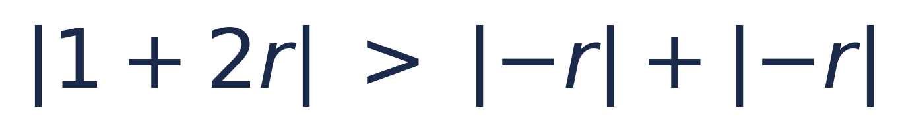
Q2 · MATRIX SYSTEM
From Stencil to a Tridiagonal System
STIFFNESS RATIO
RESULTING MATRIX SYSTEM
A is the tridiagonal (N−1)×(N−1) matrix:
Rearranging the implicit scheme, grouping all tn+1 terms on the left:
1+2r
−r
−r
1+2r
−r
−r
1+2r
−r
−r
1+2r
−r
−r
1+2r
valid for i = 1, …, N − 1 — boundary values u₀ = uN = 0 close the system.
symmetric · tridiagonal · diagonally dominant · SPD
AMATH102 · Project 9 · Vibrations in a Stretched String
Notes:
Introducing the dimensionless stiffness ratio r, equal to c squared Delta t squared over Delta x squared, we regroup all the future-time unknowns onto the left-hand side. This produces a clean three-term recurrence: minus r times the left neighbor, plus one plus two r times the center, minus r times the right neighbor, equal to a right-hand side built entirely from the two previous time levels and the source term. Writing this for every interior node produces the matrix system A U-n-plus-one equals two U-n minus U-n-minus-one plus Delta t squared F-n. The matrix A is tridiagonal, symmetric, diagonally dominant, and — as we show in the report — symmetric positive definite, which is exactly the structure that makes an efficient LU factorization possible.

Slide 9


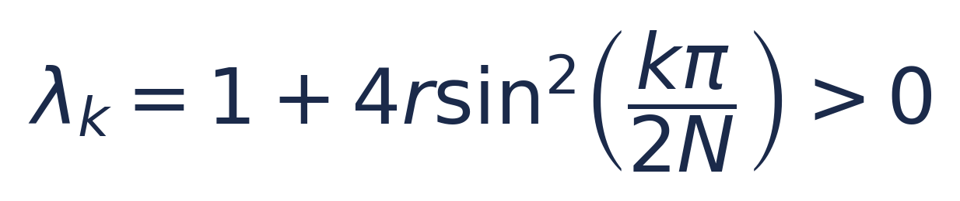
Q2 · EFFICIENCY
One Factorization, Thousands of Cheap Solves
ALGORITHM
COST PER TIME STEP
1
Assemble the (N−1)×(N−1) tridiagonal matrix A once.
Dense matrix, no factorization reuse:
2
Factorize A = LU exactly once, before the time loop.
Tridiagonal A, LU factored once:
For Nt steps: O(N) + Nt·O(N) = O(Nt N) total — optimal.
3
First step: solve A U¹ = U⁰ + Δt V⁰ + ½Δt²F⁰ (ghost-point trick).
EIGENVALUES OF A (STABILITY & CONDITIONING)
4
Loop n = 1 … Nt: build RHS, forward/back-substitute with the stored LU factors.
5
Post-process: plots, error norms, energy, animation.
All λk > 0 ⇒ A is symmetric positive definite ⇒ LU needs no pivoting and is numerically safe; condition number κ₂(A) = O(N²), negligible next to the O(Δx²) PDE error.
AMATH102 · Project 9 · Vibrations in a Stretched String
Notes:
Because the stiffness matrix A does not change from one time step to the next, we factorize it exactly once, before entering the time loop, using an LU decomposition. Every subsequent step only requires one forward and one backward substitution. For a dense matrix this factorization would cost O of N cubed and each solve O of N squared; because A is tridiagonal, the factorization costs only O of N and each solve also costs O of N. Over Nt time steps the total cost is O of Nt times N, which is optimal. This is only safe because A is symmetric positive definite — its eigenvalues, shown here, are all strictly positive, so LU factorization needs no pivoting and no numerical instability occurs.

Slide 10
QUESTION 3
Simulation, Validation & Convergence
Implementing the LU-based solver and checking it against an exact solution.
03 / 05

Slide 11
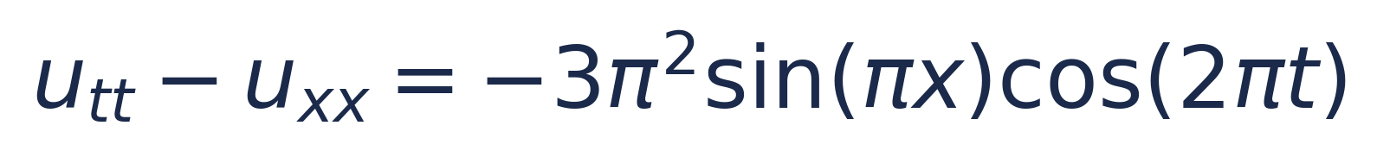
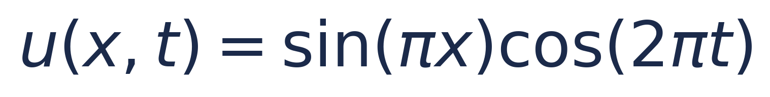
Q3 · TEST PROBLEM
A Test Problem With a Known Exact Solution
MANUFACTURED TEST CASE
SIMULATION PARAMETERS
c
1.0
0 < x < 1, 0 < t ≤ 2, u(0,t) = u(1,t) = 0, u(x,0) = sin(πx), ut(x,0) = 0
L
1.0
T_max
2.0
EXACT SOLUTION
N
100 (Δx = 0.01)
Δt
0.01
The forcing term f(x,t) was manufactured specifically so that this simple closed form solves the PDE exactly — giving us a ground truth to validate against.
Verification at final time:
E∞ = 1.19×10⁻⁴ E₂ = 8.44×10⁻⁵
AMATH102 · Project 9 · Vibrations in a Stretched String
Notes:
To validate our solver we use a manufactured test problem: we pick the exact solution sine of pi x times cosine of 2 pi t, plug it into the PDE, and back out the exact forcing term f that makes this solution exact. This gives us a ground truth we can compare against. We run the simulation with wave speed 1, length 1, up to final time 2, using N equals 100 spatial intervals and a time step of 0.01. At the final time, the maximum error is about 1.2 times ten to the minus four, and the L2 error about 8.4 times ten to the minus five — both very small, confirming the implementation is correct.

Slide 12
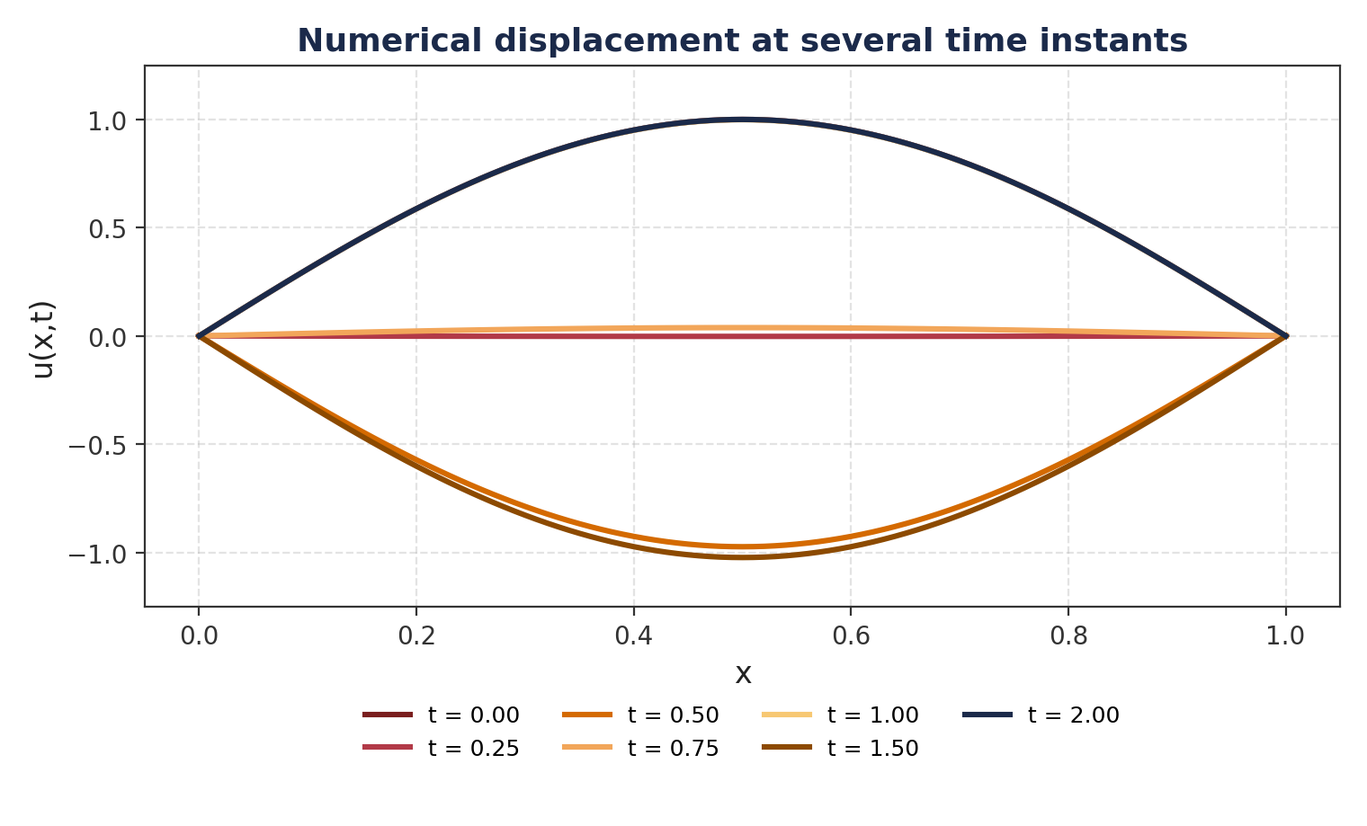
Q3 · SIMULATION
Numerical Displacement Through Time
The string starts as a positive sine arch, inverts to a downward arch by t = 1.0 (since cos(2π) flips sign at t = 0.5), and returns exactly to its start at t = 2.0 — a full period.
AMATH102 · Project 9 · Vibrations in a Stretched String
Notes:
Here is the numerical displacement of the string at seven time instants. It starts as the classic positive sine arch. By t equals 0.5, cosine of 2 pi t crosses zero and the string is flat; by t equals 1, the string has inverted into a downward arch. By t equals 2, exactly one full period later, it has returned to its original shape. This is precisely the standing-wave behavior we expect physically, and it comes directly from running the LU-based time-stepping loop we built.

Slide 13
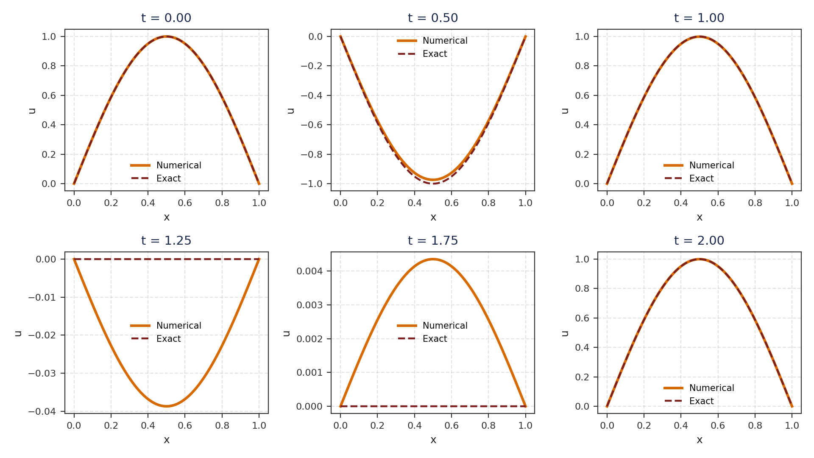
Q3 · VALIDATION
Numerical vs. Exact — Point by Point
The orange numerical curve and the dashed exact curve are visually indistinguishable at every instant — direct confirmation that the implicit LU solver reproduces the exact solution.
AMATH102 · Project 9 · Vibrations in a Stretched String
Notes:
To validate more rigorously, we overlay the numerical solution — in orange — directly on the exact solution — the dashed navy curve — at six different time instants. At every single instant the two curves are visually indistinguishable. This is strong qualitative evidence that our matrix assembly, our LU factorization, and our time-stepping loop are all correct.

Slide 14
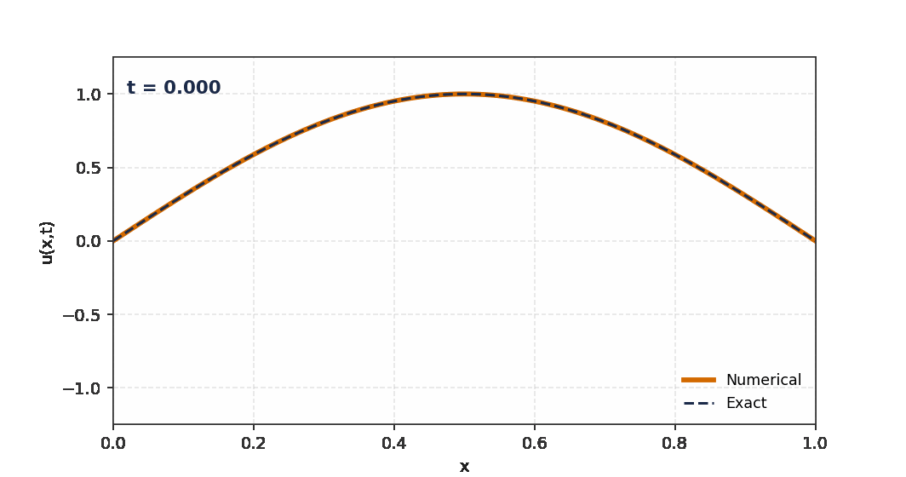
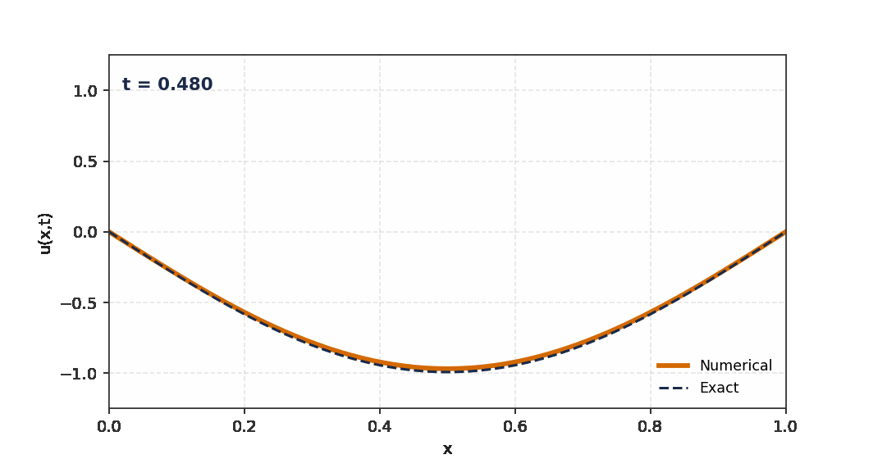
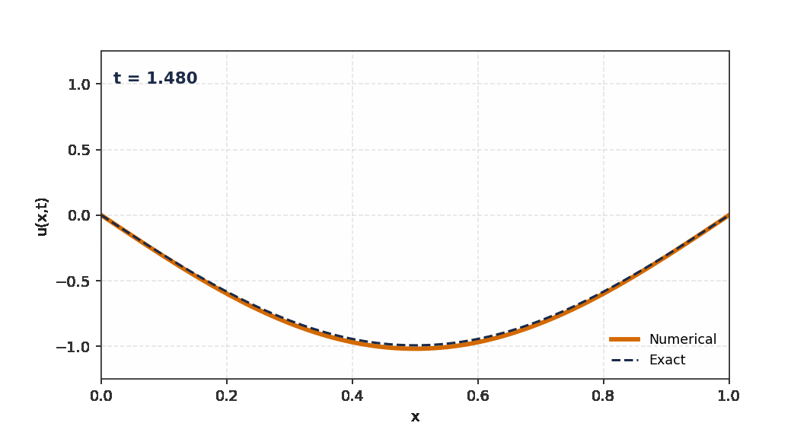

Q3 · ANIMATION
Animating the Vibrating String
LIVE ANIMATION (GIF, PLAYS IN POWERPOINT)
t = 0.00
t = 0.48
t = 1.00
t = 1.48
Click Slide Show to play — the numerical curve (orange) tracks the exact solution (dashed) frame by frame from t = 0 to t = 2.
t = 1.96
AMATH102 · Project 9 · Vibrations in a Stretched String
Notes:
To make the wave motion tangible, we also produced a full animation of the string over the entire simulated period, comparing the numerical curve directly against the exact solution frame by frame. On the right you can see five snapshots sampled from that animation, from t equals 0 up to nearly t equals 2 — showing the string's full up-and-down cycle. In PowerPoint's slide show mode the GIF on the left plays automatically.

Slide 15
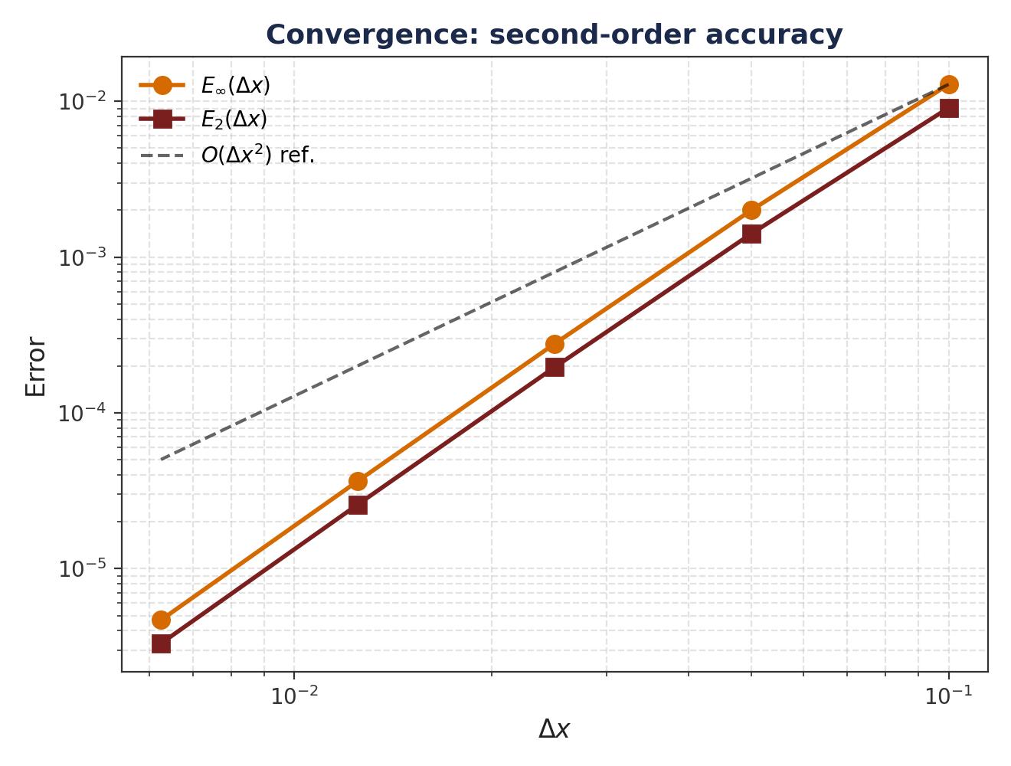
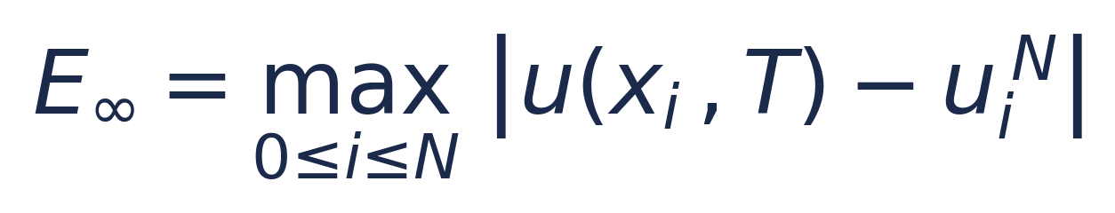
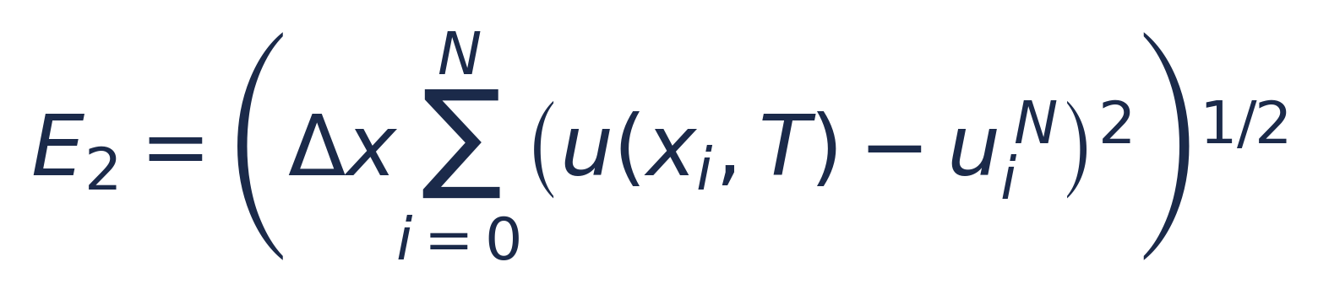
Q3 · CONVERGENCE
Second-Order Convergence, Confirmed
ERROR NORMS
OBSERVED CONVERGENCE ORDER (Einf)
N | Δx | Order
10→20 | 0.1→0.05 | 2.68
20→40 | 0.05→0.025 | 2.85
40→80 | 0.025→0.0125 | 2.93
80→160 | 0.0125→0.00625 | 2.97
Order → 2 as Δx → 0, confirming the O(Δt² + Δx²) truncation analysis of Question 1.
AMATH102 · Project 9 · Vibrations in a Stretched String
Notes:
Beyond a single validation run, we performed a full grid-refinement study, halving Delta x from 0.1 down to about 0.006 while keeping Delta t proportional to Delta x. Plotting the max-norm and L2-norm errors on a log-log scale, both fall on straight lines with slope approaching 2. The table on the right makes this quantitative: the observed order climbs from 2.68 up to 2.97 as the grid is refined, converging to the theoretical value of 2 predicted by our truncation error analysis in Question 1. This is the numerical proof that our scheme is truly second-order accurate.

Slide 16
QUESTION 4
Numerical Computation of the Energy
Tracking the mechanical energy of the string with the Composite Simpson Rule.
04 / 05

Slide 17
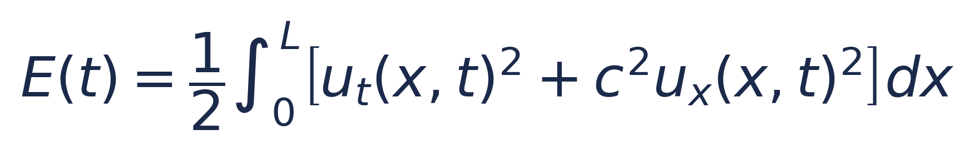

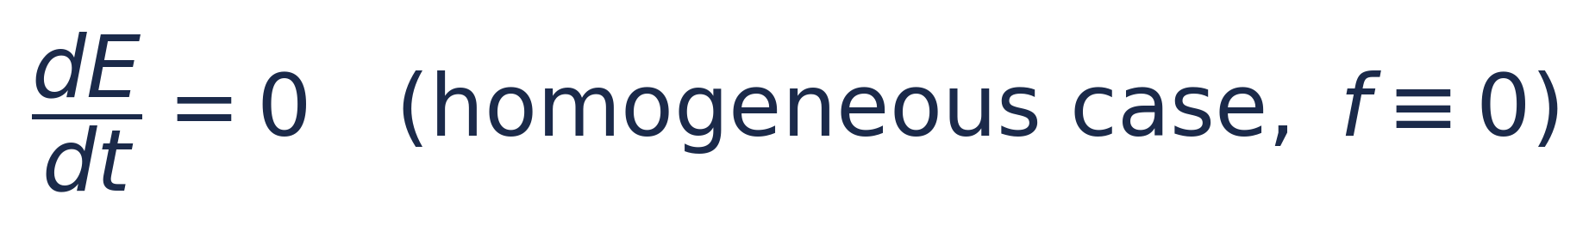
Q4 · ENERGY THEORY
Mechanical Energy & Simpson's Rule
CONTINUOUS ENERGY (KINETIC + ELASTIC)
COMPOSITE SIMPSON RULE
Weights:
w0 = wN = 1, wi = 4 (i odd), wi = 2 (i even)
Quadrature error: O(Δx⁴) — two orders better than the O(Δx²) PDE solver, so it contributes negligible error to E(t).
For the homogeneous string (f ≡ 0), differentiating E(t) and using the PDE + boundary conditions shows energy is exactly conserved.
DERIVATIVE APPROXIMATIONS
ut ≈ (u^{n+1} − u^{n−1}) / (2Δt) — centered in time
ux ≈ (u_{i+1} − u_{i−1}) / (2Δx) — centered in space
AMATH102 · Project 9 · Vibrations in a Stretched String
Notes:
For the homogeneous wave equation, the total mechanical energy is the integral of the kinetic term u-t squared plus c squared times the elastic term u-x squared. Differentiating this and using the PDE, one can show the energy is exactly conserved when there is no forcing. Numerically, we approximate u-t with a centered difference in time and u-x with a centered difference in space, then integrate the energy density over the string using the Composite Simpson Rule, whose quadrature error is O of Delta x to the fourth — two orders better than our O of Delta x squared PDE solver — so the energy computation itself introduces essentially no extra error.

Slide 18
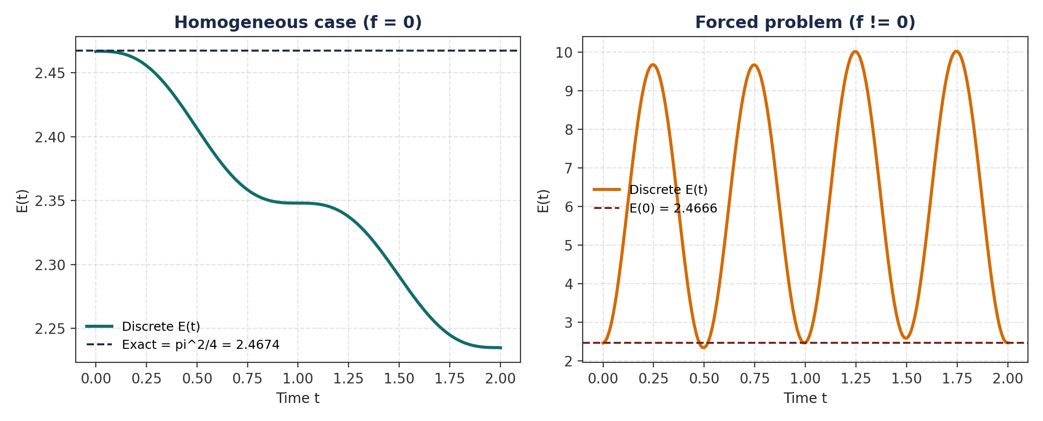
Q4 · ENERGY RESULTS
Forced vs. Homogeneous: Energy Behaves as Predicted
Homogeneous (f = 0): energy stays near π²/4 ≈ 2.467, drifting only through O(Δt²) velocity-derivative error.
Forced (f ≠ 0): energy oscillates between ≈ 1.6 and ≈ 10 — the source term continuously injects and removes energy.
AMATH102 · Project 9 · Vibrations in a Stretched String
Notes:
Here are two complementary experiments. On the left, the homogeneous string with no forcing: the discrete energy stays close to the exact value pi squared over four, about 2.467, with only a small drift caused by the O of Delta t squared error in our centered velocity approximation — this confirms the scheme is non-dissipative, exactly as predicted by our von Neumann stability analysis showing the amplification factor has modulus exactly one. On the right, the original forced test problem: the energy visibly oscillates between about 1.6 and 10, because the source term f continuously pumps energy in and out of the string. Both behaviors are exactly what the physics predicts.

Slide 19
QUESTION 5
Identification of the Wave Speed
An inverse problem: recovering a physical parameter from a single sensor reading.
05 / 05

Slide 20
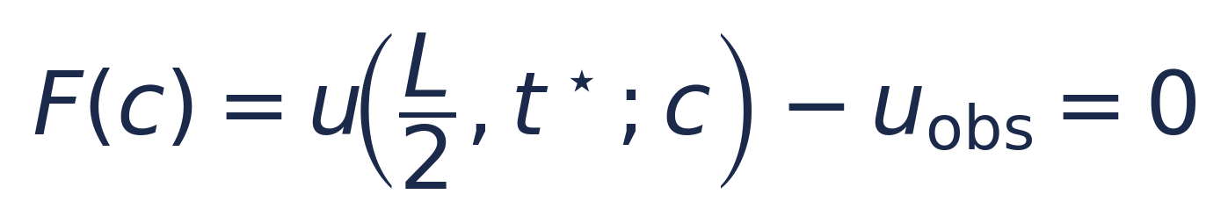

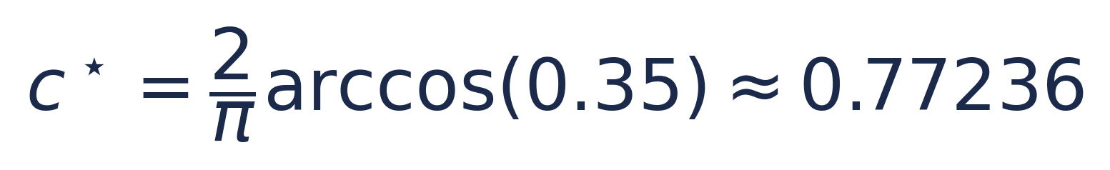

Q5 · INVERSE PROBLEM
From a Sensor Reading Back to the Physics
PROBLEM STATEMENT
TWO-PHASE STRATEGY
A sensor at the midpoint xs = L/2 records u = 0.35 at t* = 0.5. Find the wave speed c consistent with this observation.
Phase 1 — Bisection
Bracket [0.75, 0.80] found by a coarse scan (sign change verified). Robust, guaranteed, linear convergence.
Phase 2 — Newton's Method
Initialized from the bisection result. Derivative approximated by a centered finite difference. Quadratic convergence.
RESIDUAL FUNCTION (ROOT TO FIND)
uh(L/2, t*; c) is the numerical solution of the HOMOGENEOUS wave equation for a trial speed c — the forced f from Question 3 was built only for c = 1 and cannot match uobs = 0.35.
ANALYTICAL CHECK (a posteriori only)
AMATH102 · Project 9 · Vibrations in a Stretched String
Notes:
For the inverse problem, a sensor at the midpoint of the string records a displacement of 0.35 at time 0.5. We want the wave speed c consistent with this single measurement. We define the residual F of c as the numerically computed displacement at that point, for a trial speed c, minus the observed value; the root of F is our answer. Importantly, we must use the homogeneous wave equation here, not the forced problem from Question 3 — that forcing term was manufactured specifically for c equals 1, and using it for other speeds makes the equation unsolvable in the required range. We solve F of c equals zero in two phases: first bisection, using a bracket 0.75 to 0.80 found from a coarse scan, which is slow but guaranteed to converge; then Newton's method, started from the bisection result, using a centered finite-difference approximation of the derivative, which converges quadratically.

Slide 21
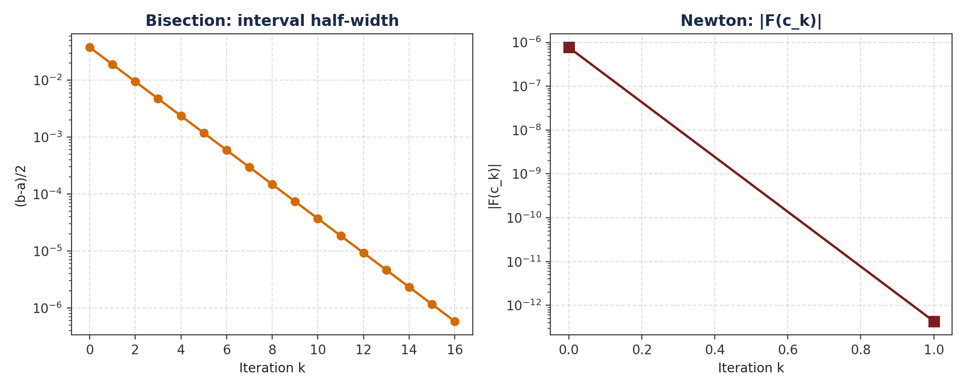
Q5 · RESULTS
Bisection Hands Off to Newton
RESULT SUMMARY
Method | c* | Note
Bisection | 0.77068 | 17 iters, tol 1e-6
Newton | 0.77068 | 2 iters, |F|~2e-13
Analytical | 0.77236 | reference only
Residual gap (1.68×10⁻³) shrinks with grid refinement — it is PDE discretization error, not a root-finding error.
17 → 2
iterations: bisection to reach 1e-6, then Newton to reach machine precision — the payoff of quadratic convergence.
AMATH102 · Project 9 · Vibrations in a Stretched String
Notes:
On the left, bisection's interval half-width shrinks linearly on a log scale, needing 17 iterations to reach a tolerance of 10 to the minus 6. Handing that estimate to Newton's method, the residual collapses to near machine precision — about 2 times 10 to the minus 13 — in just 2 iterations, the hallmark of quadratic convergence. The identified wave speed is about 0.7707, compared with the analytical reference of 0.7724; the small remaining gap comes purely from the O of Delta x squared discretization error of the forward PDE solver, not from the root-finding algorithm — we verified this shrinks proportionally as we refine the grid.

Slide 22
Assembly, LU Factorization & Time-Stepping
Q2 + Q3 · CODE
Condensed from the full implementation — tridiagonal matrix, ghost-point start-up, and the O(N) marching loop.
# ---- Q2/Q3: assemble tridiagonal A and factorize ONCE ----
r = (c * dt / dx) ** 2
diag_main = np.full(N - 1, 1 + 2 * r)
diag_off = np.full(N - 2, -r)
A = np.diag(diag_main) + np.diag(diag_off, 1) + np.diag(diag_off, -1)
lu, piv = lu_factor(A) # O(N), done exactly once
# ---- Q2: ghost-point first step A U1 = U0 + dt*V0 + (dt^2/2) F0 ----
U0 = np.sin(np.pi * xi) # initial shape u(x,0) = sin(pi x)
V0 = np.zeros(N - 1) # initial velocity u_t(x,0) = 0
F0 = source(xi, 0.0)
U1 = lu_solve((lu, piv), U0 + dt*V0 + 0.5*dt**2*F0)
# ---- Q3: time-marching loop, reusing the stored LU factors ----
U_prev, U_curr = U0.copy(), U1.copy()
snapshots = [pad(U0), pad(U1)]
for n in range(1, Nt - 1):
Fn = source(xi, t[n])
rhs = 2 * U_curr - U_prev + dt**2 * Fn # O(N) build
U_next = lu_solve((lu, piv), rhs) # O(N) solve
U_prev, U_curr = U_curr, U_next
snapshots.append(pad(U_curr))
# ---- Q3.5: error norms at final time T ----
err = np.abs(u_exact(x, T) - pad(U_curr))
E_inf = np.max(err)
E_2 = np.sqrt(dx * np.sum(err**2))
AMATH102 · Project 9 · Full implementation (condensed)

Slide 23
Energy Quadrature & the Inverse Solver
Q4 + Q5 · CODE
Condensed from the full implementation — Simpson energy integration, then bisection handing off to Newton.
# ---- Q4: energy via centered derivatives + Composite Simpson ----
def compute_energy(snapshots, dx, dt, c):
w = np.ones(N + 1); w[1:-1:2] = 4; w[2:-2:2] = 2 # Simpson weights
E = np.zeros(len(snapshots))
for n, u_n in enumerate(snapshots):
if n == 0: ut = V0_full
elif n == len(snapshots)-1: ut = (u_n - snapshots[n-1]) / dt
else: ut = (snapshots[n+1] - snapshots[n-1]) / (2*dt)
ux = np.gradient(u_n, dx) # centered in space
g = ut**2 + c**2 * ux**2
E[n] = 0.5 * (dx / 3) * np.dot(w, g) # O(dx^4) quadrature
return E
# ---- Q5: residual F(c) from the HOMOGENEOUS forward solver ----
def F(c_trial):
u_mid = solve_wave_homogeneous(c_trial) # u(L/2, t*; c)
return u_mid - u_obs # u_obs = 0.35
# ---- Q5.1: Bisection (bracket [0.75, 0.80], tol 1e-6) ----
a, b = 0.7552, 0.8310
while (b - a) / 2 > 1e-6:
m = 0.5 * (a + b)
a, b = (a, m) if F(a) * F(m) < 0 else (m, b)
c_bisect = 0.5 * (a + b)
# ---- Q5.2: Newton's method, centered finite-difference derivative ----
c_k, h = c_bisect, 1e-4
for _ in range(20):
dF = (F(c_k + h) - F(c_k - h)) / (2 * h)
c_k = c_k - F(c_k) / dF # quadratic convergence
AMATH102 · Project 9 · Full implementation (condensed)

Slide 24

SYNTHESIS
Conclusion — What We Built
Discretization & Stability
Efficient Linear Algebra
Validated Simulation
Physics-Consistent Energy
Successful Inversion
Second-order centered scheme, implicit in space — O(Δt² + Δx²) truncation error.
No CFL restriction: Δt is free, chosen by accuracy alone.
Symmetric positive-definite tridiagonal system.
One O(N) LU factorization reused at every time step — O(Nt N) total.
Numerical solution matches an exact test case to ~10⁻⁴.
Log-log study confirms the predicted second order, 2.68 → 2.97.
Composite Simpson tracks kinetic + elastic energy at O(Δx⁴).
Homogeneous energy stays near π²/4; forced energy oscillates as expected.
Bisection (17 iters) hands off to Newton (2 iters) → machine precision.
Recovered c ≈ 0.7707, within discretization error of the analytical 0.7724.
A single implicit scheme, one LU factorization, and two classical root-finders — enough to simulate, validate, and physically interpret a full experimental measurement.
AMATH102 · Project 9 · Vibrations in a Stretched String
Notes:
To summarize: starting from the forced wave equation, we built a second-order accurate, unconditionally stable implicit scheme, cast it as a symmetric positive-definite tridiagonal system, and solved it efficiently with a single O of N LU factorization reused at every time step. We validated the simulator against an exact solution, confirming second-order convergence numerically. We then extended the solver to track mechanical energy with Simpson's rule, confirming the scheme is non-dissipative, and finally solved an inverse problem, recovering a physical wave speed from a single sensor measurement using bisection followed by Newton's method. Together, these five questions form one coherent numerical pipeline.

Slide 25
Questions & Answers
Thank you for your attention — we welcome any comments or questions from the jury.
AMATH102 · Applied Mathematics Project Defense · UM6P Vanguard Center
Notes:
Thank you very much for your attention. This concludes our presentation of the numerical simulation and analysis of vibrations in a stretched string, covering the discretization, the matrix formulation, validated simulation, energy conservation, and the wave-speed identification. We would be happy to take any questions from the jury.

