Slide 1
Wi-Fi CSI Presence & Activity Sensing
End-of-week update — model comparison & antenna portability · July 2026

Slide 2
This week
• Question from leadership: does the trained model plug-and-play onto a different antenna, or a different capture device entirely?
• Ran the same placement/activity protocol with two antennas — the stock ESP32-C3 antenna and a Taoglas unit — at three positions in the same room.
• Also ran a fixed-protocol comparison across 10 model families (classical and deep) to answer a standing question: is random forest still the right choice, or would a fancier model do better?
• Both experiments below use the same recipe as always: per-config empty-room calibration, leave-one-config-out evaluation.

Slide 3
The dataset
• Configurations (placement × orientation): 14
• Recording sessions: 20
• Total recording time: ~113 min (~1.9 hours)
• CSI packets logged: 669,353
• Labeled 2-second analysis windows: 4,971
• Classes: empty, stand, sit, walk, run
• One subject, two library study rooms — a weak-link room and one range-limited configuration were excluded (documented separately), so every number above is from links that held up.

Slide 4
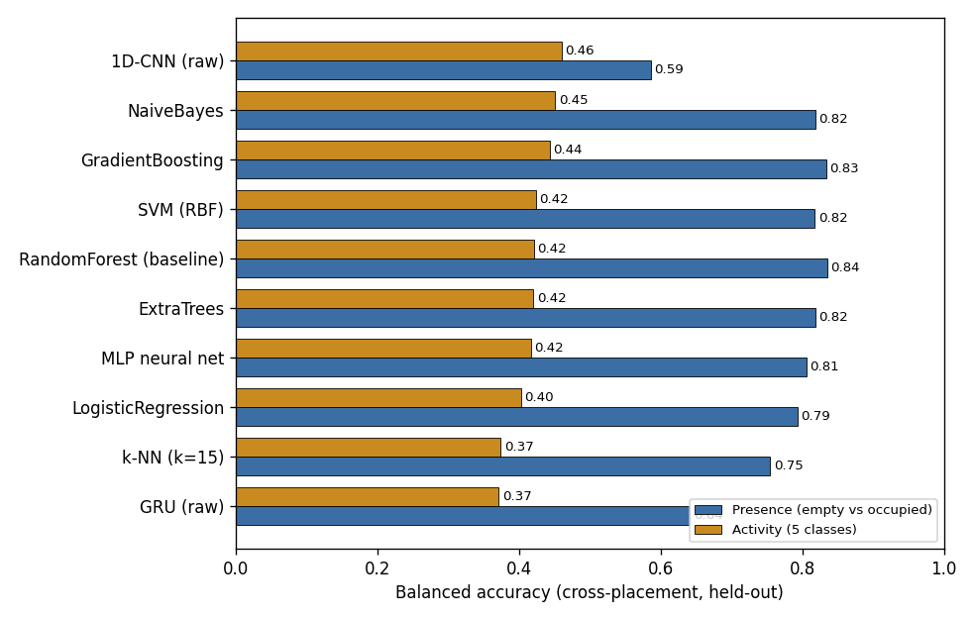
Why we still use a random forest
• Ten model families, same data / calibration / evaluation — only the classifier changes.
• Cross-placement activity is model-independent (0.37–0.46 balanced across every model); no algorithm breaks out.
• Presence favors the engineered features (0.75–0.84) over raw deep nets (1D-CNN 0.59, GRU 0.64) — random forest stays at or near the top for both.

Slide 5
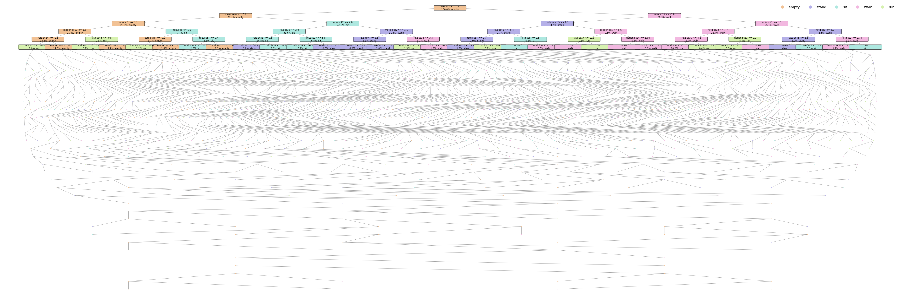
Inside the model: the whole tree
• This is tree #1 of the actual 300-tree production model — all 1,699 real nodes, nothing cut off; the top rows show real thresholds, the fan below is the same real tree continuing down to depth 36.

Slide 6
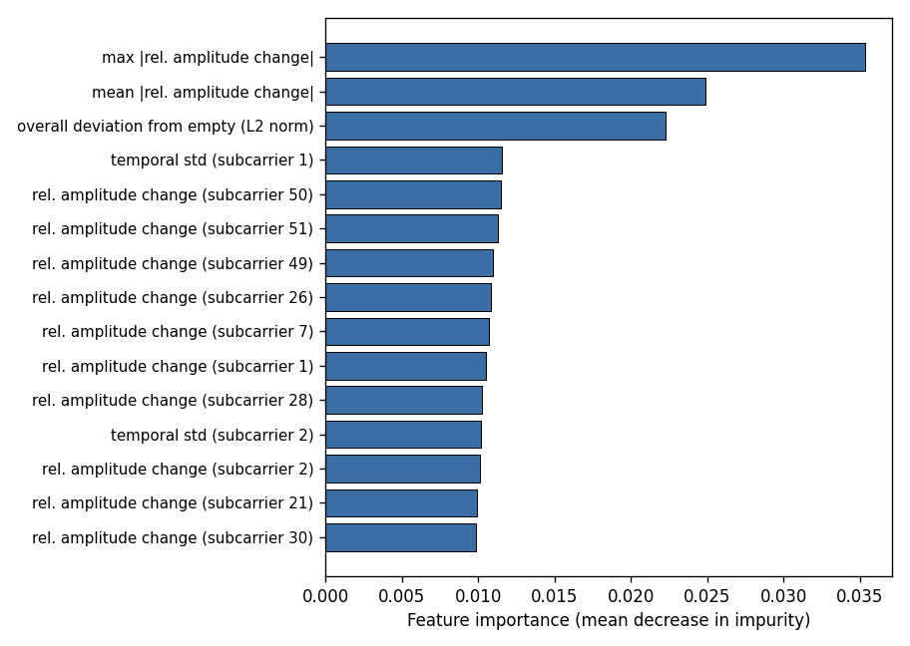
Which features the model actually uses
• Top features are all deviation-from-empty measures (max/mean relative amplitude change, overall L2 deviation) — confirms the empty-baseline calibration is doing the heavy lifting.
• Individual subcarriers matter too, but no single one dominates — the signal is spread across the channel, which is why the model needs many subcarriers rather than one.

Slide 7
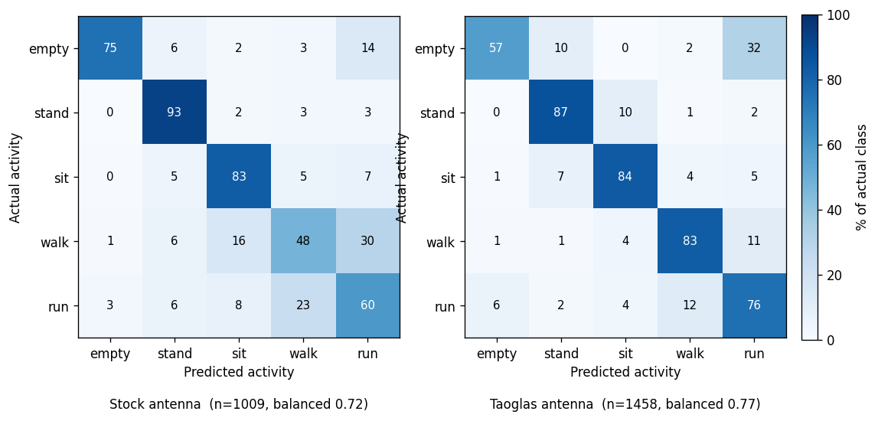
Stock vs. Taoglas: per-install accuracy
• Each antenna calibrated and evaluated on its own recordings (per-install, 5-fold): stock 0.72 balanced, Taoglas 0.77 balanced — both antennas work fine on their own.
• Taoglas link was consistently stronger (~10 dB better RSSI) and scored slightly higher; same confusions in both (sit/stand, walk/run).

Slide 8
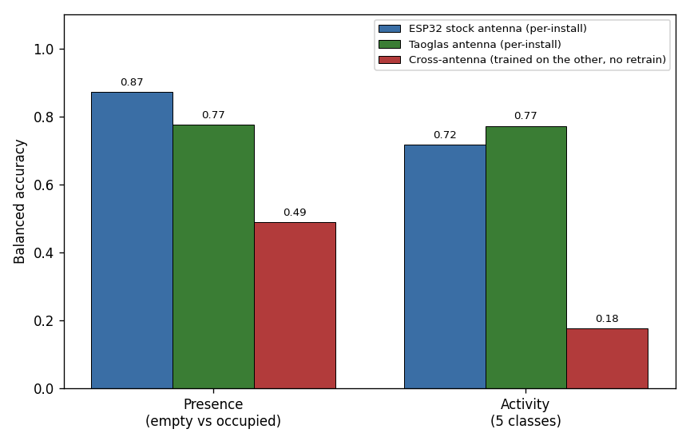
Does it plug-and-play onto a new antenna?
• No. The ESP32 stock antenna and the Taoglas antenna each work well calibrated on their own data — but a model trained on one and dropped onto the other, with no retraining, collapses to near-random.
• A new antenna or device is not a drop-in swap: CSI is hardware-specific. What transfers is the method, not the trained model.

Slide 9
Status & next steps
• Model choice is settled: random forest remains the right tool at this data scale — the ceiling is the single-antenna sensor, not the algorithm.
• Antenna portability question answered directly: retraining on the new antenna’s own data works, reusing the old antenna’s trained model does not — set that expectation with any new hardware.
• Continuing antenna recordings at more positions to firm up the result.
• Next: 2nd/3rd receiver validation (spare hardware on hand) — the lever for both coverage and fine-activity accuracy.

