Slide 1
Wi-Fi CSI Presence & Activity Sensing
Phase A interim — single-link characterization · July 2026

Slide 2
Setup
• One Wi-Fi link: two ESP32-C3 boards (2.4 GHz, single antenna). One transmits a steady ~100 Hz stream; the other reports CSI for 52 subcarriers at ~97 Hz.
• Library study room. Five configurations = different board placements and antenna orientations (the system must not depend on one exact placement).
• Each configuration runs the same script: empty / stand / sit / walk / run. Five sessions, ~1,400 analysis windows (2 s each).
• Method: per-window features → random forest, calibrated against the room’s own empty baseline. Tested on a configuration never seen in training (leave-one-session-out) — the honest measure of generalization.

Slide 3
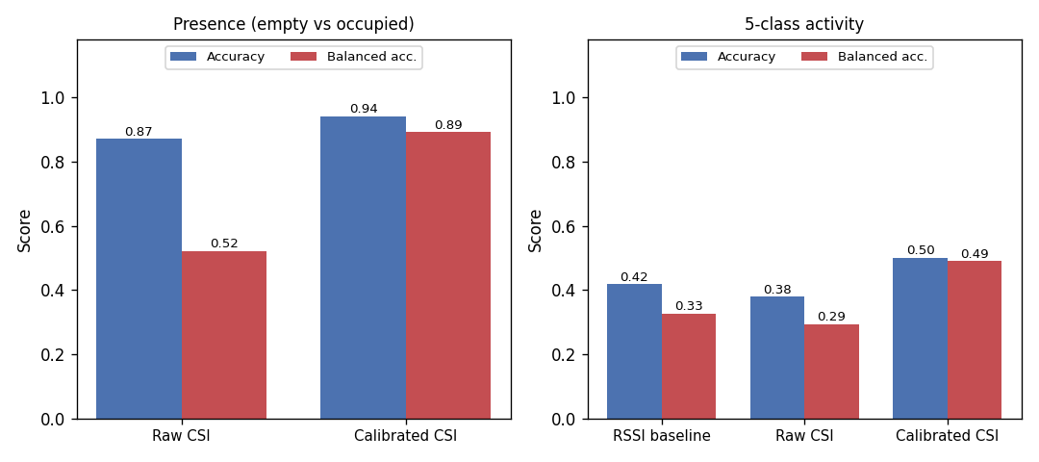
Presence works; raw CSI alone does not
• Presence on an unseen configuration: 94% accuracy, 0.89 balanced.
• Without calibration the model just answers “occupied” (0.52 balanced) — calibrating against the empty room is what makes CSI usable.
• Activity (5 classes) is far harder at ~0.50, though still ahead of RSSI-only (0.42) and raw CSI (0.38).

Slide 4
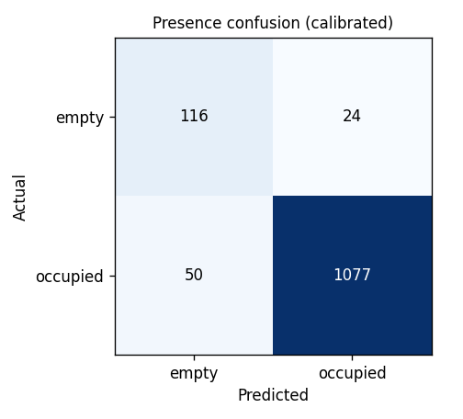
Presence: confusion matrix
• Occupied is caught 96% of the time (1077 / 1127).
• Empty is confirmed 83% of the time (116 / 140).
• The residual error is calling a truly empty room “occupied” — the harder direction.
• Numbers pooled over all five held-out configurations.

Slide 5
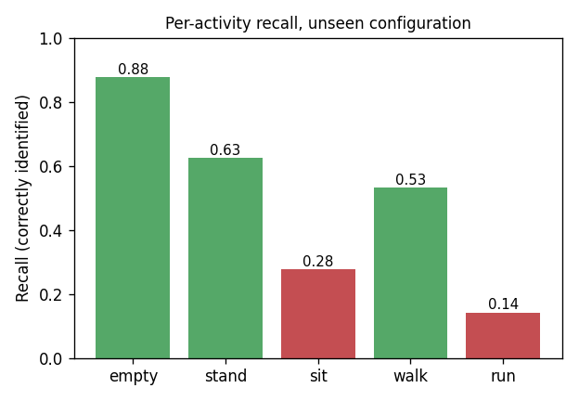
Where activity classification breaks down
• Empty, standing and walking are recognizable (0.53–0.88 recall).
• Sitting (0.28) is confused with standing; running (0.14) with walking.
• A single 2.4 GHz link cannot separate fine motion classes.
• This is the main argument for adding a 2nd and 3rd receiver.

Slide 6
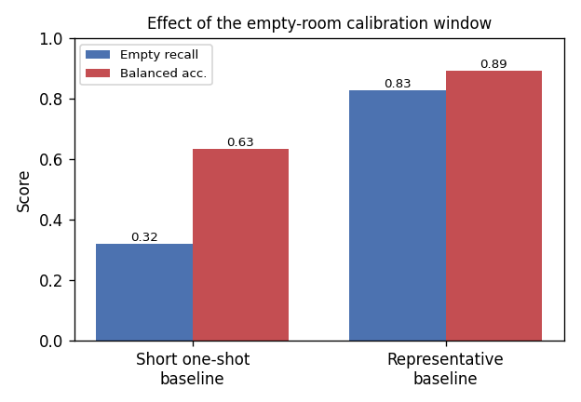
Calibration detail: the empty baseline
• The empty-room signal is stable within a session (>0.999 correlation).
• But a short one-shot empty capture underestimates normal variation and over-reports occupancy (empty recall 0.32).
• A longer, representative empty baseline restores it (0.83).
• Deployment rule: record a longer baseline at install, not one snapshot.

Slide 7
Status & next steps
• Interim snapshot: one room, one subject, one session per configuration — no confidence intervals yet.
• Solid today: presence detection, robust across placements once calibrated.
• Not yet: fine activity classification with a single link.
• Next: more configurations (for confidence intervals), more sit/run data, then a 2nd and 3rd receiver for motion coverage, followed by other rooms and subjects.

