Slide 1
Wi-Fi CSI Presence & Activity Sensing
Update · July 2026

Slide 2
This week
• Does the trained model plug and play onto a different antenna, or a different device?
• Running the same placement/activity program with two antennas, the stock ESP32C3 antenna and a Taoglas unit.
• Ran a protocol comparison across 10 model families (classical and deep) to compare the various models and see if the random forest model was still a good choice

Slide 3
The dataset
• CSI packets logged: 669,353
• Labeled 2-second analysis windows: 4,971
• Classes: empty, stand, sit, walk, run
• One subject, two/three library study rooms

Slide 4
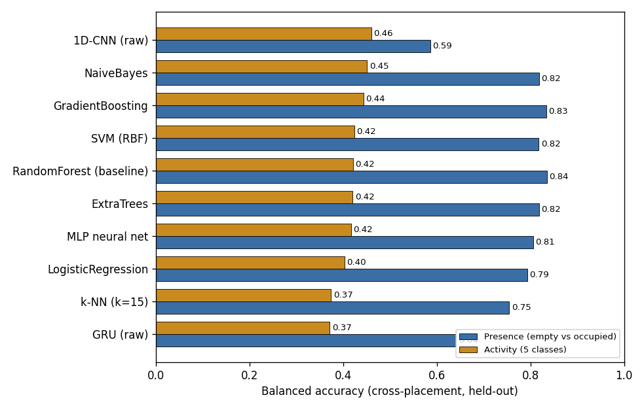
Model Comparison
• Ten different models using the exact same data, calibration, and evaluation
• Cross placement activity is model independent (0.37 – 0.46 balanced across every model)
• Presence is better with the engineered features (0.75 –0.84) over raw deep nets (1D-CNN 0.59, GRU 0.64) random forest stays at or near the top for both.

Slide 5
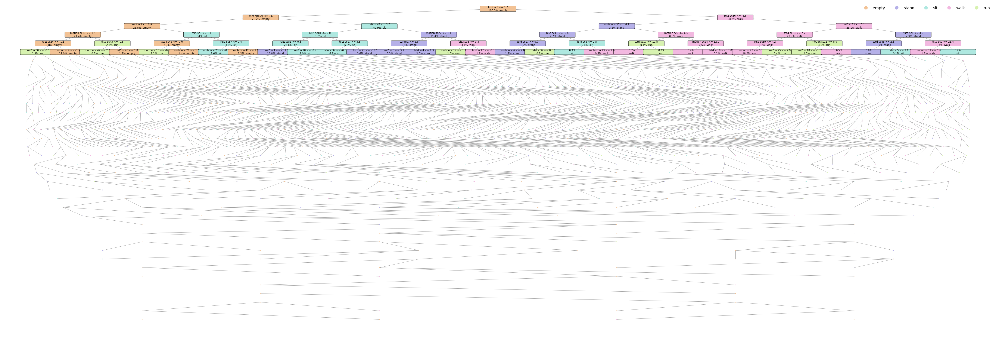
Tree Visualization
• This is tree #1 of the actual model we are using showing all 1,699 real nodes

Slide 6
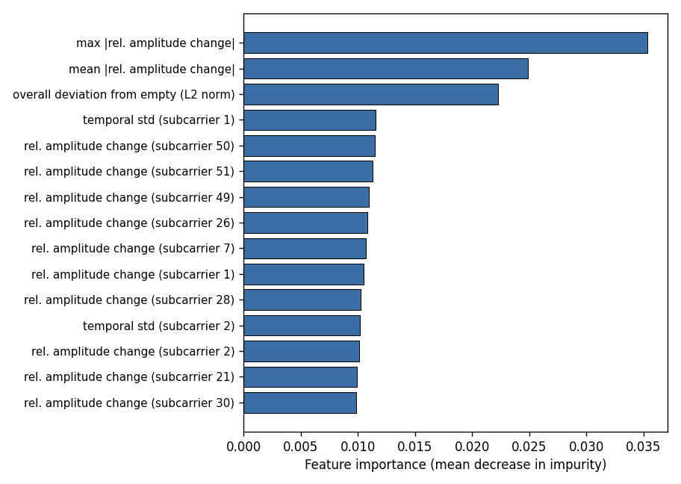
Most Important Features
• All of the top features are all deviation from empty measures like max/mean relative amplitude change, overall L2 deviation which shows that the empty baseline calibration is doing the heavy lifting.
• Individual subcarriers matter as well but no single one dominates since the signals is spread across the channel

Slide 7
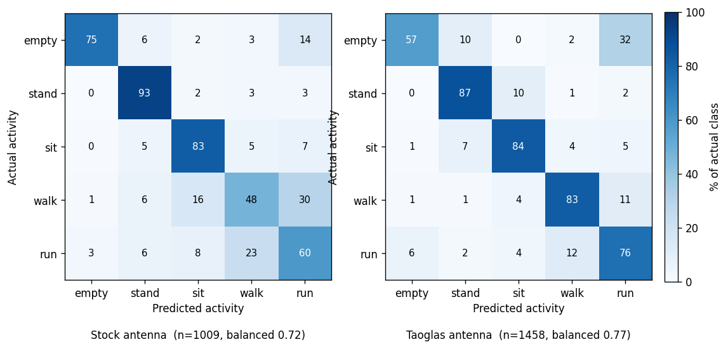
Stock vs. Taoglas: per-install accuracy
• Each antenna calibrated and evaluated on its own recordings: stock 0.72 balanced, Taoglas 0.77 balanced and both antennas work fine on their own.
• Taoglas link had a consistently stronger signal (about 10 dB better RSSI) and scored slightly higher. Same confusions in both (sit/stand, walk/run).

Slide 8
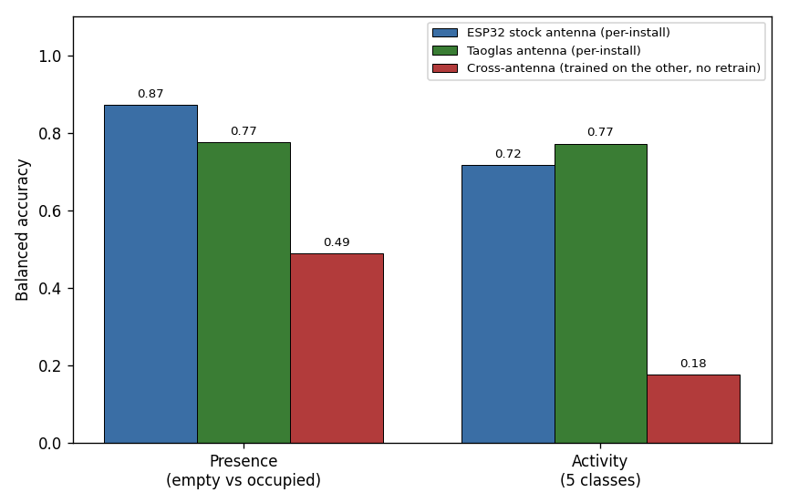
Plug and Play?
• From the dataset we have right now, the ESP32 stock antenna and the Taoglas antenna each work well calibrated on their own data, but a model trained on one and dropped onto the other, with no retraining, does no do well.
• A new antenna or device is not a drop in swap as CSI is hardware specific. What transfers is the method, not the trained model.
I will continue to expand the dataset and see if this problem is cause by a lack of data or it truly is not plug and play.

