Slide 1



TripBook
Smarter Traveling
BY ML WORRIORS
Yassin Kisrawi Riadh Gharbi
Fedi Messaoudi
Hamza Ghanem

Slide 2

Summary
01
Introduction and Context
Let me tell you a little story.
02
Features of the Project
About a project named Tripbook.
03
Architecture
Made of simplest yet sophisticated technologies.
04
Proof of Concept Demo
Promising potential and future opportunities.
05
Conclusion
That will always be enhanced by greater work.

Slide 3




Introduction and Context
Social Networks Potential in the Traveling world
Nowadays, People of all around the globe give more interest to visit places they get attracted by influencers on social networks and sometimes baited to be in a world other than the sugarhouse they were dreaming to go to.
Setting your mind to visit one of the thousands destinations is a milestone, finding an affordable one is a whole achievement, but sometimes security of the travel agency, the visited place is a big risk we should all take care about it.
Could Social Networks provide the suitable alternative to the old Travel Adventure? Through a process that guarantee both Traveler and their pockets in the mean time of the Trip.

Slide 4

Facebook .
TripBook Features
Trip Book is a Facebook add-on that will provide for its users the ability to be introduced to Trip destinations, places and opportunities through the analysis of his current profile and/or his current motivations for a Trip (i.e. unaffordable destinations that attract him)
Sentiment Analysis
Visual Similarity Approach
Through your recent posts, motivations we can provide some suggestions for you to filter later.
Through analysing your desired view, we can provide destinations which views are similar.
On demand filter.
Budget-first Recommendation.
If everything else fail, we fall back to the old-school way, Just tell us what you desire, and there you go!
TripBook will display offers and budget friendly affairs so that you can enjoy your trip even more!

Slide 5






Architecture
ML Tools
Without the power of recognitive models for image similarity and classifications we would not be ML warriors.
Python Backend Technolog
NLP Models
Using the full potential of Python to perform various computational tasks in the most moderate time
Some Deep Learning Networks to understand the complexity of your recent Facebook posts and meme updates.
Web Application as a PoC
For now, we implement the proof of concept as a web application, later-on it is meant to be a Facebook add-on.
Facebook Graph API
Facebook Graph API among others Plateform’s add-on will contribute in our Work.

Slide 6
Proof of Concept
Demo of the Web App

Slide 7
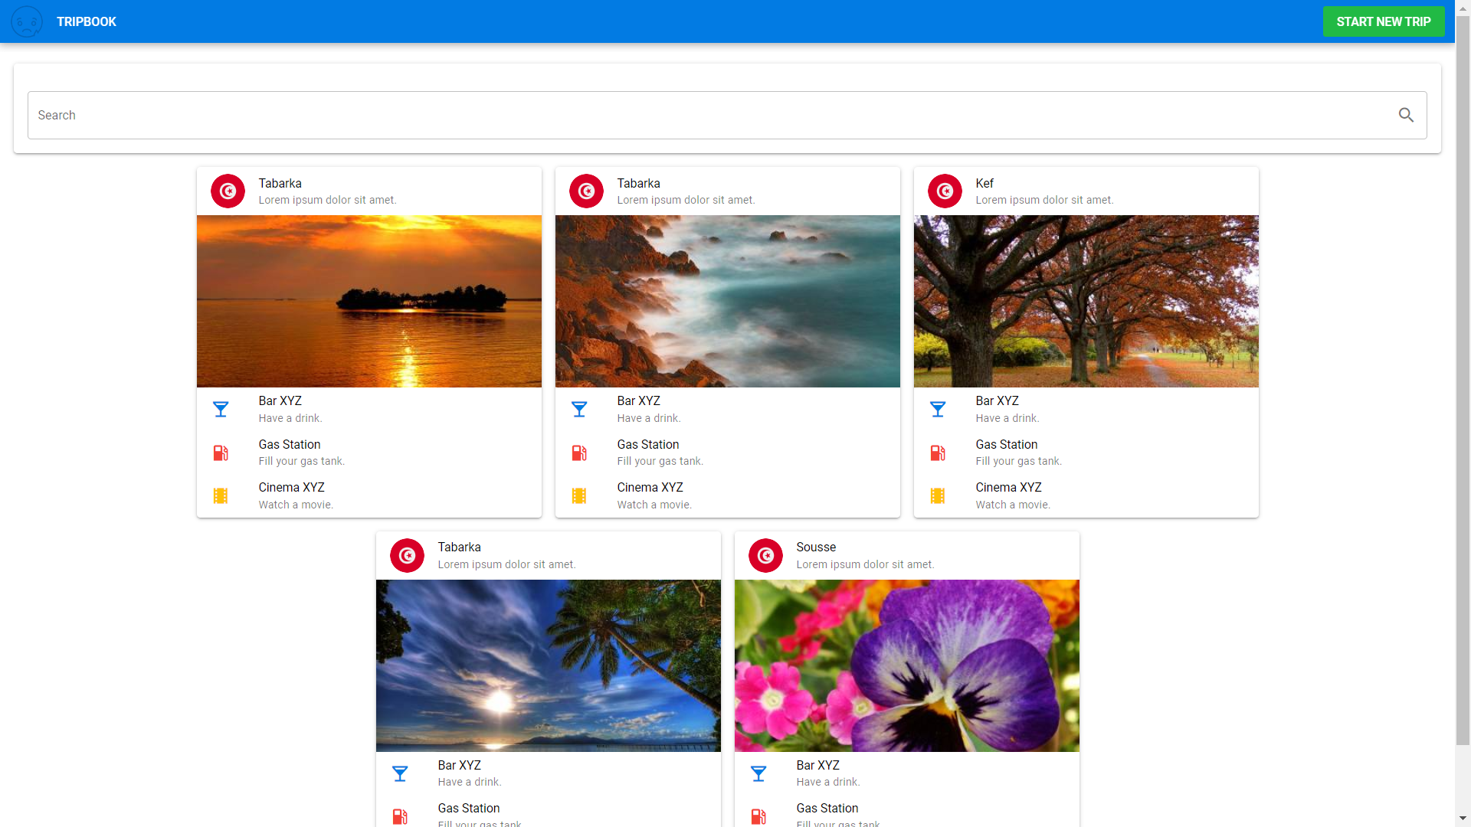
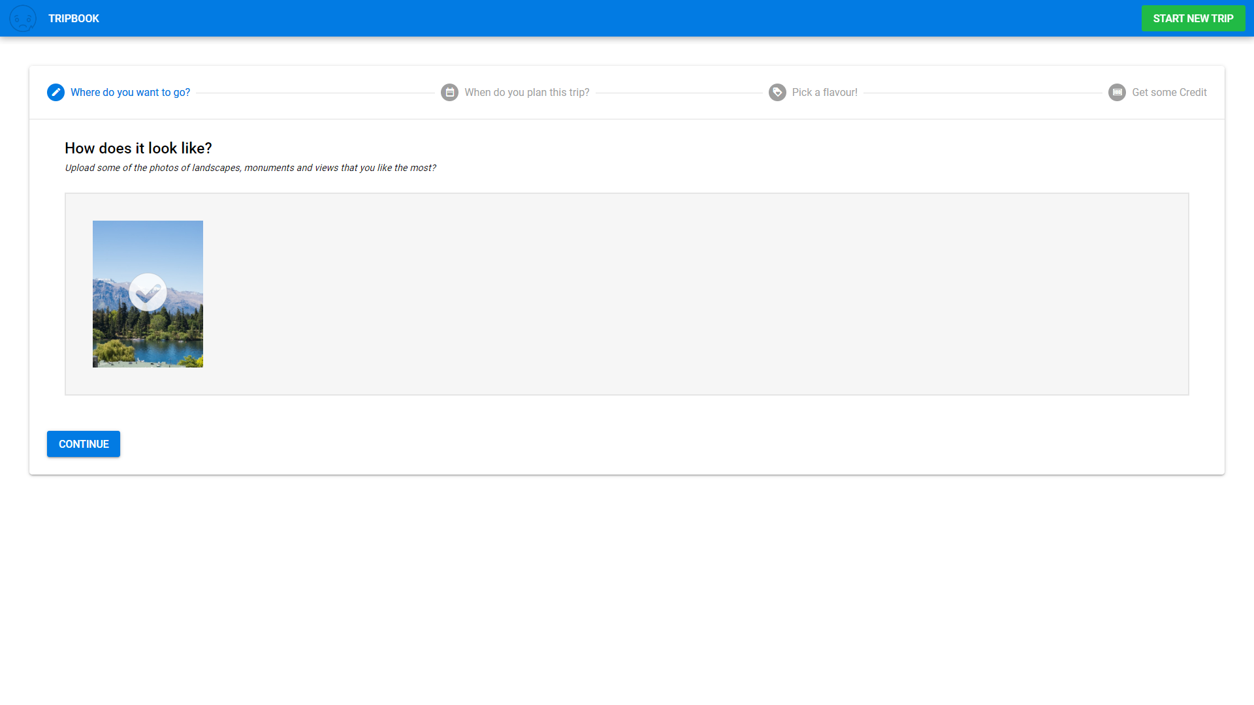
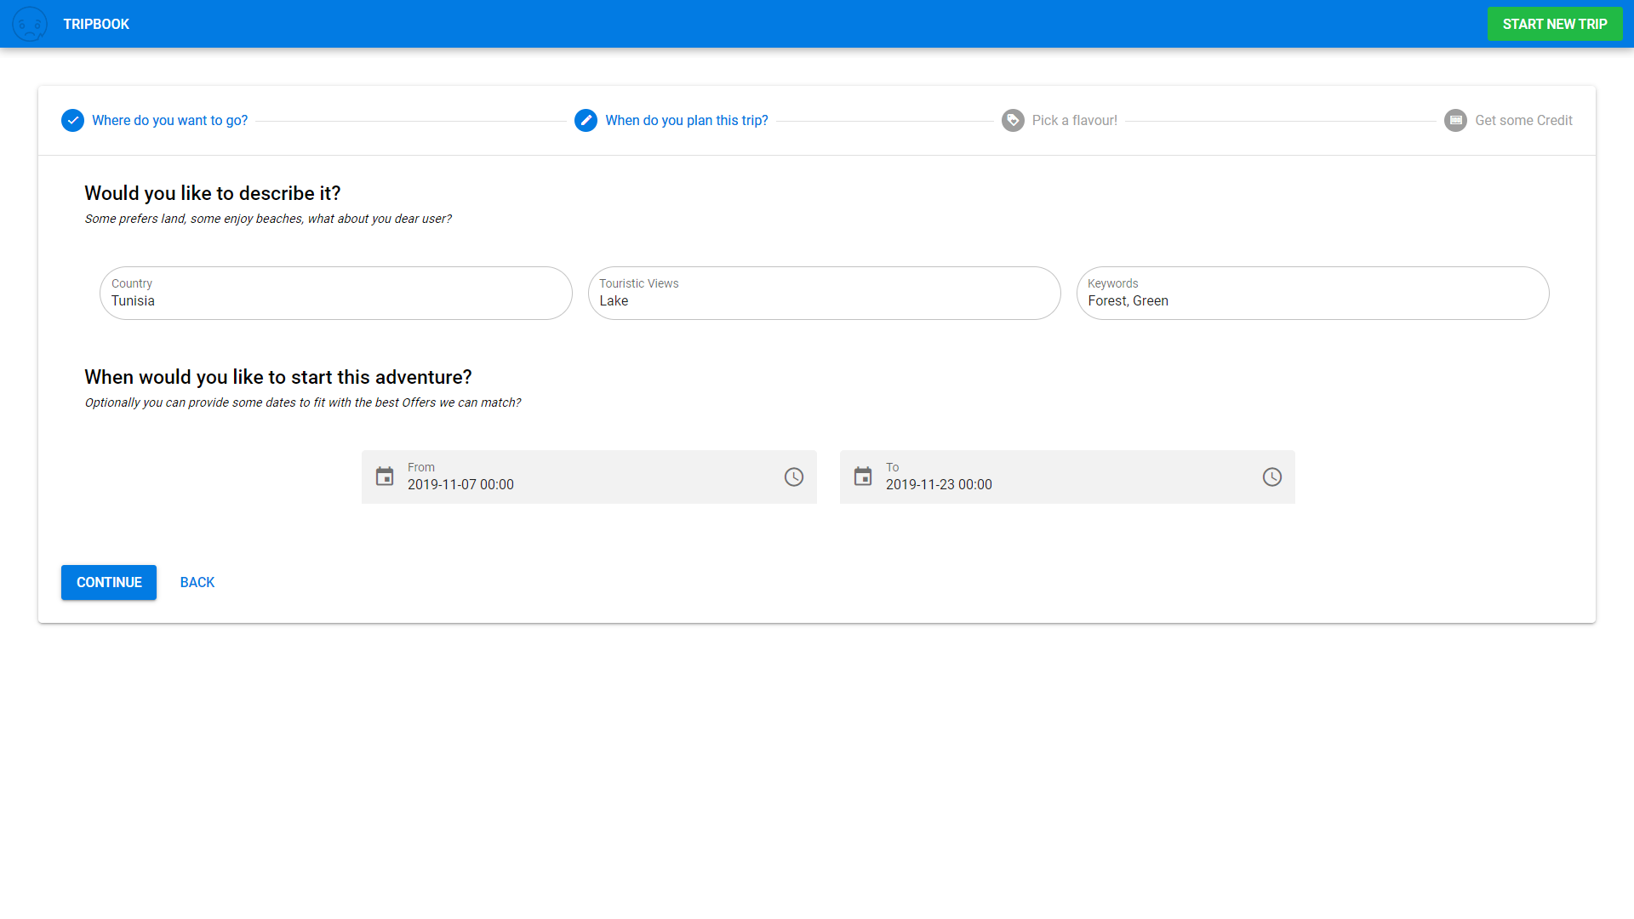
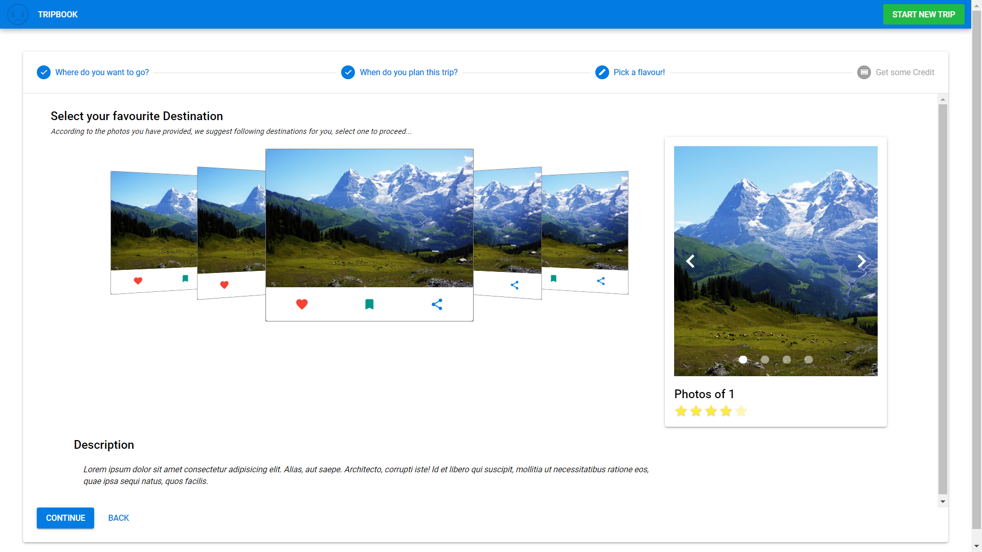
Infographic Style

Slide 8
In App Payment
 | Offer 1
 | $150
 | You can simply impress your audience and add a unique zing and appeal to your Presentations.
 | Offer 2
 | $100
 | You can simply impress your audience and add a unique zing and appeal to your Presentations.
 | Offer 3
 | $80
 | You can simply impress your audience and add a unique zing and appeal to your Presentations.
 | Offer 4
 | $99
 | You can simply impress your audience and add a unique zing and appeal to your Presentations.
Book a Trip
Book a Trip
Book a Trip
Book a Trip

Slide 9




Infographic Style
Get a Digital Band for More Security
You can simply have this band by your side, so that you can take a photo while buying for souvenirs.
Get better discounts while using Libra
Replace your wallet with Handy Currency
Money comes and goes, but discounts are not always there.
You can simply impress your audience and add a unique zing and appeal to your Presentations.

Slide 10

Conclusion
Better Trip Experience
using Facebook
Ecosystem

Slide 11
Thank you

